Slide 1
The Logic of Prediction
Will Doyle

Slide 2
Predictions Using Data
What do we need to predict?
How many students will enroll in my school?
How many customers will buy my product?
How many of my employees will leave next year?

Slide 3
Logic of Prediction
We predict future events from past occurences
In the language of data science, we use data from the past to “train” our models, then “test” our predictions against future events
A good model will accurately predict future occurences
A bad model will poorly predict future occurences

Slide 4
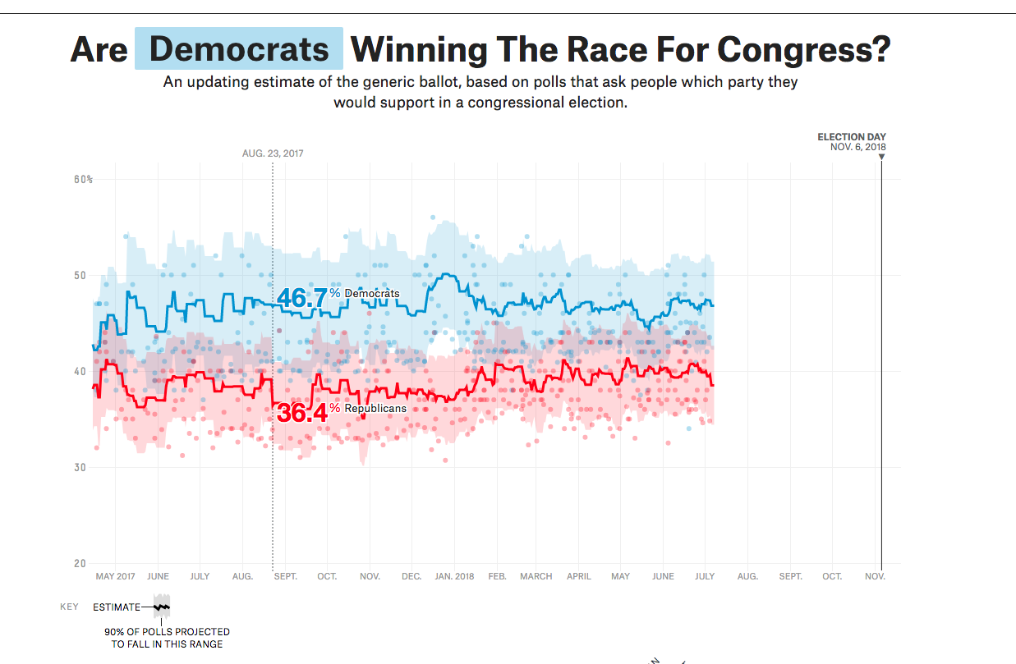
Examples: good predictions
Source: https://projects.fivethirtyeight.com/congress-generic-ballot-polls/?ex_cid=rrpromo

Slide 5
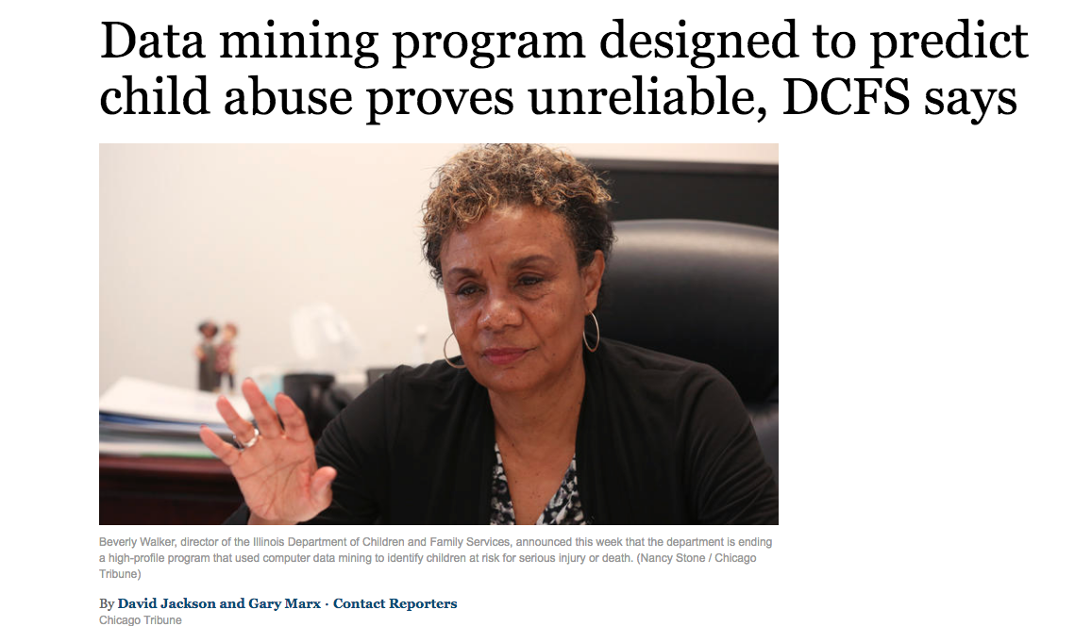
Examples: bad predictions
Source: http://www.chicagotribune.com/news/watchdog/ct-dcfs-eckerd-met-20171206-story.html

Slide 6
How We Check Our Models
Make a prediction (e.g. predict conditional means for each group)
Compare the prediction to the actual data
See how big the difference is

