Slide 1
Welcome to Data Science
Will Doyle

Slide 2
Quantifying Error
Error= Actual data- prediction
Larger errors= less predictive accuracy
We can quantify this using the MSE

Slide 3

The Root Mean Squared Error

Slide 4
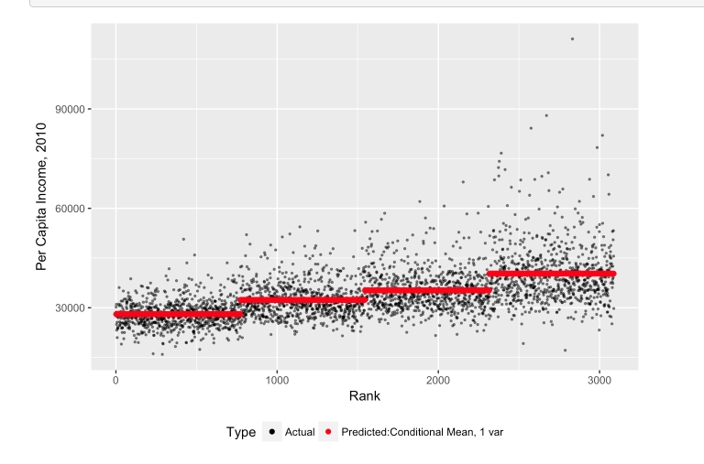
Root Mean Squared Error
Large Error

Slide 5
Root Mean Squared Error
Very small error

Slide 6
Root Mean Squared Error
This measure “averages” the size of all of the error terms
Square term is necessary, as errors average out to 0 for many predictors.
Expressed in units of the outcome variable
What’s “big” or “small” depends on the outcome of interest.

