Slide 1
Plotting Conditional Means
Will Doyle

Slide 2
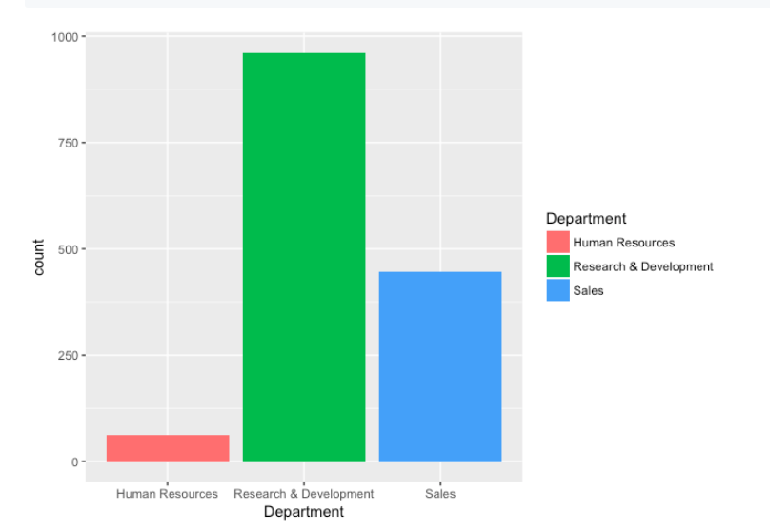
Basic Bar Plot

Slide 3
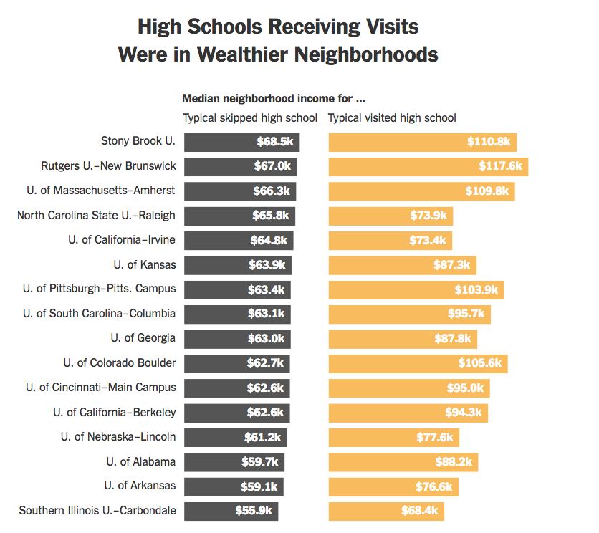
Ranked Bar Plot
Source: https://www.nytimes.com/interactive/2018/04/13/opinion/college-recruitment-rich-white.html

Slide 5
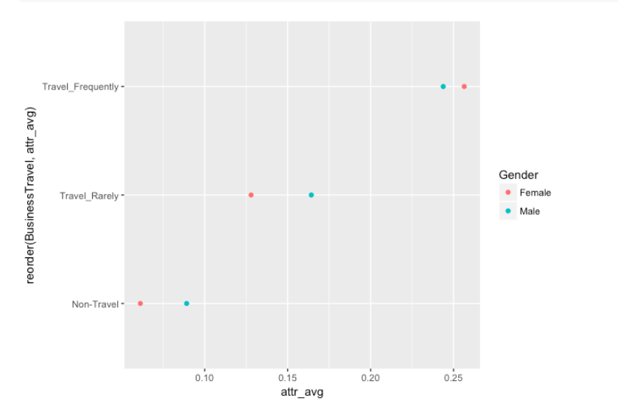
Dot Plot

Slide 6
Faceting

Slide 8
How to Download R
Will Doyle

