Slide 1
Conditional Means and Regression
Will Doyle

Slide 2
Expanding the idea of conditional means
We can generate a conditional mean for a single characteristic (e.g. average test scores for males and females)
We can expand that to include more characteristics (e.g. average test scores for males and females from each of the four regions of the country)
But it gets complicated fast. This is known as the curse of dimensionality

Slide 3
Linear Regression
Linear regression can be used to generated the expected value of the outcome for EVERY level of multiple independent variables
It does this by making one simple assumption: the conditional expectation function--- the expected value of the outcome given the predictor– is linear.

Slide 4
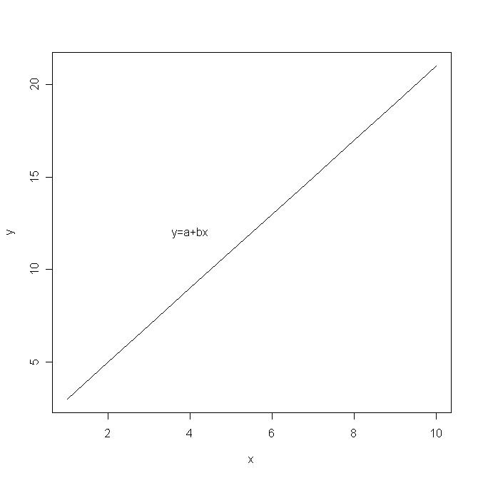
Flashback Time: Defining a Line

Slide 5
Regression: Line Fitting
Regression is a means of fitting a line to an observed set of data
In two dimensional space, the line is fit according to y=a+bx
In more dimensions, the same logic applies, but the line can not be drawn simply

Slide 6
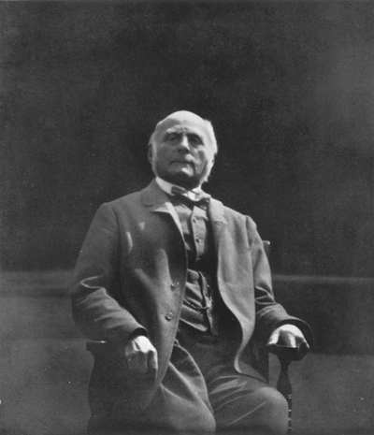
Sir Francis Galton

Slide 7
Regression lines
In regression we postulate a model of the world of the following linear (line) form:
Where:

Slide 8
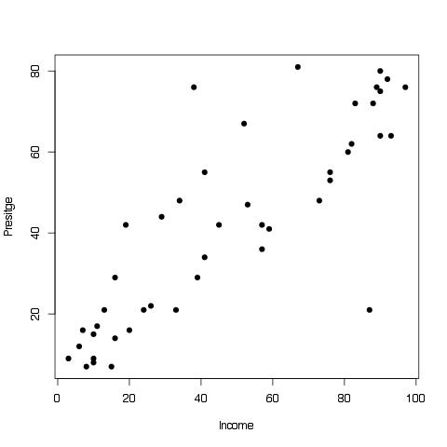
Duncan data on income and prestige

Slide 9
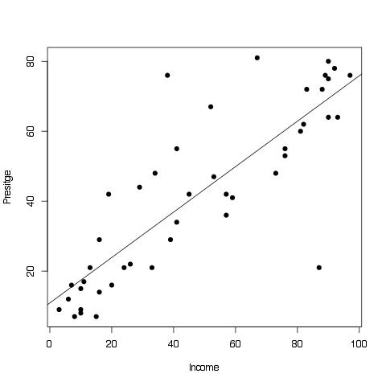
Duncan Data With Regression Line

Slide 10
Ordinary Least Squares
Ordinary Least Squares (OLS) is the most common (and usually best) form of regression when the dependent variable is continuous
OLS proceeds by finding a line that minimizes the sum of squared errors (sse) between the line and the points in the data
OLS depends on a key set of assumptions

Slide 11
Assumptions under OLS
Y is continuous
There are fewer independent variables than there are cases in the data
The errors are distributed normally, and have a mean of 0.
Error terms are not correlated with one another, nor are they correlated with any of the regressors

