Slide 1
Scatterplots
Will Doyle

Slide 2
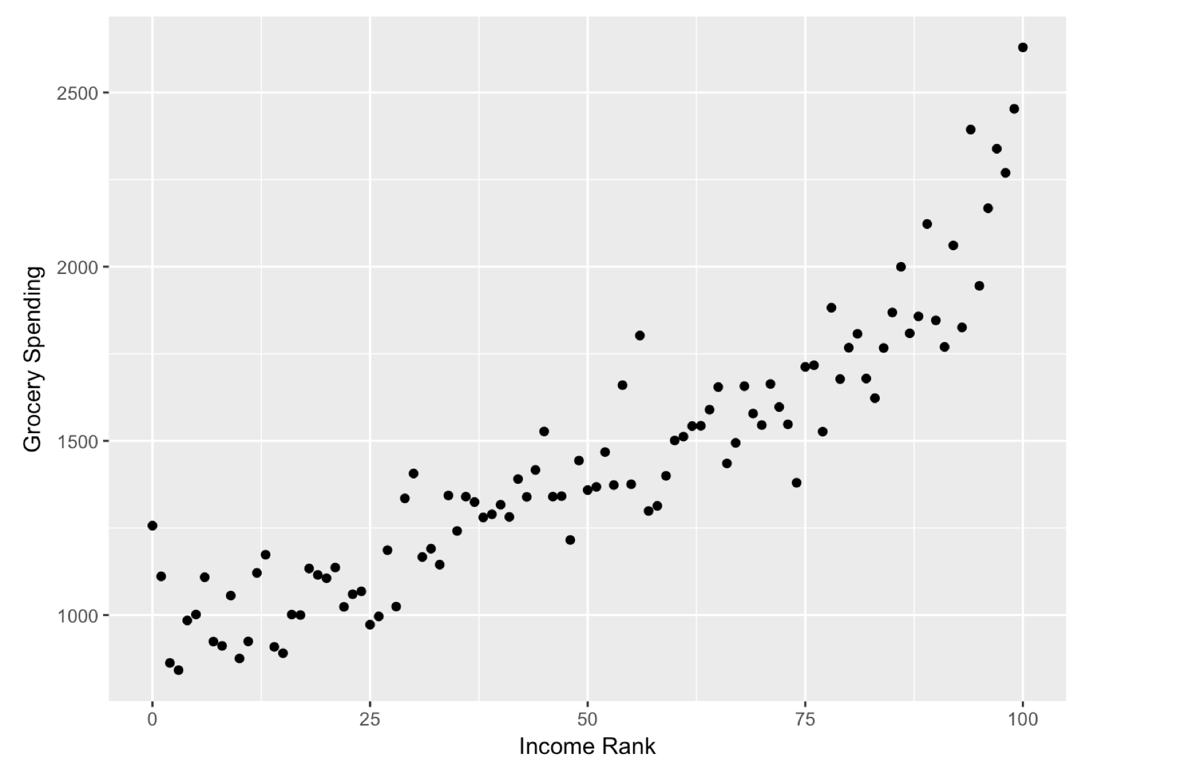
Scatterplots: Source of All Wisdom

Slide 3
Scatterplots: Source of All Wisdom
Outcome
ALWAYS
On Y Axis
Predictor ALWAYS on X axis

Slide 4
Scatterplots: Source of All Wisdom
Outcome
ALWAYS
On Y Axis
Each point
represents
a case
Predictor ALWAYS on X axis

Slide 5
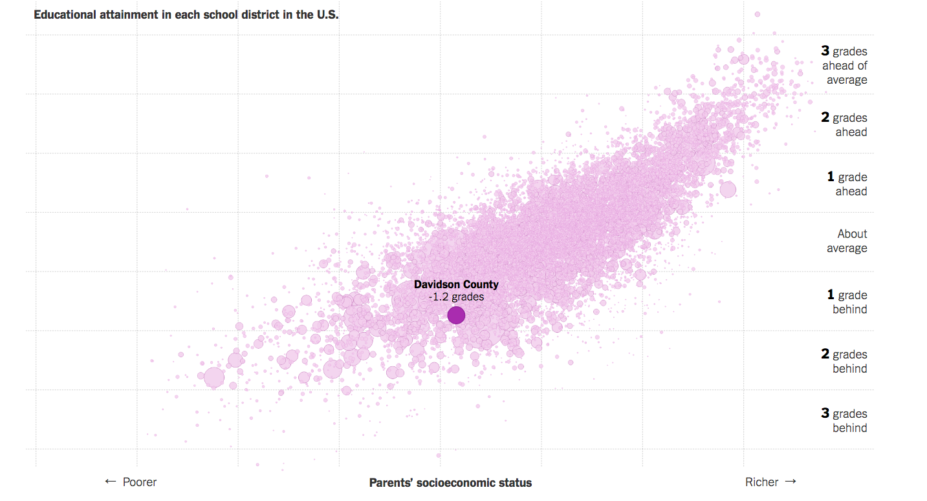
Scatterplot Example
Source: https://www.nytimes.com/interactive/2016/04/29/
upshot/money-race-and-success-how-your-school-district-compares.html

Slide 6
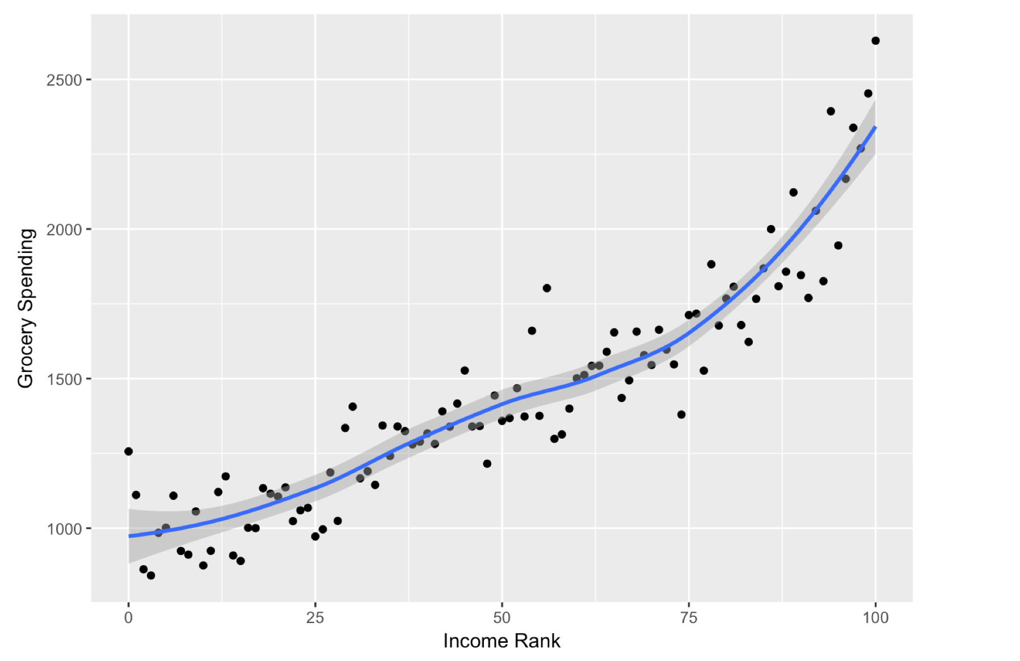
Scatterplots: Loess Line

Slide 7
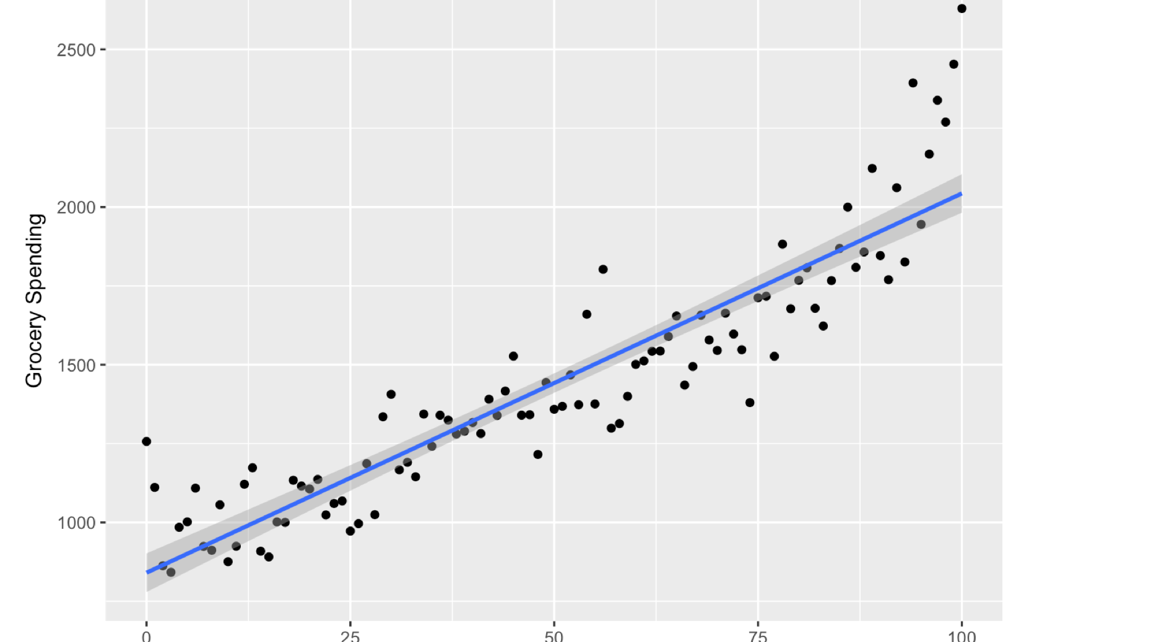
Scatterplots: Linear Regression Line

