Slide 1
Scatterplots
Will Doyle

Slide 2
Scatterplot Options
Size of markers
Shape of markers
Color of markers
Transparency of markers
Overlays: loess, linear, etc
Interactivity

Slide 3
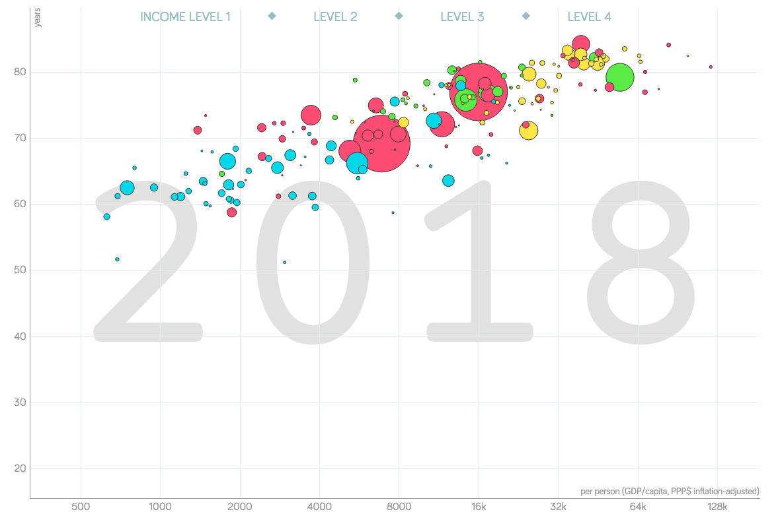
Example: GapMinder
Source: https://www.gapminder.org/tools/#$chart-type=bubbles

Slide 4
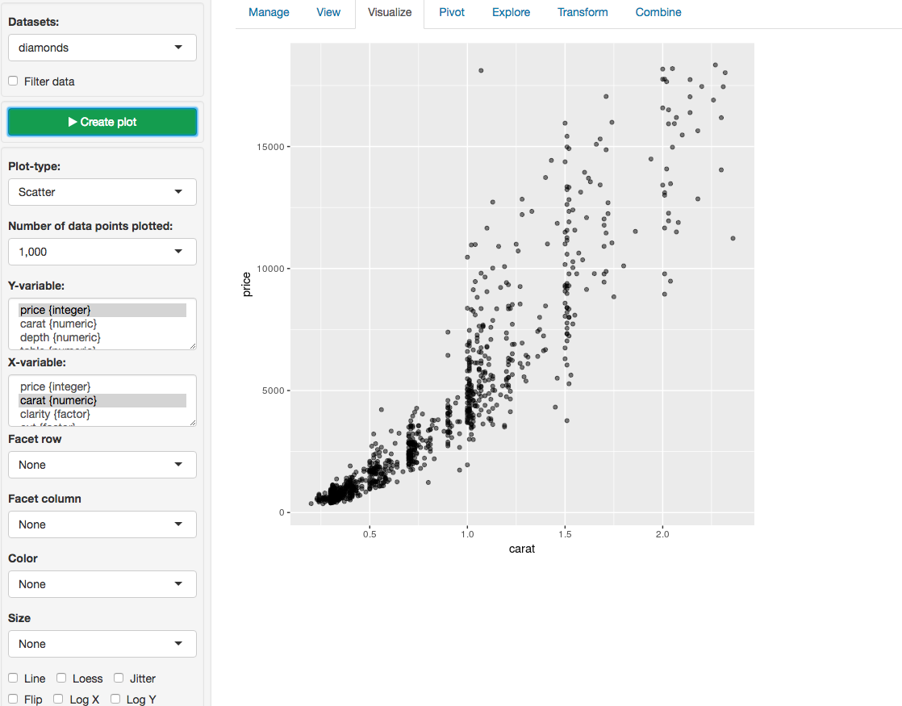
Another Example: Radiant
Source: https://vnijs.shinyapps.io/radiant/?SSUID=cd1c9a009a

Slide 5
Things to think about
Scale of variables
Similarity/dissimilarity of units
Overplotting: too much data
When to use faceting
Explanations for broader audiences

