Slide 1
Getting Data from the Web
Will Doyle

Slide 2
Getting Data from the Web
Most large websites (Facebook, Twitter, Instagram) can best be thought of as huge databases
They collect data from user interactions, then generate models to predict consumer activity
These models are then used to deliver ads to the users most likely to respond to them
This is of course very simplified
Bottom line: data is the lifeblood of many organizations

Slide 3
Getting Data from the Web
Access to data is controlled by its owner
You’re not allowed to just go and collect data from any website
You need permission
Use these carefully, and always ask for permission and/or establish that you’ve been granted permission to the data.

Slide 4
Sources of Web Data
Direct Download
Web Scraping
Application Programming Interfaces (APIs)

Slide 5
Sources of Web Data
Direct Download
Web Scraping
Application Programming Interfaces (APIs)
You are responsible for establishing that you are within the terms of agreement when using these.
(Check robots.txt)

Slide 6
Sources of Web Data
Direct Download
Web Scraping
Application Programming Interfaces (APIs)
While an API may have some built-in restrictions, you still must read and stay within the terms of service

Slide 7
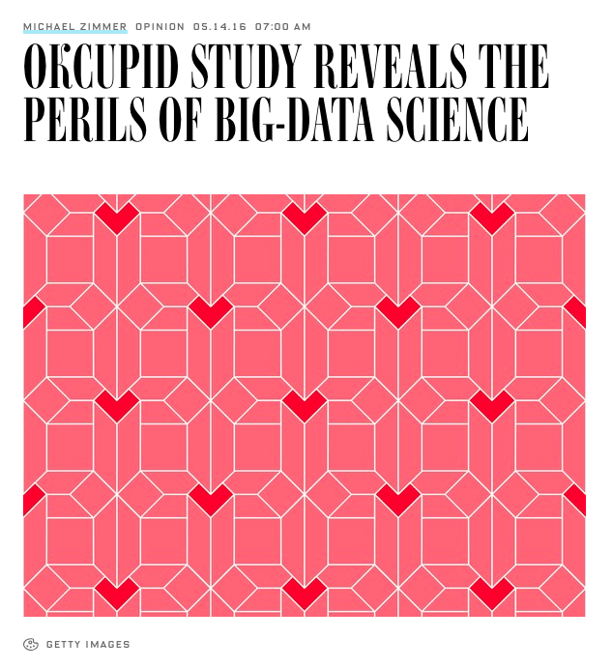
What not to do
Source: https://www.wired.com/2016/05/okcupid-study-reveals-perils-big-data-science/

Slide 8
What not to do
“When asked whether the researchers attempted to anonymize the dataset, Aarhus University graduate student Emil O. W. Kirkegaard, who was lead on the work, replied bluntly: ‘No. Data is already public.’”
Source: https://www.wired.com/2016/05/okcupid-study-reveals-perils-big-data-science/

