Slide 1
Classification
Will Doyle

Slide 2
Classification
Predicting group membership
Simplest version: binary dependent variable
Can also be used for ordinal data (ranked, but non-numeric)
Can also be used for categorical data (any of a large number of discrete groups)

Slide 3
Conditional Mean as a Classifier
We can continue to use conditional means as a classifier
Gives surprisingly good answers
But, the curse of dimensionality is always with us

Slide 4
Linear Regression as a Classifier
Linear regression can be used as a classifier for binary group membership
Known as a “Linear Probability Model”
Real world performance is often quite good
Can generate probabilities lower than 0, greater than 1 (not good)
Poor performance when there are lots of respondents in one group or another (pr(y=1)<.05, pr(y=1)>.95)

Slide 5
Logistic Regression as a Classifier
One of a family of generalized linear models
Uses Maximum Likelihood Estimation (doesn’t directly compute estimates, but chooses estimates which maximize probability of data)
Parameter estimates can’t be directly interpreted on a probability scale

Slide 6
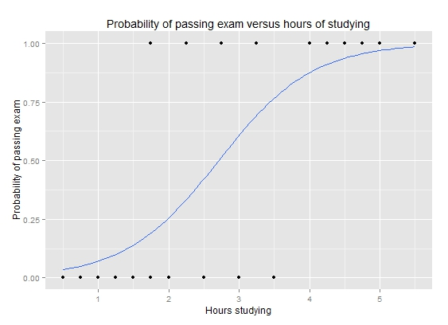
Visualizing Logistic Curve
Source: https://upload.wikimedia.org/wikipedia/commons/6/6d/Exam_pass_logistic_curve.jpeg

