Slide 1
Presenting Classifiers
Will Doyle

Slide 2
Presenting Results of Classification
Presenting these results can be difficult– binary dependent variables don’t lend themselves to plotting
Think about relevant patterns and key findings--- don’t get lost in tables
Use models to generate predicted probabilities

Slide 3
Presenting Results of Classification
Cross Tabs
Bar Graphs
Heat Maps

Slide 4
Cross Tabs
Independent Variable (predictor) goes on rows
Dependent Variable (outcome) goes on columns
Calculate row percentages

Slide 5
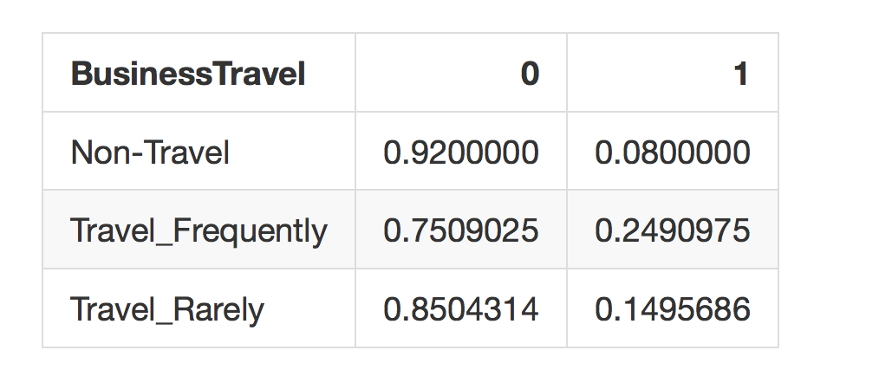
Cross Tabs Example
Q1: Which group has the highest attrition? How can you tell?
Q2: What’s the predicted attrition for those who travel rarely?

Slide 6
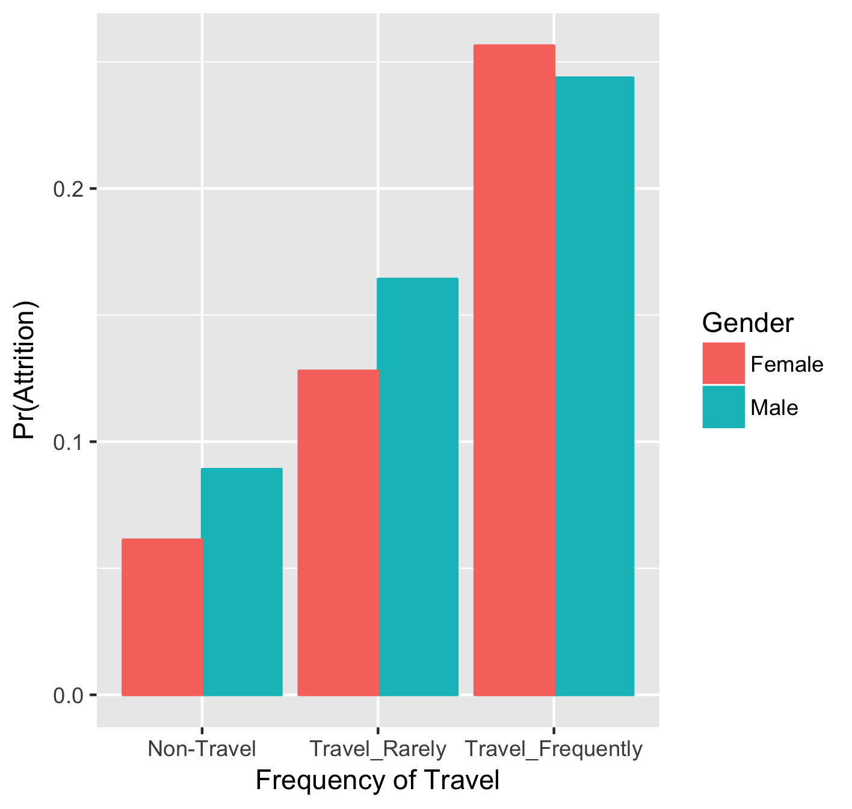
Bar Plot from Cross Tabs

Slide 7
Heat Map
Same information as table
Sometimes provides a more intuitive look
Each cell represents a cell in the table
Intensity of color represents value

Slide 8
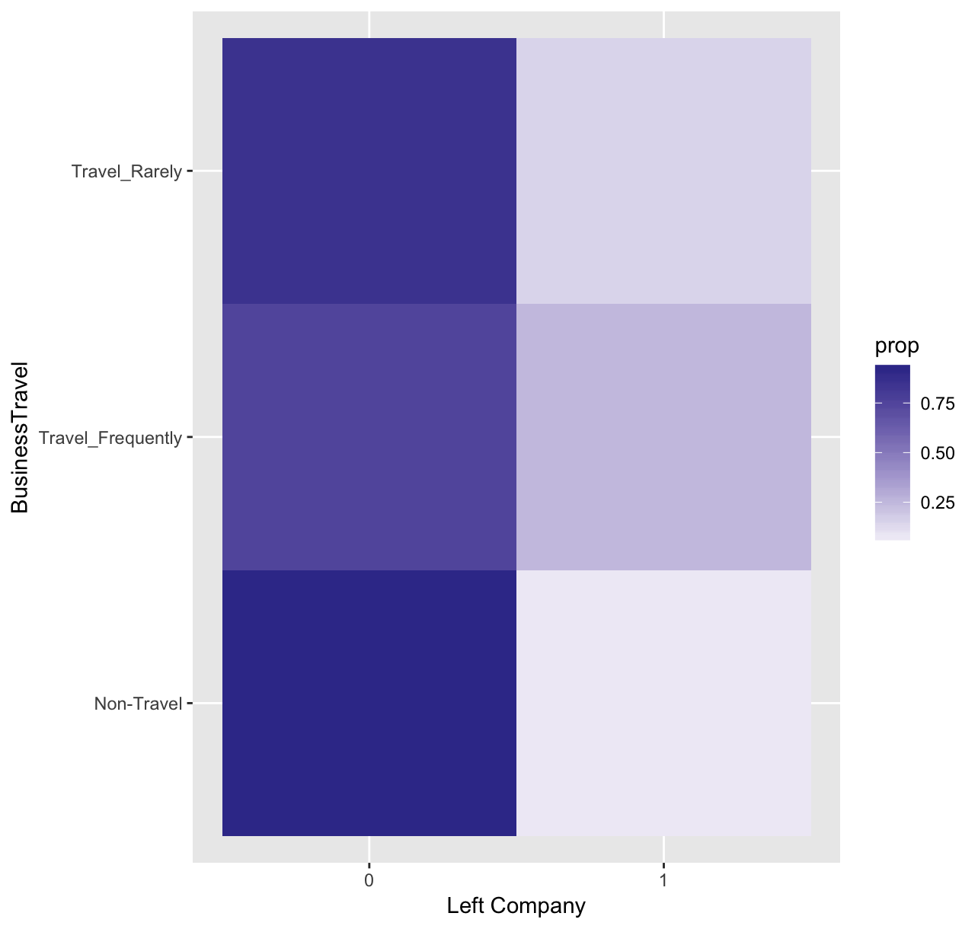
Heat Map

Slide 9
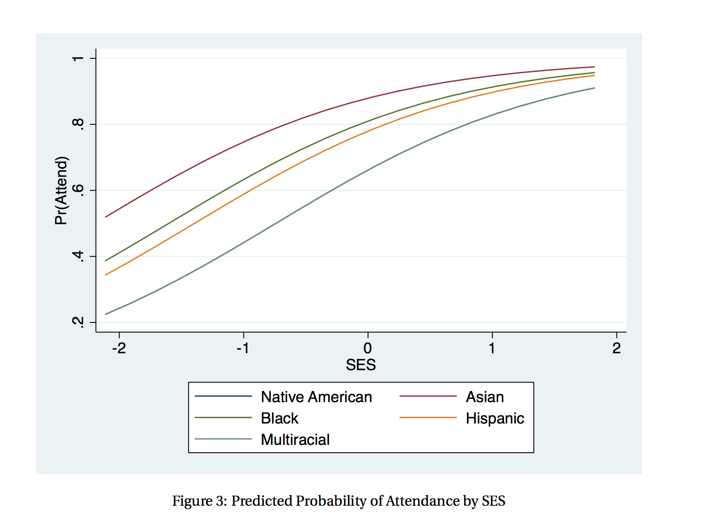
Generating Predicted Probabilities

