Slide 1
Databases
Will Doyle

Slide 2
Databases in Data Science
Databases are the primary means of entering and storing data in any reasonably sized enterprise
Design, maintenance and revision of databases is WELL beyond the scope of this course
A few concepts are quite helpful in generating datasets
Being able to communicate with database analysts is key

Slide 3
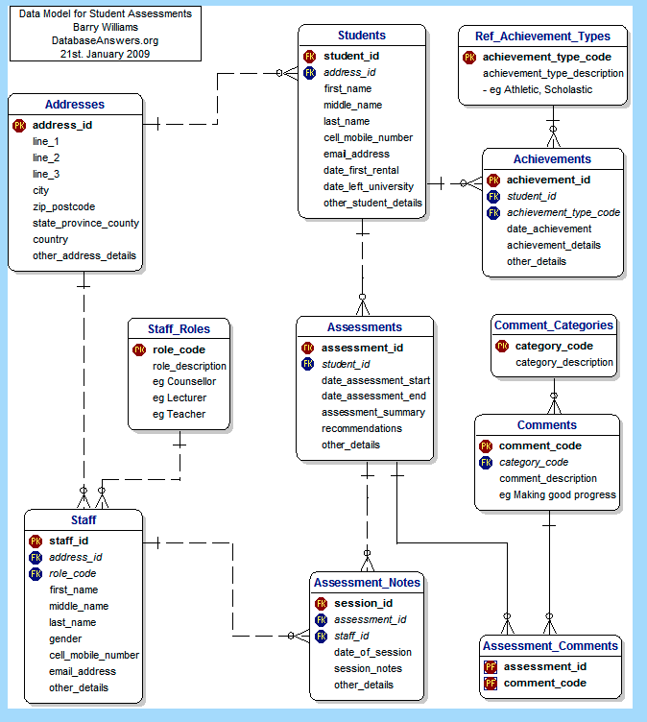
Example Database Schema
Source:
http://www.databaseanswers.org/data_models/student_assessments_simple/index.htm

Slide 4
Database terms
Record: set of fields tied to an identifier (think a row in a dataset)
Table: set of related records
Field: characteristics of a record
Query: a request sent to a database
Identifier: a field in one table which may be used to tie records together across tables
So, a database is a set of related tables, each of which contains records made of multiple fields which have identifiers

Slide 5
Database Management Systems (DBMS)
A means by which to organize, maintain and query tables
Examples include SQL, mySQL, Oracle, MS Access and so on
You do not need to have access to a DBMS to access a database
The DBMS does imply what kind of operations you may be able to do

Slide 6
Database Verbs
SELECT: choose certain fields from a table
FROM: utilize certain tables
WHERE: only select records that meet certain conditions
JOIN: combine records from certain tables

Slide 7
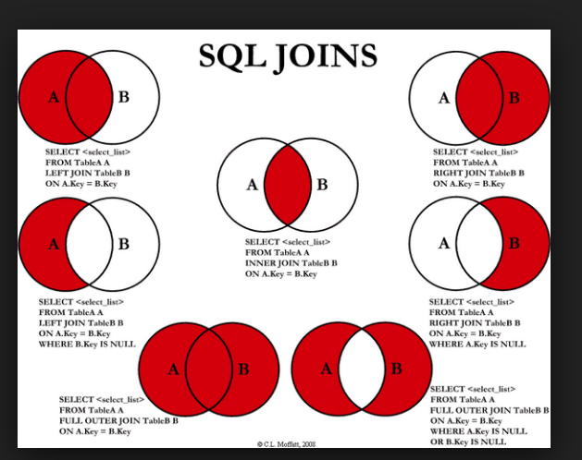
Types of Joins
Source: https://plus.google.com/111053008130113715119/posts/5TdpUKQXxpu

Slide 8
Types of Joins
99 percent of the time, it’s best to structure your setup so that you’re doing a left join of type 1
Other joins get complicated fast
If you need to do something more difficult, talk it through with the database analyst

