Slide 1
Unsupervised and Supervised Learning
Will Doyle

Slide 2
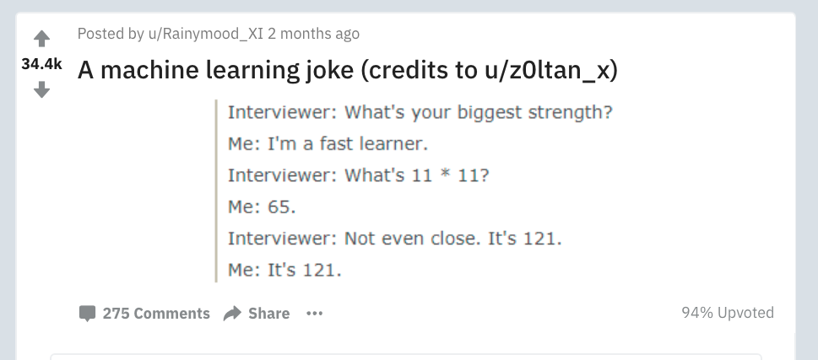
What is Machine Learning?
Source: https://www.reddit.com/r/ProgrammerHumor/comments/8inqk7/a_machine_learning_joke_credits_to_uz0ltan_x/

Slide 3
Supervised Learning
In supervised learning, we train models to create predictions, then compare their predictions on out of sample answers to the right answer
We can (and do) iteratively improve these models
We always know what the right answer is
The computer is trained to come up with predictions that are as close as possible to the right answer

Slide 4
Unsupervised Learning
In unsupervised learning, an algorithm comes up with its own classifications based on patterns in the data
There aren’t really outcomes to predict in unsupervised learning
Instead, we’re allowing the algorithm to generate insights into our data

Slide 5
Types of Unsupervised Learning Problems
Association Rules
This covers problems where we’d like to generate a series of “rules” that cover how people behave
Recommendation engines can work this way
Retail locations are (analogously) structured around association rules (bread, peanut butter, jelly)
Clustering
Covers problems where we want to classify groups in the data
Different from classification because we don’t know a priori what the groups are

Slide 6
Clustering
Clustering is a general term
Types of clustering
K-means
Principal Components
Latent Variables/ Factor Analysis
We’ll cover the most common type: K-Means clustering

Slide 7
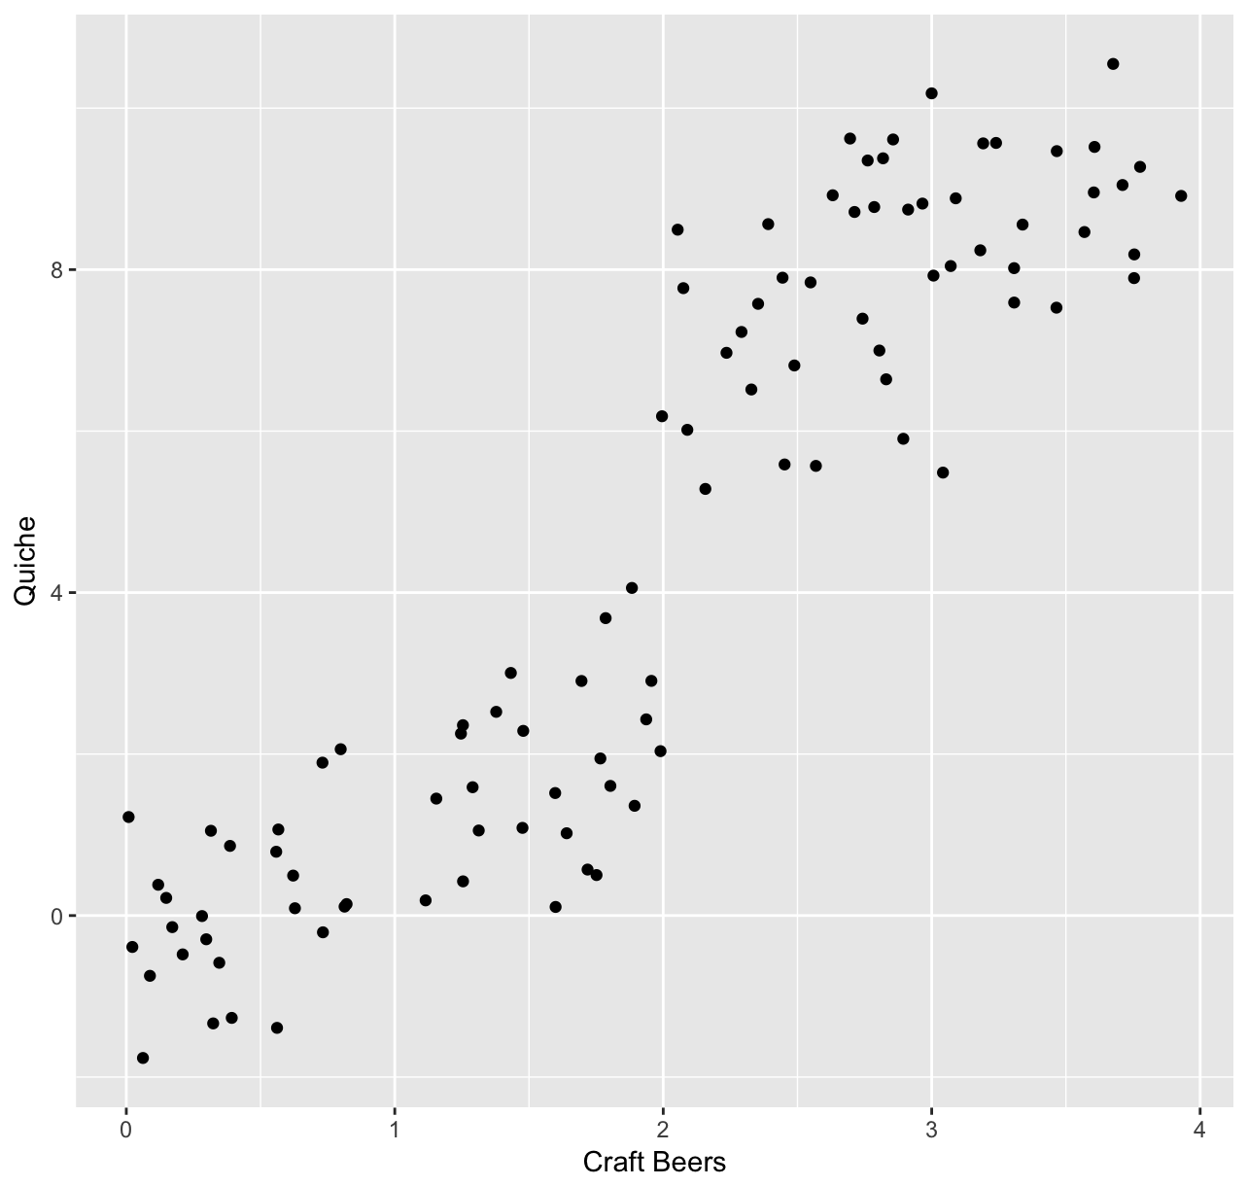
K means Clustering

Slide 8
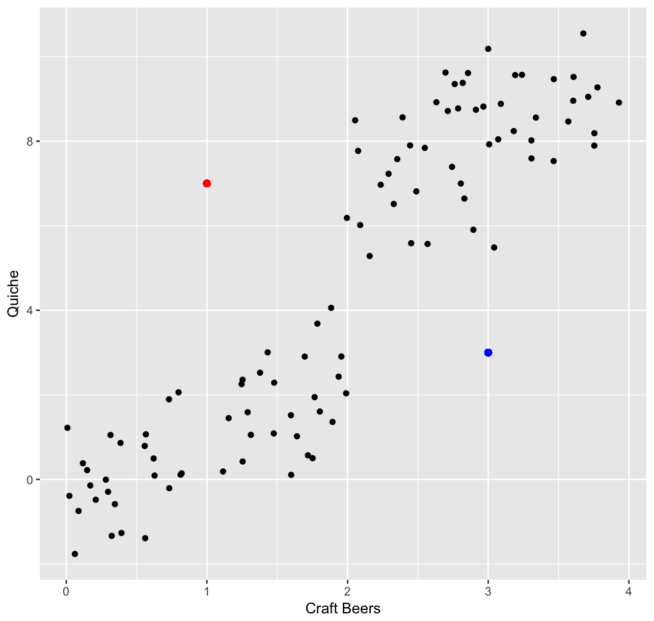
K means Clustering

Slide 9
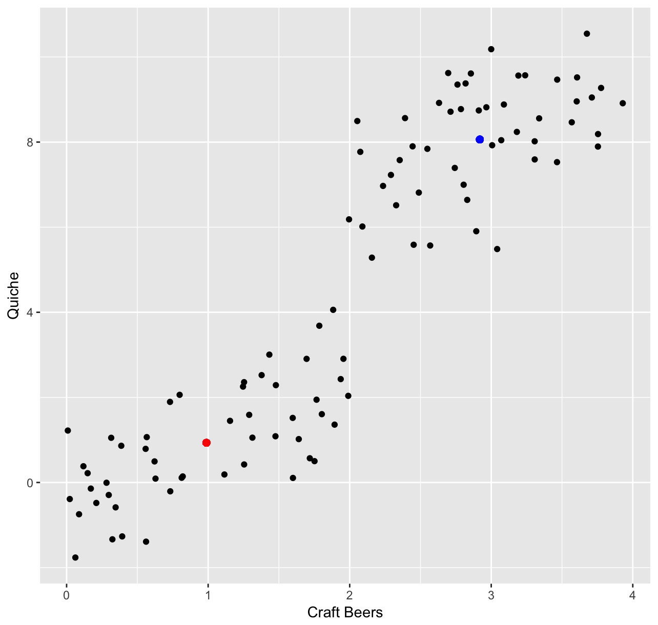
K Means Clustering

Slide 10
K Means Clustering
Gourmands
Non-snobs

Slide 11
K means algorithm
Propose centers
Calculate distances from centers to data
Assign points to closest center
Move center to minimize distance from assigned points (place it at combined mean)
Repeat 2-4 until centers cease moving (convergence)

Slide 12
Real World Applications
Political typologies (e.g. Soccer Moms, NASCAR dads)
Customer segmentation (value shoppers, fashionistas)
Health Care– clusters of problematic health issues

