Slide 1
Interactive Graphics
Will Doyle

Slide 2
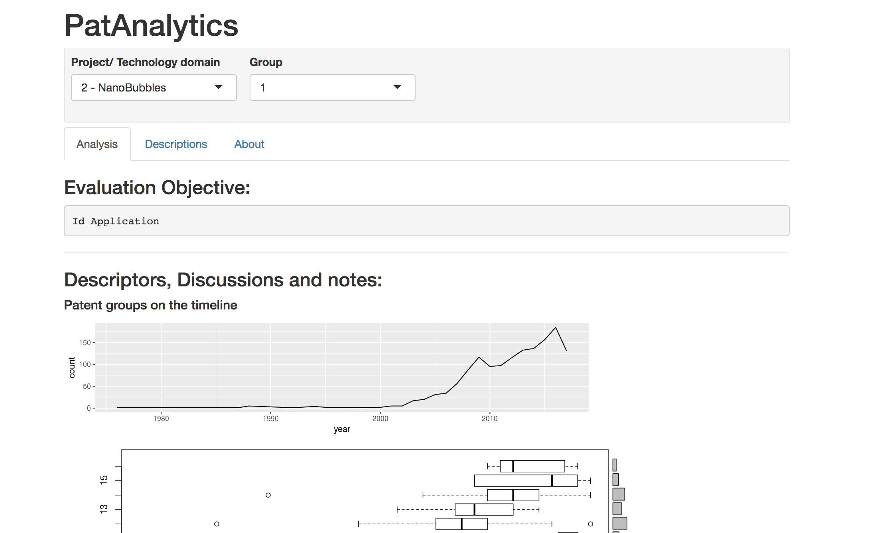
Example: Patent Analytics
Source URL: https://hamagust.shinyapps.io/patAnalyticsM5_V/

Slide 3
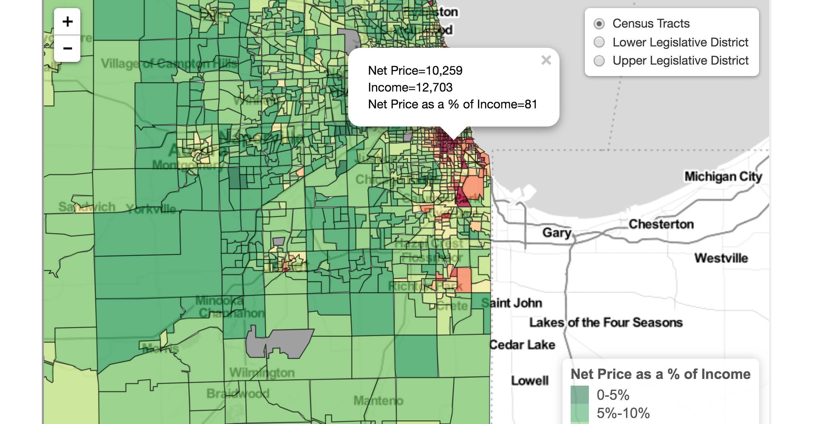
Example: College Affordability Diagnosis
Source: https://peabody.vanderbilt.edu/research/studies/affordability/maps_cc.php

Slide 4
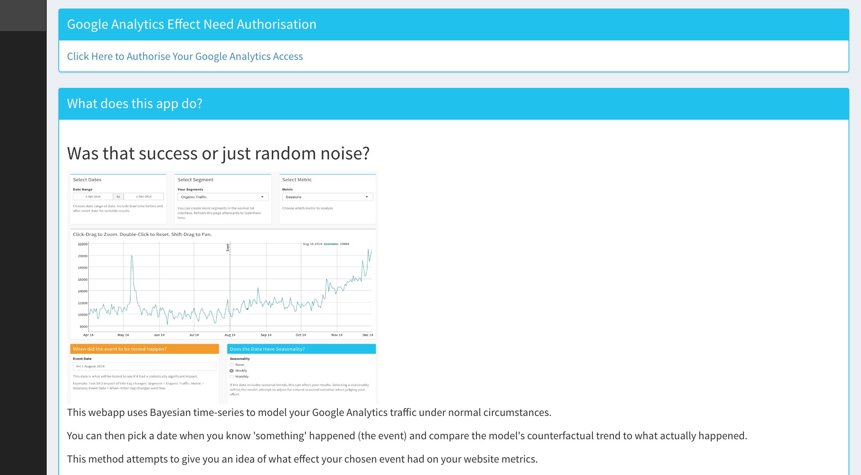
Example: Marketing Effects
Source: https://gallery.shinyapps.io/ga-effect/

Slide 5
Types of Interactive Graphics in R
D3
Plotly
Rshiny
Base R

Slide 6
Elements for Interactivity
Click on points
Adjust axes
Add new data
Adjust color schemes
Animate
Change analytic approach
Change format of plot
Examine data sources

