Slide 1
Presenting Results
Will Doyle

Slide 2
The Basics
Who is your audience?
What do they need to know?
What format will work?

Slide 3
Common Pitfalls
Not understanding audience
Technical sophistication of most audience is very low
Content knowledge among many audiences is very high
Data science presentations that emphasize technicality but miss basic context are very common

Slide 4
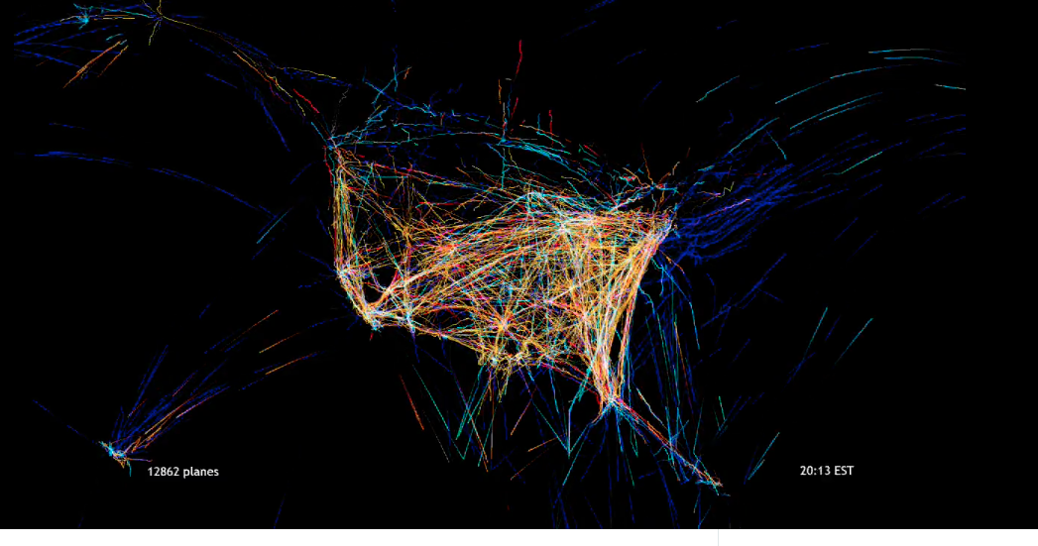
Common Pitfalls
Pridefully Obvious Presentation
Source: https://vimeo.com/5368967

Slide 5
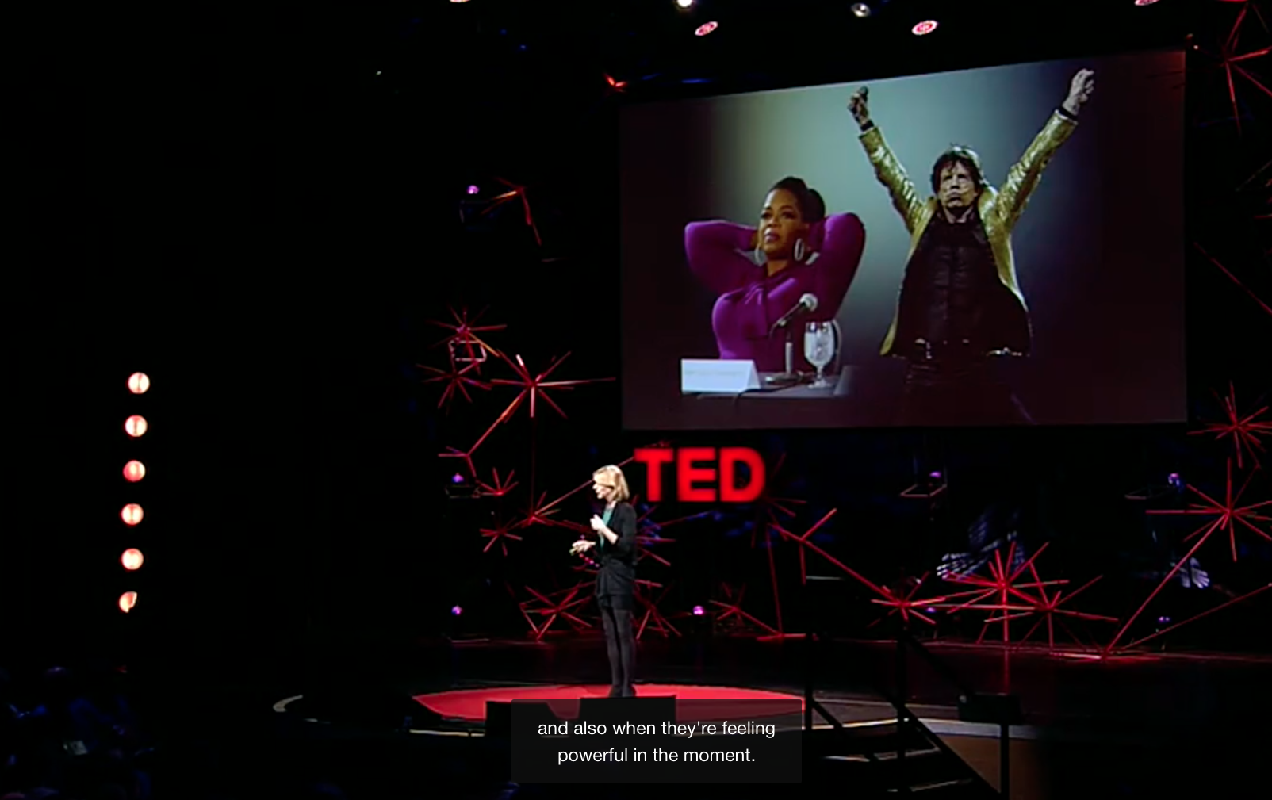
Common Pitfalls
Failing to Communicate Uncertainty
Source: https://www.ted.com/talks/amy_cuddy_your_body_language_shapes_who_you_are?utm_campaign=tedspread&utm_medium=referral&utm_source=tedcomshare

Slide 6
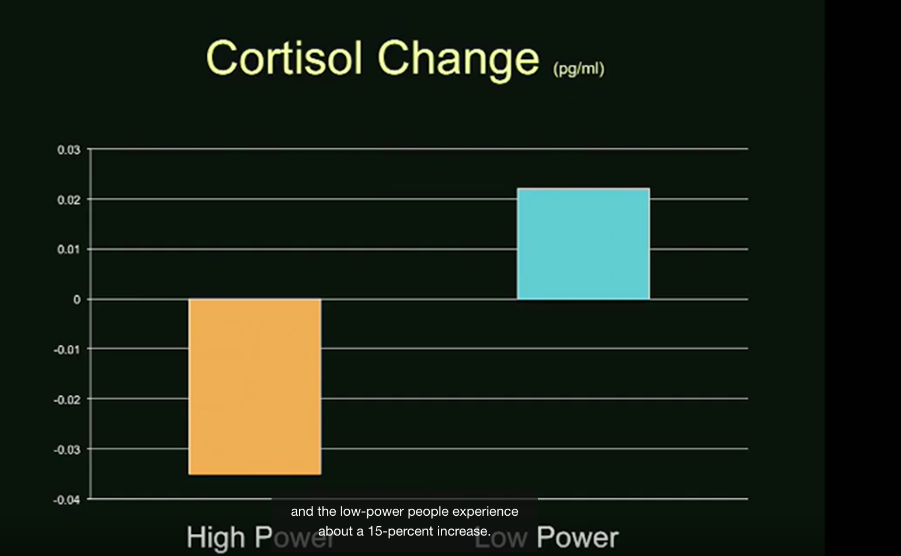
Common Pitfalls
Failing to Communicating Uncertainty
Source: https://www.ted.com/talks/amy_cuddy_your_body_language_shapes_who_you_are?utm_campaign=tedspread&utm_medium=referral&utm_source=tedcomshare

Slide 7
Common Pitfalls
Failing to Communicating Uncertainty
Source: https://www.ted.com/talks/amy_cuddy_your_body_language_shapes_who_you_are?utm_campaign=tedspread&utm_medium=referral&utm_source=tedcomshare

Slide 8
Where to Start
Start with your conclusions
Tell me– tell me how you know--- tell me again
Practice PGP
Particular
General
Particular

