Slide 1
Formats for Presenting Results
Will Doyle

Slide 2
Formats for Presenting Results
Verbal reporting/ informal methods
Slide decks
Briefing paper
Full report
Code

Slide 3
Verbal Reporting/ Informal
Quick questions in meetings, emails, Slack channels etc.
Quick answers are fine, but . . .
DOCUMENT
Many times these results propagate
Make sure you can replicate the answer

Slide 4
Slide Decks
By far most common means of communication in organizations
Simple structure
Generally easy to follow
But . . .

Slide 5

Slide Decks
Source: https://www.edwardtufte.com/tufte/powerpoint

Slide 6
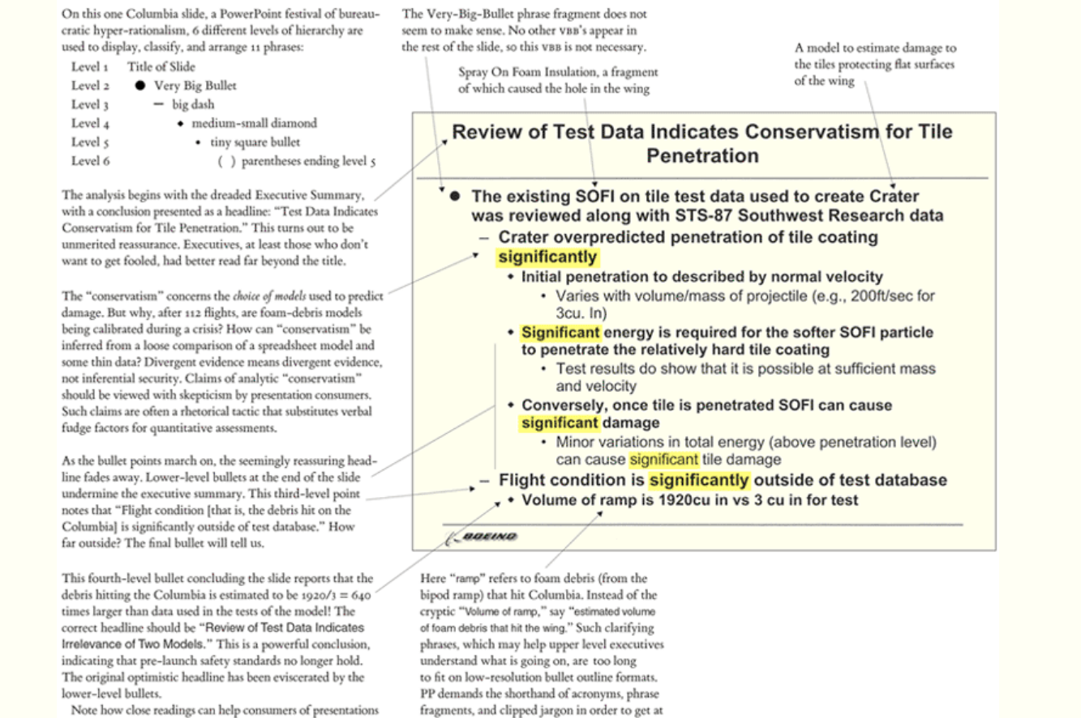
Sourcehttps://www.edwardtufte.com/bboard/q-and-a-fetch-msg?msg_id=0001yB:

Slide 7
Slide Decks
Slide decks should be based on a more comprehensive report that can be supplied
If slide deck must be stand alone, then can be more text oriented
If slide deck is purely to support verbal presentation, orientation should be toward high quality graphics

Slide 8
Briefing
Generally best way to report results
Set max length: Amazon uses six pages, single spaced
Length includes tables and graphics
Proposed structure
What do we need to know? Problem statement
Bottom line: the answer (by end of 1st page)
Data: where did we get it, is it any good?
Exploratory Data Analysis (conditional means)
Predictive model: what was used, what assumptions are made?
Accuracy of model (results from cross validation)
Predictions from model
Recommendations

Slide 9
Full Report
If goal is to create a sustainable project, a full report should be created
Briefing Paper serves as executive summary
Sections are based on briefing paper
Includes much more detail and narrative, providing a roadmap for continued development

Slide 10
Code
Your code is the best guide for replication
Code must be primarily readable by humans, secondarily by computers
Should be carefully documented
This class has emphasized literature programming: combining narrative and code in a single document (.Rmd file for us)
Well documented code should be part of product

