Slide 1
Case study: Predicting College Enrollment-- Data
Will Doyle

Slide 2
What data will you need
Unit of analysis: individual student
Coverage: full sample of applicants
Dependent Variable: enrolled in system (0,1)
Independent Variables:
SES
Race
Gender
Test scores

Slide 3
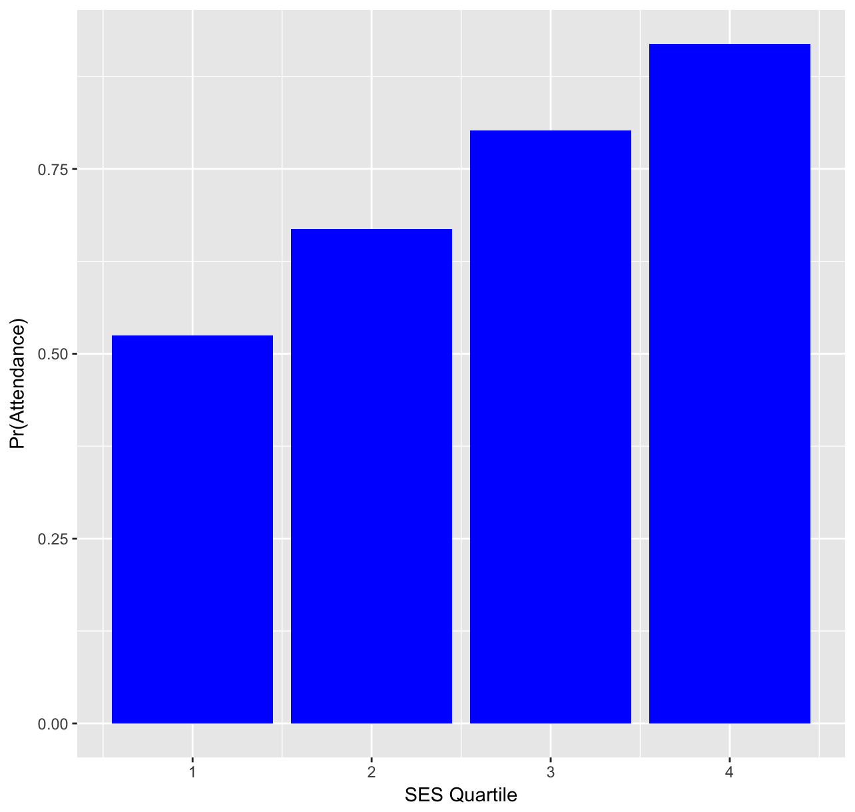
Basic Conditional Means

Slide 4
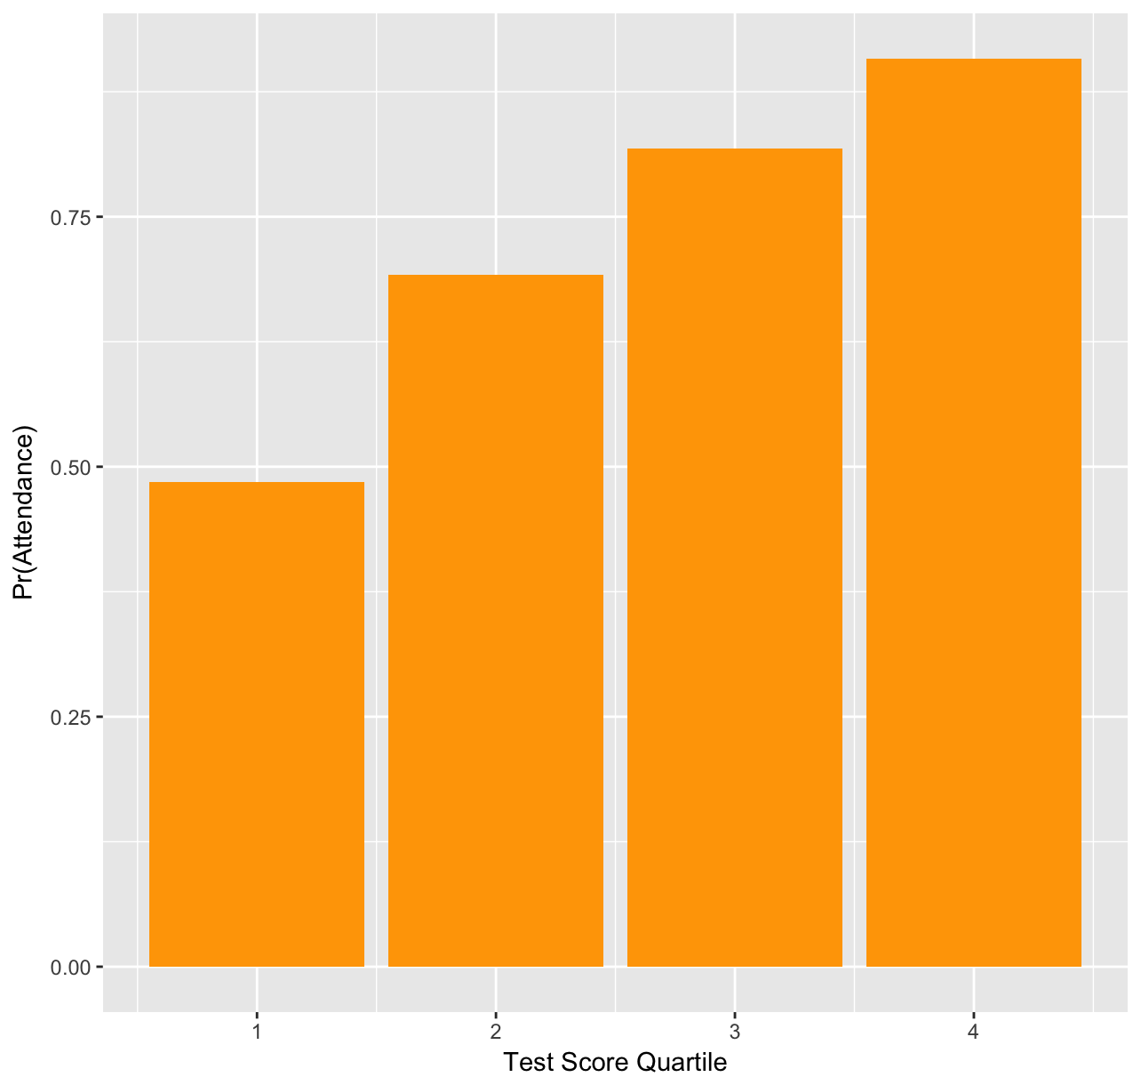
Basic Conditional Means, Continued

