Slide 1
Case study: Predicting College Enrollment-- Analysis
Will Doyle

Slide 2
What analysis to conduct
Binary Dependent Variable
Classification problem
Logistic Regression is best approach
Dependent variable: f2evratt, 0= did not attend, 1= attended
Independent variable: race, sex, ses, test scores

Slide 3
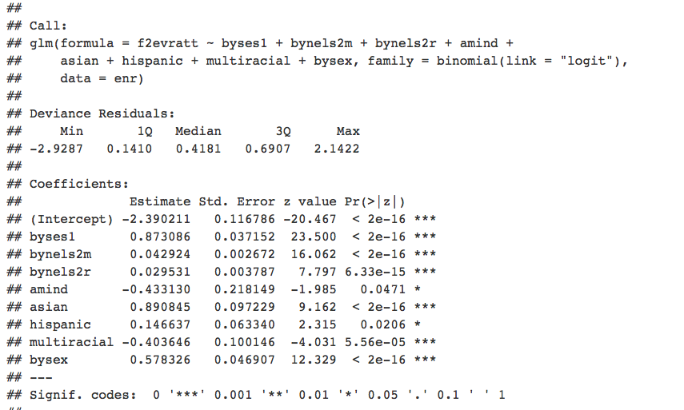
Results

