Slide 1
Case study: Predicting College Enrollment– Presenting Results
Will Doyle

Slide 2
Basic outline
SES, test scores are strongly positively associated with enrollment
If we have more high ses, high test score applicants, our enrollments will be higher
All else equal, African American, Hispanic, and Asian students are more likely to enroll
All else equal, female students are more likely to enroll

Slide 3
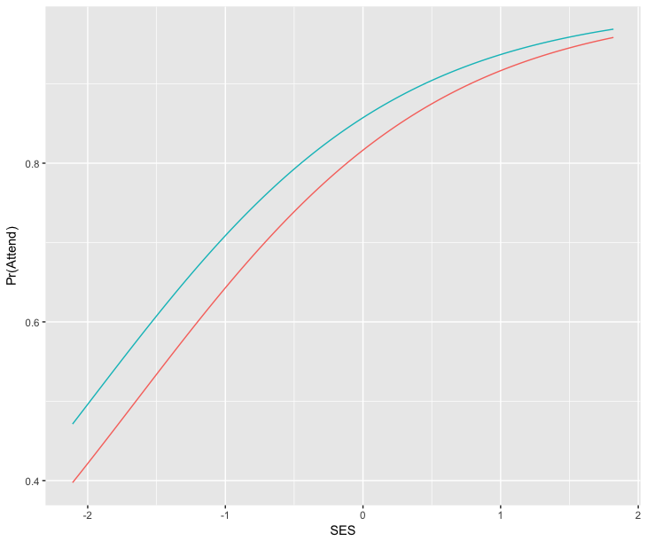
Plotting Probabilities

Slide 4
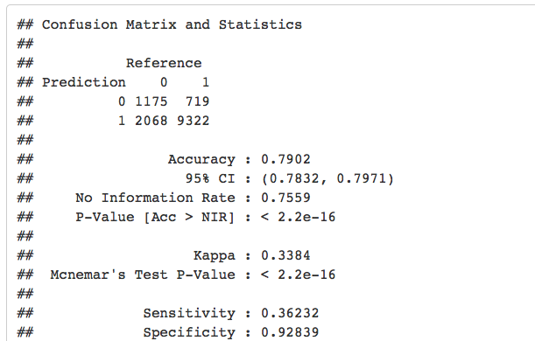
Evaluating Model Fit

Slide 5
Evaluating Model Fit
Percent Correctly Predicted= 79 percent
Specificity (who isn’t going) is MUCH better than sensitivity (who IS going)
AUC= .8– not great, but good
Model is reasonably good at predicting non-enrollment– may need to adjust to get better at predicting enrollment

