Slide 1
Review
LLO 8200, Introduction to Data Science
Vanderbilt University

Slide 2
LLO Statistical Literacy
Applied Statistics
Descriptive Statistics
Basic Inference
Data Science
Utilizing software
Advanced algorithms

Slide 3
LLO Statistical Literacy
Applied Statistics
Data Science
Descriptive statistics
Confidence Intervals
Hypothesis testing
One-sample mean
Two-sample means (independent, related)
Analysis of variance (ANOVA)
One-way
Factorial
Linear Regression
Conditional means
Continuous and discrete data
Regression
Linear – continuous
Logistic – binary or discrete
Classification/Prediction
Cross Validation
Compare models

Slide 4
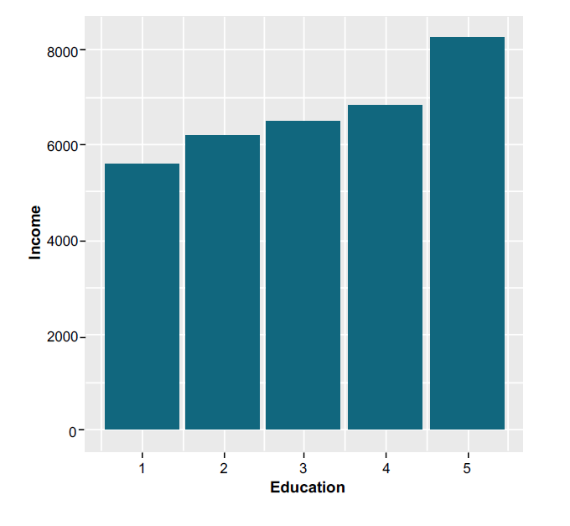
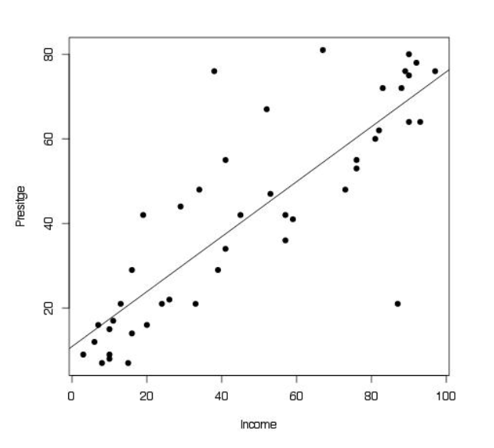
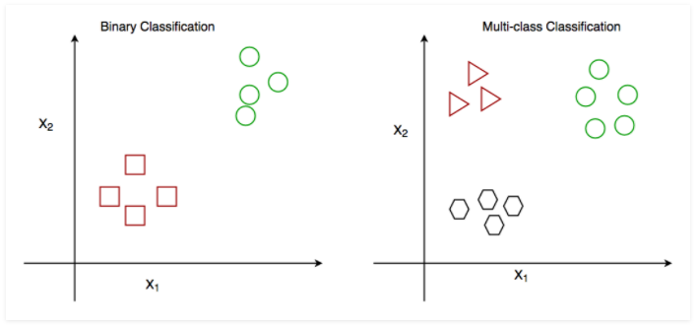
Conditional Mean
Linear Regression
Classification

Slide 5
Recap: Regression & Classification
 | Classification | Regression
Dependent variable | Discrete values | Continuous values
Nature of dependent variable | Unordered | Ordered
Model fit | Measure accuracy | Measure root mean square error
Algorithm | Logistic Regression | Linear Regression

Slide 6
Key Skills/Learning Outcomes
Using statistical software access and clean data; manipulate dataset adding new variables; save data
Describe continuous or discrete data using graphs or tables as appropriate
Using statistical software run and analyze regression algorithms for both continuous and discrete data
Demonstrate understanding of basic principles of machine learning: prediction/classification and cross validation

Slide 7
Key Skills/Learning Outcomes
As a scholar:
Produce meaningful quantitative research
Using conditional means to better understand a dependent variable across a population, calculating regression coefficients to describe relationships as a rate of change, work efficiently with large datasets
As a practitioner:
Critically consume quantitative research
Identifying methods used and theoretical underpinnings, discern statistically sound/valid conclusions

Slide 8
Key Skills/Learning Outcomes
I am comfortable using software to access data.
I can describe data using numbers, charts, and graphs.
I understand the concepts of regression and know when to utilize when analyzing data.
I can analyze statistical models by examining RMSE, accuracy, and cross-validation.
I can draw meaningful conclusions about quantitative variables, based on statistical methods.

