Slide 1
Week 2 Review
LLO 8200, Introduction to Data Science
Vanderbilt University

Slide 2
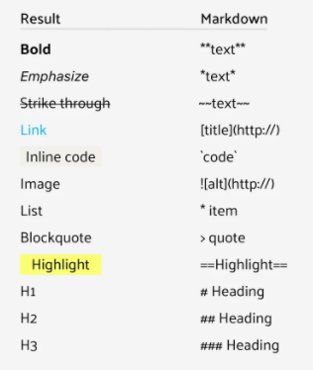
Markdown Language
RMD = R Markdown
A shorthand version of HTML
Affects the look of your knitted file

Slide 3
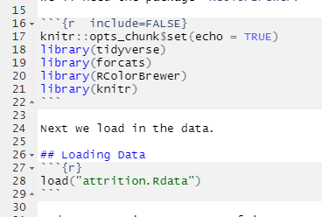
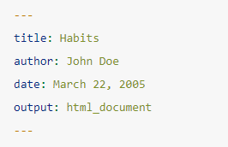
Programming Notes
Make sure your document has a header:
https://bookdown.org/yihui/rmarkdown/html-document.html

Slide 4
Programming Notes
Load all libraries in first code chunk
Multiple steps can be combined into a single code chunk
Add comments in each code chunk that explain what those particular commands are doing
Do not simply copy code from async without understanding

Slide 5
Debugging (fixing errors)
READ the text of the error. It will often tell you where and what the problem is (usually)
“___ not found” – make sure (1) your files are saved in the same folder, (2) your objects are properly defined within the .Rmd file, and (3) you have loaded all necessary libraries
You may need to Google (or Bing) the first few words of the error
Good sources: Rstudio Community; Stack Overflow; GitHub
Use the Wall (2VU) – discussion there does not count against the 3 partner limit on HW

Slide 6
Conditional Means
Conditional Mean = finding the averages of different divisions of the data
RMSE = average distance between prediction and actual value for all values in dataset
When might the RMSE be zero?
Can RMSE be negative?
Is there a maximum value for RMSE?

Slide 7
Building and Evaluating Models
A model (in data science) is made up of three parts:
Dependent (outcome) and independent (predictor) variables
Algorithm
Predictions/predicted values
Model fit describes how well the predictions match the dependent variable (e.g., low RMSE)
Example:
DV: college debt, IV: type of school, selectiveness, etc
Algorithm: conditional means
Mean values for each level of the IV

Slide 8
Building and Evaluating Models
Research question
Data collection
Determine methods
Compute predictions
Evaluate model
Compute predictions
Evaluate model

Slide 9
Building and Evaluating Models
In practice:
Research questions may be confined by available data
Independent variables should be selected based on context from a literature review (and available data)
Generally, more IV will result in better model fit, HOWEVER, need to balance precision with accuracy
In a paper, you would report your series of models, resulting the final one with best fit.

