Slide 1
Week 3 Review
LLO 8200, Introduction to Data Science
Vanderbilt University

Slide 2
Statistical Graphing
Identify dependent (and independent) variable. Classify as discrete or continuous.
Determine the key characteristic of the variable to be displayed.
Exploratory, distribution/range, comparison
Select a graph type (in ggplot, a geom) that best fits these parameters.
Adjust visual components

Slide 3
Statistical Graphing with ggplot2
“gg” = “grammar of graphics”
Every statistical graph the same simple components:
Data + Aesthetics (color, shape, size) + Geometries (points, lines, bars)
Statistical transformations
Positions (dodge, stack, fill, jitter)
Build in layers (iteratively)

Slide 4
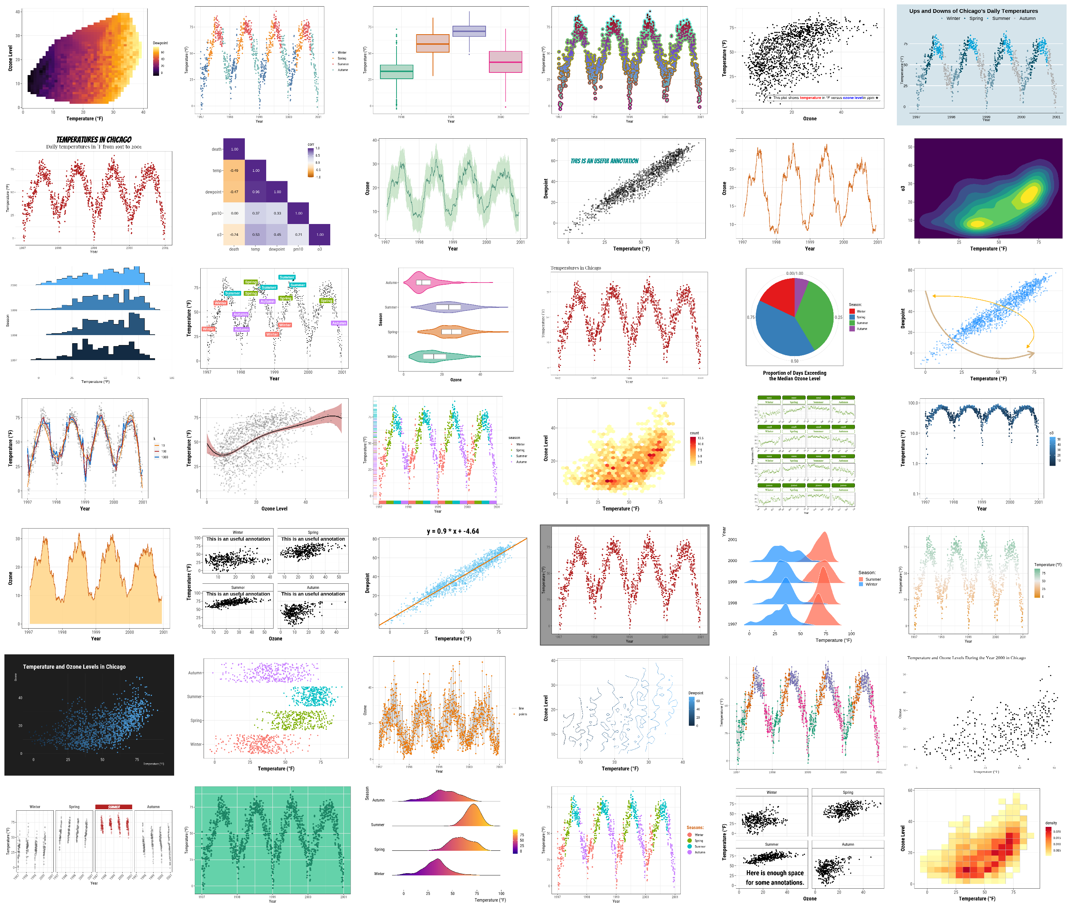

Slide 5
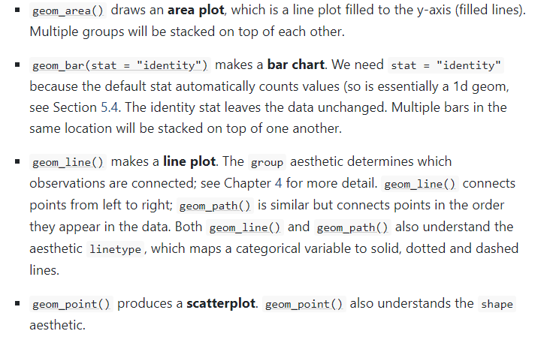
Statistical Graphing with ggplot2

