Slide 1
Review and Overview
LLO 8200, Introduction to Data Science
Vanderbilt University

Slide 2
What is linear regression?
In some ways, an extension of conditional means across interval and ratio level data
Instead of a collection of bar graphs for a discrete, finite number of categories, we use a scatterplot
Based on (a relatively common) assumption that the relationship between our dependent and mediating/explanatory variables is linear, or the amount of change is constant

Slide 3
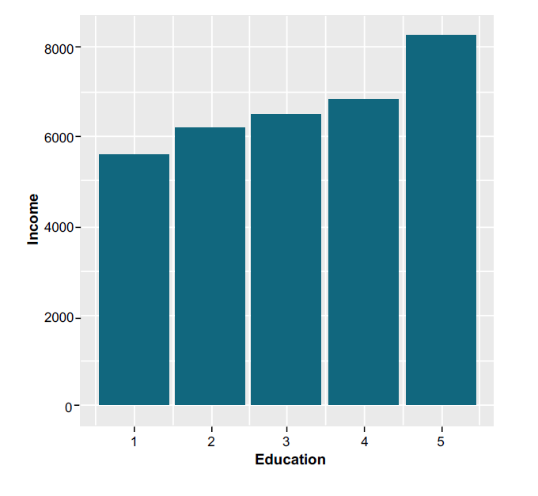
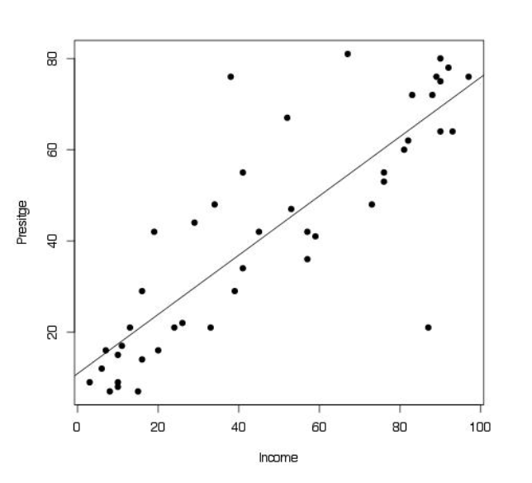
Linear Regression
Conditional mean
Linear regression

Slide 4
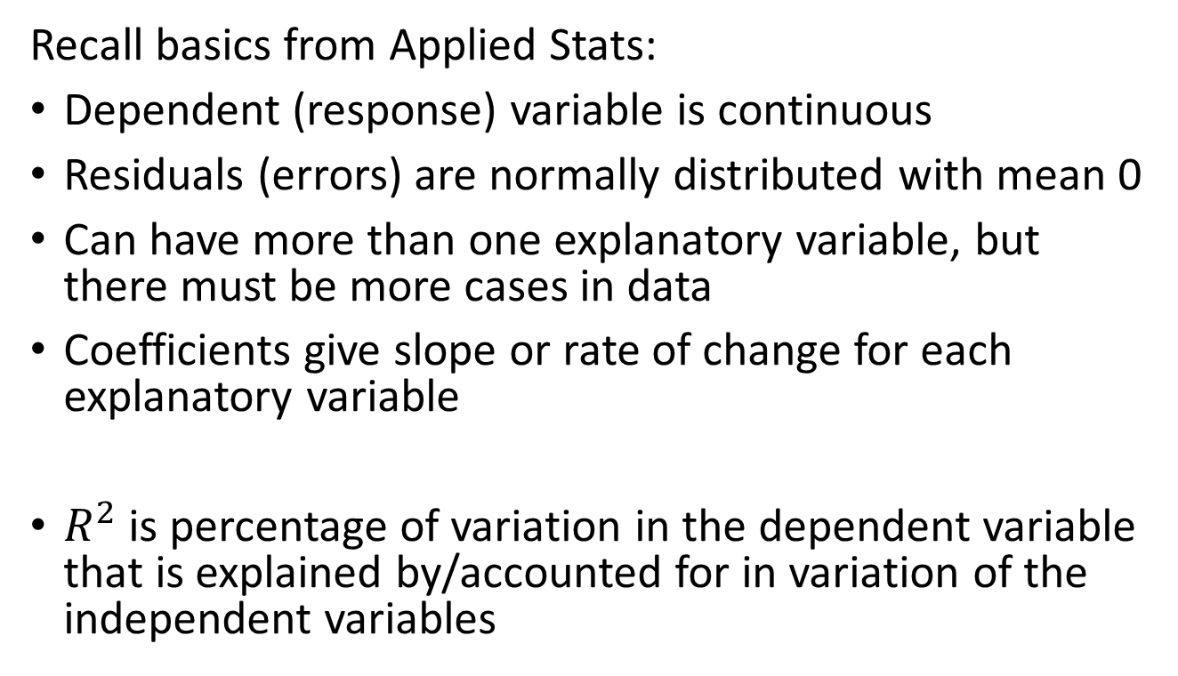
Notes on linear regression
Recall basics from Applied Stats:
Dependent (response) variable is continuous
Residuals (errors) are normally distributed with mean 0
Can have more than one explanatory variable, but there must be more cases in data
Coefficients give slope or rate of change for each explanatory variable
$R^{2}$ is percentage of variation in the dependent variable that is explained by/accounted for in variation of the independent variables

