Slide 1
Review
LLO 8200, Introduction to Data Science
Vanderbilt University

Slide 2
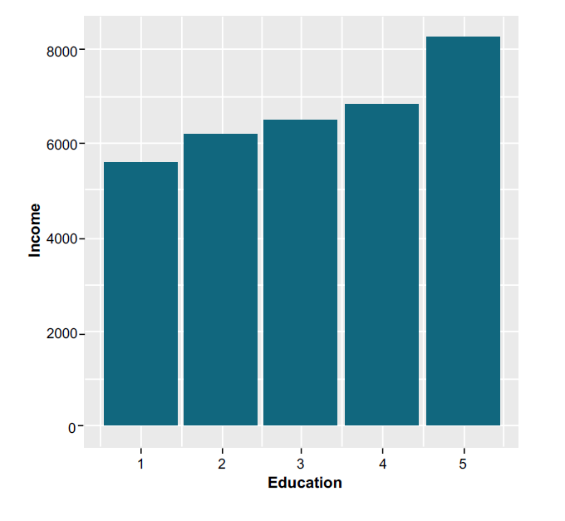
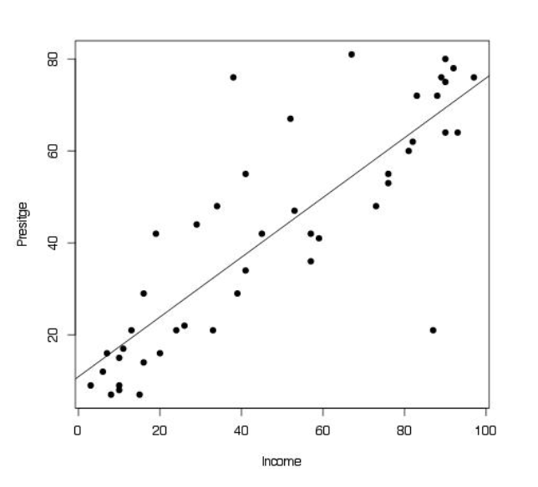
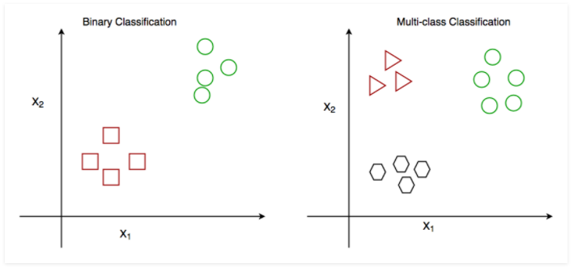
Conditional Mean
Linear Regression
Classification

Slide 3
Recap: Regression & Classification
 | Classification | Regression
Dependent variable | Discrete values | Continuous values
Nature of dependent variable | Unordered | Ordered
Model fit | Measure accuracy | Measure root mean square error
Algorithm | Logistic Regression | Linear Regression

