Slide 1
Analytics @ Pscc
What’s all the fuss, and how can we make it work for us?

Slide 2
THE MOTIVATION FOR TODAY
Trajectory Analytics Report
First piloted Spring 2015 (newest version released this month)
Maxine Smith Fellowship
work with Dr. Denley on analytics capacity and data culture of TBR institutions
Our Mission
“…the College integrates state-of-the-art technology into teaching and learning, educational support, and administration.”
Why here?
Why now?
Why me?!

Slide 3
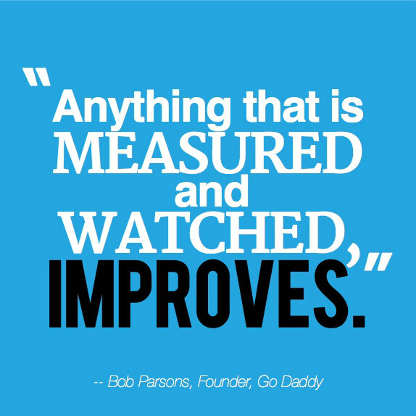

Slide 4
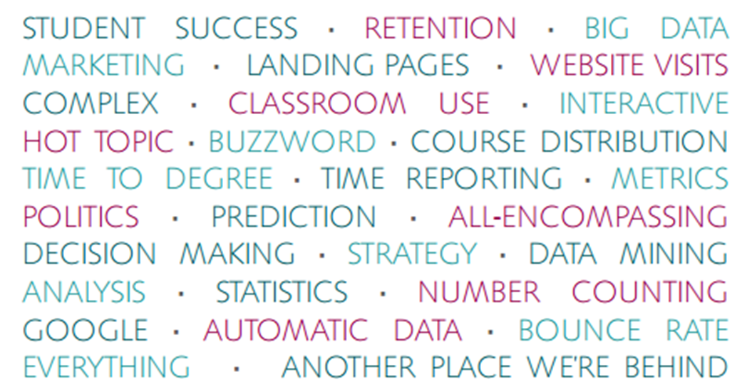
What is predictive analytics?

Slide 5





have YOU EVER...?

Slide 6
WHAT IS ANALYTICS?
Analytics is the use of data, statistical analysis, and explanatory and predictive models to gain insights and act on complex issues.

Slide 7
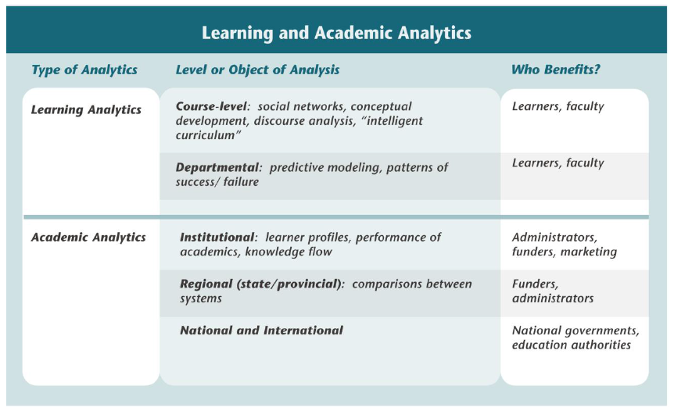
Analytics in higher education

Slide 8
Why analytics?
Understanding student demographics and behaviors
Optimizing use of resources
Recruiting students
Helping students learn more effectively/graduate
Creating data transparency
Demonstrating the institution’s effectiveness/efficiency
Improving administrative services
Top perceived benefits of utilizing predictive analytics in higher education, according to a nation-wide focus group of IT and IR professionals.

Slide 9
Isn’t this just another initiative?!
Implemented efficiently, analytics can be a tool that helps address existing initiatives with better outcomes
Investing in analytics now and creating an institutional data culture of performance (instead of a culture of reporting) will have significant returns in achieving future goals

Slide 10
HOW CAN we get started?
What are the big strategic questions at Pellissippi state?

Slide 11
About Trajectory Analytics
The project is also known as
“Intervention Analytics” or “Intrusive Advising”
Using historical, aggregated data from across the TBR system, a predictive model of graduation/completion was developed – based on major, courses completed, and grades attained in each course
The model provides a measure of likelihood of graduation/completion for individual students

Slide 12
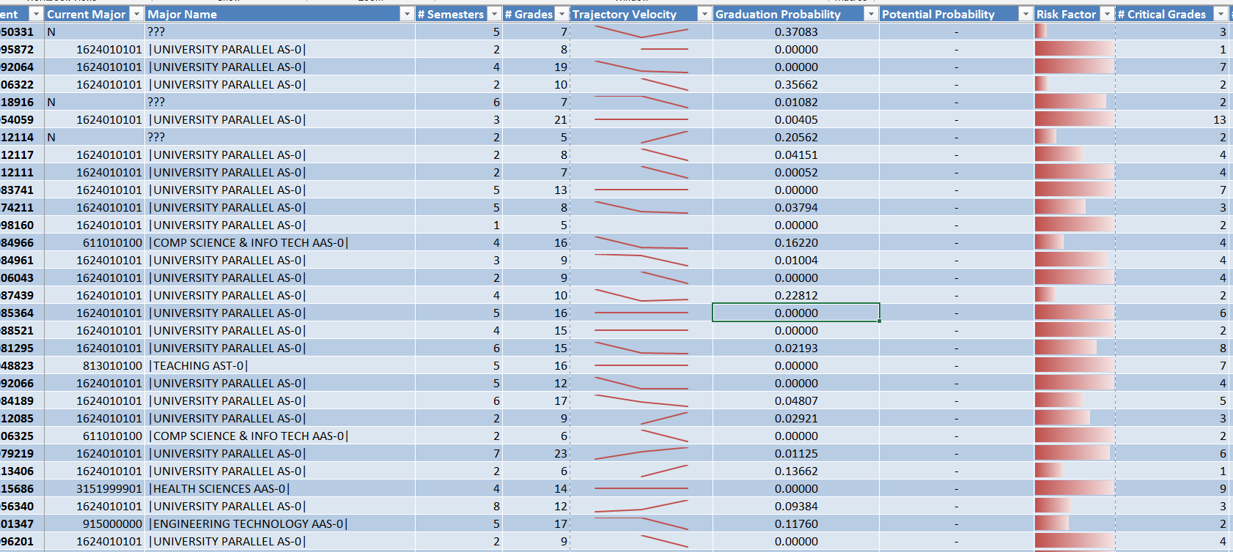

Slide 13
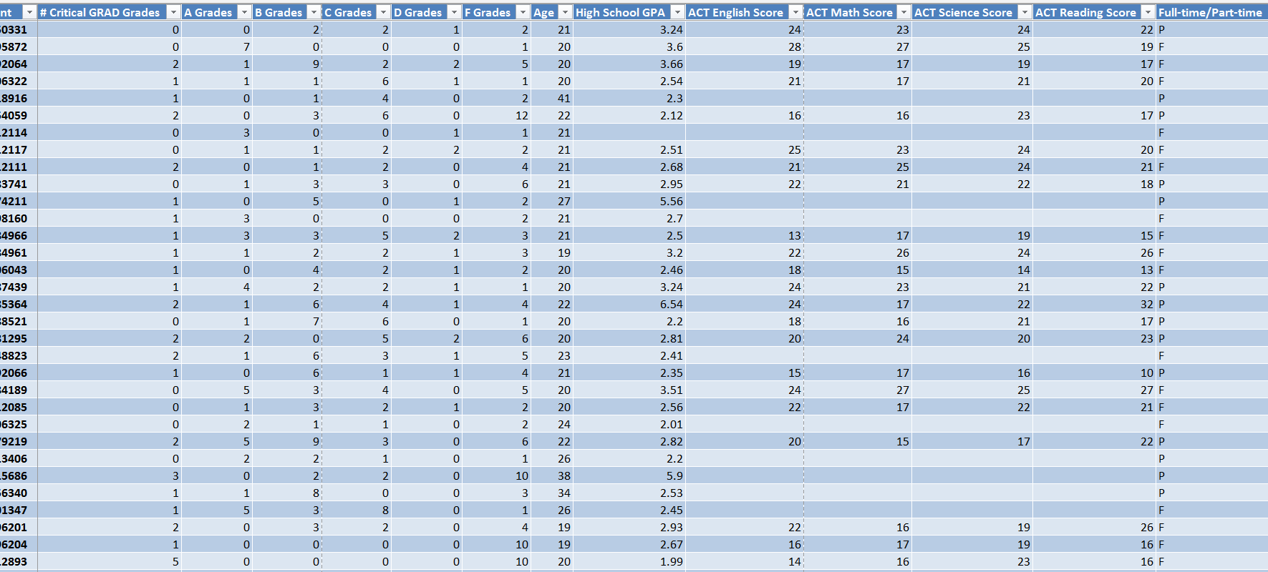

Slide 14
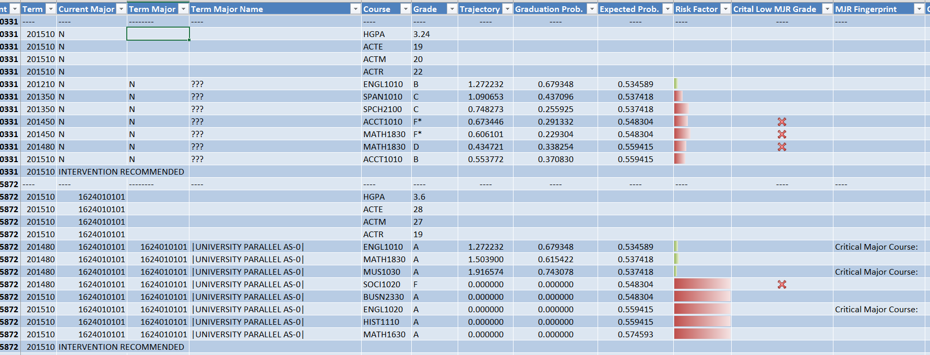

Slide 15
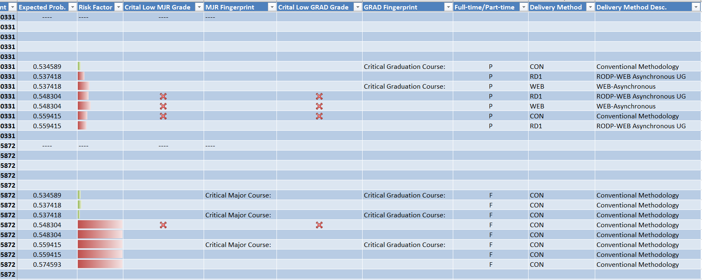

Slide 16
tbr trajectory analytics report
Who/what offices would benefit from having the specific information from the report?
What levels of intervention and support are we able to provide?
Where does the information from the report fit into existing initiatives?
How can we unify outreach to at-risk students?
Can any of the intervention strategies be automated?

Slide 17
Analytics Dream Team: Cross-Institution Involvement
Academic Affairs
Student Affairs and Enrollment Management
Institutional Research, Assessment, and Planning
Information Technology
L. Baer and D. Norris, 2013.

Slide 18
