Slide 1
Academic Mindset
Thinking about the way our students think.

Slide 2
A few modern philosophers assert that an individual's intelligence is a fixed quantity, a quantity which cannot be increased. We must protest and react against this brutal pessimism.... With practice, training, and above all, method, we manage to increase our attention, our memory, our judgment and literally to become more intelligent than we were before. – Alfred Binet

Slide 3
What is Mindset?
A mindset is a belief about yourself and your basic qualities. Mindset manifests itself in different ways, affecting how we view ourselves and the world, problem solve, and plan for the future.
Developed through the work of researchers Carol Dweck, Gilbert Gottlieb, Robert Stemberg, and others

Slide 4
What is Mindset?
Fixed Mindset
Growth Mindset
A person who has a fixed mindset believes that their qualities (such as intelligence, creativity, and talent) are predetermined and finite, fixed traits.
A person with a growth mindset believes that their basic abilities can continue to be developed through hard work and dedication.

Slide 5
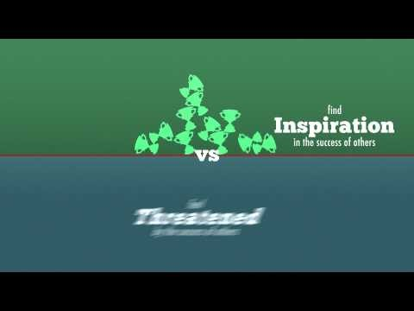
What is Mindset?

Slide 6
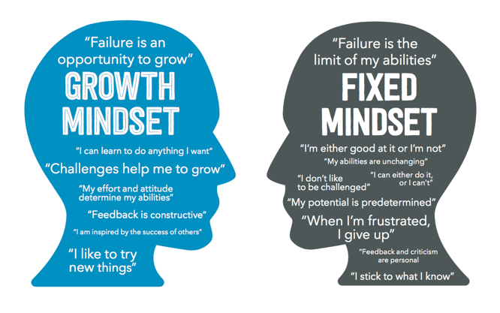
Our mindset is our self-talk.

Slide 7
Mindset in the Classroom
A fixed mindset is not an inherently “wrong” way of thinking. People who have a fixed mindset are not necessarily low achievers.
However, in a classroom setting, a growth mindset can lead to deeper learning and more meaningful connections to course content.

Slide 8
Mindset in the Classroom
When it comes to academics, many students adopt a fixed mindset.
More concerned with letter grade/points
Unwillingness to attempt “hard” subjects
“I’m just not a _____ person.”
Blaming low performance on external factors
Only come to office hours to cram or complain

Slide 9
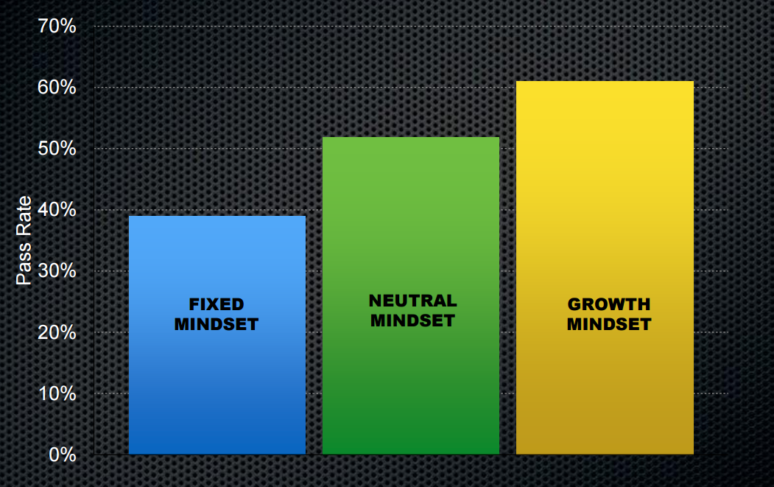
Why academic mindset matters
Data from a TBR survey of over 7,000 students
Mindset has also been identified as a key variable in closing the achievement gap

Slide 10
Why academic mindset matters
Productive Persistence
Believe they are capable of learning the material
Feel a sense of belonging and connectedness at their institution
Believe their coursework has value
Believe they have the skills, habits, and know-how to succeed

Slide 11
How can we affect mindset?
Strategies for educators

Slide 12
Affecting Mindset in the Classroom
Don’t:
Do:
Tell students how to think – or that their way of thinking is wrong.
Simply repeat the mantra, “try harder!”
Explain how intelligence works, and how the brain grows over time!
Help students understand why and how to deploy the effort to succeed.

Slide 13

What’s your struggle story?

Slide 14
Struggle Stories
Think back to a time when you had to struggle to learn or do something new.
How did you feel?
Did you overcome your struggle?
What did you learn?
Do you have advice for someone new to your struggle?
Think-Pair-Share
Swap stories with your partner. Are there any common themes in your advice?

Slide 15
Tips for Struggle Stories
Find a community.
Remove your ego from the equation.
Let go of perfectionism.
Practice, practice, practice.
These are hallmarks of thinking with a growth mindset!

Slide 16
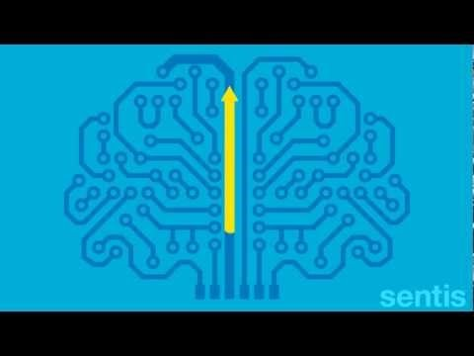
The Biology of Learning

Slide 17
A growth-centered classroom
Establish high expectations. Challenge students so they know that they have the ability to meet those expectations.
Create a risk-tolerant learning zone. Provide an environment that values challenge-seeking, learning, and effort above perfection.
Give feedback focused on process – things students can control, not their personal abilities. Avoid praising students for their intelligence and instead focus on explaining the importance of their actions towards success.
Introduce students to the concept of the malleable mind. Show students that our brains develop through effort and learning.

Slide 18
Do you think you know your mindset?
Let’s find out!

Slide 19
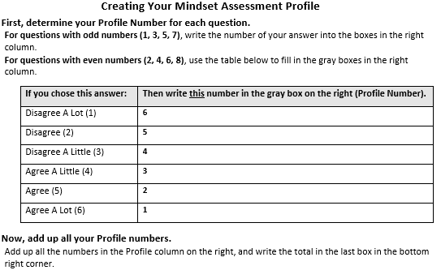

Slide 20
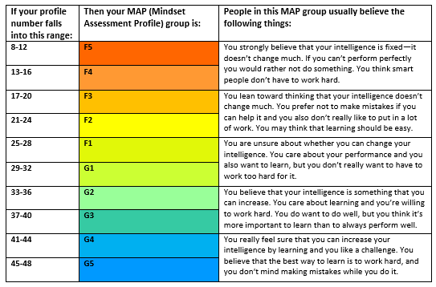

Slide 21
How might you leverage mindset?

