Slide 1
A Co-Requisite Model for First Year Mathematics
The Community College Conference on Learning Assessment

Slide 2
Presentation Outline
A Little Bit of Context
Preliminary Results
Deep Dive into Curriculum
History of developmental education in Tennessee
Glossary
Comparison of two cohorts at Pellissippi State, before and after co-requisite remediation
How the course content is structured and taught at Pellissippi State
Wrap-Up
Course Logistics
Scheduling, advising, enrollment, and progression
Questions and discussion

Slide 3
Developmental Education in Tennessee
A Brief History

Slide 4

Previous Developmental Education Model (2005 – 2010)
All developmental coursework (mathematics, writing, and reading) could be completed in one academic semester
Modular – students placed based on ACT and secondary, in-house testing at the College
Five mathematics competencies, two writing competencies, two reading competencies
Technology-centered – students were able to self-pace through content
Compartmentalized – distinct academic departments for college-level and developmental disciplines

Slide 5

Complete College Tennessee Act (2010 – today)
Established the reform agenda for public education in the state:
Universal transfer and articulation pathways between state universities and community colleges
Outcomes-based, or Quality Assurance funding formula developed for each school
State universities are no longer allowed to charge tuition for developmental courses

Slide 6
What is Co-Requisite Remediation?
Co-Requisite Remediation
An acceleration strategy for developmental students
Developmental content is taught concurrently with a paired college-level course
Implemented with developmental mathematics, writing, and reading
Pathway focused: shortening time and reducing cost for a degree or credential

Slide 7
TBR Mandate for Mathematics Co-requisite remediation:
The co-requisite experience will serve the dual purpose of supporting and illuminating the skills and concepts of the college-level credit bearing course while also providing instruction for students to remediate those mathematics developmental competencies in which they have a deficiency.

Slide 8
Preliminary Results and Success Rates
Mathematics courses only

Slide 9
About Us: Pellissippi State Community College
Knoxville, TN – five urban and suburban campuses
10,244 students (Fall 2016)
50% full-time enrollment
3 year graduation rate – 25.4% (2013-2016 cohort)
First time freshman
~20 mean composite ACT score
However (Fall 2013):
67% required to take at least one developmental course
61% enrolled in at least one developmental course

Slide 10
A comparison of two cohorts over three academic semesters
Fall 2014 – Fall 2015
Fall 2015 – Fall 2016
Before implementation of mandatory co-requisite remediation
First-time freshmen only
1332 students (62.5%) required a developmental math course
After implementation of mandatory co-requisite remediation
First-time freshmen only
1470 students (59.6%) required a developmental math course

Slide 11
College-Level Course Completion
Fall 2014 cohort
41.2% completed
Fall 2015 cohort
54.8% completed

Slide 12
College-level math courses completed

Slide 13
Other Demographics
 | Fall 2014 cohort | Fall 2015 cohort
Minority | 29.8% | 49.4%
Adult | 35.9% | 48.7%
First gen | 38.5% | 52.0%
Percentage of each cohort that successfully completed at least one college-level math course in three semesters
Definitions for demographic group
Adult – over 24 years
First generation – self-identified

Slide 14
Co-Requisite Course Logistics

Slide 15
PSCC Mathematics Courses
Co-Requisite Course | College Level Course
MATH 0010 (2 hrs) Survey of Mathematical Principles | MATH 1010 (3 hrs) Mathematics for General Studies
MATH 0530 (2 hrs) Principles of Statistics | MATH 1530 (3 hrs) Introductory Statistics
MATH 0030 (2 hrs) College Mathematics Principles | MATH 1030 (3 hrs) Introduction to College Mathematics
All three co-requisite courses have a college-level reading requirement.

Slide 16
General Education Courses – MATH 0010/1010 and MATH 0530/1530
“Blended populations” courses:
Co-requisite students meet with college-level students for the college-level portion of the course (MATH 1010, MATH 1530).
Fosters learning communities and a sense of belonging among traditionally excluded students.

Slide 17
Pre-STEM Course – MATH 0030/1030
Not a “blended populations” course:
Each section of 1030 is either entirely co-requisite students or entirely college-level (19-20 ACT) students
Sequential nature of intermediate algebra topics did not lend itself as easily to a “just-in-time” approach.

Slide 18
Placement – College algebra is not the default.
MATH 0030/1030
STEM
Business (transfer)
MATH 0530/1530
Social Sciences
Education
MATH 0010/1010
Liberal Arts
Engineering technology
Nursing
Students needing further preparation
Business (terminal)

Slide 19
Weekly Course Contact Hours
 | Face-to-Face College-level | Face-to-Face Co-Requisite | Mandatory Lab Hours*
MATH 0030/1030 | 5 hours |  | 2 hours
MATH 0010/1010 | 3 hours | 2 hours
MATH 0530/1530 | 4 hours | 1 hour
*Lab hours are completed in the Academic Support Center and tracked via scanning of the student ID card.

Slide 20
Instructional Staffing
The same instructor teaches both the co-requisite and college-level courses
Both full-time and adjunct faculty teach co-requisite sections
Faculty load hour calculation:
(contact hours + credit hours)/2 = 5 load hours for faculty

Slide 21
Course Completion
 | Pass Co-Requisite course | Fail Co-Requisite course
Pass College-level course | Student receives passing grades and credit for both courses. Competencies are marked as “completed” | Student receives failing grade for corequisite; passing grade for college-level. Competencies are marked as “satisfied”
Fail College-level course | Student may re-enroll in the college-level course, without the corequisite course. Competencies are marked as “completed” | Student must re-enroll in a corequisite-paired course.

Slide 22
Co-Requisite Curriculum

Slide 23
TBR Mathematics Learning Support Curriculum
Develop study skills for success
Communicate mathematically
Be problem solvers
Develop mathematical connections

Slide 24
Curriculum Competency Points
Real number sense and operations
Operations with algebraic expressions
Analyze graphs
Solve Equations
Critical thinking and making mathematical connections

Slide 25
Key Elements of PSCC Co-Requisite Model
Competencies in context
Project-based learning
Instructional continuity
Tutoring/required lab hours
Customized support text

Slide 26
Competencies in Context
Co-requisite coursework is mainly delivered using an online software program tied to the college-level course textbook.
Instructors on the co-requisite committees wrote and developed the majority of assignments online
Each co-requisite assignment question is written to assess the underlying developmental skill, while being framed using vocabulary from the college-level course
This creates a “seamless” feel for students, as all learning objectives are in support of the college-level course

Slide 27
Our curriculum team mapped competency points to student learning outcomes in the college-level course.
Interpret numerical data as frequencies, ratios and percentages
MLS 1.2 – perform operations with rational numbers
MLS 1.5 – write and compare numbers in standard and scientific notation
Calculate measures of center and variation using formulas and technology
MLS 1.1 – apply the order of operations to evaluate expressions
MLS 2.2 – evaluate algebraic expressions when given values for the variables
MLS 1.3 – identify and calculate with irrational numbers

Slide 28
Customized Support Text
However, publishers did not provide texts that supported competencies in context for the co-requisite course
We wanted to avoid “pancaking” two disparate texts
Co-requisite committees wrote support texts for the two general education co-requisite courses, MATH 0530 and MATH 0010.
Provided instructional content as well as examples and practice exercises

Slide 29
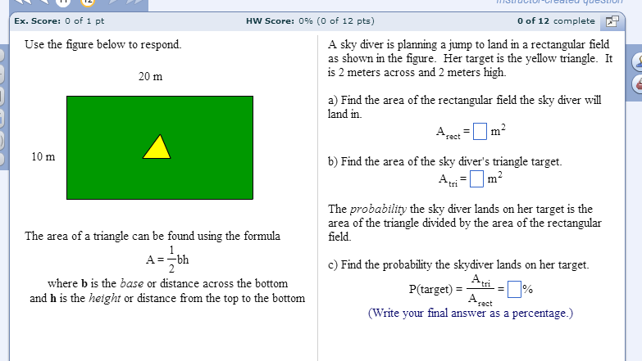
Competencies in context
Area and perimeter of rectangles, triangles, and circles and probability

Slide 30
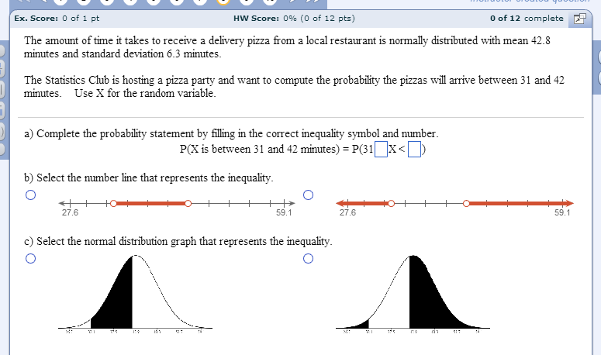
Competencies in context
Writing inequality and probability statements

Slide 31
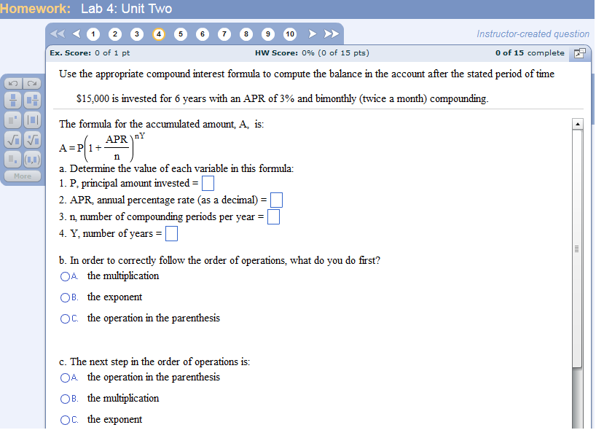
Competencies in Context
Order of operations in financial formulas

Slide 32
Project-Based Learning
Used to assess the fifth competency point of making mathematical connections
Semester-long, thematic experiences in both general education math courses
MATH 1010 Project areas include:
Logic
Personal Finance
Probability and Statistics
Algebraic Modeling and Geometry
MATH 1530 Projects work with LARGE datasets and require the use of technology for analysis
Fostering critical thinking in general education mathematics courses

Slide 33
Consumer Math: Home Sweet Home
Most Americans aspire to own their own home at some point in their lives. The choice of a home rests on many factors, almost all of them financial. In this project many aspects of home buying will be examined and the student is encouraged to make realistic choices at every step.
Task 1: Answer the following questions and then research to determine a reasonable base salary for your future.
What is your chosen career field or job?
In which state and city do you intend to live?
What is the beginning salary for a person in this field?
State the source for the information on salary
Task 2: Find an advertisement for a house for sale using real estate booklets (available at banks, groceries, etc.) or online (www.zillow.com). You will need to attach the information about your selected house to this project.

Slide 34
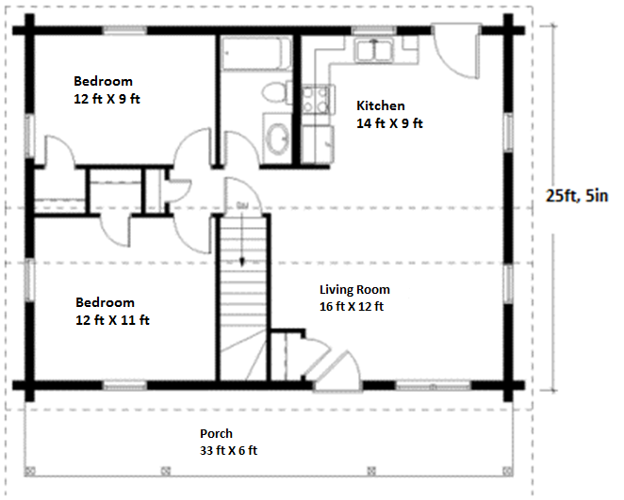
Home Geometry
Task 1:
Compute the total square footage including the attached porch.
What is the square footage of areas that are heated and cooled?
Task 2:
The furnace you are considering will heat up to 10,000 cubic feet. Will this furnace be adequate to heat your home? Assume that you have 9 foot ceilings throughout the house and show all the calculations you made in order to answer this question.

Slide 35
Statistics Capstone Project Datasets
Youth Smoking
Discrimination in Hiring
Appalachia
United States of Appalachia common book experience
Police Involved Deaths
Careers
US Presidents
Global Terrorism

Slide 36
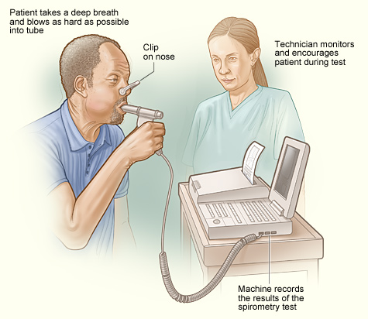
Youth Smoking Preliminary Discussion Questions:
What conjectures (educated guesses) could be made about the relationship between smoking and FEV?
What is the difference between “average” and “normal range”?
Why is FEV a good variable to measure the effects of smoking on lung function?

Slide 37
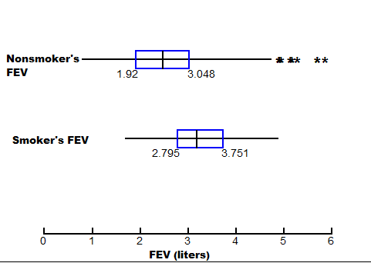
Youth Smoking Analysis
Task 4: StatDisk is able to produce side-by-side boxplots to facilitate comparison of data. This graph shows that, for our data set, the forced expiratory volume of the smokers was on average greater than the FEV for nonsmokers.
Does this observation make sense? How can you explain this result?

Slide 38
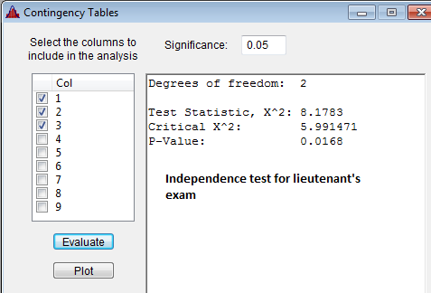
Discrimination in Hiring Analysis
One way to examine discrimination data is to analyze the relationship between variables. In the Ricci case, we want to look at the possible relationship between whether or not a candidate passed their exam and their race.
Task 1: Use StatDisk to create a contingency table for the Lieutenant’s exam. Fill in the table below:
Task 2: Perform the chi-squared independence test for the lieutenant’s position. Insert the results below.
Can we conclude that the lieutenant exam results are independent of race? What does this imply about fairness in the promotion exam?
 | Black | Hispanic | White
Pass | 6 | 3 | 25
Fail | 13 | 12 | 18

Slide 39
Wrap Up – Questions? Shareables?
Feel free to email us!
Brittany L. Mosby, blmosby@pstcc.edu
Sue Ann Jones Dobbyn, sadobbyn@pstcc.edu

