Slide 1
Continuous Improvement Best Practices
Brittany L. Mosby
Associate Professor, Mathematics
Pellissippi State Community College

Slide 2
Timeline of Implementation
Planning
Implementation 1.0
Reflection
Implementation 2.0

Slide 3
Continuous Improvement
Actionable feedback
Designated drivers

Slide 4
Improvement Drivers
Small group (3-5) of faculty who designed and taught the new co-requisite course in the first phase of implementation
Committed to meeting biweekly during the semester and at least monthly between semesters to discuss implementation strategy
Served as contact points for other faculty teaching the course and campus personnel (academic advisors, tutoring, etc.) during implementation phase
Also collected and analyzed data, pursued grant funding

Slide 5
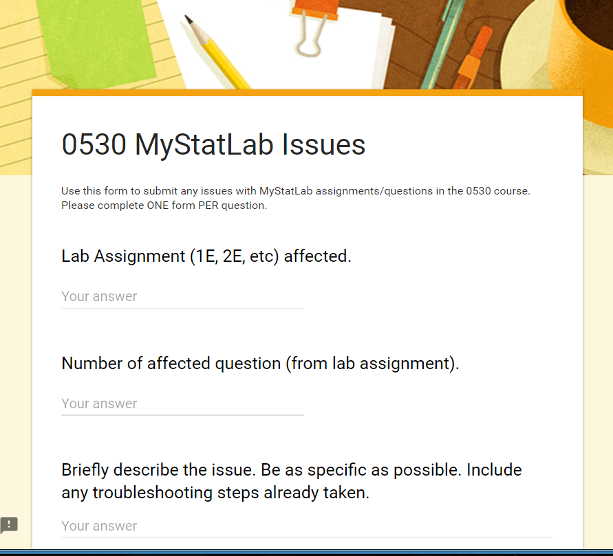
Gathering Feedback
Leverage technology – Google Forms, Survey Monkey
Make available during real-time implementation
Consider constituent groups who need to weigh in: faculty, students, campus partners

Slide 6
Feedback for Making Improvements
From faculty
From students
How did students progress through the curriculum?
What strategies did you use that you found particularly successful?
What will you try differently next year?
[Data collection: final exam scores, course grades]
In what ways did the co-requisite course supplement your learning in the college-level course?
What advice would you give to future students?
What academic support services did you take advantage of while in this course?

Slide 7
Feedback for Making Improvements
From other campus personnel
Other data to examine
Advising and registration processes
Usage of academic facilities (computer labs, testing centers)
Academic support and tutoring coverage
Student demographics
Non-traditional, veteran, Pell eligible, major/concentration, etc
Placement/ACT scores
Pass/fail matrix for co-requisite and college-level courses:
Passed both courses | Passed college-level course only
Passed co-requisite course only | Failed both courses

Slide 8
Results at Pellissippi State
In-house creation of instructional materials and text
Increasing academic support for co-requisite students
Involving the Counseling Department and inclusion of growth mindset theory
Consideration of a variety of scheduling options
Exploration of publishers and software packages that support both courses
After our first semesters at full-scale implementation, feedback collected led our faculty committee to consider the following improvements to the co-requisite program.

