Slide 1
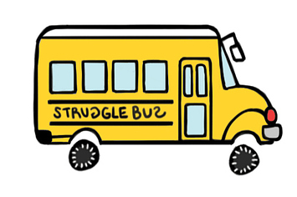
Driving the Struggle Bus
Productive struggle, persistence, and the learning process

Slide 2
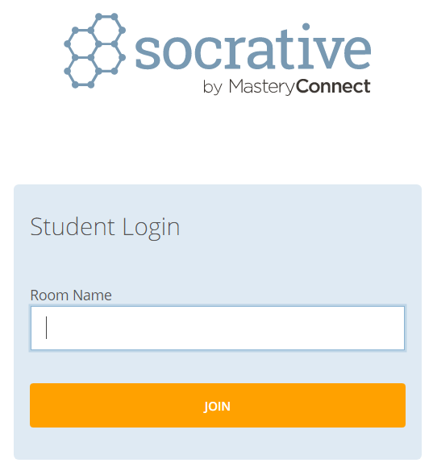
This presentation is interactive!
Grab your mobile devices or laptops
Go to
  http://b.socrative.com/student
In the box for Room Name, type
  MOSBY115

Slide 3

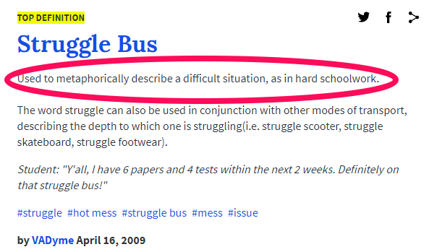

Slide 4

Let’s talk about the struggle
How do you think about “struggle”?
In your Socrative session, answer the following:
  What word comes to mind when you hear the word “struggle”?
  Please enter only one word at a time. You may enter as many words as you like!
What do you think our students are thinking about “struggle”?
  With the person next to you, discuss and then vote for the word you think your students would use to describe “struggle”

Slide 5
Let’s talk about the struggle
Our society tends to frame struggle as an undesirable, tedious, arduous, fruitless… process
As educators, we know that struggle is a vital part of the learning and improvement process
There is a positive side to working through difficult or challenging tasks, called Productive Struggle.

Slide 6
What is PRODUCTIVE struggle?
Productive Persistence = Tenacity + Good Strategies
The effort to make sense of something, to figure something out that is not immediately apparent
Effortful practice that goes beyond passive reading, listening or watching – that builds useful, lasting understanding and skill

Slide 7
Productive vs. Destructive Struggle
Productive Struggle
Destructive Struggle
Leads to understanding
Makes learning goals feel attainable and effort seem worthwhile
Yields results
Leads students to feelings of empowerment and efficacy
Creates a sense of hope
Leads to frustration
Makes learning goals feel hazy and out of reach
Feels fruitless
Leaves students feeling abandoned and on their own
Creates a sense of inadequacy

Slide 8
Why productive struggle matters
Students develop a persistence and resilience that can be applied across a wide variety of activities
Fosters agency and ownership in the learning process
Instructor-student interaction and communication is strengthened
Replaces passive participation with active engagement (yay QEP!)

Slide 9
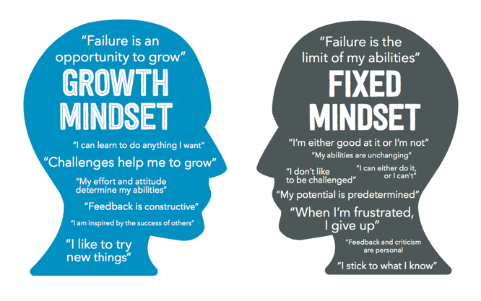
Academic Mindset Reference
The approach to struggle is the heart of mindset theory…
…but how do we apply this theory in our classrooms?

Slide 10
Strategies for driving the bus

Slide 11
Create a safe environment to take risks and struggle
Especially for those students who tend towards a fixed mindset
Provide feedback without “coming to the rescue”
  Instead of hints, offer students an alternative starting point for thinking through the problem
Praise the process, not the person
  Strategies used, specific work done, persistence or improvement

Slide 12
Designate “Struggle Assignments”
Low stakes or non-graded assignments
Use as formative rather than summative assessment
Include tasks that are slightly beyond the students’ abilities
Open ended questions that have multiple approaches or answers

Slide 13
Anticipate struggles that might occur
Work through assignments as a student
Plan ways to support students without removing the opportunities for students to develop deeper understanding
Consider utilizing parallel tasks – two or more tasks that are designed to meet the needs of students working at different levels but that address the same concept in a similar context and can be discussed simultaneously

Slide 14
Struggle as an individual, a group, or class-wide
Experienced individually, students understand their own thought process
  Become more adaptive and strategic when dealing with challenging tasks
As a group, struggle can encourage discussion and discourse, prompting a deeper engagement with course content
  Communicating, critical thinking, civility

Slide 15
Example: the rain barrel problem
There is a 48-gallon barrel that contains 24 gallons of rainwater and a 5-gallon barrel that contains 3 gallons of water. Which barrel would you say is more full?
  Answer using your Socrative session
Now I have removed one gallon of water from each barrel. Does this change your answer?
  After discussing with a partner, provide your answer in your Socrative session

Slide 16
What productive struggle looks like
…are accustomed to explaining their ideas
…question solutions that don’t make sense to them
…are not afraid to take risks and make mistakes
…recognize that mistakes are a means to learning and not an end
…know that it is acceptable to struggle with some ideas
Productive strugglers are student who…

Slide 17
Think about your course: where is the struggle?
Take a minute to think about where students could benefit from a productive struggle with your course content.
Remember: productive struggle should lead to understanding and feelings of empowerment.

Slide 18

An Analogy: Struggle Wine

Slide 19
Thank you!
This presentation, along with my sources and other links for further reading can be found online at: www.BrittanyMosby.com
Please make sure you’ve signed in!
Enjoy the rest of in-service, and have a great year!

