Slide 1
Stats Toolbox: Inference
One-sample z- and t-tests | Population mean
Two-sample t-tests Independent Related | Difference between the means of two populations/groups
Analysis of Variance (ANOVA) One-way (1 IV) Two-way (2 IV) | Difference between the means of more than two populations/groups
Regression | Relationship between two continuous variables
Chi-square | Relationship between two discrete variables

Slide 2
Stats Toolbox: Descriptive
Measures of center | Mean, median mode
Measures of variation | Range, standard deviation, IQR
Measures of relative position | Z-scores
Correlation | Correlation coefficients Pearson Spearman Point-Biserial Phi

Slide 3

Symbols
Population correlation coefficient: $ρ$
Sample correlation coefficient: $r$
Coefficient of determination: $r^{2}$

Slide 4
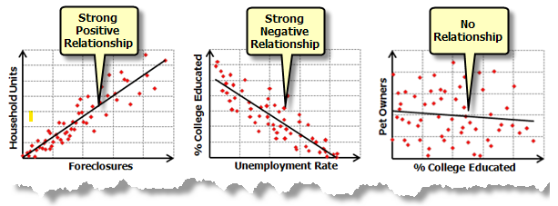
Describing Correlation

Slide 5
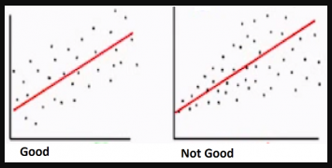
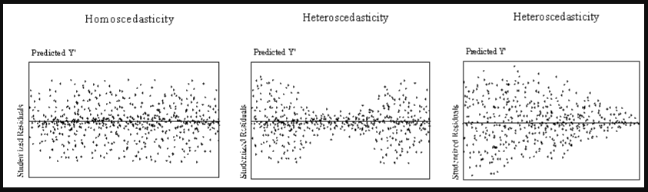
Assumptions for Linear Model

