Slide 1



Slide 2
AI as assistance
Validate output
Limit use of AI

Slide 3
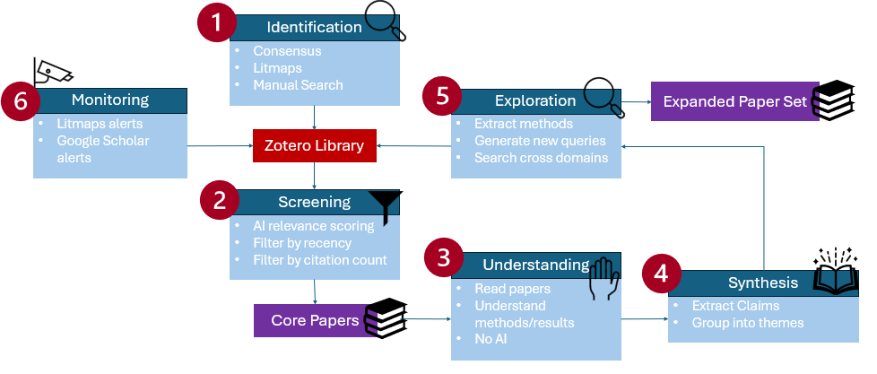

Slide 4
Consensus: How does occlusion level influence the performance of machine learning models on amodal completion tasks?
=> 50 articles

Slide 5
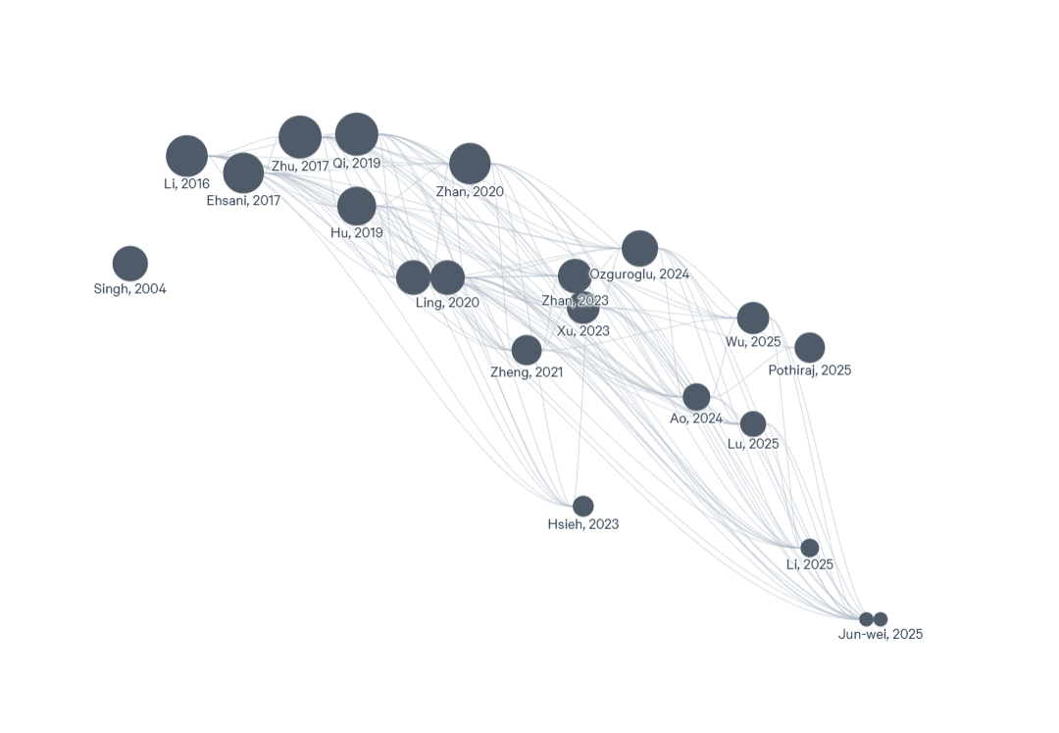
=> 21 articles

Slide 6
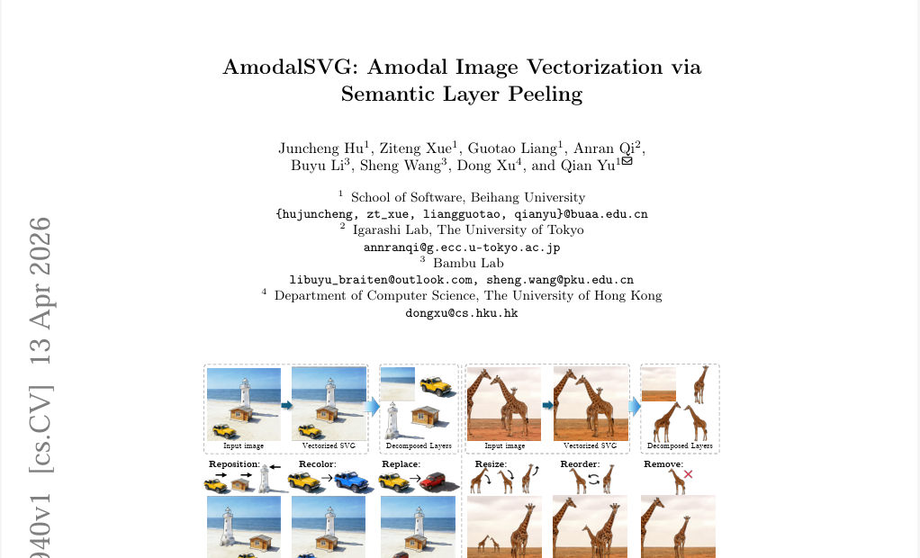
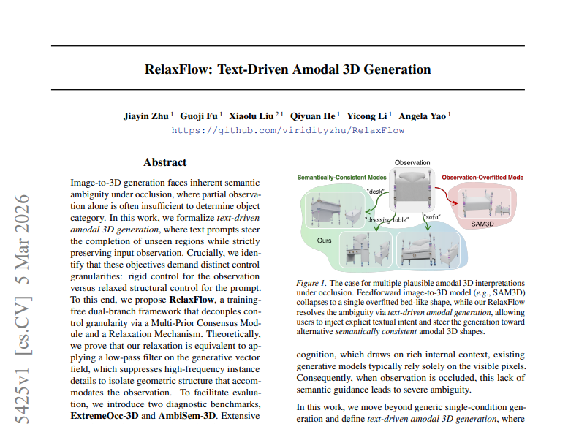
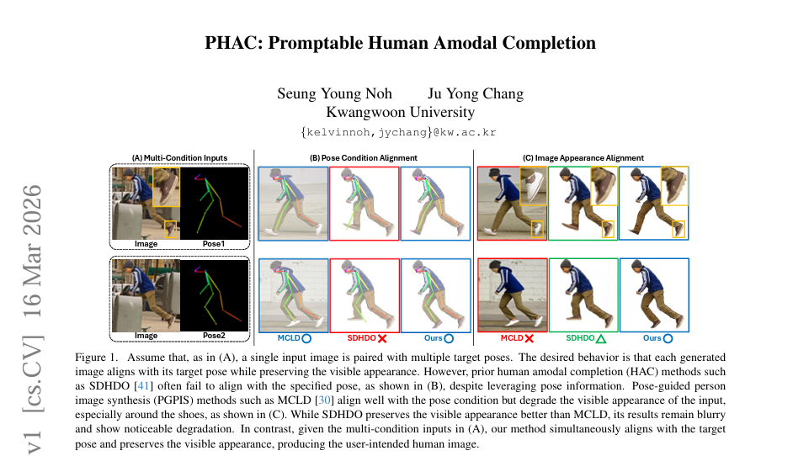
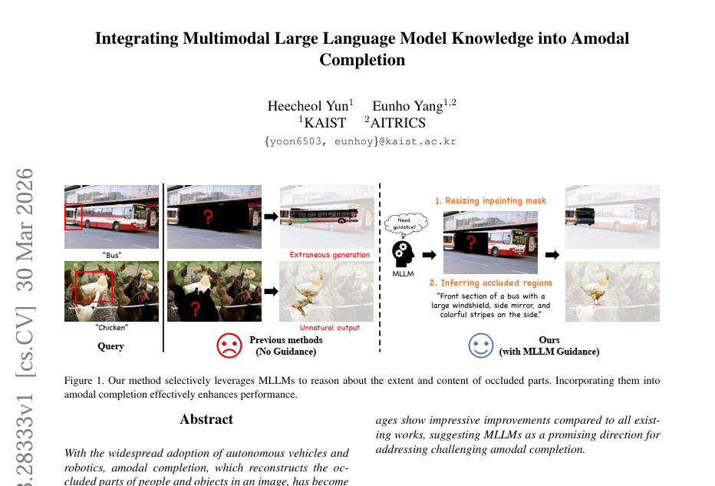
=> 63 articles

Slide 8
Screening with Consensus
Manual Screening
Topic Relevance
Method Relevance
Domain Relevance
Usefulness
Recency
Novelty
Score from 0-2
Based on Year
Citation Count
Venue?

Slide 12
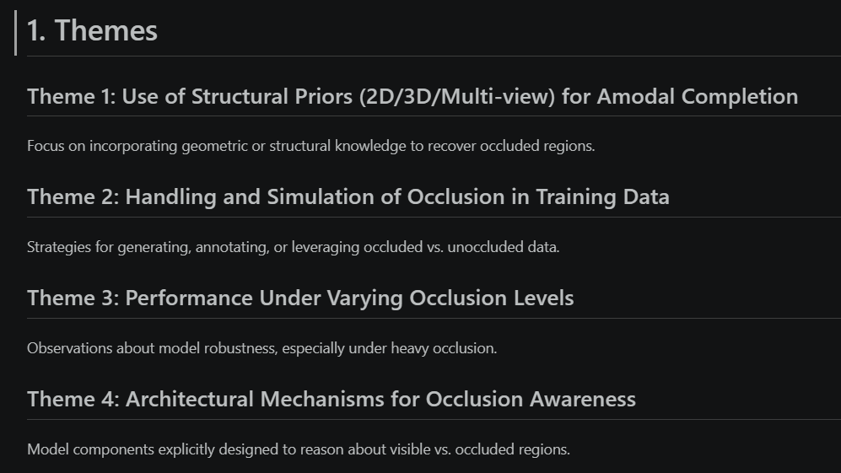
Structured Notes

Slide 14
Exploration
Other Research Fields
Medical imaging
Autonomous driving / robotics
Remote sensing / earth observation
Search queries

Slide 15
Impact
Faster screening
Connection between papers
Inspiration for connected fields

Slide 16
Risks
Missing papers
Hallucinations
Bias (Screening, Exploration)

Slide 17
Luleå University of Technology Logotype

