Slide 2
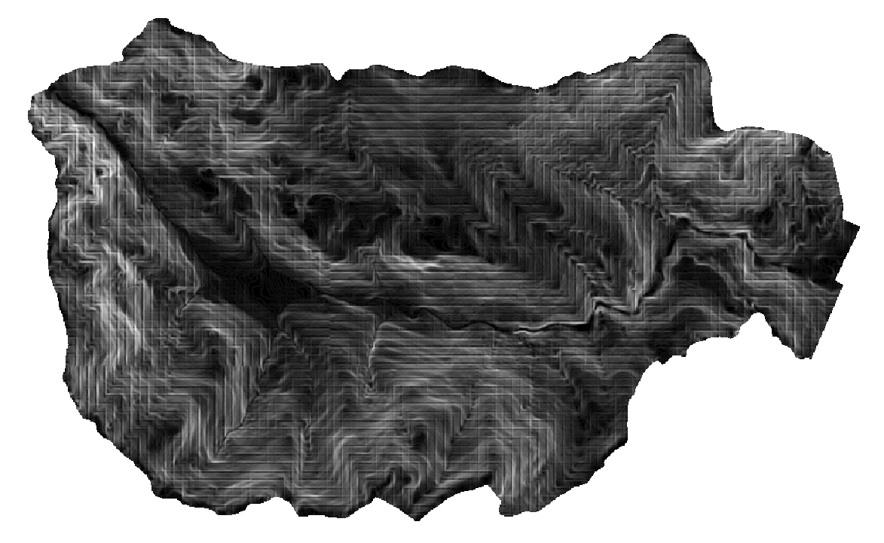

Slide 3
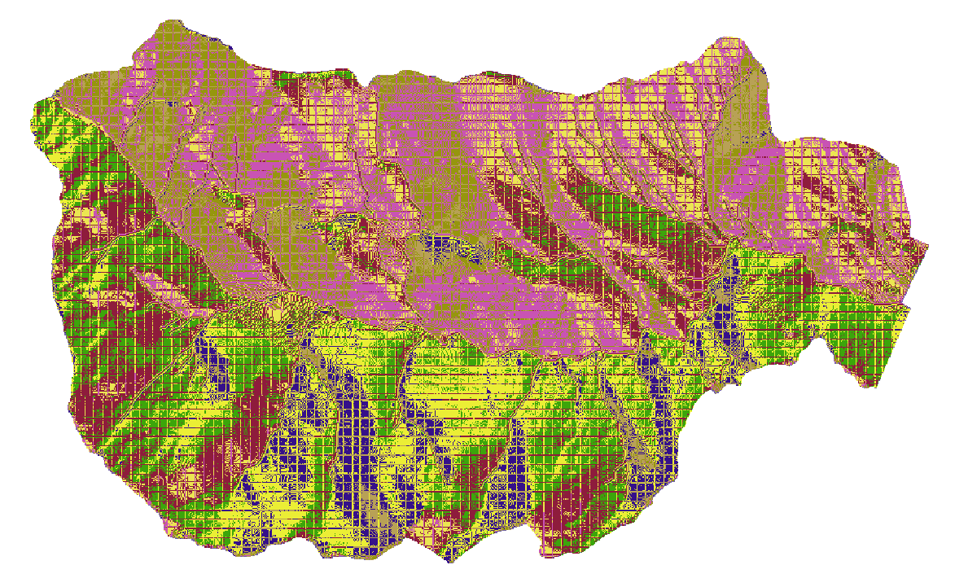

Slide 4
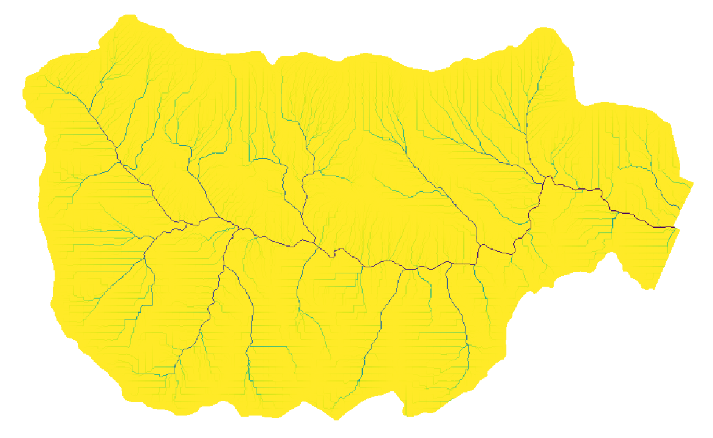

Slide 5
Goals
Compare the performance of classic TOPMODEL and an alternative version that includes soil parameters
Extend the comparison analysis across different watersheds and, possibly scales
Propose a formulation of saturation excess (improved TOPMODEL), recommend contexts/landscapes where to apply it

Slide 6
Δx
Δx
1
2
3
Groundwater table (same slope as ground surface, S₀)
D
Q₁₂
d
Q₂₃
Q_{3out}
K_{S}
, S_{y}

