Slide 1
Evaluating runoff generation processes across different scales and regions
Aquaholics Anonymous: Federico, Brittany, Stefany & Ishrat
https://github.com/brittbarreto/Aquaholics_Anonymous

Slide 2
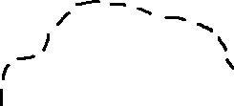
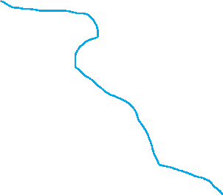

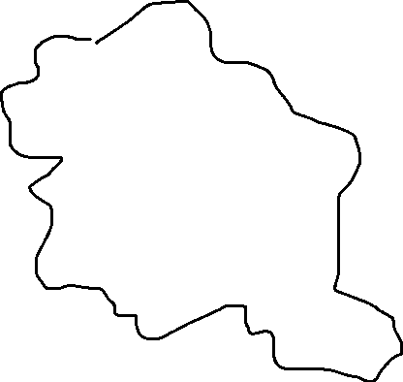

Modeling Saturation Excess
Non saturated area
Saturated area

Slide 3
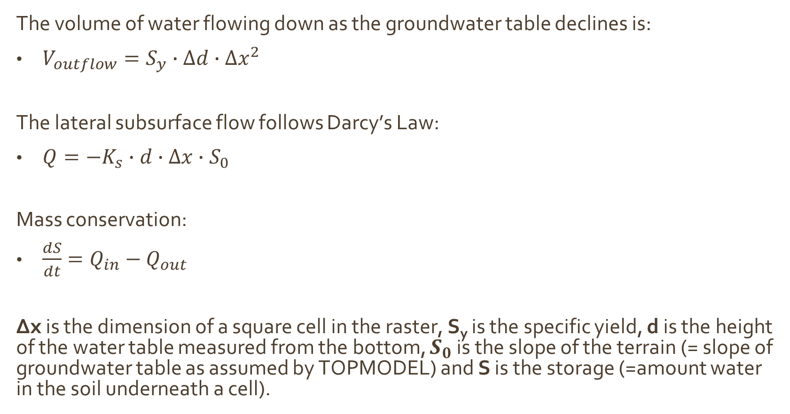
Modeling Saturation Excess
The volume of water flowing down as the groundwater table declines is:
$V_{outflow}=S_{y}∙∆d∙∆x^{2}$
The lateral subsurface flow follows Darcy’s Law:
$Q=−K_{s}∙d∙∆x∙S_{0}$
Mass conservation:
$\frac{dS}{dt}=Q_{in}−Q_{out}$
Δx is the dimension of a square cell in the raster, S_{y} is the specific yield, d is the height of the water table measured from the bottom, $S_{0}$ is the slope of the terrain (= slope of groundwater table as assumed by TOPMODEL) and S is the storage (=amount water in the soil underneath a cell).

Slide 4
Modeling Saturation Excess
We combined the previous equations to model the drainage of a saturated aquifer in a watershed. The initial condition is that the groundwater table has the same elevation as the land surface.
In absence of rainfall, the groundwater table naturally lowers, water in the soil flows laterally down to an outlet cell which allows the subsurface flow out to a stream. Lateral flow is only modeled in the saturated part of the soil, not in the unsaturated part, since flow times are much longer here.
We created a dynamic model (your last presentation was very helpful!) and recorded water table elevation and water storage inside each cell, at each time step.
Finally, we defined as unsaturated a cell where the groundwater table elevation was below the bubbling pressure; saturated otherwise.

Slide 5
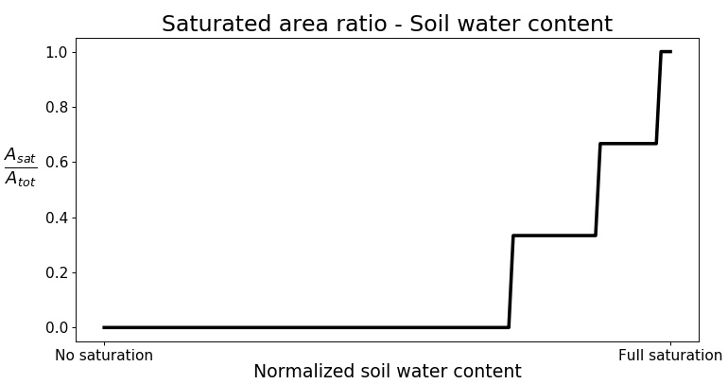
Modeling Saturation Excess
The scope of this (somewhat unrealistic) exercise was to establish a relationship, at the watershed level, between the area of watershed that can be considered saturated (where saturation excess would occur when it rains) and the volumetric content of water in the soil.
From the latter, one can estimate the former. As more water enters the watershed as rain, it is possible to calculate saturation excess runoff using this relationship.

Slide 6
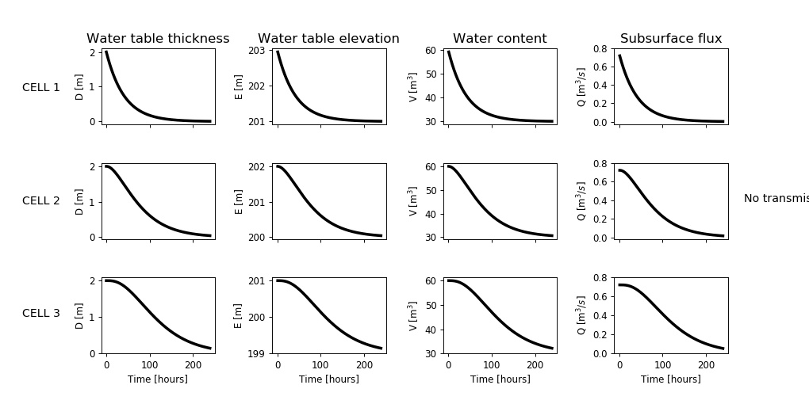
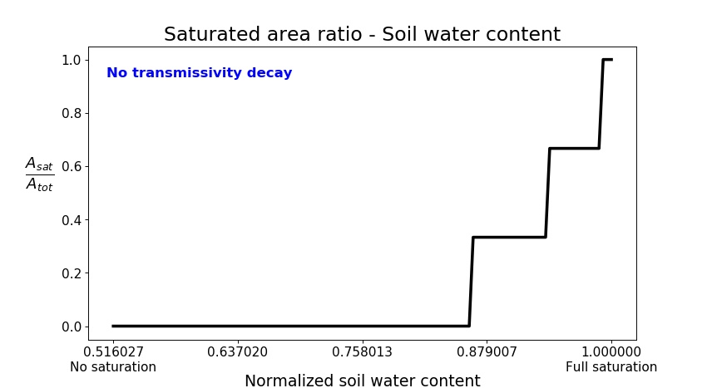

Modeling Saturation
Excess
No transmissivity decay
$$T_{0}=K_{s}∙D$$

Slide 7
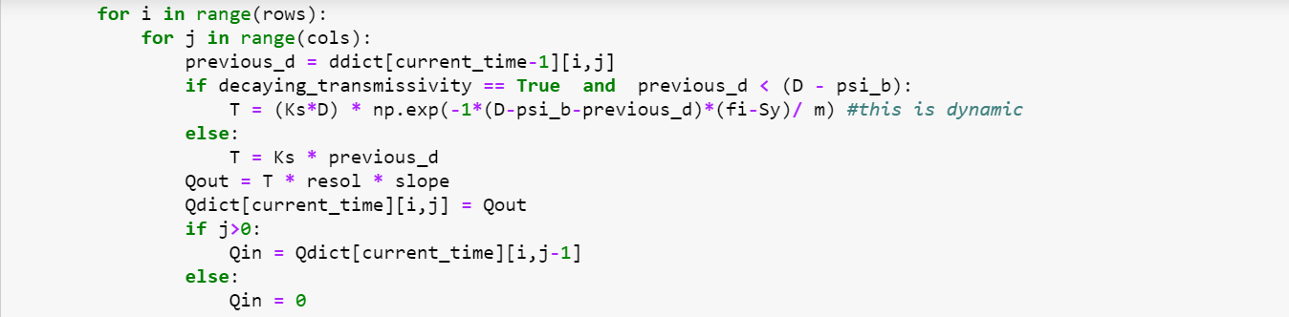

Modeling Saturation
Excess
Transmissivity decay
$$T\left(d\right)=(K_{S}∙D)∙e^{−\frac{(D−ψ_{b}−d)∙(φ−S_{y})}{m}}$$
Question for Fred:
Is this implementation of the exponential function for transmissivity correct?

Slide 8
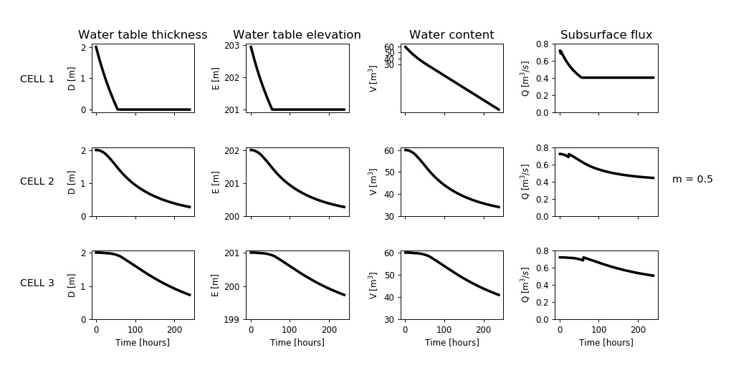
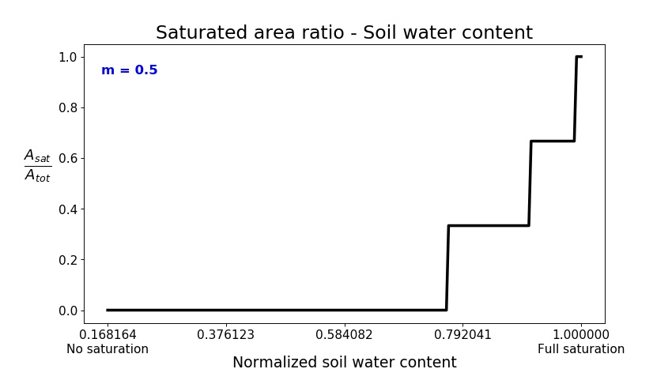

Modeling Saturation
Excess
Transmissivity decay
$$T\left(d\right)=(K_{S}∙D)∙e^{−\frac{(D−ψ_{b}−d)∙(φ−S_{y})}{m}}$$
m = 0.5

Slide 9
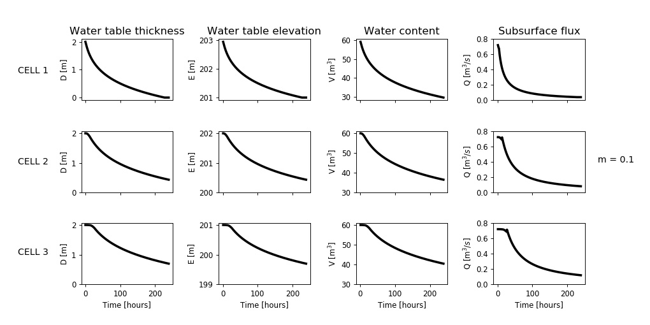
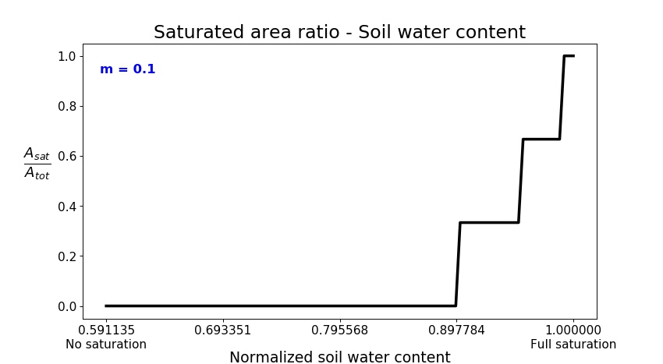
Modeling Saturation
Excess
Transmissivity decay
$$T\left(d\right)=(K_{S}∙D)∙e^{−\frac{(D−ψ_{b}−d)∙(φ−S_{y})}{m}}$$
m = 0.1

Slide 10
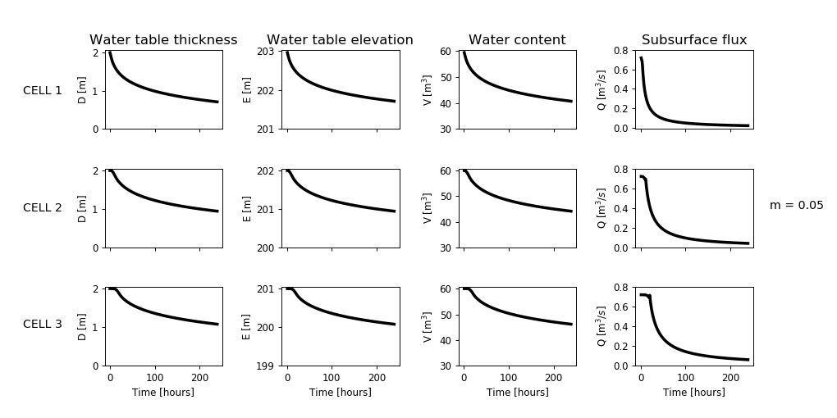
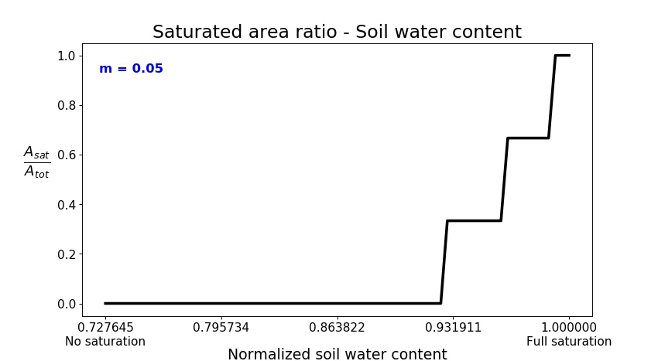
Modeling Saturation
Excess
Transmissivity decay
$$T\left(d\right)=(K_{S}∙D)∙e^{−\frac{(D−ψ_{b}−d)∙(φ−S_{y})}{m}}$$
m = 0.05

Slide 11
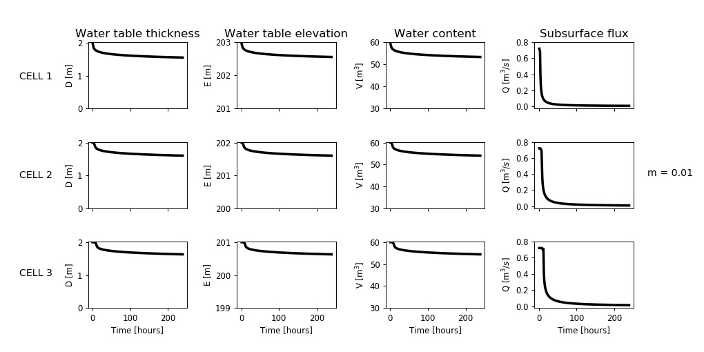
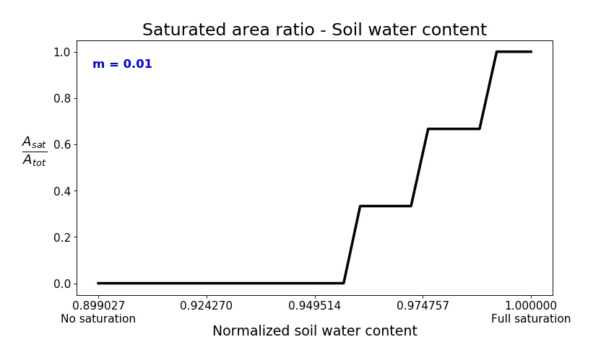
Modeling Saturation
Excess
Transmissivity decay
$$T\left(d\right)=(K_{S}∙D)∙e^{−\frac{(D−ψ_{b}−d)∙(φ−S_{y})}{m}}$$
m = 0.01

Slide 12
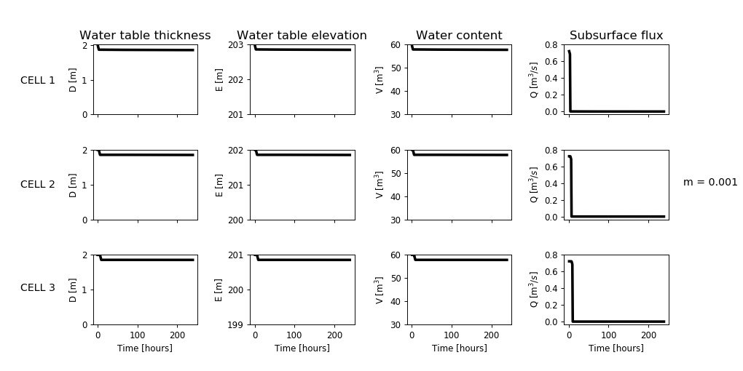
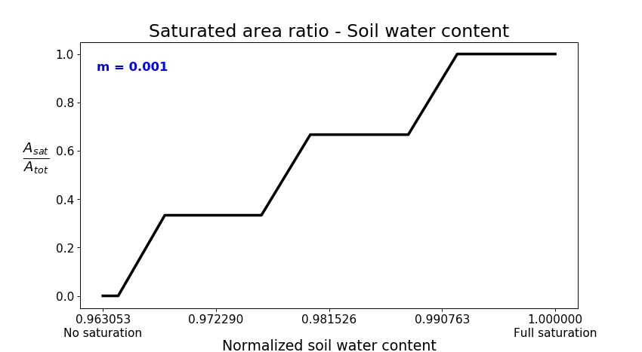
Modeling Saturation
Excess
Transmissivity decay
$$T\left(d\right)=(K_{S}∙D)∙e^{−\frac{(D−ψ_{b}−d)∙(φ−S_{y})}{m}}$$
m = 0.001
Question for Fred:
Do we expect these results? Values of m in literature ≤ those used here

Slide 13
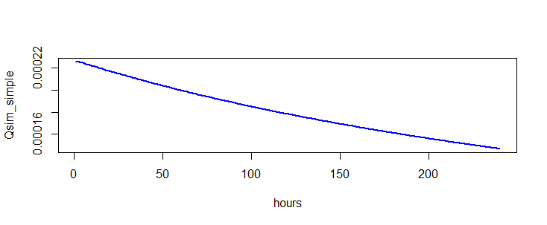
Modeling Saturation Excess
https://cran.r-project.org/web/packages/topmodel/index.html
https://cran.r-project.org/web/packages/topmodel/topmodel.pdf
We have also been working on the “classic” version of TOPMODEL, as available from TOPMODEL package in R. In fact, R uses a set of functions written in C, so we might have to dig into that. Apparently, there is not a python package doing the same job.
As in the image below, in R we see a smaller subsurface flow by multiple orders of magnitude), and we are not sure why, since we are using the same parameters.
CELL 3 outflow
m = 0.1

Slide 14
Modeling Saturation Excess
We are implementing D8 routine to apply our improved TOPMODEL to a real watershed.
When multiple cells drain to one cell downstream, Q_{in} > Q_{out}, we expect the excess of water to raise the groundwater table in that cell and generate overland runoff (Dunne). Is this correct?
Another problem we have is to make sure that source cells are analyzed first by the dynamic model, then down along the flow. That means establishing an order among cells. We are still researching for existing code that somehow tackles this. Hilary advised us about the possible instability of a dynamic model in a more spatially complex watershed.
Any comment or suggestion on the above is very much appreciated.
Thank you!

