Slide 1
Tweets spread like wildfire
Brittany Bowers

Slide 2
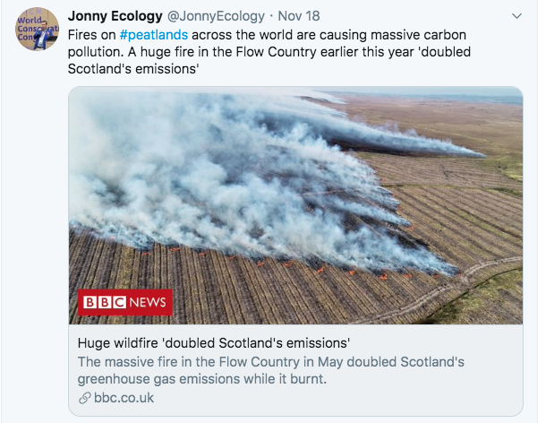
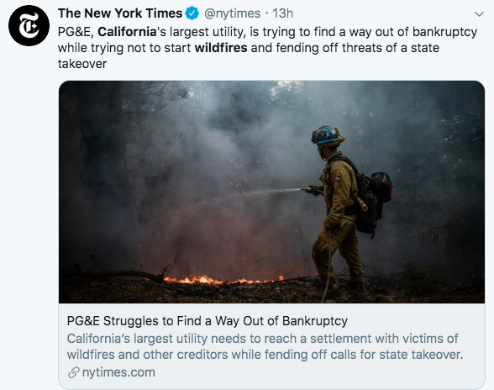
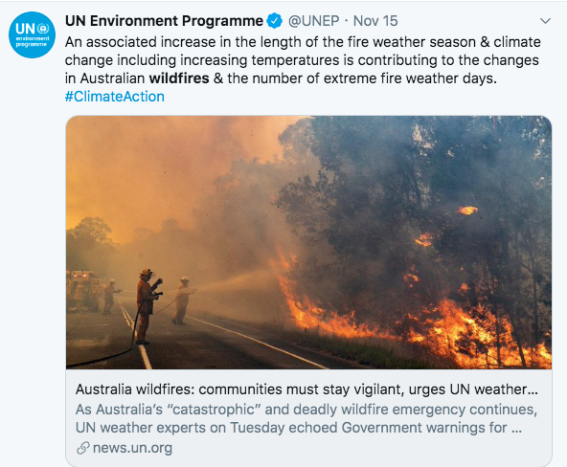
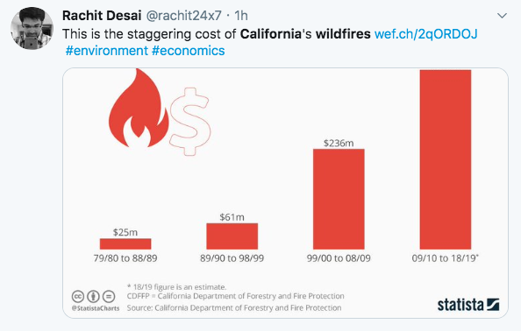
The History: 3 years of fire
2019
Australia/Scotland/California
Kincade Fire
2018
Camp Fire
Shasta Fire
2017
Santa Rosa Fires
Santa Barbara Fires

Slide 3
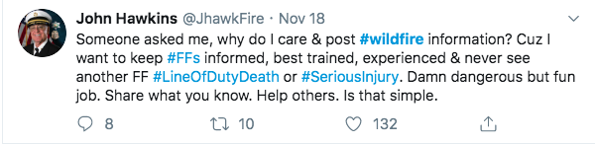
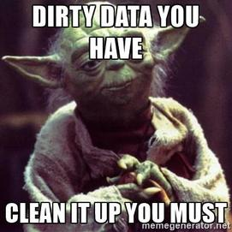
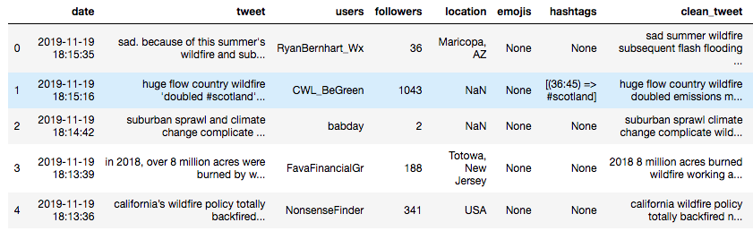
The Wrangling
hashtags
misspelling
abbreviations
username
Tweets are messy
So I cleaned them

Slide 4
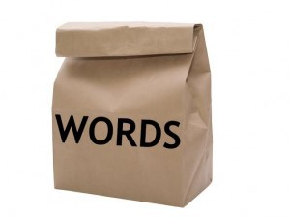
The Process: Bag of Words
TF-IDF: ngrams = 2,3 ω i, j = tf i,j x log(N/df i)
Ngrams (Words) Tweets (Documents) | Sad summer | Summer wildfire | Summer climate | Climate change | Sad summer wildfire | Sad summer climate | Summer climate change | Climate change sad
“Sad summer wildfire” | 0 | 0.3 | 0 | 0 | 0.3 | 0 | 0 | 0
“Sad summer climate change sad” | 0 | 0 | 0.3 | 0.3 | 0 | 0.3 | 0.3 | 0.3

Slide 5
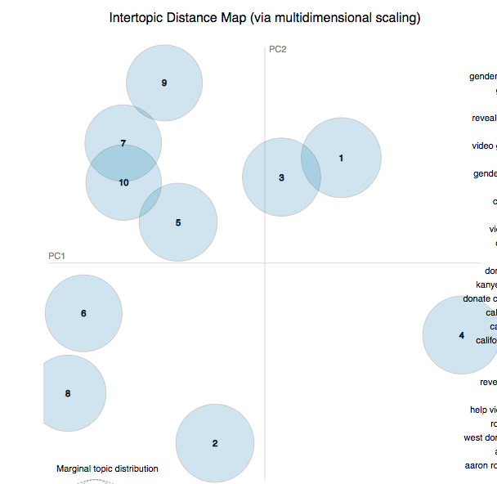
The Process: Topic Modeling
LDA didn’t work super well… but it does highlight some interesting things
LSA performed better
GDSMM coming up!
Climate Change
Gender Reveal Accident
Relief Efforts

Slide 6
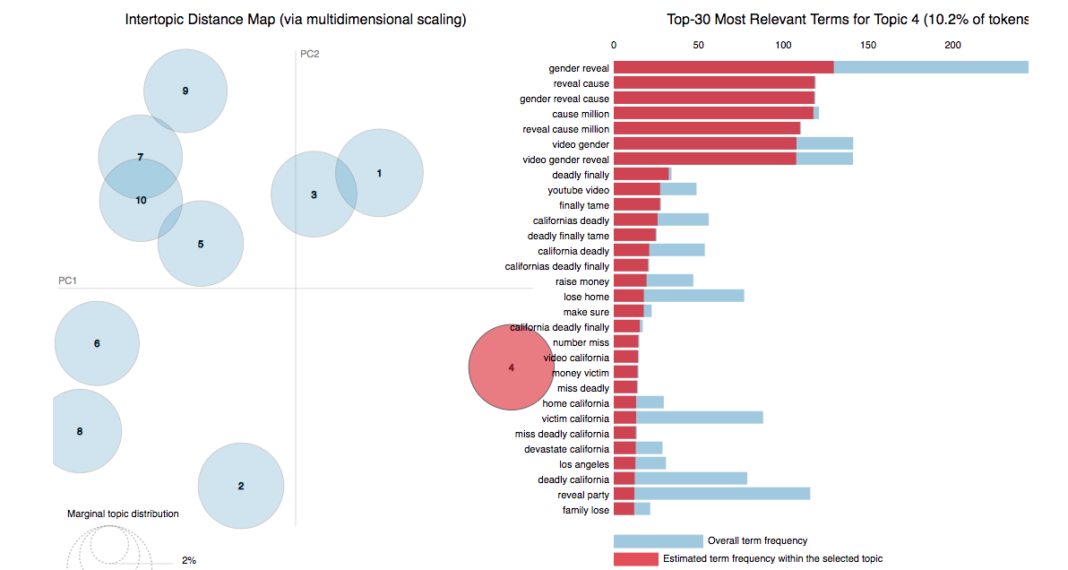
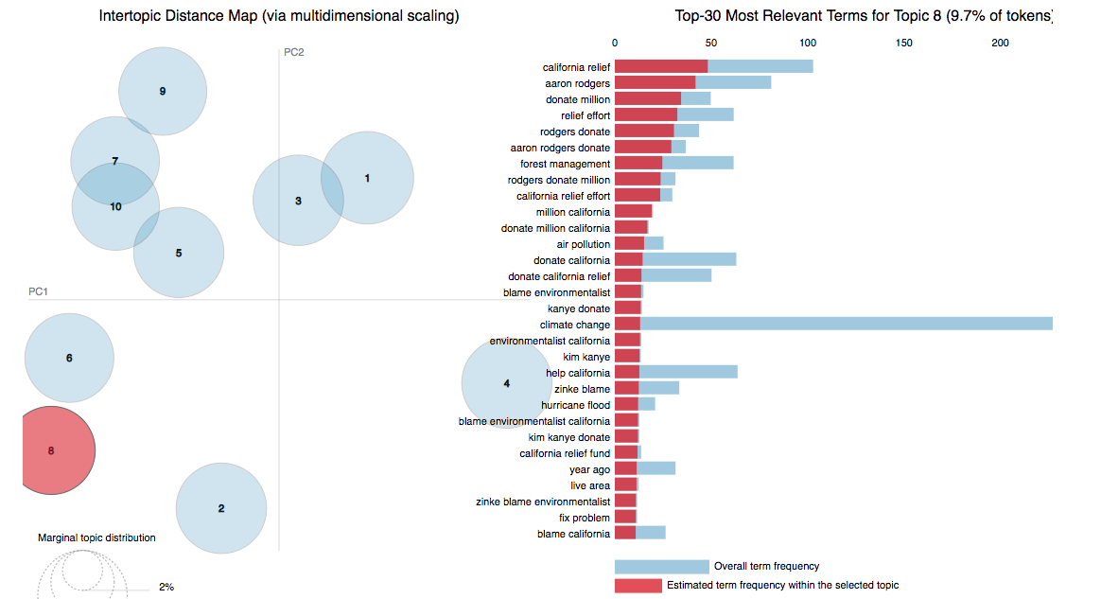
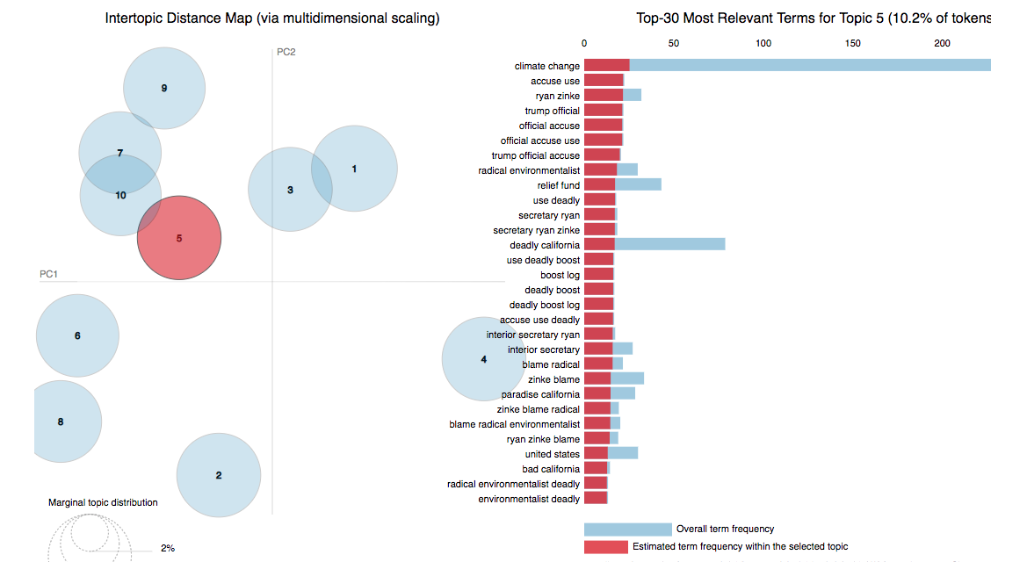
Deep Dive: Camp Fire Topics

Slide 7
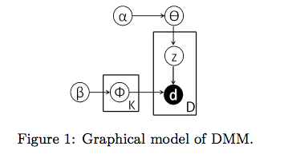
Clustering: The Model
GSDMM = Gibbs Sampling algorithm for the Dirichlet Multinomial Mixture
Infers the number of clusters automatically
Balances completeness and homogeneity
Copes with sparsity of short text
A Dirichlet Multinomial Mixture Model-based Approach for Short Text Clustering Jianhua Yin Jianyong Wang Tsinghua National Laboratory for Information Science and Technology (TNList), Department of Computer Science and Technology, Tsinghua University, Beijing, China

Slide 8
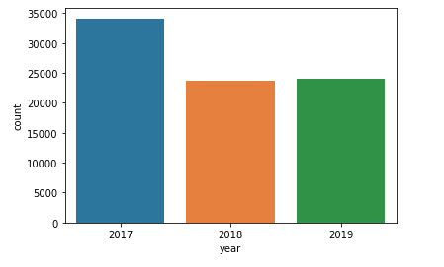
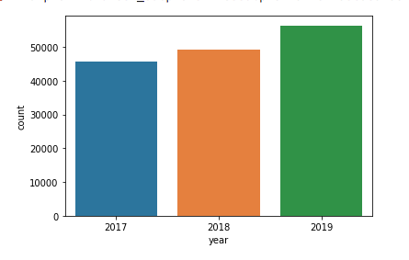
So what changed?
GSDMM performed better than KNN….
Topic: Safety, Acres Burned, Fatal
Topic: Air quality, Wind, Power

Slide 9
So what changed?
….but LSA was still better at selecting distinct topics
2017 Topics:
Death Toll
Personal Accounts
Devastation
Spain, Portugal Death
Charles Shultz Home
Burns
2019 Topics:
Federal Aid
Climate Change
Gas Prices
Trump
Nasa Images

