Slide 1
pianissimo
Brittany Bowers
Notes:
beta release of pianissimo. The absolute latest in hobbyist music generation

Slide 2
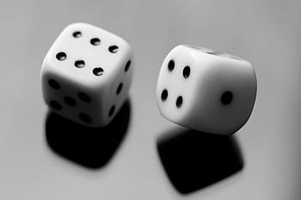
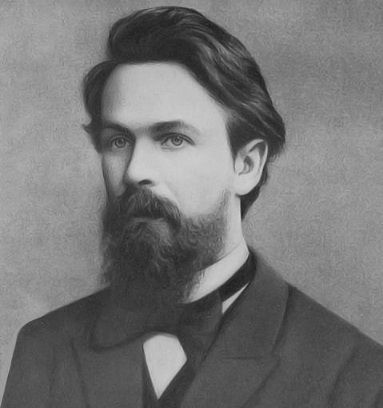
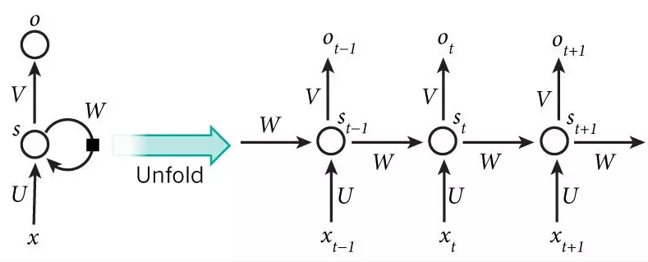

music | generation
history
N
E
1700
musical dice game
1900
markov chains
1989
first RNN
2018
Google launches Magenta
U
motivation
what if there was a tool to assist creative inspiration?
ever wonder what a composer could write given infinite time?
R
A
goal
use neural nets to generate new songs and patterns from existing composers and styles using classical music dataset from Magenta
M
U
S
I
C
A
L
Notes:
Before we look at the demos you’re all here
David Cope

Slide 3
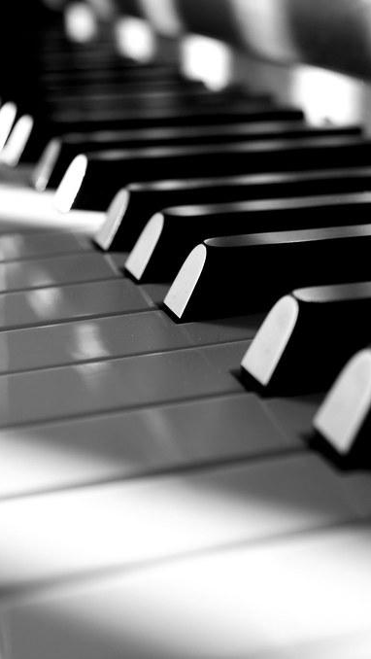
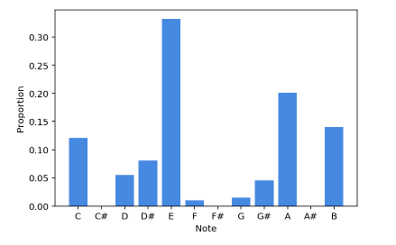

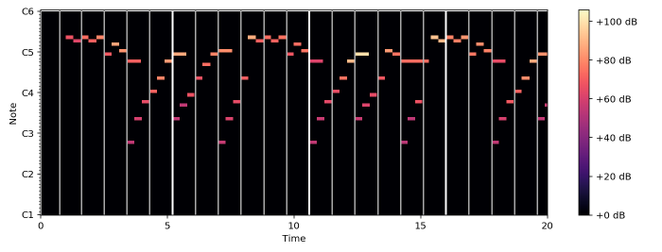
visualize | für elise
MIDI Files
Musical Instrument Digital Interface
(i.e. instrument instructions)
pretty midi
music21
librosa
mir eval

Slide 4
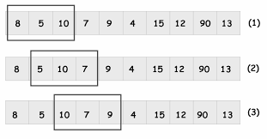
neural | inputs
piano roll array
binary array of every time point in the piece by frame
time notes dictionary
convert binary vectors into string of notes at every time point
shifting windows
separate dictionary on increments of 50 and convert to integers representing unique notes or chords
training
target

Slide 5
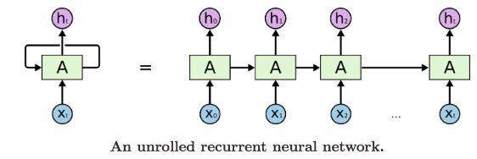
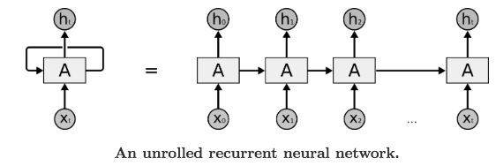
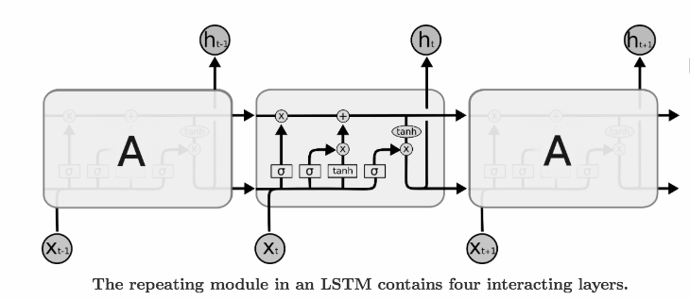
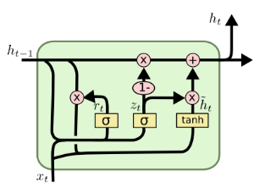
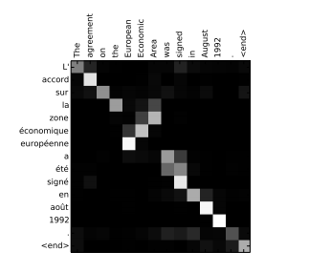
architecture | lstm
recurrent neural net
long-term dependency fails when the gaps are too big
lstm
forget gate
input gate
output gate
gated recurrent unit
self attention
helps the output follow a meaningful path by telling it what to focus on
Notes:
Forget Gate: Decide what to drop
Input Gate: Replace the things you drop
Output Gate: Decide what to output
Self Attention: if note is incredibly far away from last...don’t predict

Slide 6
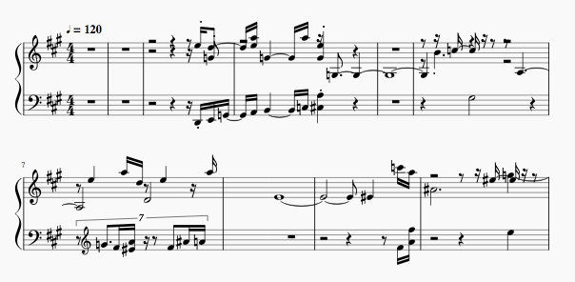
pianissimo | performance
Sonata: 100 songs, 5 epochs
Brahms: 30 songs, self attention, 5 epochs
Random: 40 songs, self attention, 2 epochs
Sonata of the Future

Slide 7

any questions?

