Slide 1

Bayesian Decision Theory
An approach to two-category classification
Tim Haines
ECE486
April 8, 2008
Image courtesy of wikimedia.org (http://upload.wikimedia.org/wikipedia/en/thumb/f/fe/Unbalanced_scales.svg/400px-Unbalanced_scales.svg.png)

Slide 2
Bayesian Decision Theory Assumptions
1) There are only two states of nature.
We are examining something which has only two possible values. These values are referred to as ω1 and ω2.
For example, the book discusses classifying two kinds of fish: sea bass and salmon. These two types of fish are the only states of nature. Therefore, there can be no other kind of fish considered in this classification.
2) Both states are probabilistic.
The probabilities are comprised of a single random variable and are denoted as P(ω1) for state one and P(ω2) for state two. These probabilities are also known as the a priori probabilities or, simply, the prior probabilities. Because there are only two states of nature, then we know that the two probabilities must sum to one.

Slide 3
Bayesian Decision Theory Assumptions (cont.)
The Probability Density Function (PDF) of each state is fully known.
The PDF of each state describes the complete prior probability for
the random variables ω1 and ω2. The PDF is a Gaussian (normal)
distribution.
The decision rule
If P(ω1) > P(ω2), then decide ω1, else decide ω2.
This rule works well if we are only going to make the decision once, but if we
continually apply the rule to multiple instances of the states, then we always
make the same decision. Therefore, we need to consider a factor which does not
affect the prior probability but which can be observed each time we make a
decision.

Slide 4
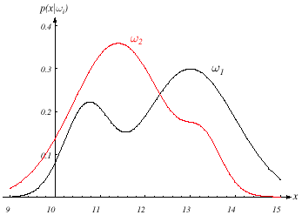
Class-Conditional Probability Density Function
Let there be some continuous, random variable x that describes an
observation that is made each time we make a decision. This observation
is dependent on the state of nature and is expressed as p(x|ω).
The two curves show the difference in the observation made for each state.
This is much better than using just the prior probabilities, but it still doesn't
provide a clear distinction over the full range of observations.

Slide 5
Bayes Formula
Now that we know the class-conditional probability density function, how
do we find the probabilities associated with the density function for certain
values of x?
Recall:
p(ωj,x) = P(ωj|x)p(x) = p(x|ωj)P(ωj) where p(x|ωj) is called the likelihood.
Therefore,
Using this, we can now convert the prior probability P(ωj) into the a posteriori
probability P(ωj|x) – the probability of the state of nature being ωj given that
we made the observation x.

Slide 6
Posterior Probabilities and Bayes Decision Rule
The old Bayes decision rule:
If P(ω1) > P(ω2), then decide ω1, else decide ω2.
The new Bayes decision rule:
if P(ω1|x) > P(ω2|x), then decide ω1, else decide ω2.
Therefore,
P(error|x) = min[P(ω1|x) , P(ω2|x)].
Since the factor p(x) is merely a scaling factor for the posterior probability
and can thus be removed, then the Bayes decision rule can be written as
if p(x|ω1)P(ω1) > p(x|ω2)P(ω2) then decide ω1, else decide ω2.

Slide 7
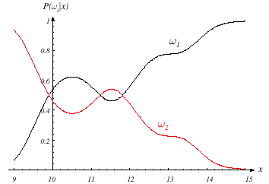
Posterior Probabilities and Bayes Decision Rule (cont.)
Using the posterior probabilities gives us a much larger difference between
the two states of nature and thus a much better probability of making the
correct decision.

Slide 8
Continuous Features - A More General Approach
Thus far we have restricted ourselves to a rather limited subset of the
Bayesian Decision Theory. Now let us generalize in these ways:
Allow more than one feature
Allow more than two states of nature
Allow rejection
General loss function
Allow more than one feature
To do this, we simply replace the scalar x with the vector x. This creates
a feature space in where d is the length of x.
Allow more than two states of nature
This involves merely replacing ω1, ω2 with ωj for j=1...n.

Slide 9
Continuous Features - A More General Approach (cont.)
Allow rejection
Instead of being forced to make a decision, we allow ourselves to reject
an observation if the probabilities are too close.
General loss function
We no longer assume that making an incorrect decision is equal for
all states.
Let there be a finite set of states ωj for j=1...n and a finite set of
actions αi for i=1...k. The loss function is denoted as λ(αi|ωj) and
describes the loss incurred when we take action αi when the state
of nature is ωj.

Slide 10
Bayes Risk
The generalized posterior probability
We can now compute the expected loss (conditional risk)
To achieve the best performance, we must minimize the risk. Therefore,
Bayes Decision rule can be reduced to
for i=1...k

Slide 11
Two-Category Classification Using Bayes Risk
We define the risk for the two states of nature as being
where
The Bayesian Decision Rule then becomes
Substituting the posterior probability and canceling the evidence term

Slide 12
Two-Category Classification Using Bayes Risk (cont.)
We can rearrange the Bayesian Decision rule to produce the likelihood ratio
We can now use an arbitrary likelihood ratio as a decision factor that is
independent of the observation x.

