Slide 1
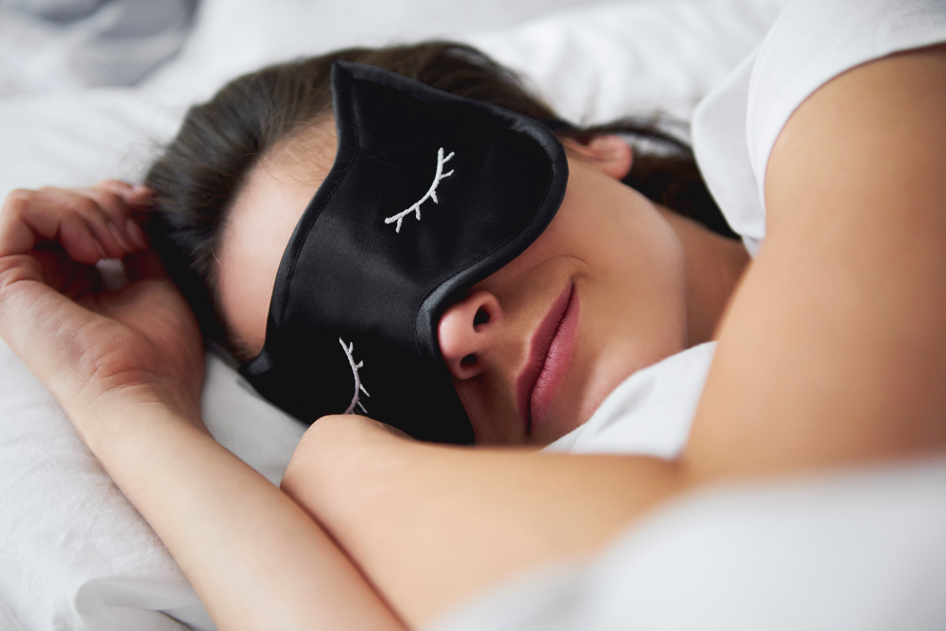
Predictors of Sleep Disorders
Brittney Kuroski

Slide 2
Background
Approximately 1 in 6 adults in the US are living with some type of sleep disorder
Could we accurately predict likelihood of a sleep disorder based on a person’s BMI, stress, and sleep quality?

Slide 3
Data Source &
Transformations
Data Source:
Sourced from Kaggle.com
Based on data from adults, both male and female, ages 27-59
  Data shape = (374, 13)
Contains both numerical and categorical data
Transformations:
Removed data that will not be used in this analysis
Normalized BMI Categories
Converted Gender, Quality of Sleep, Stress Score, and Sleep Disorder columns to binary columns
Converted “BMI Category” dimension to one-hot columns

Slide 4
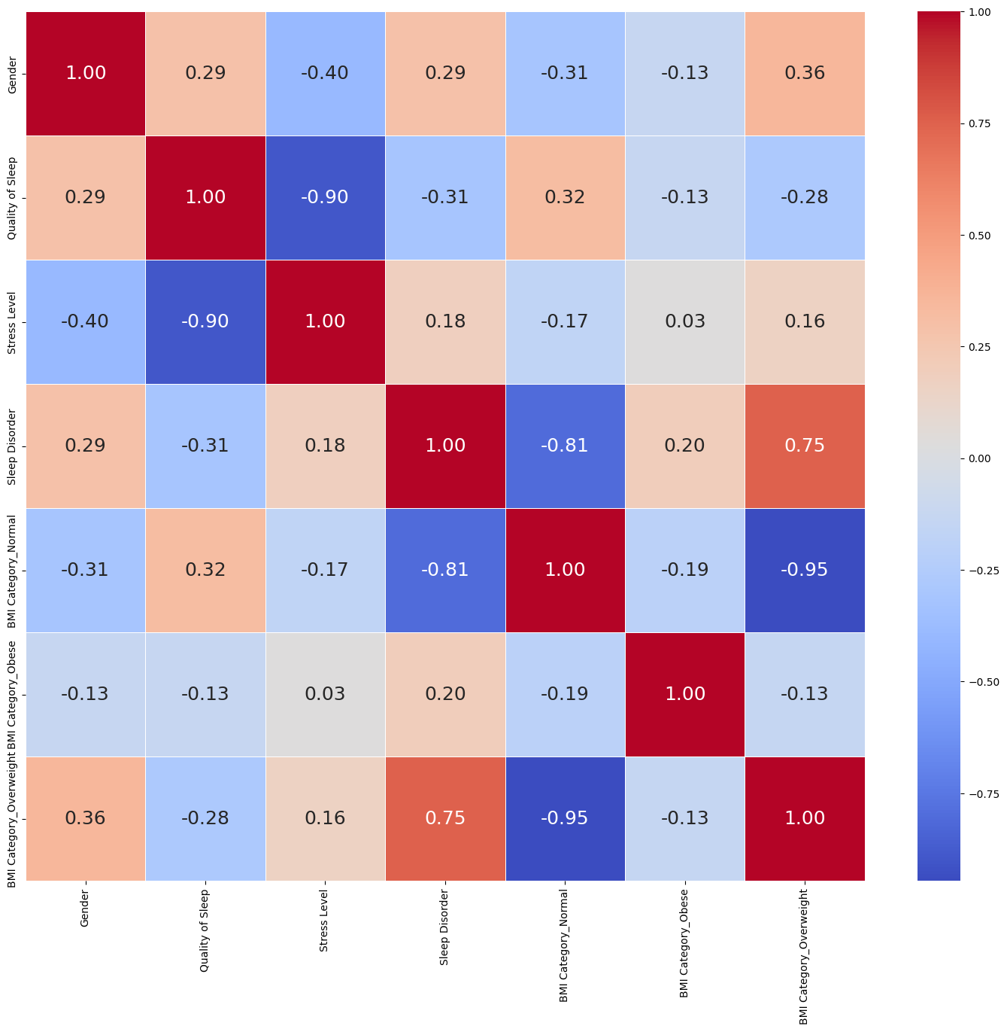
Exploratory Data Analysis
  Correlation Matrix:
  A BMI Category of Normal had a negative correlation with a sleep disorder
  A BMI Category of Overweight has a positive correlation with a sleep disorder

Slide 5
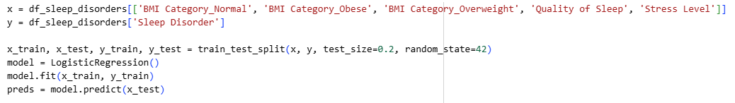
Model Selection:
Logistic Regression
Predicting 1 of 2 outcomes:
  You have a sleep disorder
  You do not have a sleep disorder

Slide 6
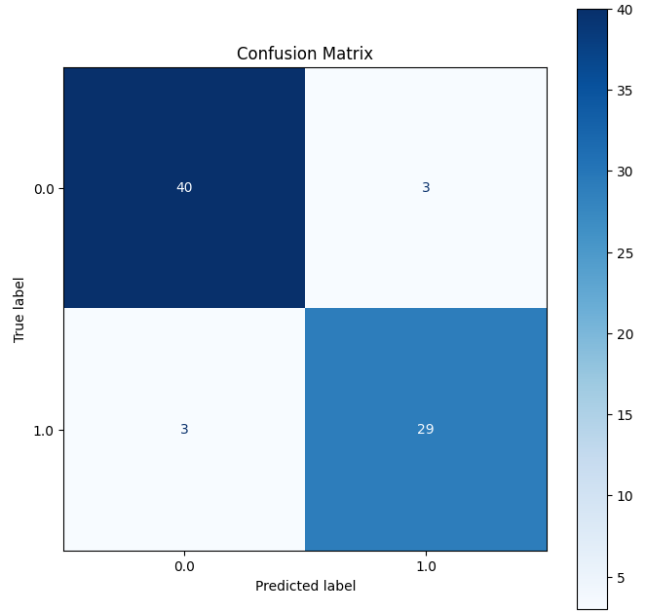
Confusion Matrix
  The model correctly predicted no sleep disorder for 40 individuals and incorrectly predicted a sleep disorder for 3 people
  The model incorrect predicted no sleep disorder for 3 people and correctly predicted a sleep disorder for 23 people.

Slide 7
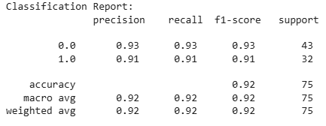
Classification Report
The model correctly predicted the presence or absence of a sleep disorder in 91% of the test cases.
Out of the 32 people with a sleep disorder in the test dataset, the model correctly identified 91% of those
There was a well-balanced performance across both classes

