Slide 1


Custom Functions in R
BioFrass
January 29th, 2021

Slide 2
Download repository from GitHub
https://github.com/brittnibertolet/BioFrass2021_functions

Slide 3

What are functions?
INPUTS
data and other
instructions
OUTPUTS
often data,
but doesn’t have to be
FUNCTION
code to
“do stuff”
Tools that “do stuff”
They take arguments in the form of data or instructions
They return some output

Slide 4
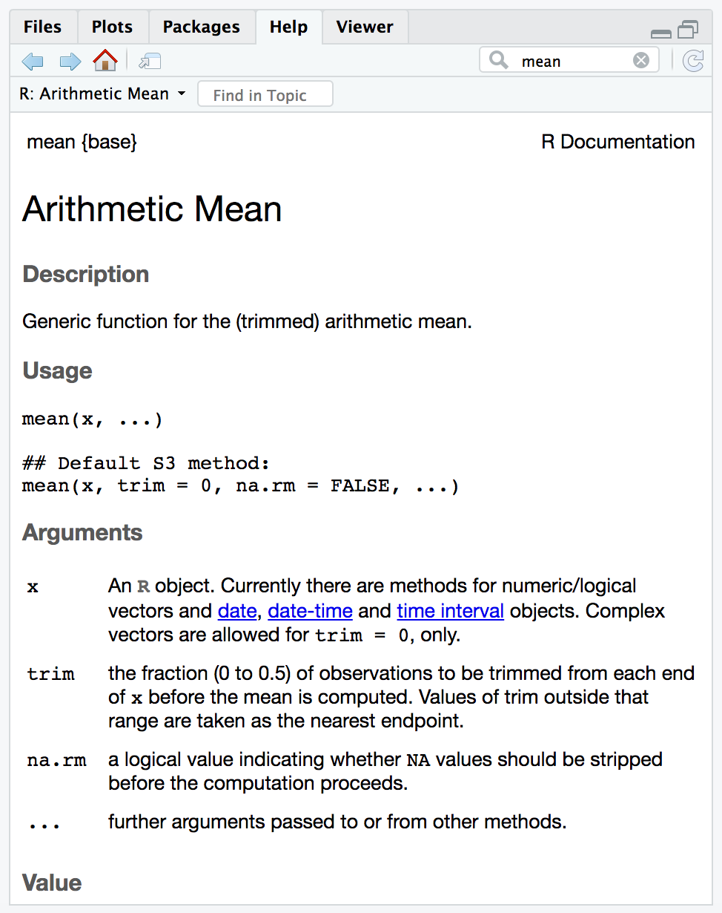
mean()
What is the mean of this set of numbers?
5, 5, 7, 12, 18, 10
A human:
(5 + 5 + 7 + 12 + 18 + 10) / 6 = 9.5
R:
n = c(5, 5, 7, 12, 18, 10)
mean(x = n)
[1] 9.5

Slide 5
Defining a custom function:
# Create the function
NAME <- function(ARGUMENTS){ # Define inputs
ACTIONS # Code to “do stuff” on arguments
return(OUTPUT) # Return output to user
}

Slide 6
my.mean()
# Create the function
my.mean <- function(x){ # Define inputs
output = sum(x)/length(x) # Code to “do stuff”
return(output) # Return output to user
}

Slide 7
Why use custom functions?

Slide 8
Why use custom functions?
Efficiency
Shareability
Transparency
Reproducibility

Slide 9
Challenge #1
In the data directory, you will find 5 csv (comma-separated values) files. Each file corresponds to water temperature data from a different lake at UNDERC, where the LakeID corresponds to the two letter ID in the file name.
Write a custom function to calculate the average water temperature of each lake at some depth. We want to use this function for multiple different lakes and different depths, so write the function so that the LakeID and depth are passed as arguments. Return a dataframe with one row and three columns as shown below:
LakeID | Depth_m | meanTemp_C
CR | 0

Slide 10
Challenge #1 Pseudo-Code First solve the problem, then write the code. – John Johnson
# Create the function
lakeTemp<- function(lakeID, depth){ # Define inputs
# Read in csv
# Subset to only observations at depth
# Calculate mean temperature
# Create dataframe
# Return dataframe to user
}

Slide 11
Challenge #2
Modify your custom function from Challenge 1 to calculate the average water temperature of every lake in the data directory.
Hint 1: Pass the directory name as an argument
Hint 2: Use a for loop to loop through every lake in the directory

Slide 12

Challenge #2 Pseudo-Code First solve the problem, then write the code. – John Johnson
# Create the function
lakeTemp<- function(dir, depth){ # Define inputs
# Get vector of every file in the directory
# Create your output dataframe
# Use a for loop to loop through every file
# Read in file for the ith lake
# Subset to only observations at depth
# Calculate mean temperature
# Create row
# Add the row to the bottom of the output
# Return dataframe to user
}

Slide 13
COMMENT YOUR CODE!
I’m not a great programmer. I’m just a good programmer with great habits.
- Kent Beck

