Slide 1


Slide 2
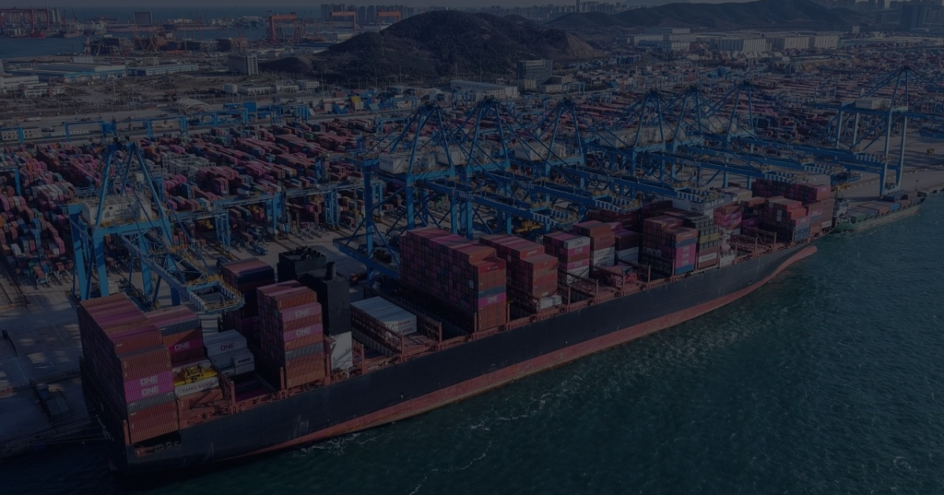

Silence, Spin, or Straight Talk?
How tariff-related price messaging shapes fairness, reactance, and brand outcomes
Britton R. Leggett
Assistant Professor of Marketing
McNeese State University
Notes:
Frame this as pricing communication, not trade policy. The paper asks how firms explain externally imposed costs without sounding opportunistic or political.

Slide 3
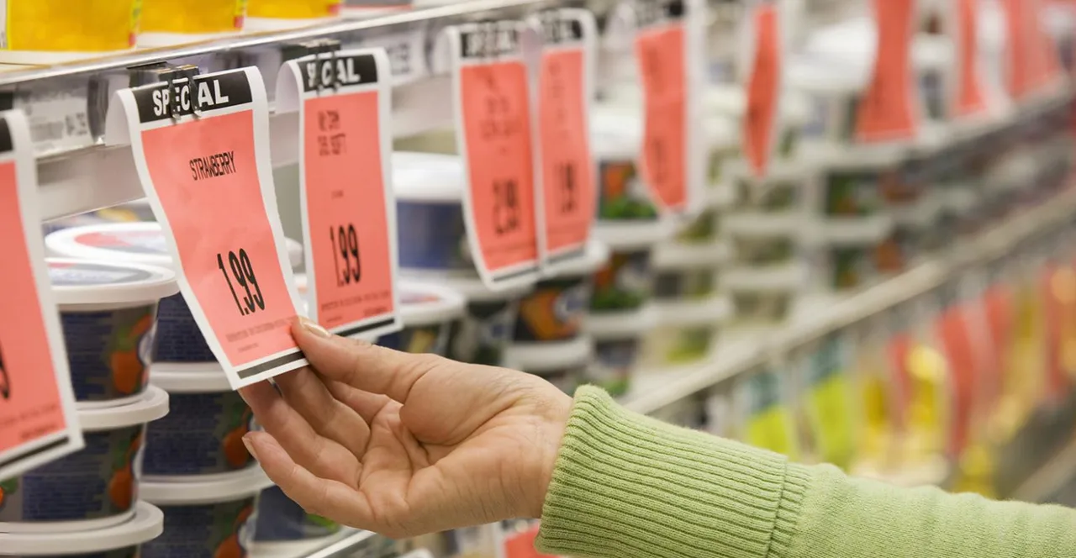
The shelf is where trade policy becomes personal
Consumers rarely see customs forms; they see higher prices.
3.1%
≈90%
76%
Federal Reserve estimate: lift in core goods PCE prices from tariffs implemented through Nov. 2025
New York Fed estimate: tariff burden falling on U.S. firms and consumers
NRF/Morning Consult: voters concerned tariffs will raise prices
Translation for managers
The price increase may be unavoidable. The explanation is not.
GSRBC presentation draft | Tariff-related price messaging
Leggett
Notes:
Use this slide for urgency. Fed work estimates a 3.1% core-goods PCE price lift, and New York Fed researchers estimate most of the tariff burden landed on U.S. firms and consumers. The point: consumers feel tariffs as shelf prices.

Slide 4

Corporate disclosures and executive surveys show tariffs are part of pricing strategy
Tariffs have moved from background policy risk to front-stage pricing language.
91%
55%
34%
KPMG: executives planning price increases up to 15% within six months
KPMG: businesses passing on more than half of tariff costs
FactSet: S&P 500 earnings calls mentioning "tariff" or "tariffs" since Mar. 15, 2025
The managerial problem is no longer whether tariffs matter. It is how to communicate price changes without losing fairness, trust, or choice.
.
GSRBC presentation draft | Tariff-related price messaging
Leggett
Notes:
This is the managerial pivot. FactSet shows tariffs showed up across S&P 500 earnings calls, and KPMG shows executives are planning price moves. Firms are not only absorbing costs; they are deciding how to explain them.

Slide 5
Research question
When firms raise prices under tariff-driven cost pressure, what should they tell consumers?
Silence
Neutral attribution
Gain-framed mitigation
Loss-framed consequence
Raise prices without mentioning tariffs
Tariffs contributed to higher costs
We absorbed/
delayed/reduced the impact first
Tariffs leave us no choice but to raise prices
The twist: the same tariff explanation can feel like transparency to one consumer and politicized excuse-making to another.
.
GSRBC presentation draft | Tariff-related price messaging
Leggett
Notes:
Define the four conditions. Silence offers no explanation; neutral attribution names tariff cost pressure; gain-framed mitigation shows restraint; loss-framed consequence emphasizes little choice.

Slide 6
Theory: one message, two psychological paths
A tariff explanation can restore legitimacy and trigger resistance at the same time.
Fairness appraisal
“Is this legitimate?”
Message strategy
Brand outcomes
Reactance
“Are they pressuring me?”
Tariff-policy attitude moderates the meaning consumers attach to the explanation
GSRBC presentation draft | Tariff-related price messaging
Leggett
Notes:
This is the core theory: the same explanation can increase perceived fairness and trigger reactance. The contribution is the dual-pathway tension.

Slide 7
Three-study program
Start with real marketplace language, then test causality, then validate the model.
Study 1
Study 2
Study 3
Thematic analysis
Vignette experiment
PLS-SEM validation
4-cell message strategy design
Target N = 300 U.S. adults
Independent sample
Parallel mediation + moderation
Corporate communications
Customer emails • press releases • earnings calls
(Braun & Clarke, 2006, 2019)
Sequential logic: ecological validity → causal inference → construct-level evidence
GSRBC presentation draft | Tariff-related price messaging
Leggett
Notes:
Walk reviewers through the sequence: real corporate language, causal vignette test, then SEM validation. The design builds realism first, then causality, then construct-level evidence.

Slide 8
Study 1: Build stimuli from real corporate talk
The goal is not just classification; it is stimulus realism.
Corpus
Coding targets
Output
Customer emails
Retail announcements
Press releases
Corporate blogs
Earnings-call excerpts
Responsibility attribution
Cost absorption language
Customer empathy
Inevitability cues
Policy references
Message typology
Realistic language
Experimental vignettes
Cleaner manipulation checks
GSRBC presentation draft | Tariff-related price messaging
Leggett
Notes:
Study 1 keeps the stimuli from sounding fake. We code real messages for responsibility attribution, cost absorption, empathy, inevitability cues, and policy references.

Slide 9
Study 2: The causal test
Hold the price increase constant; vary only the explanation.
Before stimulus
Stimulus
Outcomes
Measure tariff-policy attitude
Reduce demand effects
Random assignment
Tariff-exposed product
8–12% price increase
Four message conditions
Perceived fairness
Psychological reactance
Trust, attitude, purchase
Switching + negative WOM
Design: four-cell between-subjects vignette experiment, target N = 300 on Prolific
GSRBC presentation draft | Tariff-related price messaging
Leggett
Notes:
Study 2 holds the price increase constant and varies only the explanation. Tariff-policy attitude is measured first so it can moderate reactions without being primed by the vignette.

Slide 10
Expected pattern: transparency is not automatically good
The dominant strategy should combine explanation with customer protection.
Message strategy
Fairness
Reactance
Net brand effect
Silence
Low
Low–mod
Weak
Neutral attribution
Moderate
Moderate
Mixed +
Gain mitigation
Highest
Lowest
Strongest
Loss consequence
Conditional
Highest
Riskiest
Managerial hypothesis: “We tried to protect you first” beats “policy leaves us no choice.”
Expected findings based on proposed fairness and reactance pathways.
Notes:
Expected result: gain-framed mitigation should be safest because it combines transparency with customer protection. Loss-framed consequence is riskiest because it can sound coercive or defensive.

Slide 11
Why this paper contributes
Tariffs create a boundary condition where economic attribution becomes political meaning.
1
Dual entitlement
3
Dual pathway
Extends price fairness into politically contested cost shocks.
Models fairness restoration and resistance as parallel processes.
2
Reactance
4
Brand polarization
Shows how price explanations can threaten perceived freedom.
Moves beyond voluntary activism to involuntary policy responses.
GSRBC presentation draft | Tariff-related price messaging
Leggett
Notes:
State the contributions quickly: price fairness in a political cost context, reactance in pricing explanations, parallel mediation, and political moderation of consumer response.

Slide 12
Managerial takeaway
Do not just blame tariffs. Show restraint. Preserve consumer choice.
Acknowledge
Name the cost pressure without sounding defensive.
Absorb
Show what the firm did before passing along the increase.
Empathize
Frame the message around customer impact.
Avoid coercion
Skip “no choice,” “forced,” and partisan blame cues.
Best message logic: “Costs went up, but we worked to reduce the hit before making this change.”
GSRBC presentation draft | Tariff-related price messaging
Leggett
Notes:
Managerial takeaway: do not simply blame tariffs. Acknowledge cost pressure, show what the firm absorbed or delayed, and avoid language that implies consumers have no choice.

Slide 13
The story in one sentence
Tariffs create a pricing problem, but the consumer reaction is a communication problem.
Question for the audience: when policy becomes embedded in price, does transparency build trust — or trigger resistance?
Notes:
Close with the big idea: tariffs create the pricing problem, but message framing shapes the consumer reaction. Use the source line only if asked about the figures.

Slide 14
SELECTED REFERENCES
Amiti, M., Flanagan, C., Heise, S., & Weinstein, D. E. (2026, February 12). Who is paying for the 2025 U.S. tariffs? Federal Reserve Bank of New York Liberty Street Economics. https://doi.org/10.59576/lse.20260212
Braun, V., & Clarke, V. (2006). Using thematic analysis in psychology. Qualitative Research in Psychology, 3(2), 77-101.
Braun, V., & Clarke, V. (2019). Reflecting on reflexive thematic analysis. Qualitative Research in Sport, Exercise and Health, 11(4), 589-597.
Brehm, J. W. (1966). A theory of psychological reactance. Academic Press.
Eyster, E., Madarasz, K., & Michaillat, P. (2021). Pricing under fairness concerns. Journal of the European Economic Association, 19(3), 1853-1898.
Haupt, M., Wannow, S., Marquardt, L., Graubner, J. S., & Haas, A. (2023). Who is more responsive to brand activism? Journal of Product & Brand Management, 32(8), 1248-1273.
Hayes, A. F. (2022). Introduction to mediation, moderation, and conditional process analysis: A regression-based approach (3rd ed.). Guilford Press.
Kahneman, D., Knetsch, J. L., & Thaler, R. H. (1986). Fairness as a constraint on profit seeking: Entitlements in the market. American Economic Review, 76(4), 728-741.
Kahneman, D., & Tversky, A. (1979). Prospect theory: An analysis of decision under risk. Econometrica, 47(2), 263-291.
Minton, R., Ray, M., & Somale, M. (2026, April 8). Detecting tariff effects on consumer prices in real time - Part II. FEDS Notes. Board of Governors of the Federal Reserve System. https://doi.org/10.17016/2380-7172.4040
Morning Consult. (2025, April 3). Tariffs, consumer spending, and what comes next. Morning Consult Pro.
Rawal, M., Kar, S., & Bhaduri, G. (2026). Gain vs. loss framing in rational and emotional appeals. Marketing Management Journal.
Steindl, C., Jonas, E., Sittenthaler, S., Traut-Mattausch, E., & Greenberg, J. (2015). Understanding psychological reactance. Zeitschrift fuer Psychologie, 223(4), 205-214.
Tarrahi, F., Eisend, M., & Dost, F. (2016). A meta-analysis of price change fairness perceptions. International Journal of Research in Marketing, 33(1), 199-212.
Villagra, N., Clemente-Mediavilla, J., Lopez-Oza, C., & Sanchez-Herrera, J. (2021). When polarization hits corporations. El Profesional de la Informacion.

