Slide 1

Prepared by:
Brittney Wylie

Slide 2
Organization Overview
Communication Goals
Target Audience
Site Design

Slide 3
Organization Overview
Small Law firm in Fort Worth Texas
Serves Cities
Areas of Practice
Government
School
Real Estate
Oil & Gas
Economic Development

Slide 4
Communication Goals
Easy to find information
Attract new clients
Ease of use for current clients

Slide 5
Target Audience
Government Official
Superintendent
Real Estate Company
Company's looking for help with employees.
Officials running for public office.

Slide 6
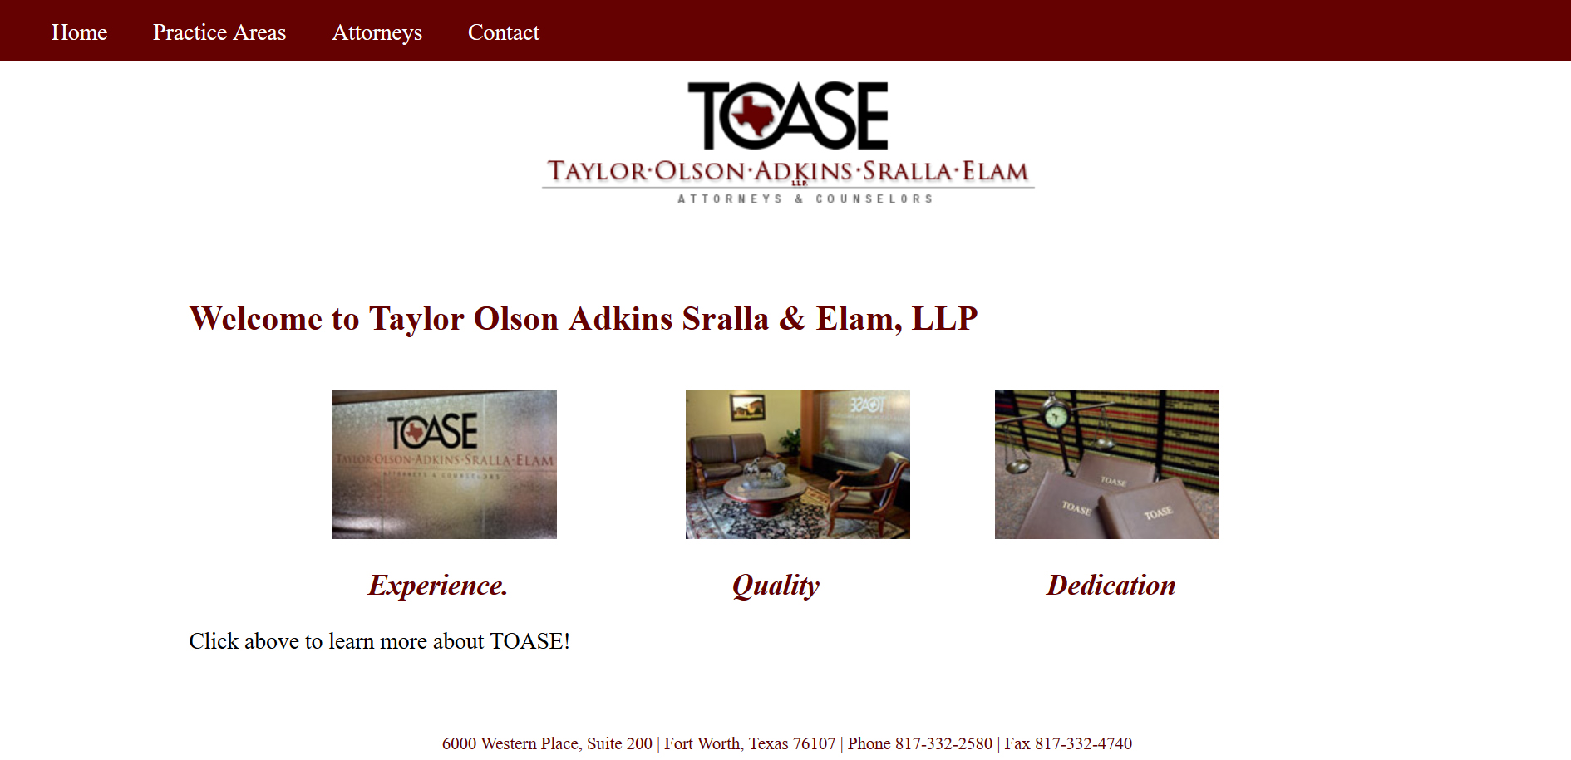
Site Design

