Slide 1
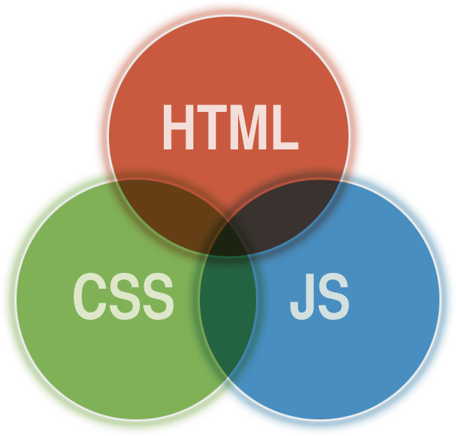

Slide 2

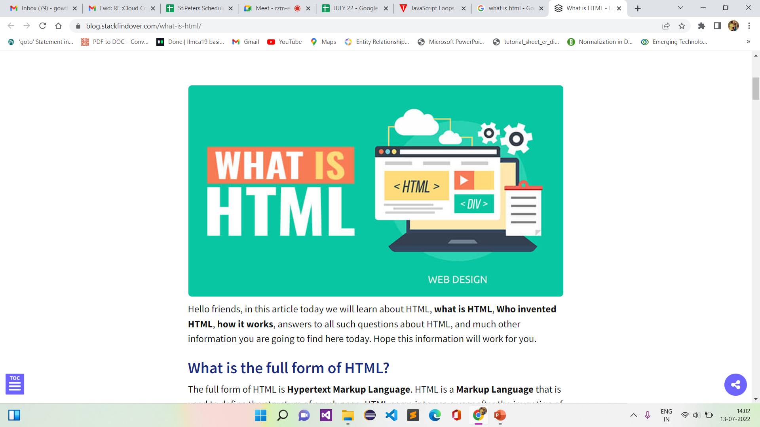



Slide 3
WHAT IS HTML?
HTML stands for Hyper Text Markup Language.
HTML is the most widely used language on Web to develop web pages.
HTML was created by Berners-Lee in late 1991 but "HTML 2.0" was the first standard HTML specification which was published in 1995.
HTML documents are also called web pages
Create WebPages
Using Interfaces

Slide 4
HTML tags are keywords (tag names) surrounded by angle brackets like <html>
HTML tags normally come in pairs like <b> and </b>
The first tag in a pair is the start tag, the second tag is the end tag
The end tag is written like the start tag, with a forward slash before the tag name
Start and end tags are also called opening tags and closing tags

Slide 5
USES OF LEARNING HTML?
Create Web site
Become a web designer
Understand web
Learn other languages

Slide 6
WHY WE NEED HTML?
Web pages development -
Internet Navigation
Responsive UI
Game development

Slide 7
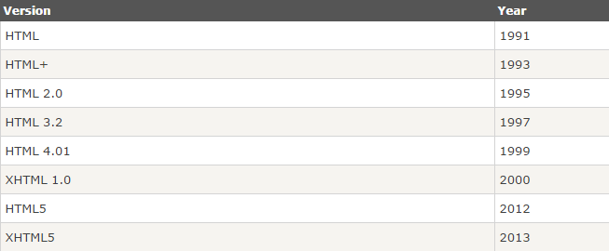
HTML VERSIONS

Slide 8
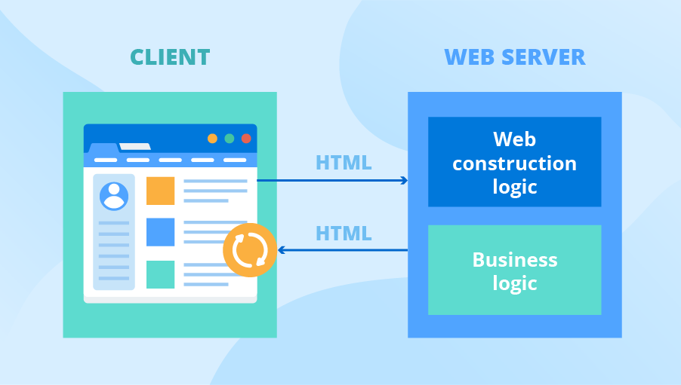
WEB APPLICATION

Slide 9
WEB APPLICATION
All content is loaded from web.
Familiar web based programming.
HTML/CSS/JavaScript are been used.

Slide 10
HTML REQUIREMENTS
Editor(Text)
Web Browser

Slide 11
HTML TEXT EDITORS
Notepad
Notepad++
Sublime

Slide 12
WEB BROWSERS
HTML documents and display them as web pages.
The browser does not display the HTML tags, but uses the tags to determine how the content of the HTML page is to be presented/displayed to the user.
ie)Google Chrome, Internet Explorer, Firefox, Safari) is to read .

Slide 13
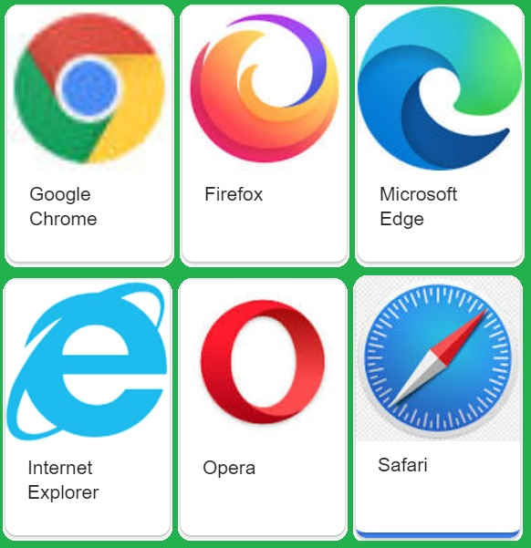

Slide 14
HTML DOCUMENT STRUCTURE
Document declaration tag
<html>
<head>
Document header related tags
</head>
<body>
Document body related tags
</body>
</html>

Slide 15
Structure of HTML
<!DOCTYPE html> <html> <head>a <title>Page Title</title> </head> <body> <h1>This is a Heading</h1> <p>This is a paragraph.</p> </body> </html>

Slide 16
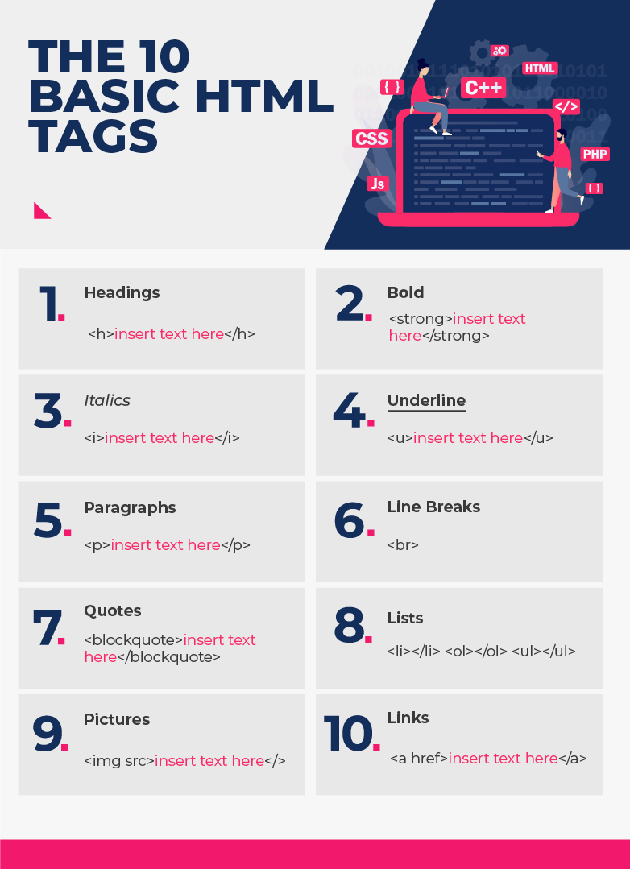
Basic Tags in HTML

Slide 17
HTML COMMENTS
Comment is a piece of code which is ignored by any web browser.
It is a good practice to add comments into your HTML code.
HTML comments are placed in between <!-- ... --> tags.
So any content placed with-in <!-- ... --> tags will be treated as comment and will be completely ignored by the browser.

Slide 18
HTML TAGS
HTML tags are like keywords .
HTML tags contain three main parts:
opening tag,
content
closing tag.
But some HTML tags are unclosed tags.

Slide 19
Syntax:
<tag> content </tag>
HTML Tag Examples:
<p> Paragraph Tag </p>
<h2> Heading Tag </h2>
<b> Bold Tag </b>
<i> Italic Tag </i>
<u> Underline Tag</u>

Slide 20
Unclosed HTML Tags:
Some HTML tags are not closed,
Example: br and hr.
<br> Tag: br stands for break line, it breaks the line of the code.
<hr> Tag: hr stands for Horizontal Rule.
HTML Meta Tags:
DOCTYPE, title, link, meta and style

Slide 21
HTML Text Tags
<p>, <h1>, <h2>, <h3>, <h4>, <h5>, <h6>, <strong>, <em>, <abbr>, <acronym>, <address>, <bdo>, <blockquote>, <cite>, <q>, <code>, <ins>, <del>, <dfn>, <kbd>, <pre>, <samp>, <var> and <br>

Slide 22
HTML Link Tags
<a> and <base>
HTML Image and Object Tags
<img>, <area>, <map>, <param> and <object>
HTML List Tags
<ul>, <ol>, <li>, <dl>, <dt> and <dd>
HTML Table Tags
table, tr, td, th, tbody, thead, tfoot, col, colgroup and caption

Slide 23
HTML Form Tags
form, input, textarea, select, option, optgroup, button, label, fieldset and legend
HTML Scripting Tags
script and noscript

Slide 24
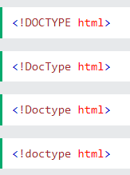
<!DOCTYPE>
All HTML documents must start with a <!DOCTYPE> declaration.
The declaration is not an HTML tag.
It is an "information" to the browser about what document type to expect.
The <!DOCTYPE> declaration is NOT case sensitive.

Slide 25
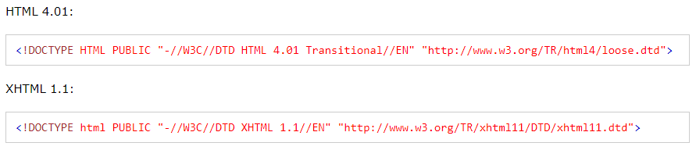
<!DOCTYPE> in Older HTML versions

Slide 26
HEADING TAGS
Any document starts with a heading. You can use different sizes for your headings.
HTML also has six levels of headings,
which use the elements <h1>, <h2>, <h3>, <h4>, <h5>, and <h6>.
While displaying any heading, browser adds one line before and one line after that heading.

Slide 27
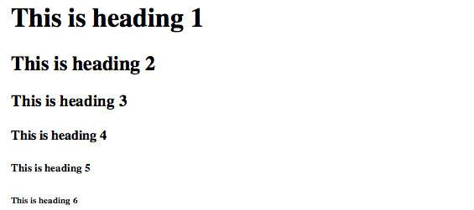
HEADER OUTPUT

Slide 28
PARAGRAPH TAG
The <p> tag offers a way to structure your text into different paragraphs.
Each paragraph of text should go in between an opening <p> and a closing </p> tag.
Example:
<p>Here is a first paragraph of text</p>
<p>Here is a second paragraph of text</p>
<p>Here is a third paragraph of text</p>

Slide 29
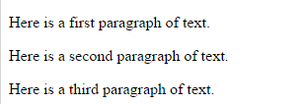
PARAGRAPH OUTPUT

Slide 30
LINE BREAK TAG
Whenever you use the <br/> element, anything following it starts from the next line.
This tag is an example of an empty element.
where you do not need opening and closing tags, as there is nothing to go in between them.
The <br/> tag has a space between the characters br and the forward slash.
If you omit this space, older browsers will have trouble rendering the line break, while if you miss the forward slash character and just use <br> it is not valid in XHTML

Slide 31
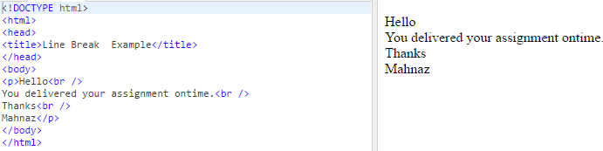
LINE BREAK OUTPUT

Slide 32
CENTERING CONTENT
You can use <center> tag to put any content in the center of the page or any table cell.
Example:
<center>
<p>This text is in the center</p>
</center>

Slide 33

CENTER OUTPUT

Slide 34
HORIZONTAL LINES
Horizontal lines are used to visually break up sections of a document.
The <hr>tag creates a line from the current position in the document to the right margin and breaks the line accordingly.
Example:
<p>This is paragraph one and should be on top</p>
<hr />
<p>This is paragraph two and should be at bottom</p>

Slide 35

HORIZONTAL OUTPUT

Slide 36
NON-BREAKING SPACES
<!DOCTYPE html>
<html>
<head>
<title>Non-breaking Spaces Example</title>
</head>
<body>
<p>An example of this technique appears in the movie "12&nbsp;Angry&nbsp;Men."</p>
</body>
</html>

Slide 37
NON-BREAKING SPACES OUTPUT

Slide 38
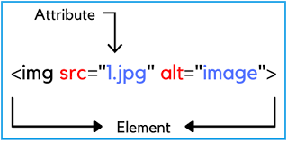
ATTRIBUTES IN HTML
HTML attributes are used to describe the characteristic of an HTML element in detail.
It provide additional information about elements.
It usually come in name/value pairs like: name="value"

Slide 39
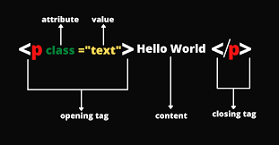
ATTRIBUTES IN HTML

Slide 40
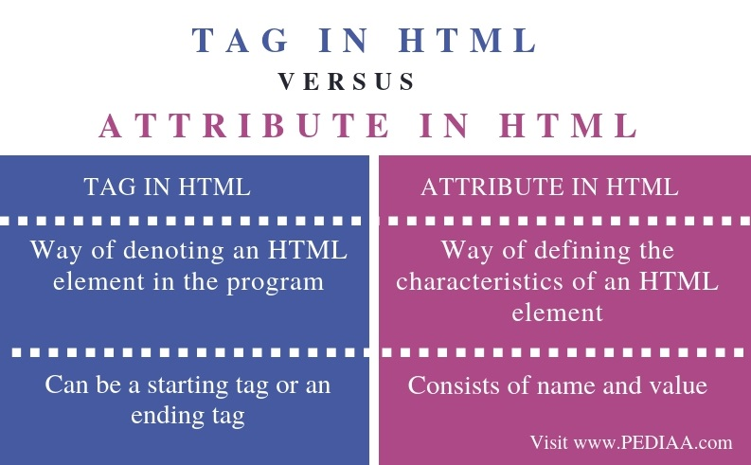
TAG VS ATTRIBUTE

Slide 41
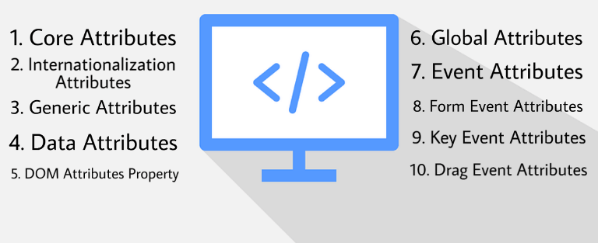
TYPES OF ATTRIBUTE

Slide 42
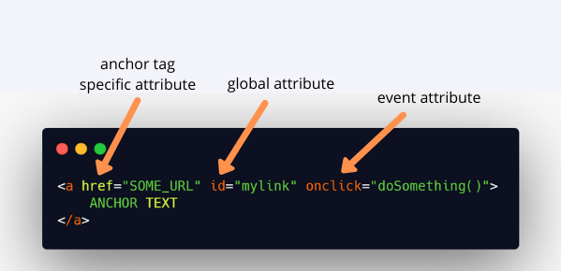
EVENT ATTRIBUTE

Slide 43
EVENT ATTRIBUTE
web page or a website created using the HTML script (HyperText Markup Language).
Every action performed by the user and the web tool itself is termed an HTML Event.

Slide 44
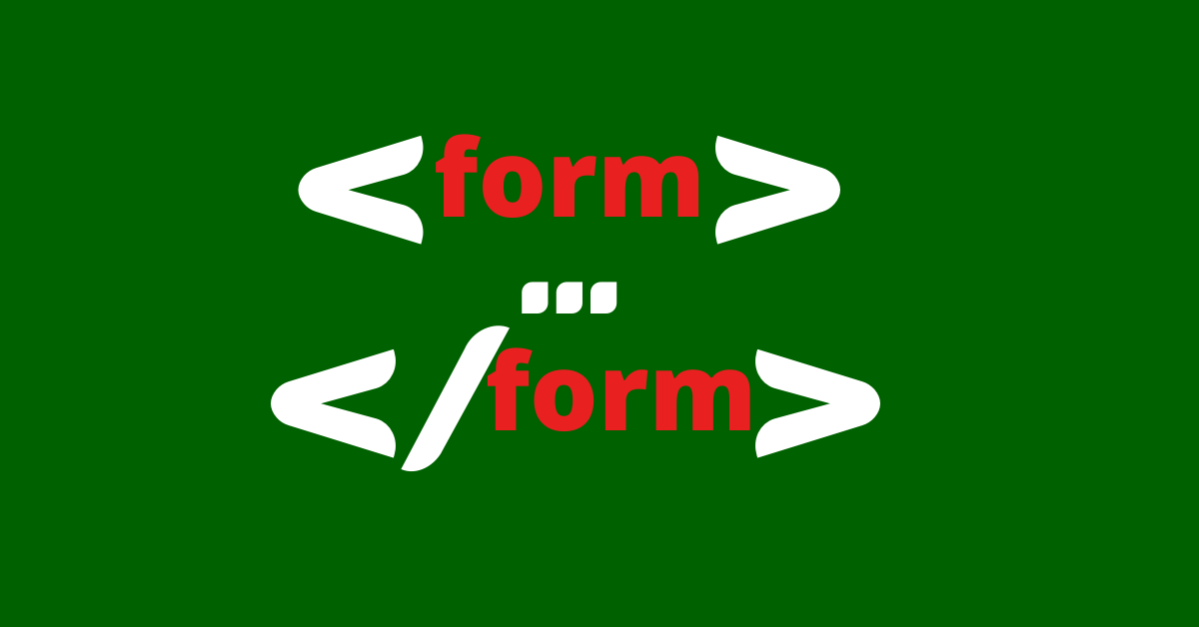
FORM EVENT ATTRIBUTES

Slide 45
ATTRIBUTE EXAMPLE
The paragraph <p> element in the example carries an attribute whose name is align.
which you can use to indicate the alignment of paragraph on the page.
The value is what you want the value of the property to be set and always put within quotations.
The below example shows three possible values of align attribute: left, center and right.

Slide 46
Example
<!DOCTYPE html>
<html>
<head>
<title>Align Attribute Example</title>
</head>
<body>
<p align="left">This is left aligned</p>
<p align="center">This is center aligned</p>
<p align="right">This is right aligned</p>
</body>
</html>

Slide 47
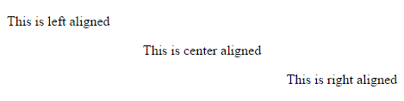
Output

Slide 48
HTML Elements
An element in HTML usually consist of a start tag <tag name>, close tag </tag name> and content inserted between them. Technically, an element is a collection of start tag, attributes, end tag, content between them.

Slide 49
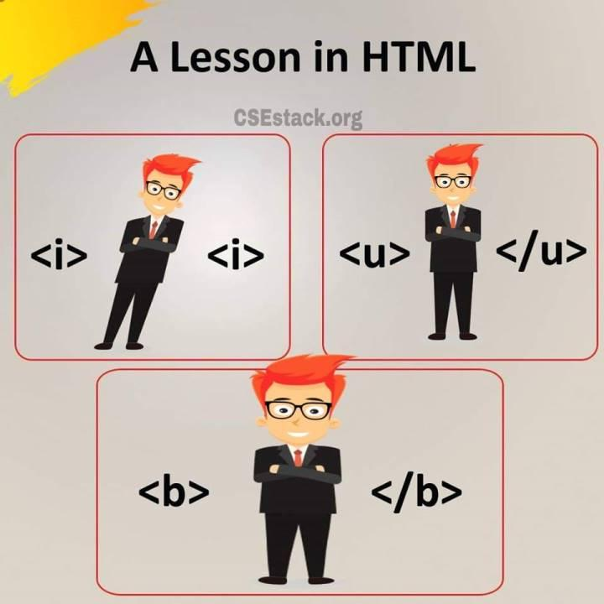

Slide 50
HTML FORMATTING
Bold Text:
Anything that appears within <b>...</b> element, is displayed in bold.

Slide 51
HTML FORMATTING
HTML Formatting is a process of formatting text for better look and feel.
HTML the formatting tags are divided into two categories:
Physical tag: These tags are used to provide the visual appearance to the text.
Logical tag: These tags are used to add some logical or semantic value to the text.

Slide 52
ITALIC TEXT
Anything that appears within <i>...</i> element is displayed in italicized.

Slide 53
UNDERLINED TEXT
Anything that appears within <u>...</u> element, is displayed with underline.

Slide 54
STRIKE TEXT
Anything that appears within <strike>...</strike> element is displayed with strikethrough

Slide 55
SUPERSCRIPT TEXT
The content of a <sup>...</sup> element is written in superscript;
The font size used is the same size as the characters surrounding it but is displayed half a character's height above the other characters.

Slide 56
SUBSCRIPT TEXT
The content of a <sub>...</sub> element is written in subscript;
The font size used is the same as the characters surrounding it, but is displayed half a character's height beneath the other characters.

Slide 57
EXAMPLE
<!DOCTYPE html>
<html>
<head>
<title>Subscript Text Example</title>
</head>
<body>
<b>Bold</b><br>
<i>Italic</i><br>
<u>Underline</u><br>

Slide 58
EXAMPLE
<strike>Strike</strike><br>
<sub>subscript</sub><br>
<sup>superscript</sup>
</body>
</html>

Slide 59
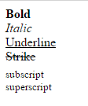
OUTPUT

Slide 60
Inserted Text
Anything that appears within <ins>...</ins> element is displayed as inserted text.
Deleted Text
Anything that appears within <del>...</del> element, is displayed as deleted text.

Slide 61
INSERTED EXAMPLE
<!DOCTYPE html>
<html>
<head>
<title>Inserted Text Example</title>
</head>
<body>
<p>I want to <del>run</del> <ins>walk</ins></p>
</body>
</html>

Slide 62

OUTPUT

Slide 63
DELETED EXAMPLE
<!DOCTYPE html>
<html>
<head>
<title>Deleted Text Example</title>
</head>
<body>
<p>I want to drink <del>cola</del> <ins>coffee</ins></p>
</body>
</html>

Slide 64
OUTPUT

Slide 65
Larger Text
The content of the <big>...</big> element is displayed one font size larger than the rest of the text surrounding
Smaller Text
The content of the <small>...</small> element is displayed one font size smaller than the rest of the text surrounding

Slide 66
SMALL & LARGE EXAMPLE
<!DOCTYPE html>
<html>
<head>
<title>Smaller Text Example</title>
</head>
<body>
<small>small</small>
<large>Large</large>
</body>
</html>

Slide 67

OUTPUT

Slide 68
Marked Text
Anything that appears with-in <mark>...</mark> element, is displayed as marked with yellow ink.
Strong Text
Anything that appears within <strong>...</strong> element is displayed as important text.

Slide 69
EXAMPLE
<!DOCTYPE html>
<html>
<head>
<title>Strong Text Example</title>
</head>
<body>
<mark>work</mark> <strong>strong</strong>
</body>
</html>

Slide 70
OUTPUT

Slide 71
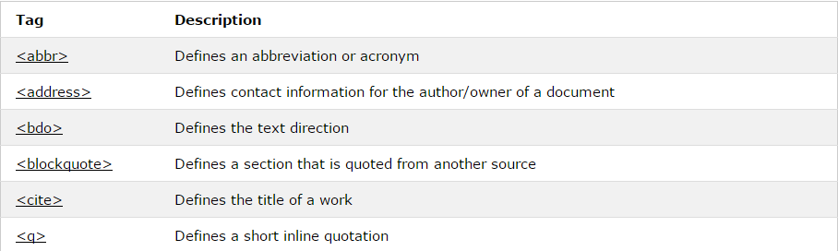

Slide 72

EXAMPLE
<!DOCTYPE html>
<html>
<head>
<title>Text Abbreviation</title>
</head>
<body>
<p>My best friend's name is <abbr title="Abhishek">Abhy</abbr>.</p>
</body>
</html>

Slide 73

EXAMPLE
<!DOCTYPE html>
<html>
<head>
<title>Text Direction Example</title>
</head>
<body>
<p>This text will go left to right.</p>
<p><bdo dir="rtl">This text will go right to left.</bdo></p>
</body>
</html>

Slide 74

EXAMPLE
<!DOCTYPE html>
<html>
<head>
<title>quote Example</title>
</head>
<body>
<q>quoted</q>
</html>

Slide 75
HTML IMAGES
Images are very important to beautify as well as to depict many complex concepts in simple way on your web page.
This tutorial will take you through simple steps to use images in your web pages.

Slide 76
INSERT IMAGE
You can insert any image in your web page by using <img> tag. Following is the simple syntax to use this tag.
<img src="Image URL" ... attributes-list/>
The <img> tag is an empty tag.
which means that it can contain only list of attributes and it has no closing tag.

Slide 77
EXAMPLE
<!DOCTYPE html>
<html>
<body>
<h2>Spectacular Mountain</h2>
<img src="pic_mountain.jpg" alt="Mountain View" style="width:304px;height:228px;">
</body>
</html>

Slide 78

OUTPUT

Slide 79
ALT ATTRIBUTE
The alt attribute provides an alternate text for an image,(because of slow connection, an error in the src attribute, or if the user uses a screen reader).
If a browser cannot find an image
It will display the value of the alt attribute.

Slide 80
EXAMPLE
<!DOCTYPE html>
<html>
<body>
<p>If a browser cannot find an image, it will display the alternate text:</p>
<img src="wrongname.gif" alt="HTML5 Icon" style="width:128px;height:128px;">
</body>
</html>

Slide 81
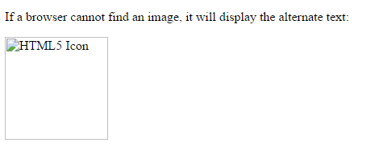
OUTPUT

Slide 82
HTML TABLES
The HTML tables allow web authors to arrange data like text, images, links, other tables, etc.
In to rows and columns of cells.
The HTML tables are created using the <table> tag .
which the <tr> tag is used to create table rows and <td> tag is used to create data cells.

Slide 83
TABLE HEADING
Table heading can be defined using <th> tag.
This tag will be put to replace <td> tag.
which is used to represent actual data cell.
Normally you will put your top row as table heading as shown below, otherwise you can use <th> element in any row.

Slide 84
<!DOCTYPE html>
<html>
<head>
<title>HTML Table Header</title>
</head>
<body>
<table border="1">

Slide 85
<th>Name</th>
<th>Salary</th>
</tr> <tr>
<td>ABC</td>
<td>5000</td>
</tr> <tr>
<td>DEF</td>
<td>7000</td>
</tr> </table>
</body>
</html>

Slide 86

OUTPUT

Slide 87
CELLPADDING AND CELLSPACING ATTRIBUTES
cellpadding and cellspacing are use to adjust the white space in your table cells.
The cellspacing attribute defines the width of the border.
while cellpadding represents the distance between cell borders and the content within a cell.

Slide 88
<!DOCTYPE html>
<html>
<head>
<title>HTML Table Cellpadding</title>
</head> <body>
<table border="1" cellpadding="5" cellspacing="5">
<tr> <th>Name</th>
<th>Salary</th>
</tr> <tr>

Slide 89
<td>Ramesh Raman</td>
<td>5000</td>
</tr> <tr>
<td>Shabbir Hussein</td>
<td>7000</td>
</tr> </table>
</body>
</html>

Slide 90
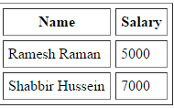
OUTPUT

Slide 91
TABLES BACKGROUNDS
bgcolor attribute - You can set background color for whole table or just for one cell.
background attribute - You can set background image for whole table or just for one cell.

Slide 92
<!DOCTYPE html>
<html>
<head>
<title>HTML Table Background</title>
</head> <body>
<table border="1" bordercolor="green" bgcolor="yellow">
<tr>
<th>Column 1</th>
<th>Column 2</th>
<th>Column 3</th>
</tr>

Slide 93
<tr><td rowspan="2">Row 1 Cell 1</td><td>Row 1 Cell 2</td><td>Row 1 Cell 3</td></tr>
<tr><td>Row 2 Cell 2</td><td>Row 2 Cell 3</td></tr>
<tr><td colspan="3">Row 3 Cell 1</td></tr>
</table>
</body>
</html>

Slide 94

OUTPUT

Slide 95
HTML LISTS
HTML offers web authors three ways for specifying lists of information. All lists must contain one or more list elements.
Lists may contain:
<ul> - An unordered list. This will list items using plain bullets.
<ol> - An ordered list. This will use different schemes of numbers to list your items.
<dl> - A definition list. This arranges your items in the same way as they are arranged in a dictionary.

Slide 96
HTML UNORDERED LISTS
An unordered list is a collection of related items that have no special order or sequence.
This list is created by using HTML <ul> tag.
Each item in the list is marked with a bullet.

Slide 97
EXAMPLE
<!DOCTYPE html>
<html> <head>
<title>HTML Unordered List</title>
</head> <body>
<ul>
<li>Beetroot</li>
<li>Ginger</li>
<li>Potato</li>
<li>Radish</li>
</ul> </body>
</html>

Slide 98
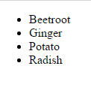
OUTPUT

Slide 99
THE TYPE ATTRIBUTE
You can use type attribute for <ul> tag to specify the type of bullet you like.
By default it is a disc.
Following are the possible options:
<ul type="square">
<ul type="disc">
<ul type="circle">

Slide 100
<!DOCTYPE html>
<html>
<head>
<title>HTML Unordered List</title>
</head>
<body>
<ul type="square">
<li>Beetroot</li>
<li>Ginger</li>
<li>Potato</li>
<li>Radish</li>
</ul>
</body>
</html>

Slide 101

OUTPUT

Slide 102
HTML ORDERED LISTS
If you are required to put your items in a numbered list instead of bulleted then HTML ordered list will be used.
This list is created by using <ol> tag.
The numbering starts at one and is incremented by one for each successive ordered list element tagged with <li>.

Slide 103
THE TYPE ATTRIBUTE
You can use type attribute for <ol> tag to specify the type of numbering you like. By default it is a number.
Following are the possible options:
<ol type="1"> - Default-Case Numerals.
<ol type="I"> - Upper-Case Numerals.
<ol type="i"> - Lower-Case Numerals.
<ol type="a"> - Lower-Case Letters.
<ol type="A"> - Upper-Case Letters.

Slide 104
EXAMPLE
<!DOCTYPE html>
<html>
<head>
<title>HTML Ordered List</title>
</head> <body>
<ol type="1">
<li>Beetroot</li>
<li>Ginger</li>
<li>Potato</li>
<li>Radish</li>
</ol> </body>
</html>

Slide 105

OUTPUT

Slide 106
HTML TEXT LINKS
A webpage can contain various links that take you directly to other pages and even specific parts of a given page.
These links are known as hyperlinks.
Hyperlinks allow visitors to navigate between Web sites by clicking on words, phrases, and images.
Thus you can create hyperlinks using text or images available on a webpage.

Slide 107
LINKING DOCUMENTS
A link is specified using HTML tag <a>.
This tag is called anchor tag and anything between the opening <a> tag and the closing </a> tag becomes part of the link and a user can click that part to reach to the linked document.
Following is the simple syntax to use <a> tag.
<a href="Document URL" ... attributes-list>Link Text</a>

Slide 108
EXAMPLE
<!DOCTYPE html>
<html>
<head>
<title>Hyperlink Example</title>
</head>
<body>
<h1>Click following link</h1>
<a href="https://www.google.com" target="_self">Google</a>
</body>
</html>

Slide 109

OUTPUT

Slide 110
THE TARGET ATTRIBUTE
We have used target attribute in our previous example.
This attribute is used to specify the location where linked document is opened.

Slide 111
Option Description
_blank Opens the linked document in a new window or tab.
_self Opens the linked document in the same frame.
_parent Opens the linked document in the parent frame.
_top Opens the linked document in the full body of the window.
Targetframe Opens the linked document in a named targetframe.

Slide 112

SETTING LINK COLORS
<style>
a:link {color:green; background-color:transparent; text-decoration:none}
a:visited {color:pink; background-color:transparent; text-decoration:none}
a:hover {color:red; background-color:transparent; text-decoration:underline}
a:active {color:yellow; background-color:transparent; text-decoration:underline}
</style>

Slide 113

HTML Image Links
<!DOCTYPE html>
<html>
<head>
<title>Image Hyperlink Example</title>
</head>
<body>
<p>Click following link</p>
<a href="https://www.google.com" target="_self">
<img src="/a.jpeg" alt="Google" width=200px border="0"/>
</a>
</body>
</html>

Slide 114
HTML EMAIL TAG
HTML <a> tag provides you option to specifiy an email address to send an email.
While using <a> tag as an email tag, you will use mailto:email address along with href attribute.
Following is the syntax of using mailto instead of using http.
<a href= "mailto:abc@example.com">Send Email</a>
This code will generate following link which you can use to send email.

Slide 115
Send Email Now if a user clicks this link, it launches one Email Client ( like Lotus Notes, Outlook Express etc. ) installed on your user's computer.
There is another risk to use this option to send email because if user do not have email client installed on their computer then it would not be possible to send email.

Slide 116
FRAMES
HTML frames are used to divide your browser window into multiple sections .
where each section can load a separate HTML document.
A collection of frames in the browser window is known as a frameset.
The window is divided into frames in a similar way the tables are organized: into rows and columns.

Slide 117
DISADVANTAGES OF FRAMES
There are few drawbacks with using frames, so it's never recommended to use frames in your web pages:
Some smaller devices cannot cope with frames often because their screen is not big enough to be divided up.
Sometimes your page will be displayed differently on different computers due to different screen resolution.
The browser's back button might not work as the user hopes.
There are still few browsers that do not support frame technology.

Slide 118
FRAMES (EXAMPLE)
<!DOCTYPE html>
<html>
<head>
<title>HTML Frames</title>
</head>
<frameset rows="10%,80%,10%">
<frame name="top" src="/html/top_frame.htm" />
<frame name="main" src="/html/main_frame.htm" />
<frame name="bottom" src="/html/bottom_frame.htm" />
<noframes>

Slide 119
FRAMES (EXAMPLE)
<body>
Your browser does not support frames.
</body>
</noframes>
</frameset>
</html>

Slide 120
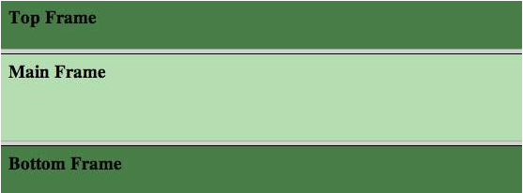
OUTPUT

Slide 121
EXAMPLE
<!DOCTYPE html>
<html>
<head>
<title>HTML Frames</title>
</head>
<frameset cols="25%,*,25%">
<frame name="left" src="/html/top_frame.htm" />
<frame name="center" src="/html/main_frame.htm" />
<frame name="right" src="/html/bottom_frame.htm" />
<noframes>

Slide 122
EXAMPLE
<body>
Your browser does not support frames.
</body>
</noframes>
</frameset>
</html>

Slide 123
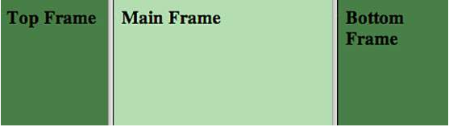
OUTPUT

Slide 124
HTML Backgrounds
By default, your webpage background is white in color. You may not like it, but no worries.
HTML provides you following two good ways to decorate your webpage background.
Html Background with Colors
Html Background with Images

Slide 125
<!DOCTYPE html>
<html>
<head>
<title>HTML Background Colors</title>
</head>
<body>
<!-- Format 1 - Use color name -->
<table bgcolor="yellow" width="100%">
<tr><td>
This background is yellow
</td></tr>
</table>

Slide 126
<!-- Format 2 - Use hex value -->
<table bgcolor="#6666FF" width="100%">
<tr><td>
This background is sky blue
</td></tr>
</table>

Slide 127
<!-- Format 3 - Use color value in RGB terms -->
<table bgcolor="rgb(255,0,255)" width="100%">
<tr><td>
This background is green
</td></tr>
</table>
</body>
</html>

Slide 128

Output

Slide 129
HTML FORM
An HTML form is a section of a document which contains controls such as text fields, password fields, checkboxes, radio buttons, submit button, menus etc.
An HTML form facilitates the user to enter data that is to be sent to the server for processing.

Slide 130
WHY USE HTML FORM
HTML forms are required if you want to collect some data from of the site visitor.
For example:
If a user want to purchase some items on internet, he/she must fill the form such as shipping address and credit/debit card details so that item can be sent to the given address.

Slide 131
HTML FORM SYNTAX
<form action="server url" method="get|post">
//input controls e.g. textfield, textarea, radiobutton, button
</form>

Slide 132
HTML TEXT FIELD CONTROL
<form>
First Name: <input type="text" name="firstname"/> <br/>
Last Name: <input type="text" name="lastname"/> <br/>
</form>

Slide 133
LABEL TAG IN FORM
It is considered better to have label in form. As it makes the code parser/browser/user friendly.
If you click on the label tag, it will focus on the text control.
To do so, you need to have for attribute in label tag that must be same as id attribute of input tag.

Slide 134
EXAMPLE
<form>
<label for="firstname">First Name: </label>
<input type="text" id="firstname" name="firstname"/> <br/>
<label for="lastname">Last Name: </label>
<input type="text" id="lastname" name="lastname"/> <br/>
</form>

Slide 135
HTML PASSWORD FIELD CONTROL
<form>
<label for="password">Password: </label>
<input type="password" id="password" name="password"/> <br/>
</form>

Slide 136
HTML 5 EMAIL FIELD CONTROL
The email field in new in HTML 5. It validates the text for correct email address. You must use @ and . in this field.
<form>
<label for="email">Email: </label>
<input type="email" id="email" name="email"/> <br/>
</form>

Slide 137
RADIO BUTTON CONTROL
The radio button is used to select one from multiple options.
It is used in gender, quiz questions etc.
If you use one name for all the radio buttons, only one radio button can be selected at a time.
<form>
<label for="gender">Gender: </label>
<input type="radio" id="gender" name="gender" value="male"/>Male <input type="radio" id="gender" name="gender" value="female"/>Female <br/>
</form>

Slide 138
CHECKBOX CONTROL
<form>
Hobby:<br>
<input type="checkbox" id="cricket" name="cricket" value="cricket"/>
<label for="cricket">Cricket</label>
<input type="checkbox" id="football" name="football" value="football"/>
<label for="football">Football</label>
<input type="checkbox" id="hockey" name="hockey" value="hockey"/>
<label for="hockey">Hockey</label>
</form>

Slide 139
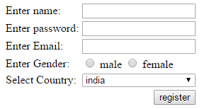
OUTPUT

Slide 140
MARQUEE HTML
The Marquee HTML tag is a non-standard HTML element .
which is used to scroll a image or text horizontally or vertically.
Marquee tag was first introduced in early versions of Microsoft's Internet Explorer. It is compared with Netscape's blink element.
<marquee>This is an example of html marquee </marquee>

Slide 141
EXAMPLE

Slide 142
DIRECTION IN HTML MARQUEE
This is used to change the direction of scrolling text.
Let's take an example of marquee scrolling to the right.
The direction can be left, right, up and down.
<marquee width="100%" direction="right">
This is an example of a right direction marquee...
</marquee>

Slide 143
HTML TEXT AREA
The HTML <text area> tag is used to define a multi-line text input control.
It can hold unlimited number of characters and the texts are displayed in a fixed-width font (usually courier).
The size of the HTML text area is defined by <cols> and <rows> attribute, or it can also be defined through CSS height and width properties.

Slide 144
EXAMPLE
<textarea rows="9" cols="70">
textarea tag example with rows and columns.
</textarea>

Slide 145
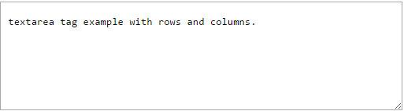
OUTPUT

Slide 146
HTML QUOTES
HTML quotes are used to put a short quotation on your website. To do so, you need to use HTML q tag and HTML blockquote tag.
HTML q tag
HTML q tag is used to put small quotation. To do so, write your text within <q>.............</q> tag.

Slide 147
EXAMPLE
p> Great quote on love and life.</p>
<p> Dr. Seuss once said :
<q>Reality is finally better than your dreams.</q></p>

Slide 148

OUTPUT

Slide 149
HTML STYLE
HTML Style is used to change or add the style on existing HTML elements.
There is a default style for every HTML
E.g. background color is white, text color is black etc.
The style attribute can by used with any HTML tag.
To apply style on HTML tag, you should have the basic knowledge of css properties
E.g. color, background-color, text-align, font-family, font-size etc.

Slide 150
HTML STYLE COLOR
<h3 style="color:green">This is Green Color</h3>
<h3 style="color:red">This is Red Color</h3>

Slide 151

OUTPUT

Slide 152
HTML STYLE BACKGROUND-COLOR
<h3 style="background-color:yellow;">This is yellow background</h3>
<h3 style="background-color:red;color:white">This is red background</h3>

Slide 153

OUTPUT

Slide 154
HTML STYLE FONT-FAMILY
<h3 style="fontfamily:times new roman">This is times new roman font family</h3>
<p style="font-family:arial">This is arial font family</p>

Slide 155

OUTPUT

Slide 156
HTML STYLE FONT-SIZE
<h3 style="font-size:200%">This is 200% h3 tag</h3>
<p style="font-size:200%">This is 200% p tag</p>

Slide 157
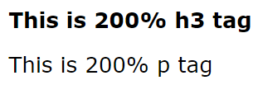
OUTPUT

Slide 158
DIV TAG
The div tag is generally used by web developers to group HTML elements together and apply CSS styles to many elements at once.
For example:
If you wrap a set of paragraph elements into a div element so you can take the advantage of CSS styles and apply font style to all paragraphs at once instead of coding the same style for each paragraph element.

Slide 159
EXAMPLE
<!DOCTYPE>
<html>
<body>
<div style="border:1px solid pink;padding:20px;font-size:20px">
<p>Welcome This is first Paragraph.</p>
<p>This is second paragraph</p>
</div>
</body>
</html>

Slide 160
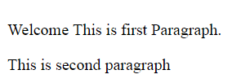
OUTPUT

Slide 161
HTML LABEL TAG
The <label> tag is used to specify a label for an <input> element.
It adds a label to a form control such as text, email, password, textarea etc.

Slide 162
EXAMPLE
<!DOCTYPE>
<html>
<body>
<label for="email">EMAIL-ID:<br /> <input type="email" value="" name="emailid" size="30"
placeholder="Enter a valid email address"><br /><br />
<label for="phone">PHONE NO:<br /> <input type="text" value="" name="phno" size="30"
maxlength="10" placeholder="Enter a valid phone number" pattern="[0-9]{10}"><br /><br />
</body>
</html>

Slide 163
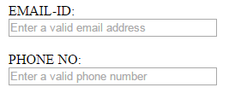
OUTPUT

Slide 164
HTML BUTTON TAG
<button name="button" type="button">Click Here</button>

Slide 165
OUTPUT

Slide 166
HR TAG
HTML <hr> tag is used to specify a paragraph-level thematic break in HTML document.
It is used when you abruptly change your topic in your HTML document.
It draw a horizontal line between them.
It is also called a Horizontal Rule in HTML.

Slide 167
EXAMPLE
<h2>HTML</h2>
<p>HTML is a language for describing web pages.</p>
<hr/>
<h2>HR Tag </h2>
<p> HR tag is used to draw a horizontal line within the texts to sepate content
<p>

Slide 168
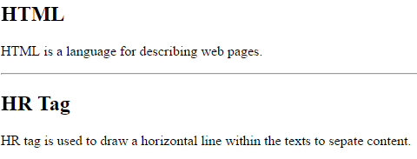
OUTPUT

Slide 169
HTML BR TAG
HTML <br> tag or element is used to break line in a paragraph.
It is generally used in poem or address where the division of line is necessary.
It is an empty tag, means it does not need a company of end tag.

Slide 170
EXAMPLE
<!DOCTYPE>
<html>
<body>
<p>If you want to break line<br>in a paragraph,<br>use the br element.</p>
</body>
</html>

Slide 171

OUTPUT

Slide 172
HTML 5
HTML5 is the next major revision of the HTML standard superseding HTML 4.01, XHTML 1.0, and XHTML 1.1. HTML5 is a standard for structuring and presenting content on the World Wide Web.
HTML5 is a cooperation between the World Wide Web Consortium (W3C) and the Web Hypertext Application Technology Working Group (WHATWG).

Slide 173
BROWSER SUPPORT
The latest versions of Apple Safari, Google Chrome, Mozilla Firefox, and Opera all support many HTML5 features and Internet Explorer 9.0 will also have support for some HTML5 functionality.
The mobile web browsers that come pre-installed on iPhones, iPads, and Android phones all have excellent support for HTML5.

Slide 174
NEW FEATURES
New Semantic Elements − These are like <header>, <footer>, and <section>.
Forms 2.0 − Improvements to HTML web forms where new attributes have been introduced for <input> tag.
Persistent Local Storage − To achieve without resorting to third-party plugins.
WebSocket − A next-generation bidirectional communication technology for web applications.
Server-Sent Events − HTML5 introduces events which flow from web server to the web browsers and they are called Server-Sent Events (SSE).

Slide 175
NEW FEATURES
Canvas − This supports a two-dimensional drawing surface that you can program with
JavaScript.
Audio & Video − You can embed audio or video on your webpages without resorting to third-party plugins.
Geolocation − Now visitors can choose to share their physical location with your web application.
Microdata − This lets you create your own vocabularies beyond HTML5 and extend your web pages with custom semantics.
Drag and drop − Drag and drop the items from one location to another location on the same webpage.

Slide 176
HTML5 - Attributes
Elements may contain attributes that are used to set various properties of an element.
Attributes may only be specified within start tags and must never be used in end tags.
Ex: <div class = "example">...</div>
Custom Attributes
A custom data attribute starts with data- and would be named based on your requirement.
Ex: <div class = "example" data-subject = "physics" data-level = "complex"> ... </div>
<div class = "example" data-subject = "physics" data-level = "complex"> ... </div>

Slide 177
HTML5 - EVENTS
They perform various activities such as clicking on text and images and links, hover over defined elements, etc.
These are examples of what JavaScript calls events.
set of attributes to trigger any javascript or vbscript code given as value, when there is any event that takes place for any HTML5 element.
Ex:Onclick,Onfocus,Ondrop

Slide 178
HTML5 - Web Forms 2.0
The <input> element in HTML5
Date time
Date timelocal
Date
Month
Week
Time
Number
Range
Email
url

Slide 179
HTML5 - DATETIME
A date and time (year, month, day, hour, minute, second, fractions of a second) encoded according to ISO 8601 with the time zone set to UTC.
<!DOCTYPE HTML>
<html>
<body>
<form action = "/cgi-bin/html5.cgi" method = "get">
Date and Time : <input type = "datetime" name = "newinput" />
<input type = "submit" value = "submit" /> </form>
</body>
</html>

Slide 180
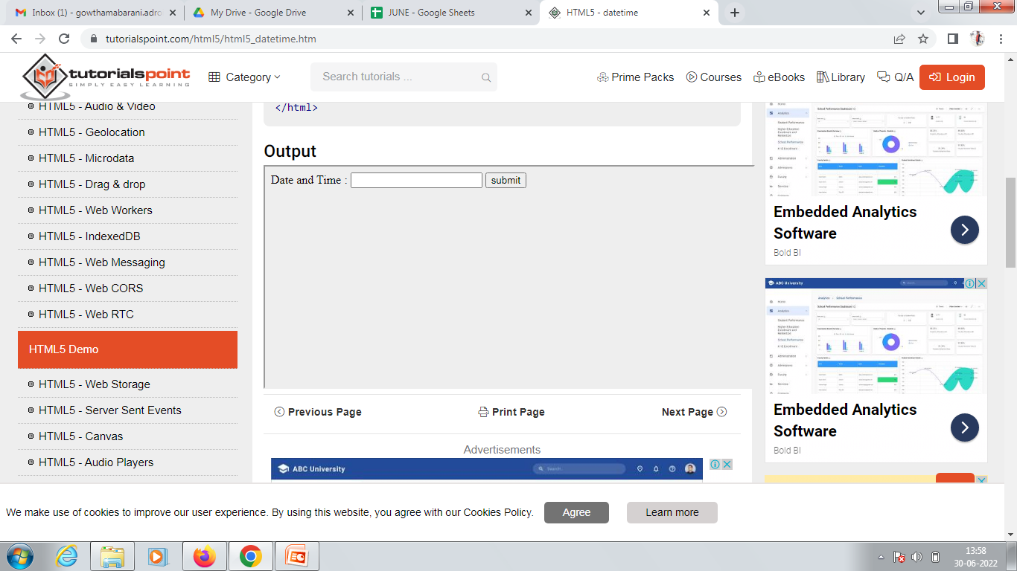
OUTPUT

Slide 181
HTML5 - Web Forms 2.0
HTML5 introduced a new element <output>.
which is used to represent the result of different types of output, such as output written by a script.

Slide 182
EXAMPLE
<!DOCTYPE HTML>
<html> <head>
<script type = "text/javascript">
function showResult() {
x = document.forms["myform"]["newinput"].value; document.forms["myform"]["result"].value = x; } </script>
</head>
<body>

Slide 183
EXAMPLE
<form action = "/cgi-bin/html5.cgi" method = "get" name = "myform">
Enter a value : <input type = "text" name = "newinput" />
<input type = "button" value = "Result" onclick = "showResult();" />
<output name = "result"></output> </form>
</body>
</html>

Slide 184
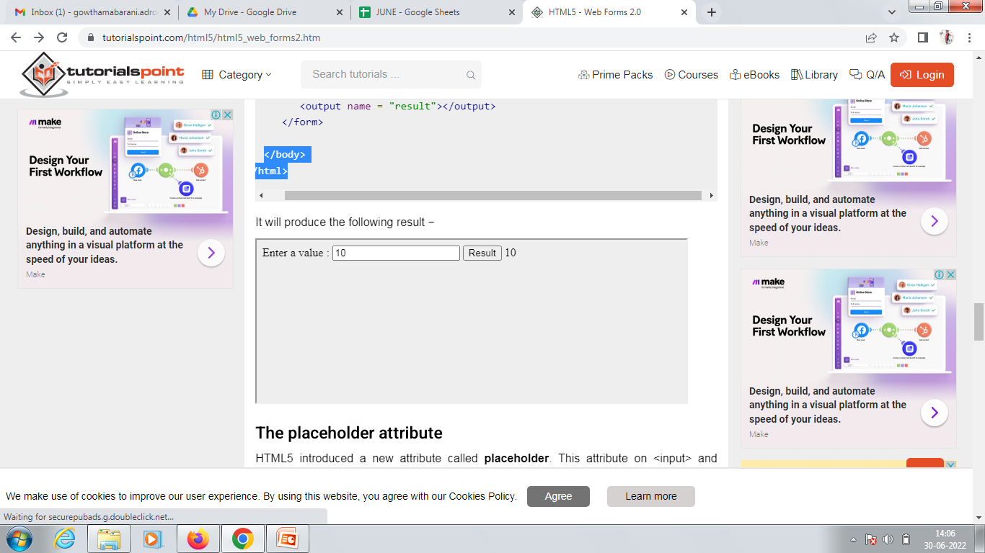
OUTPUT

Slide 185
HTML SCRIPT TAG
HTML script tag is used to specify client-side script such as JavaScript. It facilitate you to place a script within your HTML document.
JavaScript is used for image manipulation, form validation, and dynamic content.

Slide 186
EXAMPLE
<html>
<body>
<script type="text/javascript">
document.write("JavaScript is a simple language for new learners");
</script>
</body>
</html>

Slide 187

OUTPUT

Slide 188
HTML AUDIO TAG
HTML audio tag is used to define sounds such as music and other audio clips. Currently there are three supported file format for HTML 5 audio tag.
mp3
wav
ogg
HTML5 supports <video> and <audio> controls. The Flash, Silverlight and similar technologies are used to play the multimedia items.

Slide 189
EXAMPLE
<!DOCTYPE>
<html>
<body>
<audio controls>
<source src="koyal.mp3" type="audio/mpeg">
Your browser does not support the html audio tag.
</audio>
</body>
</html>

Slide 190

OUTPUT

Slide 191
HTML VIDEO TAG
HTML 5 supports <video> tag also. The HTML video tag is used for streaming video files such as a movie clip, song clip on the web page.
Currently, there are three video formats supported for HTML video tag:
mp4
webM
ogg

Slide 192
EXAMPLE
<!DOCTYPE>
<html>
<body>
<video controls>
<source src="movie.mp4" type="video/mp4">
Your browser does not support the html video tag.
</video>
</body>
</html>

Slide 193
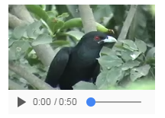
OUTPUT

Slide 194
HTML PROGRESS TAG
HTML <progress> tag is used to display the progress of a task.
It provides an easy way for web developers to create progress bar on the website.
It is mostly used to show the progress of a file uploading on the web page.

Slide 195
EXAMPLE
<!DOCTYPE>
<html>
<body>
<progress></progress>
</body>
</html>

Slide 196

OUTPUT

Slide 197
EXAMPLE
<!DOCTYPE>
<html>
<body>
Downloading progress:
<progress value="43" max="100"></progress>
</body>
</html>

Slide 198
OUTPUT

Slide 199
HTML METER TAG
HTML <meter> tag is used to measure data within a given range.
It defines a scalar measurement with range. It is also known as a gause.
It should be used to display disk usage, voting population etc.

Slide 200
EXAMPLE
<!DOCTYPE html>
<html>
<body>
<p>Display a gauge:</p>
<meter value="30" min="1" max="100">30 out of 100</meter><br>
<meter value="0.8">80%</meter>
</body>
</html>

Slide 201

OUTPUT

Slide 202
HTML TIME TAG
HTML <time> tag is used to define date and time. It displays time value in a 24 hour clock or a precise date in a Gregorian calendar in HTML.
It is used to encode dates and times in a machine-readable way to make easy to mark or schedule your task.
HTML <time> is a new tag and introduced in HTML5.

Slide 203
EXAMPLE
<!DOCTYPE>
<html>
<body>
<p>We open our shop at <time>09:00</time> am.</p>
<p>The business meeting is scheduled on <time datetime="2009-02-18">next wednesday</time>.</p>
<p>The wedding of Salman's sister was scheduled at <time datetime="2014-11-19 T0 7:00-09:00">7pm last wednesday </time>.</p>
</body>
</html>

Slide 204

OUTPUT

Slide 205
HTML CANVAS TAG
The HTML canvas element provides HTML a bitmapped surface to work with.
The HTML 5 <canvas> tag is used to draw graphics using scripting language like JavaScript.
The <canvas> element is only a container for graphics, you must need a scripting language to draw the graphics.
The <canvas> element allows for dynamic and scriptable rendering of 2D shapes and bitmap images.

Slide 206
It is a low level, procedural model that updates a bitmap and does not have a built-in scene.
There are several methods in canvas to draw paths, boxes, circles, text and add images.

Slide 207
EXAMPLE
<!DOCTYPE>
<html>
<body>
<canvas id="myCanvas" width="300" height="200" style="border:2px solid;">
Your browser does not support the HTML5 canvas tag.
</canvas>
</body>
</html>

Slide 208

OUTPUT

Slide 209
HTML CANVAS TAG WITH JAVASCRIPT
A canvas is a two dimensional grid.
Coordinates (0,0) defines the upper left corner of the canvas.
The parameters (0,0,200,100) is used for fillRect() method.
This parameter will fill the rectangle start with the upper-left corner (0,0) and draw a 200 * 100 rectangle.

Slide 210
EXAMPLE
<canvas id="myCanvas" width="250" height="150" style="border:1px solid #c3c3c3;">
Your browser does not support the HTML5 canvas tag.
</canvas>
<script>
var c = document.getElementById("myCanvas");
var cctx = c.getContext("2d");
ctx.fillStyle = "#FF0000";
ctx.fillRect(0,0,200,100);
</script>

Slide 211

OUTPUT

Slide 212
DRAWING LINE ON CANVAS
If you want to draw a straight line on the canvas, you can use the following two methods.
moveTo(x,y): It is used to define the starting point of the line.
lineTo(x,y): It is used to define the ending point of the line.
If you draw a line which starting point is (0,0) and the end point is (200,100), use the stroke method to draw the line.

Slide 213
EXAMPLE
<canvas id="myCanvasLine" width="200" height="100" style="border:1px solid #d3d3d3;">
Your browser does not support the HTML5 canvas tag.</canvas>
<script>
var c = document.getElementById("myCanvasLine");
var cctx = c.getContext("2d");
ctx.moveTo(0,0);
ctx.lineTo(200,100);
ctx.stroke();
</script>

Slide 214
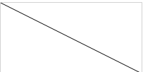
OUTPUT

Slide 215
DRAWING CIRCLE ON CANVAS
If you want to draw a circle on the canvas, you can use the arc() method:
arc(x, y, r, start, stop)
To sketch circle on HTML canvas, use one of the ink() methods, like stroke() or fill().

Slide 216
EXAMPLE
<canvas id="myCanvasCircle" width="200" height="100" style="border:1px solid #d3d3d3;">
Your browser does not support the HTML5 canvas tag.</canvas>
<script>
var c = document.getElementById("myCanvasCircle");
var cctx = c.getContext("2d");
ctx.beginPath();
ctx.arc(95,50,40,0,2*Math.PI);
ctx.stroke();
</script>

Slide 217
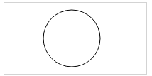
OUTPUT

Slide 218
HTML SVG
The HTML SVG is an acronym which stands for Scalable Vector Graphics.
HTML SVG is a modularized language which is used to describe graphics in XML.
It describe two-dimensional vector and mixed vector/raster graphics in XML.
It is a W3C recommendation. SVG images and their behaviours are defined in XML text files.
So as XML files, you can create and edit an SVG image with text editor, but generally drawing programs like linkspace are preferred to create it.

Slide 219
SVG is mostly used for vector type diagrams like pie charts, 2-Dimensional graphs in an X,Y coordinate system etc.
The <svg> element specifies the root of a SVG fragment. You can animate every element and every attribute in SVG files.

Slide 220
EXAMPLE
<!DOCTYPE html>
<html>
<body>
<svg width="100" height="100">
<circle cx="50" cy="50" r="40" stroke="yellow" stroke-width="4" fill="red" />
</svg>
</body>
</html>

Slide 221

OUTPUT

Slide 222
HTML SVG RECTANGLE
<!DOCTYPE html>
<html>
<body>
<svg width="200" height="100">
<rect width="200" height="100" stroke="yellow" stroke-width="4" fill="red" />
</svg>
</body>
</html>

Slide 223

OUTPUT

Slide 224
HTML SVG polygon
<!DOCTYPE html>
<html>
<body>
<svg height="210" width="500">
<polygon points="100,10 40,198 190,78 10,78 160,198"
style="fill:red;stroke:yellow;stroke-width:5;fill-rule:nonzero;" />
</svg>
</body>
</html>

Slide 225

OUTPUT

Slide 226
HTML5 - WEB SQL DATABASE
The Web SQL Database API isn't actually part of the HTML5 specification but it is a separate specification which introduces a set of APIs to manipulate client-side databases using SQL.
The Core Methods
openDatabase − This method creates the database object either using existing database or creating new one.
transaction − This method gives us the ability to control a transaction and performing either commit or rollback based on the situation.
executeSql − This method is used to execute actual SQL query.

Slide 227
OPENING DATABASE
The openDatabase method takes care of opening a database if it already exists, this method will create it if it already does not exist.
To create and open a database:
var db = openDatabase('mydb', '1.0', 'Test DB', 2 * 1024 * 1024);

Slide 228
The above method took the following five parameters −
Database name
Version number
Text description
Size of database
Creation callback
The last and 5th argument, creation callback will be called if the database is being created.

Slide 229
EXECUTING QUERIES
To execute a query you use the database.transaction() function. This function needs a single argument,
var db = openDatabase('mydb', '1.0', 'Test DB', 2 * 1024 * 1024);
db.transaction(function (tx) {
tx.executeSql('CREATE TABLE IF NOT EXISTS LOGS (id unique, log)');
});

Slide 230
INSERT OPERATION
To create enteries into the table we add simple SQL query.
var db = openDatabase('mydb', '1.0', 'Test DB', 2 * 1024 * 1024);
db.transaction(function (tx) {
tx.executeSql('CREATE TABLE IF NOT EXISTS LOGS (id unique, log)'); tx.executeSql('INSERT INTO LOGS (id, log) VALUES (1, "foobar")'); tx.executeSql('INSERT INTO LOGS (id, log) VALUES (2, "logmsg")');
});

Slide 231
READ OPERATION
var db = openDatabase('mydb', '1.0', 'Test DB', 2 * 1024 * 1024);
db.transaction(function (tx) {
tx.executeSql('CREATE TABLE IF NOT EXISTS LOGS (id unique, log)'); tx.executeSql('INSERT INTO LOGS (id, log) VALUES (1, "foobar")'); tx.executeSql('INSERT INTO LOGS (id, log) VALUES (2, "logmsg")'); }); db.transaction(function (tx) {
tx.executeSql('SELECT * FROM LOGS', [], function (tx, results) {
var len = results.rows.length, i;
msg = "<p>Found rows: " + len + "</p>"; document.querySelector('#status').innerHTML += msg;
for (i = 0; i < len; i++) {
alert(results.rows.item(i).log );
} }, null);
});

Slide 232
EXAMPLE
<!DOCTYPE HTML>
<html>
<head>
<script type = "text/javascript">
var db = openDatabase('mydb', '1.0', 'Test DB', 2 * 1024 * 1024);
var msg;
db.transaction(function (tx) {
tx.executeSql('CREATE TABLE IF NOT EXISTS LOGS (id unique, log)'); tx.executeSql('INSERT INTO LOGS (id, log) VALUES (1, "foobar")'); tx.executeSql('INSERT INTO LOGS (id, log) VALUES (2, "logmsg")');
msg = '<p>Log message created and row inserted.</p>'; document.querySelector('#status').innerHTML = msg;
})

Slide 233
db.transaction(function (tx) {
tx.executeSql('SELECT * FROM LOGS', [], function (tx, results) {
var len = results.rows.length, i;
msg = "<p>Found rows: " + len + "</p>"; document.querySelector('#status').innerHTML += msg;
for (i = 0; i < len; i++) {
msg = "<p><b>" + results.rows.item(i).log + "</b></p>"; document.querySelector('#status').innerHTML += msg;
}
}, null);
});

Slide 234
</script>
</head>
<body>
<div id = "status" name = "status">Status Message</div>
</body>
</html>

Slide 235
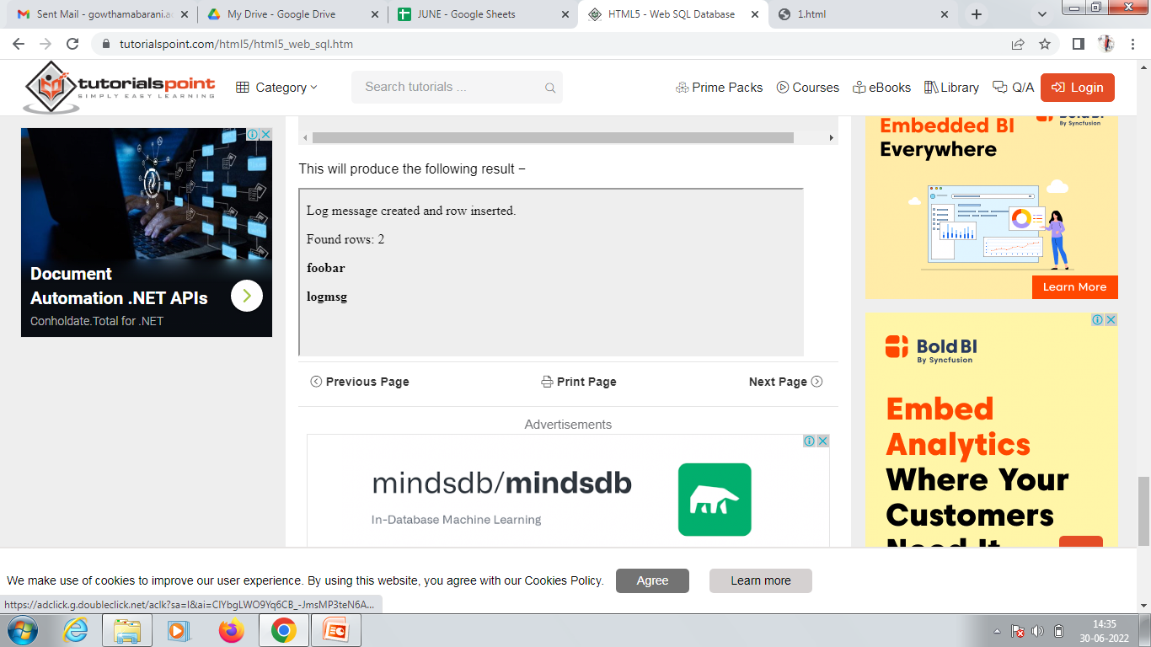

Slide 236


Slide 237


