Slide 1
Distributed System
Why distributed systems?
Centralized vs. Distributed computing
Examples of distributed systems
Characteristics
Middleware
Transparency
Issues & challenges
Conclusion

Slide 2
Distributed Systems

Slide 3
Distributed System
A distributed system is a collection of autonomous hosts that are connected through a computer network.
Each host executes components and operates a distribution middleware.
Middleware enables the components to coordinate their activities.
Users perceive the system as a single, integrated computing facility.

Slide 4
ARCHITECTURE
○
Distributed programming typically falls into one of several basic architectures Client-server, 3-tier architecture and N-tier architecture
○ Client-server — Smart client code contacts the server for data, then formats and displays it to the user. Input at the client is committed back to the server when it represents a permanent change.
○ 3-tier architecture — Three tier systems move the client intelligence to a middle tier so that stateless clients can be used. This simplifies application deployment.
○ N-tier architecture — N-Tier refers typically to web applications which further forward their requests to other enterprise services. This type of application is the one most responsible for the success of application servers.

Slide 5
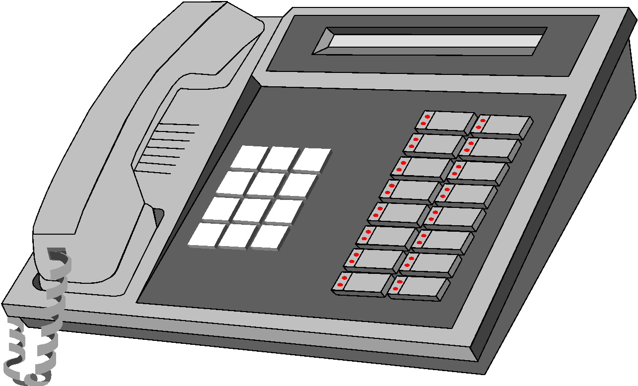
Why Distributed Systems?
Every application is part of your business model
must make them work together!
Payables/ Receivables
Sales
Accounting
Manufacturing
Inventory
Shipping/ Receiving
Engineering

Slide 6
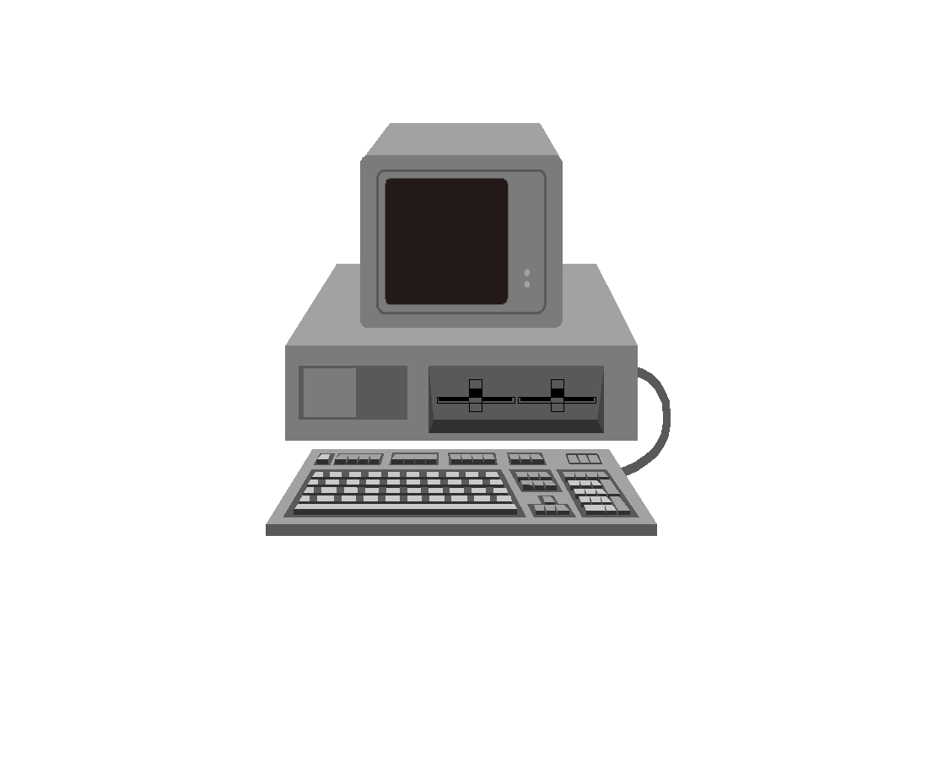
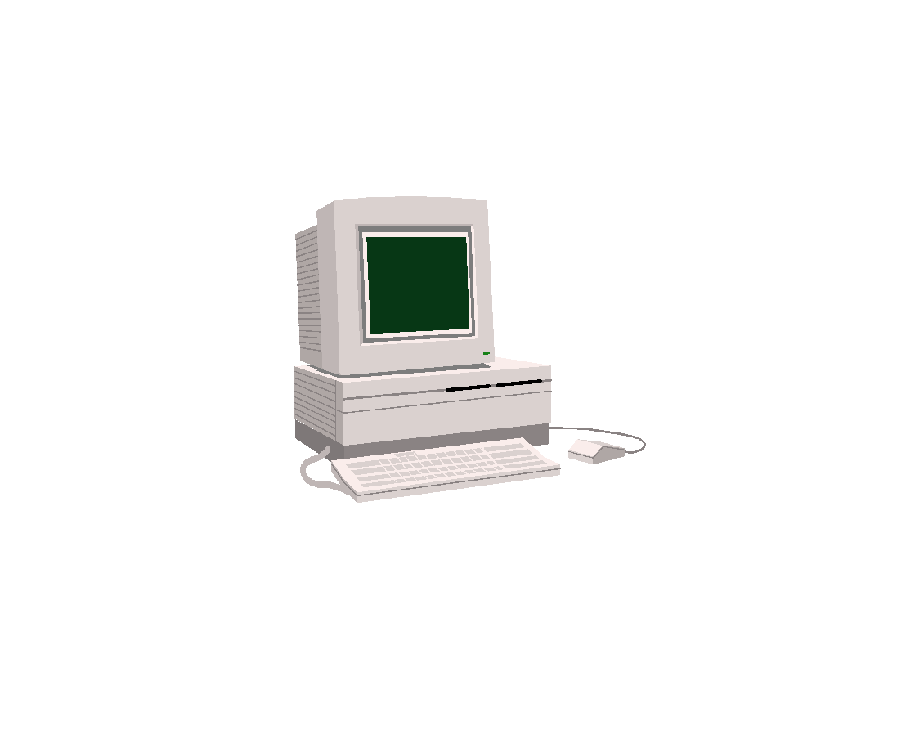
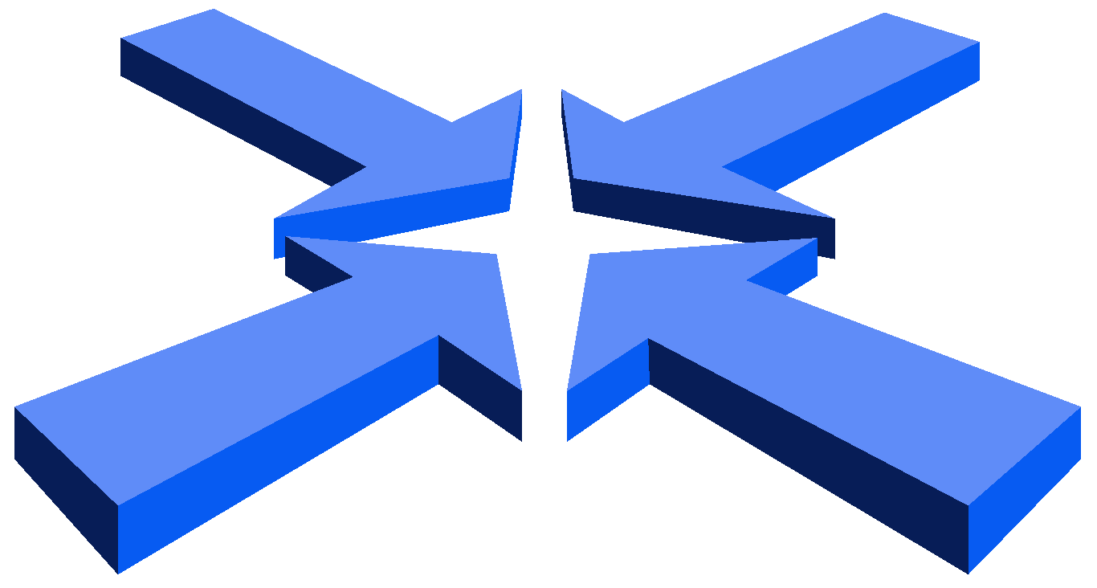
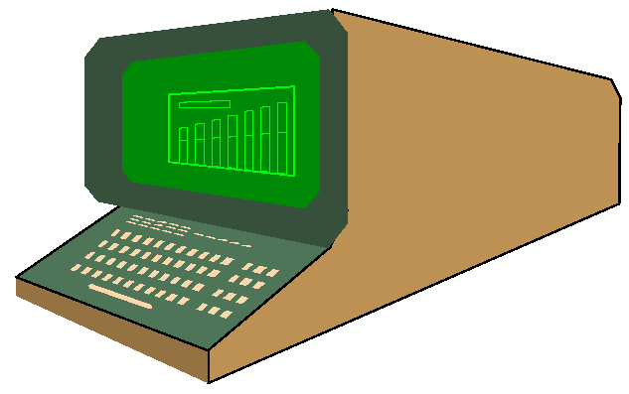
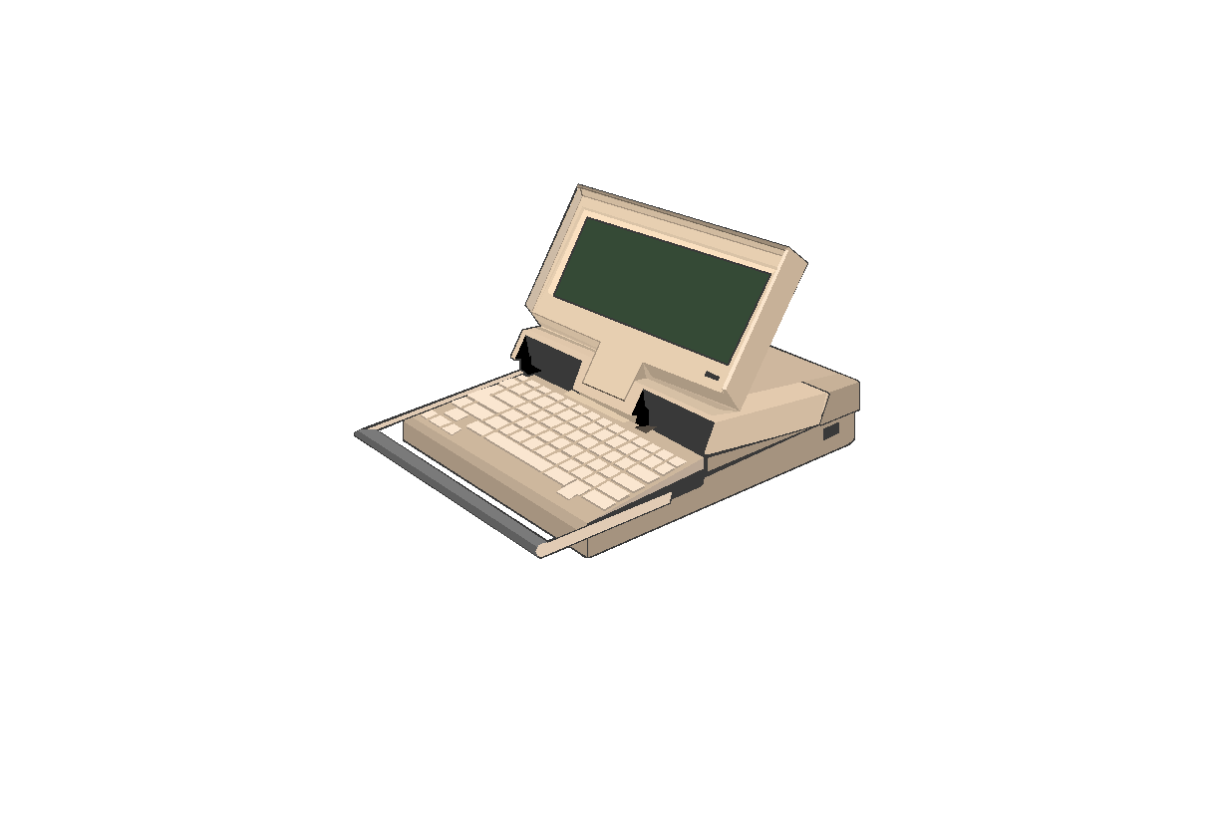
Why Distributed Systems?
Application Integration and Distributed Processing are the same thing
Constructing information-sharing distributed systems from diverse sources:
heterogeneous
networked
physically disparate
multi-vendor

Slide 7
CENTRALIZED VS. DISTRIBUTED COMPUTING
w o r k s t a t io n
n e t w o r k lin k
n e t w o r k h o s t
d i s t r i b u t e d c o m p u t i n g
t e r m in a l
m a in f r a m e c o m p u t e r
c e n t r a l i z e d c o m p u t i n g

Slide 8
CENTRALIZED VS. DISTRIBUTED COMPUTING
Centralized computing
Distributed computing
Early computing was performed on a single processor. Uni processor computing can be called Centralized computing.
A Distributed system is a collection of independent computers, interconnected via a network, capable of collaborating on a task.

Slide 9
Centralized vs Distributed Systems
Centralized Systems
Centralized systems have non-autonomous components
Centralized systems are often build using homogeneous technology
Multiple users share the resources of a centralized system at all times
Centralized systems have a single point of control and of failure
Distributed Systems
Distributed systems have autonomous components
Distributed systems may be built using heterogeneous technology
Distributed system components may be used exclusively
Distributed systems are executed in concurrent processes
Distributed systems have multiple points of failure

Slide 10
Advantages of Distributed Systems over Centralized Systems
Why do we develop distributed systems?
availability of powerful yet cheap microprocessors (PCs, workstations), continuing advances in communication technology
Economics: a collection of microprocessors offer a better price/performance than mainframes. Low price/performance ratio: cost effective way to increase computing power.
Speed: a distributed system may have more total computing power than a mainframe.
Reliability: If one machine crashes, the system as a whole can still survive. Higher availability and improved reliability.
Incremental growth: Computing power can be added in small increments. Modular expandability
Another deriving force: the existence of large number of personal computers, the need for people to collaborate and share information.

Slide 11
Examples of Distributed Systems
IT Service Architecture of a Bank
Service architecture consists of heterogeneous components.
Hardware platforms range from mainframes to NTs
Programming languages including Assembler, Cobol, C, C++, Java, …
middleware can be used to resolve distribution and heterogeneity
Authorization Services
Customer Information Services
Trading Services
ATM Services

Slide 12
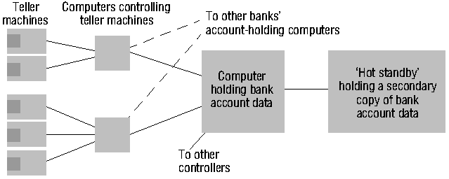
AUTOMATIC TELLER MACHINE NETWORK

Slide 13
Distributed System Characteristics
To present a single-system image:
Hide internal organization, communication details
Provide uniform interface
Easily expandable
Adding new computers is hidden from users
Continuous availability
Failures in one component can be covered by other components
Supported by middleware

Slide 14
Middleware :- INTERFACE
Variety and differences in
Networks
Computer hardware
Operating systems
Programming languages
Implementations by different developers
Middleware as software layers to provide a programming abstraction as well as masking the heterogeneity of the underlying networks, hardware, OS, and programming languages (e.g., CORBA).
Mobile Code to refer to code that can be sent from one computer to another and run at the destination (e.g., Java applets and Java virtual machine).

Slide 15
Middleware Examples
CORBA (Common Object Request Broker Architecture)- OMG
DCOM (Distributed Component Object Management)
Sun’s ONC RPC (Open Network Computing Remote Procedure Call)
RMI (Remote Method Invocation)
SOAP (Simple Object Access Protocol)

Slide 16
Middleware Examples
All of the previous examples support communication across a network:
They provide protocols that allow a program running on one kind of computer, using one kind of operating system, to call a program running on another computer with a different operating system
The communicating programs must be running the same middleware.

Slide 17
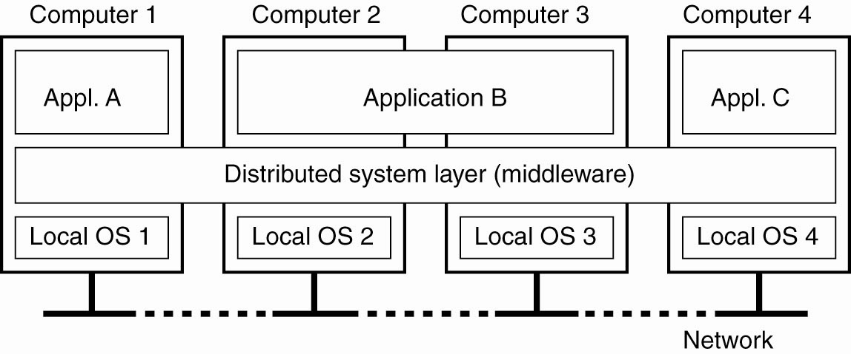
Definition of a Distributed System
A distributed system organized as middleware. The middleware layer runs on all machines, and offers a uniform interface to the system

Slide 18
What Is a Distributed System?
Component-1
…
Component-n
Component-1
…
Component-n
Middleware
Middleware
Network OS
Network OS
Hardware
Hardware
Host-1
Host-2
Network
Component-1
…
Component-n
Component-1
…
Component-n
Middleware
Middleware
Network OS
Network OS
Hardware
Hardware
Host-n
Host-3

Slide 19
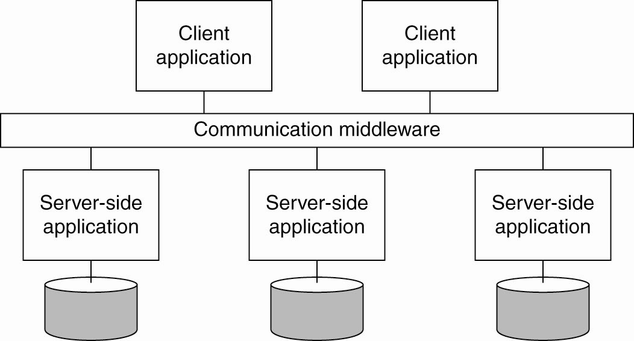
Enterprise Application Integration
Middleware as a communication facilitator in enterprise application integration.

Slide 20












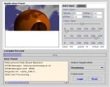

Agent
Agent
Cooperation
Agent
Cooperation
Distribution
Distribution
Cooperation
Distribution
Internet
Agent
Subscription
Distribution
Job Request
Resource Management
Large-scale Application

Slide 21
Transparency in Distributed Systems
○ Transparency:-
make certain aspects of distribution are invisible to the application programmer ; focus on design of their particular application.
They not concern the locations and details of how it operate, either replicated or migrated.
Failures can be presented to application programmers in the form of exceptions – must be handled.
Dimensions of transparency in DS
Access Transparency
Location Transparency
Migration Transparency
Replication Transparency
Concurrency Transparency
Scalability Transparency
Performance Transparency
Failure Transparency
Notes:
Access transparency means that the interfaces for local and remote communication are the same (Unix networked file systems)
Location transparency means that service requesters do not need to know physical component locations (NFS in unix environment, we don’t need to the ip address).
Migration transparency means that the component can be relocated without users or clients noticing it. It depends on both access and location transparency.
Replication transparency means the users and programmers do not know whether a replica or a master provides a service (a replica is a component copy that remains synchronized with its original.) Example: video-on-demand. It depends on access and location transparency
Concurrency transparency means that users and programmers are unaware that components request services concurrently. (Bank application is an example)
Scalability transparency means that users and programmers do not know how scalability of a distributed system is achieved. (The Internet is an example). It depends on replication and migration transparency.
Performance transparency means that users and programmers are unaware how good system performance is maintained. (Example: distributed version of make). It depends on replication and migration transparency.
Failure transparency means that users and programmers are unaware of how distributed systems conceal failures. It depends on concurrency and replication transparency. (Example: banking applications)

Slide 22
Types of transparency
Location Transparency: users cannot tell where hardware and software resources such as CPUs, printers, files, data bases are located.
Migration Transparency: resources must be free to move from one location to another without their names changed. E.g., /usr/lee, /central/usr/lee
Replication Transparency: OS can make additional copies of files and resources without users noticing.
Concurrency Transparency: The users are not aware of the existence of other users. Need to allow multiple users to concurrently access the same resource. Lock and unlock for mutual exclusion.
Parallelism Transparency: Automatic use of parallelism without having to program explicitly. The holy grail for distributed and parallel system designers.
Access transparency: enables local and remote resources to be accessed using identical operations.
Failure transparency: enables the concealment of faults, allowing users and application programs to complete their tasks despite the failure of hardware or software components.
Mobility transparency: allows the movement of resources and clients within a system without affecting the operation of users or programs.
Performance transparency: allows the system to be reconfigured to improve performance as loads vary.
Scaling transparency: allows the system and applications to expand in scale without change to the system structure or the application algorithms.

Slide 23
Communication Networks
Computers are connected through a communication network
Wide Area Networks (WAN) connect computers spread over a wide geographic area point-to-point or store-and-forward -- data is transferred between computers through a series of switches switch -- a special purpose computer responsible for routing data (to avoid network congestion) data can be lost due to: switch crashes, communication link failures, limited buffers at switches, transmission errors, etc.

Slide 24
ISSUES & CHALLENGES
○ Heterogeneity of components :-
Variety or differences that apply to computer hardware, network, OS, programming language and implementations by different developers.
All differences in representation must be deal with if to do message exchange.
Example : different call for exchange message in UNIX different from Windows.
○ Openness:-
System can be extended and re-implemented in various ways.
Cannot be achieved unless the specification and documentation are made available to software developer.
The most challenge to designer is to tackle the complexity of distributed system; design by different people.

Slide 25
○ Security:-
Security for information resources in distributed system have 3 components :
Confidentiality : protection against disclosure to unauthorized individuals.
Integrity : protection against alteration/corruption
Availability : protection against interference with the means to access the resources.
The challenge is to send sensitive information over Internet in a secure manner and to identify a remote user or other agent correctly.

Slide 26
Scalability :-
○
Distributed computing operates at many different scales, ranging from small Intranet to Internet.
A system is scalable if there is significant increase in the number of resources and users.
The challenges is :
controlling the cost of physical resources.
controlling the performance loss.
preventing software resource running out.
avoiding performance bottlenecks.

Slide 27
○ Failure Handling :-
Failures in a distributed system are partial – some components fail while others can function.
That’s why handling the failures are difficult
Detecting failures : to manage the presence of failures cannot be detected but may be suspected.
Masking failures : hiding failure not guaranteed in the worst case.
○ Concurrency :-
Where applications/services process concurrency, it will effect a conflict in operations with one another and produce inconsistence results.
Each resource must be designed to be safe in a concurrent environment.

Slide 28
CONCLUSION
○ The concept of distributed computing is the most efficient way to achieve the optimization.
○ Distributed computing is anywhere : intranet, Internet or mobile ubiquitous computing.
○ It deals with hardware and software systems, that contain more than one processing / storage and run in concurrently.
○ Main motivation factor is resource sharing; such as files , printers, web pages or database records.
○ Grid computing and cloud computing are form of distributed computing.

