Slide 1
Introducing SQL Into the Application
Data Management: SQL helps in organizing large amounts of data, making it easy to store, access, and modify.
Business Decisions: SQL allows businesses to analyze data, generate reports, and make informed decisions.
Universal: SQL is widely used across different industries and is a foundational tool for anyone working with databases.

Slide 2
Interactive vs. Non-Interactive SQL
Interactive SQL: SQL statements input from terminal; DBMS outputs to screen
Inadequate for most uses
It may be necessary to process the data before output
Amount of data returned not known in advance
SQL has very limited expressive power
Non-interactive SQL: SQL statements are included in an application program written in a host language, like Java, Python, and .NET Languages
2

Slide 3
Introducing SQL Into the Application
SQL statements can be incorporated into an application program in two different ways:
Statement Level Interface (SLI): Application program is a mixture of host language statements and SQL statements and directives
Call Level Interface (CLI): Application program is written entirely in host language
SQL statements are values of string variables that are passed as arguments to host language (library) procedures
3

Slide 4
Statement Level Interface
SQL statements and directives in the application have a special syntax that sets them off from host language constructs
e.g., EXEC SQL SQL_statement
Precompiler scans program and translates SQL statements into calls to host language library procedures that communicate with DBMS
Host language compiler then compiles program
4

Slide 5
Statement Level Interface
SQL constructs in an application take two forms:
Standard SQL statements (static or embedded SQL): Useful when SQL portion of program is known at compile time
Directives (dynamic SQL): Useful when SQL portion of program not known at compile time. Application constructs SQL statements at run time as values of host language variables that are manipulated by directives
Precompiler translates statements and directives into arguments of calls to library procedures.
5

Slide 6
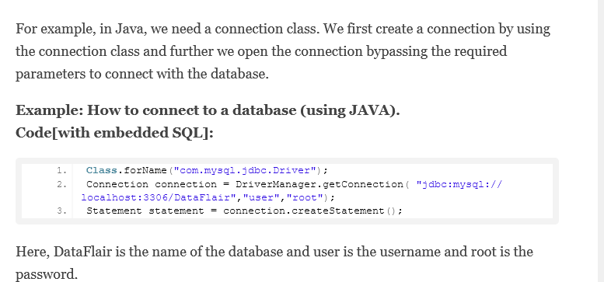
Static or Embedded SQL are SQL statements in an application that do not change at runtime and, therefore, can be hard-coded into the application.
/ SQL query is static (hard-coded into the program)
String sqlQuery = "SELECT id, name, age FROM employees";
6

Slide 7
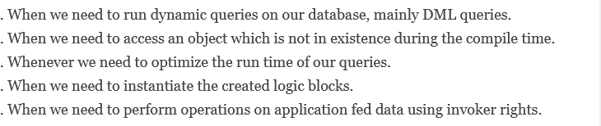
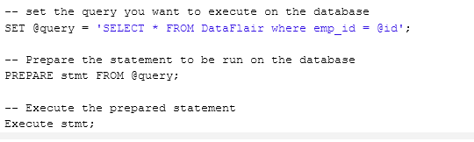
Dynamic SQL
7

Slide 8
// Using Scanner to get user input for dynamic SQL
Scanner scanner = new Scanner(System.in);
// Ask the user for a filter (e.g., age) to use in the query
System.out.print("Enter minimum age to filter: ");
int minAge = scanner.nextInt();
// Building the dynamic SQL query based on user input
String sqlQuery = "SELECT id, name, age FROM employees WHERE age >= " + minAge;

Slide 9
Call Level Interface
Application program written entirely in host language (no precompiler)
Examples: JDBC, ODBC
SQL statements are values of string variables constructed at run time using host language
Similar to dynamic SQL
Application uses string variables as arguments of library routines that communicate with DBMS
e.g. executeQuery(“SQL query statement”)
9

Slide 10
Dynamic SQL
Problem: Application might not know in advance:
The SQL statement to be executed
The database schema to which the statement is directed
Example: User inputs database name and SQL statement interactively from terminal
In general, application constructs (as the value of a host language string variable) the SQL statement at run time
Preparation (necessarily) done at run time
10

Slide 11
JDBC
Call-level interface (CLI) for executing SQL from a Java program
SQL statement is constructed at run time as the value of a Java variable (as in dynamic SQL)
JDBC passes SQL statements to the underlying DBMS. Can be interfaced to any DBMS that has a JDBC driver
11

Slide 12
JDBC: SQL Function Calls for Java Programming
Connection object
Statement object has two subclasses:
PreparedStatement and CallableStatement
Question mark (?) symbol
Represents a statement parameter
Determined at runtime
ResultSet object
Holds results of query

Slide 13
SQLJ: Embedding SQL Commands in Java
Provides a way to integrate SQL with Java similar to how embedded SQL combines SQL with high−level languages.
Acts as a simpler and easier−to−use alternative to JDBC (Java Database Connectivity).
Developers must utilize an SQLJ translator to use SQLJ, which transforms SQL statements into Java code that can be run using the JDBC interface.
SQLJ also requires importing specific classes, such as java.sql, for database connectivity
Example
This example will show how the SQLJ query is written to insert a value into the database.
#sql [ctx] { INSERT INTO employee (ID, NAME, AGE, SALARY) VALUES (:id, :name, :age, :salary) };

Slide 14
Database Stored Procedures and SQL/PSM
Stored procedures
Program modules stored by the DBMS at the database server
Can be functions or procedures
SQL/PSM (SQL/Persistent Stored Modules)
Extensions to SQL
Include general-purpose programming constructs in SQL

Slide 15
Database Stored Procedures and Functions
Persistent stored modules
Stored persistently by the DBMS
Useful:
When database program is needed by several applications
To reduce data transfer and communication cost between client and server in certain situations
To enhance modeling power provided by views by allowing more complex types of derived data

Slide 16
Database Stored Procedures and Functions (cont’d.)
Declaring stored procedures:
CREATE PROCEDURE <procedure name> (<parameters>)
<local declarations>
<procedure body> ;
declaring a function, a return type is necessary, so the declaration form is
CREATE FUNCTION <function name> (<parameters>)
RETURNS <return type>
<local declarations>
<function body> ;

Slide 17
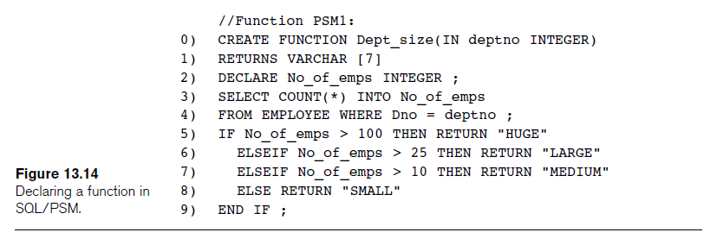
SQL/PSM (cont’d.)

Slide 18
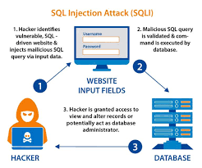
SQL injection is a serious security vulnerability that allows attackers to manipulate SQL queries by injecting malicious SQL code through user inputs, potentially compromising the integrity of your database and application. The best way to prevent SQL injection is to ensure that user inputs are never directly inserted into SQL queries. Instead, use secure methods like prepared statements, parameterized queries, and other best practices to prevent unauthorized access and manipulation of data.
18

