Slide 1

Planning Analysis & Optimization of Supply Chain at Optimus Fulfill
SUBMITTED BY:
Brity Jain(1001627912)
Deep Shah(1001387906)
Aishan Sharma(1001667734)
Dhairya Shah(1001508357)

Slide 2
INTRODUCTION
Optimus Fulfill is one of the multinational CPG firms focusing on the supply chain of food processing over a decade. It is one of the producer of Texas Tea in Texas with revenue of $5-$30M.
The aim of this project is to identify the problems faced by the company in their supply chain and recommending them new strategies and methodologies to overcome that problems.
All the relevant data like production logs, previous sales data, master product list and manufacturing formulas of the product were analyzed.
While coming up with new methodologies all the key assumptions recommended by references have been duly taken into consideration.
The new recommendation touches upon the most important issues like Inventory management and Facility Planning.

Slide 3
Issues Addressed
Not keeping up with the production.
Raw material Stockouts
Higher downtimes
Improper storage strategy
Improper Inventory Planning
Loads of wastage
Improper Production Plan
Space utilization
Poor Sales & Operations Planning
Lost Orders
Apart from this, the industry faces various unique challenges from long raw material lead-times to safety and quality requirements combined with high demand uncertainty, perishability and complex manufacturing constraints.

Slide 4
METHODOLOGY
Understanding current supply chain
Value Stream Mapping
Facility Modelling
Materials Management
Integrating Processes Using Aggregate Planning
IT Applications

Slide 5
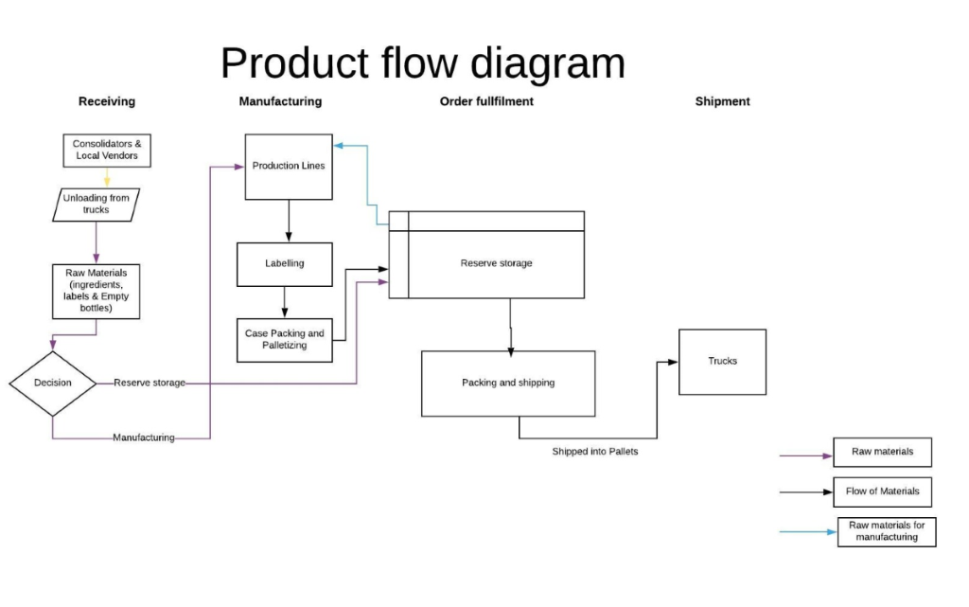
Understanding Current Supply Chain
This is graphic representation of the physical route or flow of materials associated with a process and procedure plan.

Slide 6
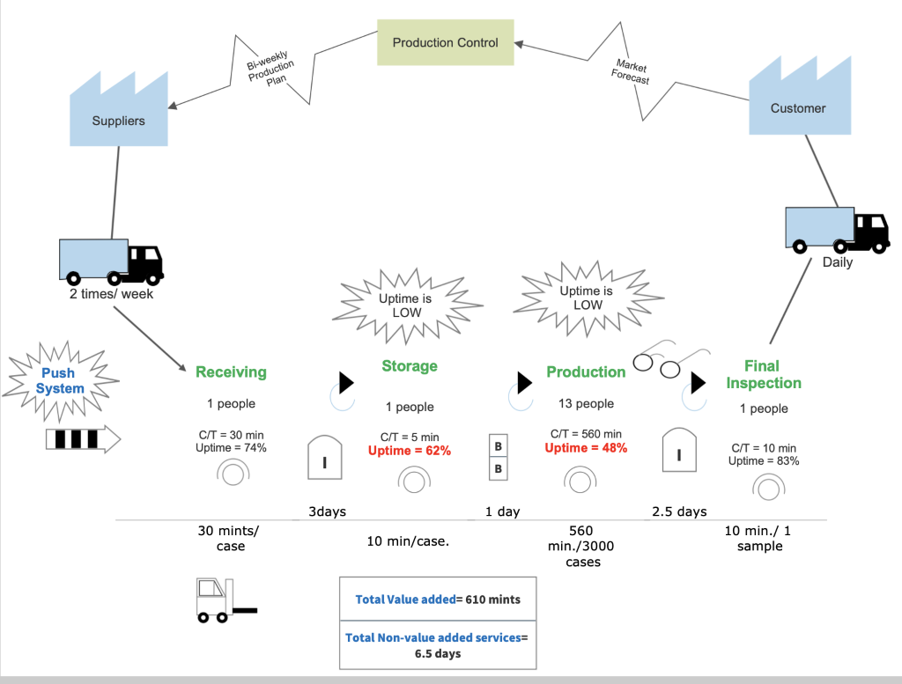
VALUE STREAM MAPPING
Outcomes:
Unnecessary travel is too much
Inconsistent production

Slide 7
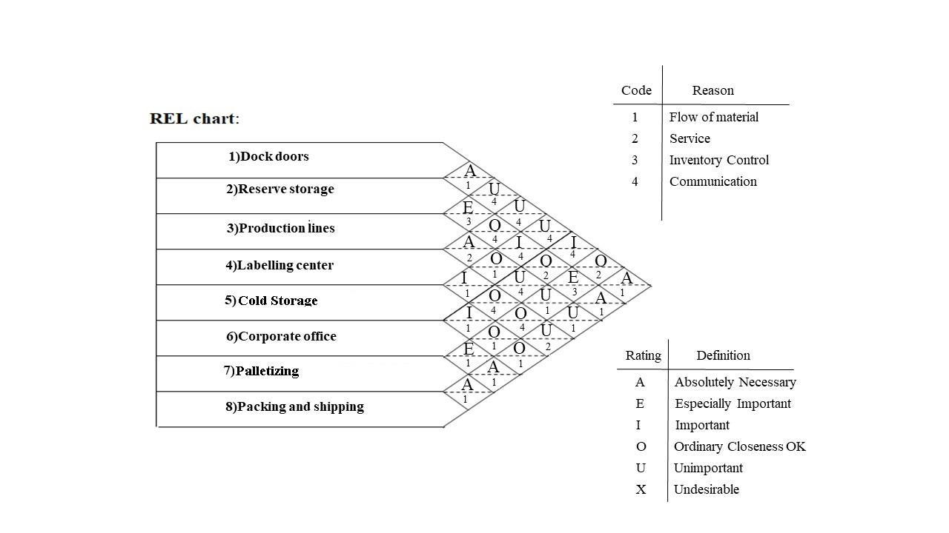
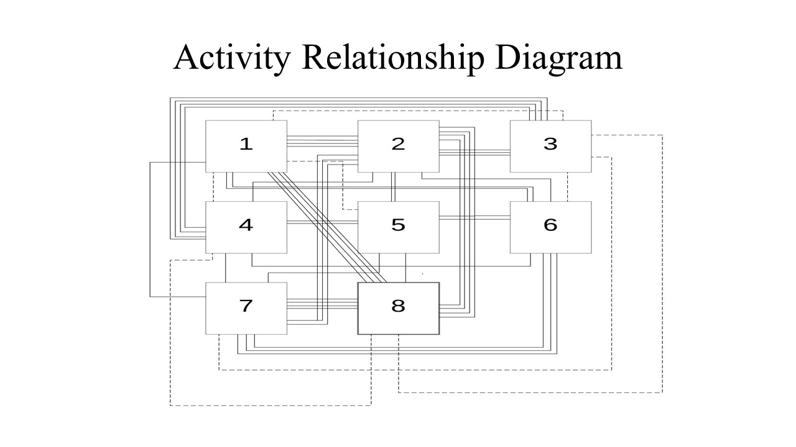
Facility Modelling

Slide 8
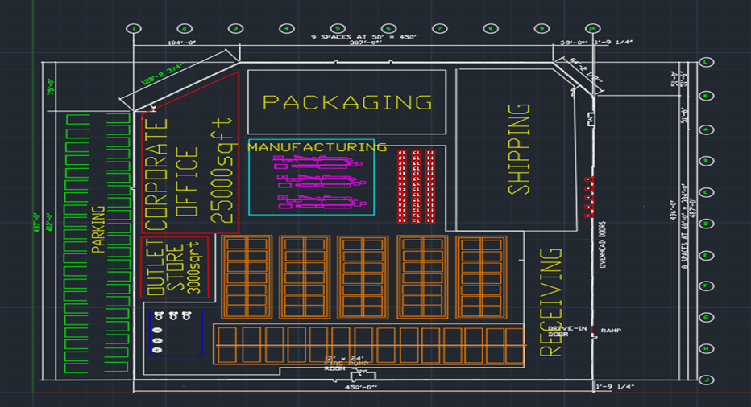
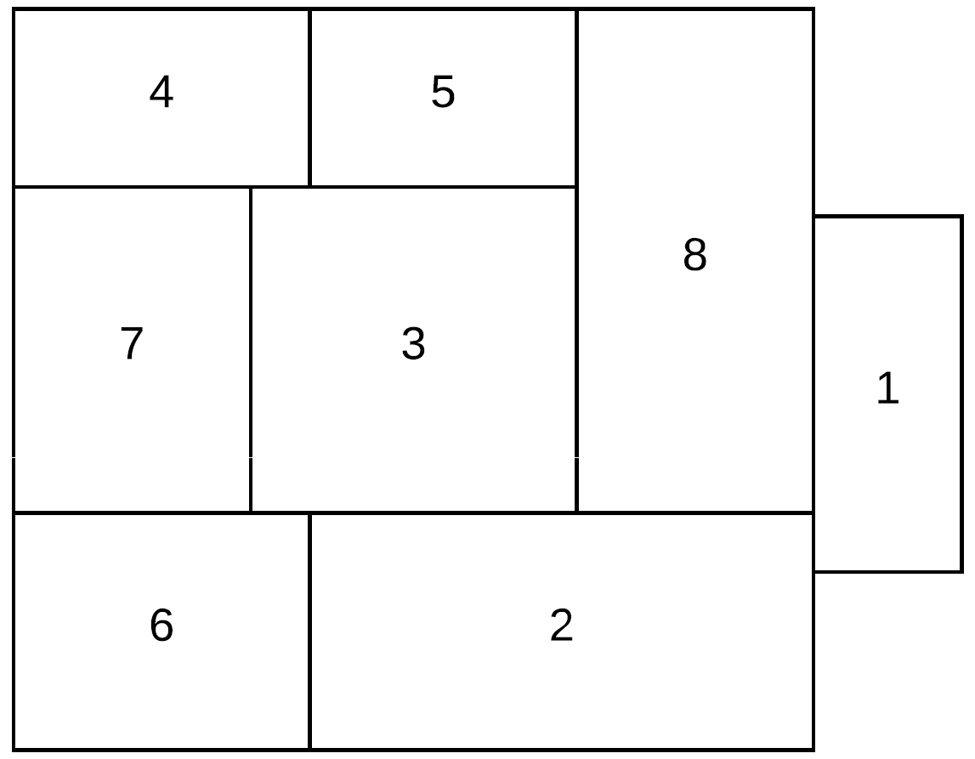
Facility Modelling
FINAL LAYOUT

Slide 9
Materials Management
Materials management include inventory management, purchase management, value analysis, store keeping, maintenance and upkeep of the inventories in hand and in process.
Data Analysis was performed to check the points where company failed with their orders.
Company lost the order from Walmart and many other customers.
There were inconsistencies in production.
Production stopped because of raw materials unavailability.
Company was not able to keep up with their orders

Slide 10
PRODUCTION PLANNING
Production was interrupted because of the stockouts of raw materials. So reordering strategy for raw materials were introduced.
We designed small software in excel to have a quick information of how much days it will take to finish production of an order and the amount of inventory required to finish that particular order.
Excel software of monthly production plan was introduced to keep the track of the production and the inventory so that company can reorder if the inventory of raw materials drops below certain level.

Slide 11
Standardization
An essential aspect of any Quality System the ability to work in alignment and according to standardized and explicit Standard Operating Procedures (SOPs).
Standard operating procedures were made and recommended.

Slide 12
Standardization
A skills matrix is a grid or table that clearly and visibly illustrates the skills and competence held by individuals within a team.
Its primary aim is to help in the understanding, development, deployment and tracking of people and their skills.

Slide 13
Standardization
Jishu Hozen (JH) is one of the eight pillars of Total Productive Maintenance.
The main objective of Jishu Hozen is to empower the employee to make a daily conscious effort to maintain the performance of equipment and processes.

Slide 14
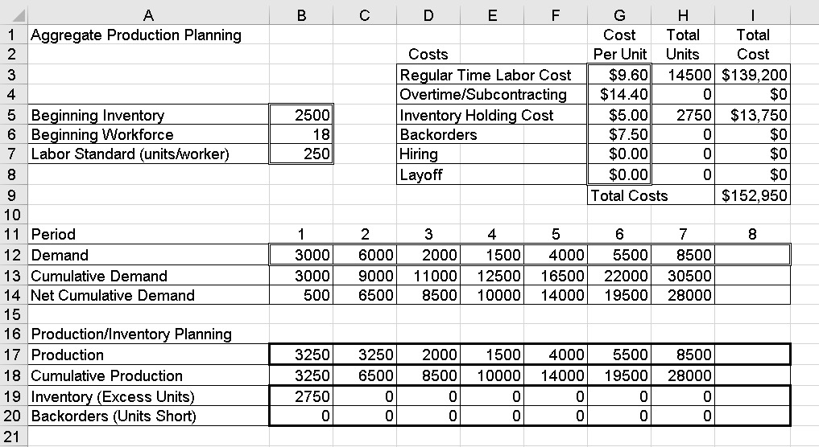
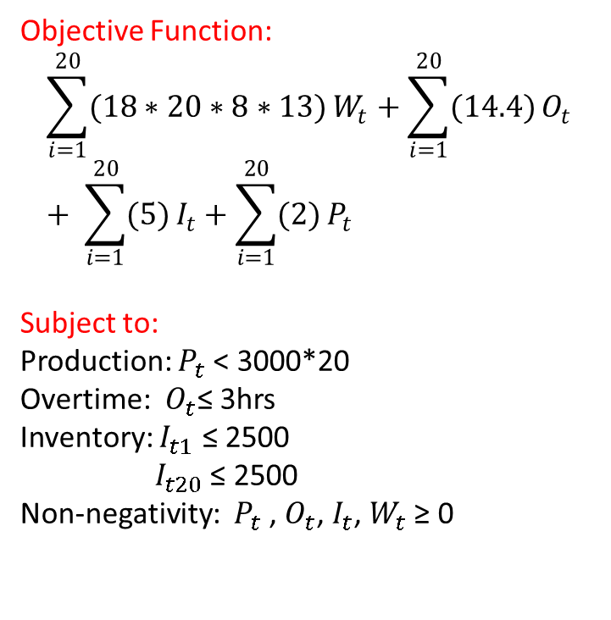
AGGREGATE PLANNING
Aim is to set the output levels near the face of uncertain demands.
Objective Function:
$$\sum_{i=1}^{20}{(18∗20∗8∗13)}W_{t}+\sum_{i=1}^{20}{(14.4)}O_{t}+ \sum_{i=1}^{20}{(5)}I_{t}+\sum_{i=1}^{20}{(2)}P_{t}$$
Subject to:
Production: $P_{t}$< 3000*20
Overtime: $O_{t}$≤ 3hrs
Inventory: $I_{t1}$ ≤ 2500
$I_{t20}$ ≤ 2500
Non-negativity: $P_{t}$, $O_{t}$, $I_{t}$, $W_{t}$ ≥ 0

Slide 15
AGGREGATE PLANNING
Chase Strategy: Production Matches Demand
The chase strategy refers to the notion that you are chasing the demand set by the market.
Production is set to match demand and doesn't carry any leftover products. This is a lean production strategy, saving on costs until the demand – the order – is placed.
The chase strategy is common in industries where perishables are an issue or with a company that doesn't have a lot of extra cash on hand and doesn't want the added risks of loss, theft or unsold products.
The production schedule is based on orders and immediate demand.

Slide 16
In a nutshell……
All the problems related to supply chain were addressed.
Graphical representation of Optimus Fulfill supply chain were made to understand the process and procedure.
Value stream mapping was done which lead us to the wastes, stockouts, bottlenecks and delays in the facility.
Facility modelling was done to reduce the travel-waste and increase layout efficiency using tools like Relativity Chart, Activity Relationship diagram and AutoCAD.
Data Analysis was performed to check for the lost orders and the reasons behind them.

Slide 17
In a nutshell……
Reordering strategy was introduced.
IT applications were introduced to get the production plan and inventory planning done at the early stage using Excel. Production tracking was introduced.
SOP’s, Jishu Hozen (JH) sheet and skill matrix were introduced to ensure the smooth flow of the production.
Aggregate planning was done to get a general idea of inventory management and raw materials required in future.
Chase strategy was recommended as it is compatible for perishable items and low in-hand cash.

Slide 18


THANK YOU
ANY QUESTIONS?

