Slide 1
Spark Streaming
Spark SQL
MLib
GraphX
Spark Core
spark-nutshell

Slide 2
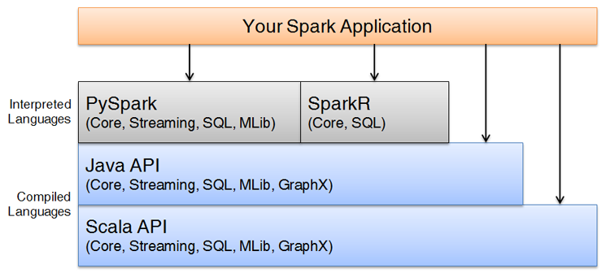
spark-nutshell

Slide 3
Spark Cluster
Result
Worker 1
Status
Executor
Tasks
Driver
Cluster Manager
Application
Job
...
Tasks
Worker n
Status
Executor
Result
managing-clusters

Slide 4
Real Spark Cluster
3 instances with 3 roles
sparkour-dev
spark-submit
sparkour-master
sparkour-slave
development environment
master
worker
sparkour-app
Tutorial Spark Cluster
1 instance with 3 roles
development environment
spark-submit
master
worker
instance
role
logical cluster
Key
managing-clusters

Slide 5
cluster
Client Deploy Mode
Driver exists where spark-submit runs
spark-submit
development environment
driver
master
worker
cluster
Cluster Deploy Mode
Driver exists inside cluster
development environment
driver
master
worker
submitting-applications

Slide 6
Spark Cluster
Spark Cluster
Driver
Cluster Manager
Driver
Cluster Manager
Job
Job
Client Deploy Mode
Driver exists where spark-submit runs
Cluster Deploy Mode
Driver exists inside cluster
submitting-applications

Slide 7
array / list of numbers
file of string numbers
parallelize
map
textFile
filter
union
flatMap
count
reduce
reduce
More than 30 in Chicago
Most books owned in either city
Total books in both cities
working-rdds

