Slide 1
IronPass
From a gym membership app to a monitored Kubernetes cluster
DevOps final capstone | Romit
Notes:
Hi, I am Romit. This is IronPass, a gym membership app. The app is small, but the point of this project is the journey. It goes from my laptop, through tests, containers and a pipeline, to a Kubernetes cluster on AWS with monitoring.

Slide 2
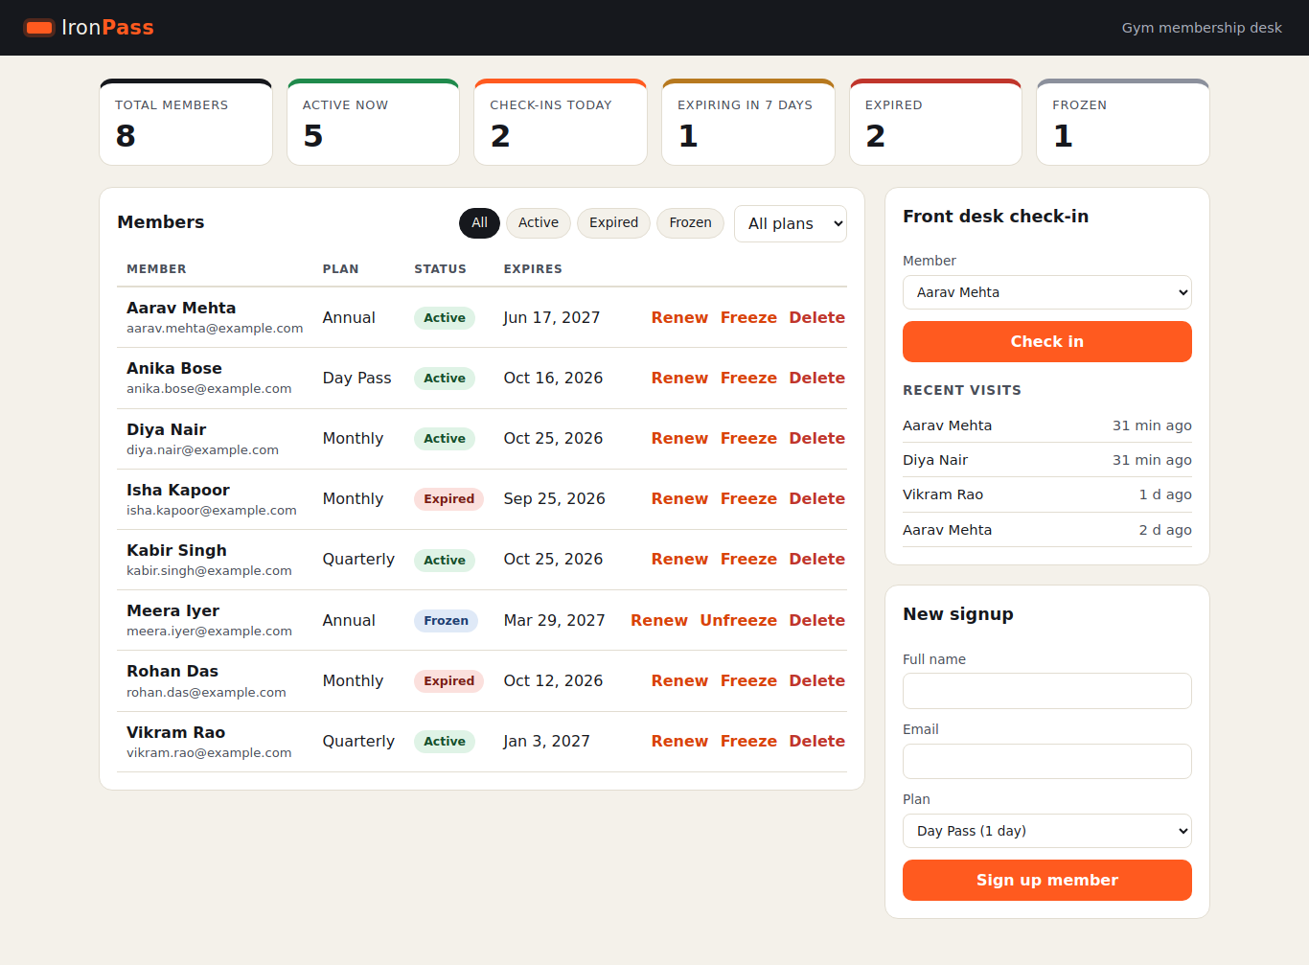
The problem and the app
■ Members, plans and check-ins
■ Rule: expired plan means no check-in
■ React + FastAPI + PostgreSQL
■ 12 REST endpoints, /health, /ready, /metrics
IronPass | DevOps capstone
2
Notes:
A gym front desk needs to know if a member can walk in. IronPass keeps members, plans and check-ins. The API enforces one real rule. If the plan has expired, the check-in is rejected with a clear message. The frontend is React, the backend is FastAPI, and the data is in PostgreSQL.

Slide 3
Architecture
Developer
GitHub
GitHub Actions
GHCR images
AWS ap-south-1 | VPC | EKS (built by Terraform)
Frontend x2
Ingress NGINX
Backend x2 (HPA)
PostgreSQL + PVC
/ goes to the frontend
/api goes to the backend
Prometheus
Grafana
IronPass | DevOps capstone
3
Notes:
This is the full picture. A developer pushes to GitHub. GitHub Actions tests, builds, scans and pushes images. Terraform builds the network and the cluster. Helm puts the app on the cluster. The Ingress is the single door. Prometheus scrapes the backend and Grafana draws the graphs.

Slide 4
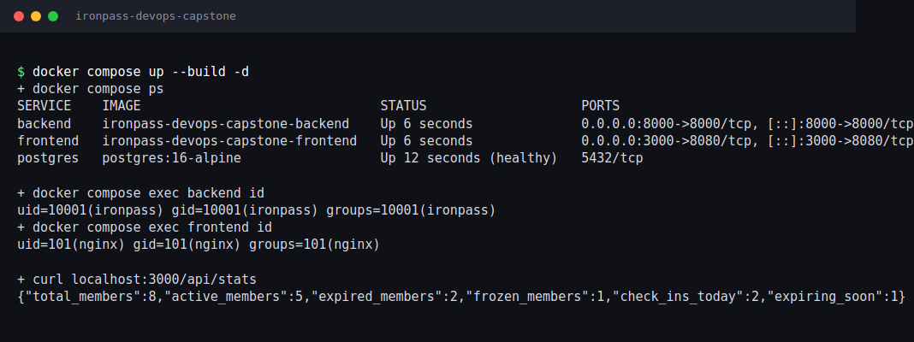
Run it locally with Docker
■ docker compose up --build
■ 3 services: frontend, backend, postgres
■ Frontend: multi-stage, unprivileged nginx
■ Both images run as non-root
IronPass | DevOps capstone
4
Notes:
One command starts the whole stack, docker compose up --build. Postgres, the backend and the frontend all come up. The backend runs as user 10001 and nginx runs as user 101, so neither is root. The frontend image is a multi-stage build, so Node is not in the final image.

Slide 5
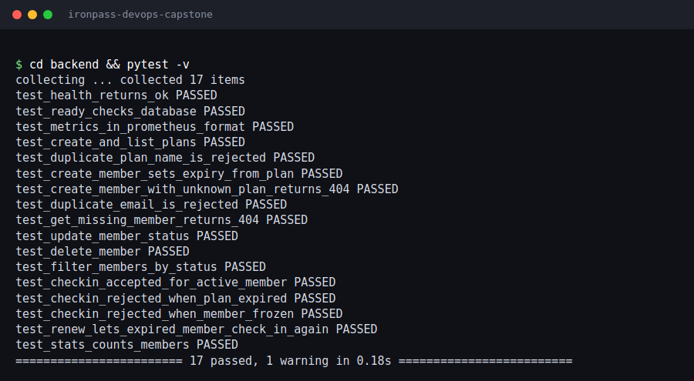
Tests
■ 17 tests, all passing
■ SQLite test database
■ Rule tested: expired plan is rejected
■ Runs first in the pipeline
IronPass | DevOps capstone
5
Notes:
There are seventeen pytest cases across health, plans, members, check-ins and stats. They use an in-memory SQLite database, so they are fast and safe. One test proves that an expired member cannot check in, and another proves that renewing fixes it. The pipeline runs these before any image is built.

Slide 6
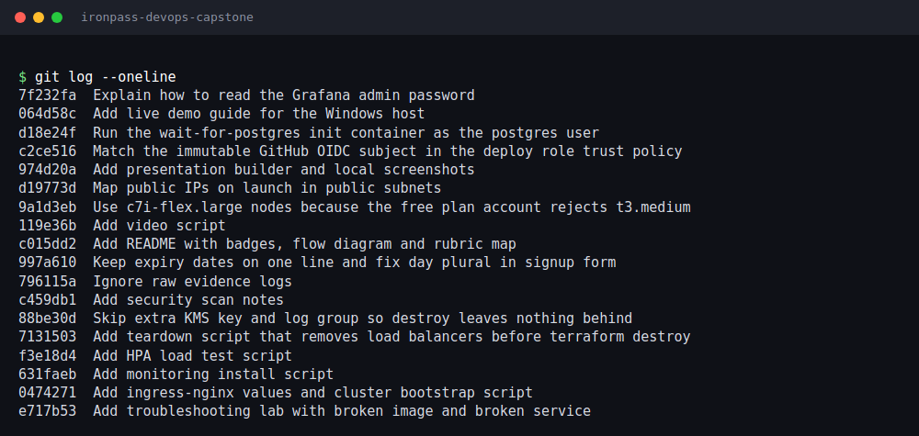
Git and GitHub
■ Small commits, one change each
■ Plain messages
■ .gitignore: .env, state, node_modules
■ No secrets in history
IronPass | DevOps capstone
6
Notes:
I worked in small commits, one logical change each, in build order. The messages say what changed in plain words. The gitignore keeps secrets, caches and Terraform state out of the repo.

Slide 7
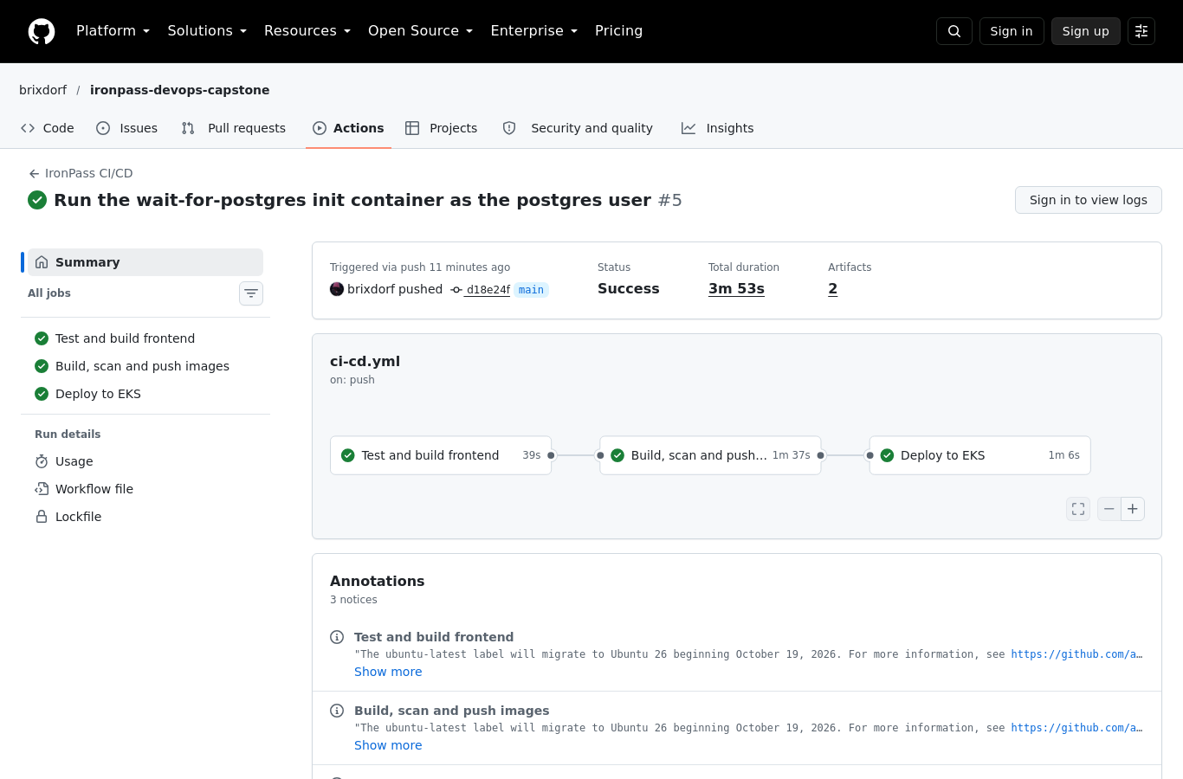
CI/CD pipeline
pytest
Build frontend
Build images
Trivy scan
Push to GHCR
Helm deploy
IronPass | DevOps capstone
7
Notes:
Every push to main runs the pipeline. First pytest and the frontend build. Then both images are built, scanned by Trivy, and only then pushed to GHCR with the commit SHA as the tag. The last job deploys with Helm. It signs in to AWS using OIDC, so there are no stored keys.

Slide 8
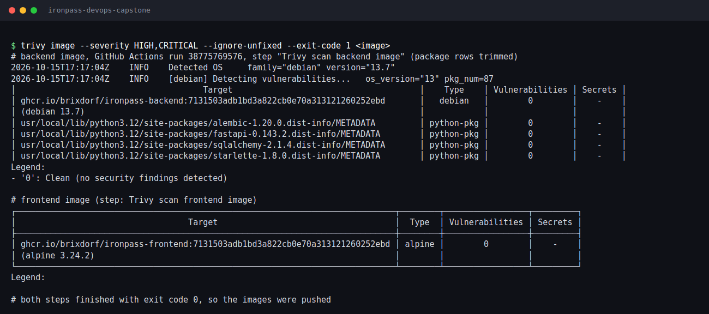
Security scan with Trivy
■ HIGH and CRITICAL, fixable only
■ Fails the build
■ First runs failed: 7 and 41 findings
■ Fixed, now clean
IronPass | DevOps capstone
8
Notes:
Trivy scans both images for high and critical problems that already have a fix. My first runs failed on purpose. The backend had seven findings and the frontend had forty one. I upgraded the libraries, removed pip from the runtime image and moved to a current nginx base. Then both scans were clean. Clean means no known fixable problem today, not safe forever.

Slide 9
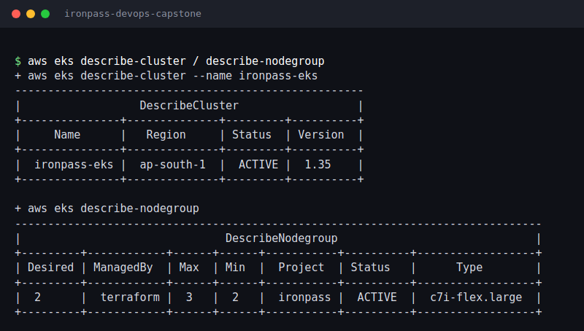
Terraform and AWS
■ VPC: 2 public + 2 private subnets
■ One NAT gateway
■ EKS with managed nodes, ap-south-1
■ GitHub OIDC role, no AWS keys
IronPass | DevOps capstone
9
Notes:
All the AWS infrastructure is code. A VPC with two public and two private subnets, one NAT gateway, and an EKS cluster with a managed node group. Terraform also creates the GitHub OIDC provider and a deploy role that only the main branch of this repo can assume. Every resource is tagged Project ironpass and ManagedBy terraform.

Slide 10
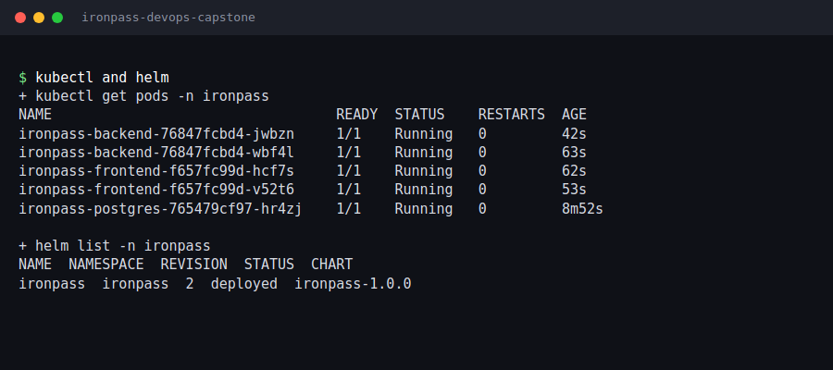
Kubernetes and Helm
■ One Helm chart, prod and dev values
■ 2 replicas each, ClusterIP services
■ Probes: /health and /ready
■ Postgres with a PVC
IronPass | DevOps capstone
10
Notes:
The Helm chart holds everything. Two Deployments with two replicas each, ClusterIP services, a PostgreSQL deployment with a volume claim, an Ingress, an HPA and a ServiceMonitor. Probes use health and ready. The ready endpoint checks the database.

Slide 11

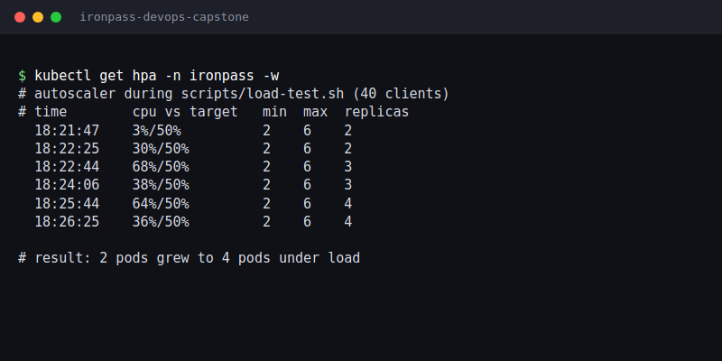
Ingress and autoscaling
IronPass | DevOps capstone
11
Notes:
The Ingress sends slash to the frontend and slash api to the backend, on one load balancer address. For autoscaling, the HPA watches backend CPU. My load script sends steady traffic, CPU rises, and the replica count grows.

Slide 12
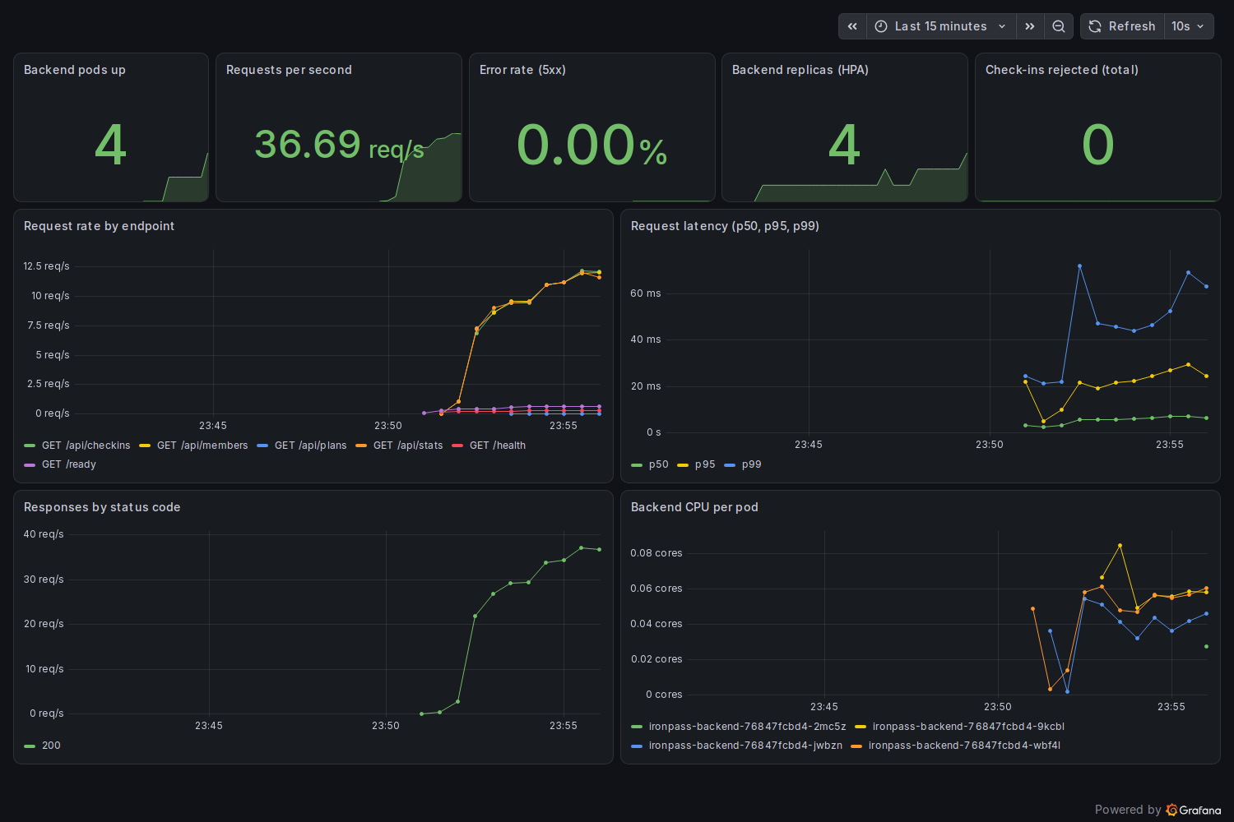
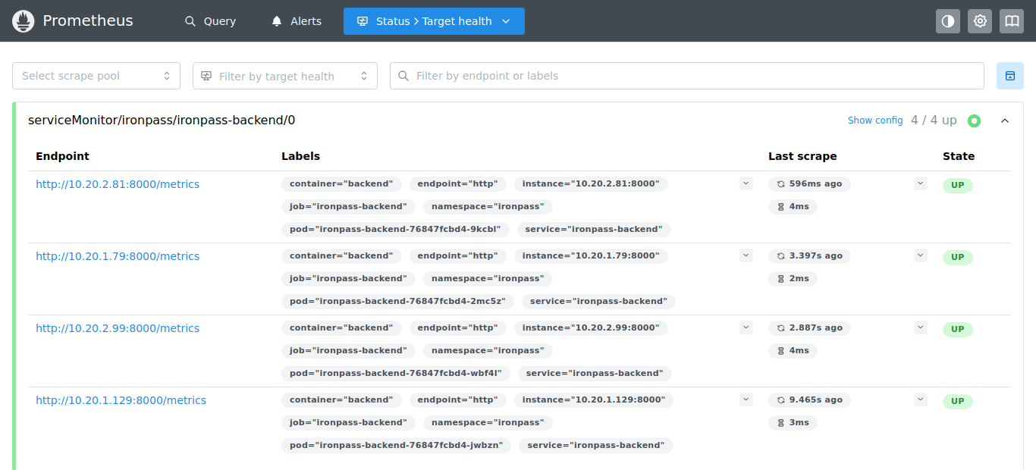
Monitoring
Target ironpass-backend
4 of 4 UP
Dashboard is provisioned from a ConfigMap
IronPass | DevOps capstone
12
Notes:
Prometheus scrapes the backend metrics endpoint, and the target is up. Grafana has a provisioned dashboard with request rate, latency and error rate, plus CPU and replicas. You can see them move during the load test.

Slide 13
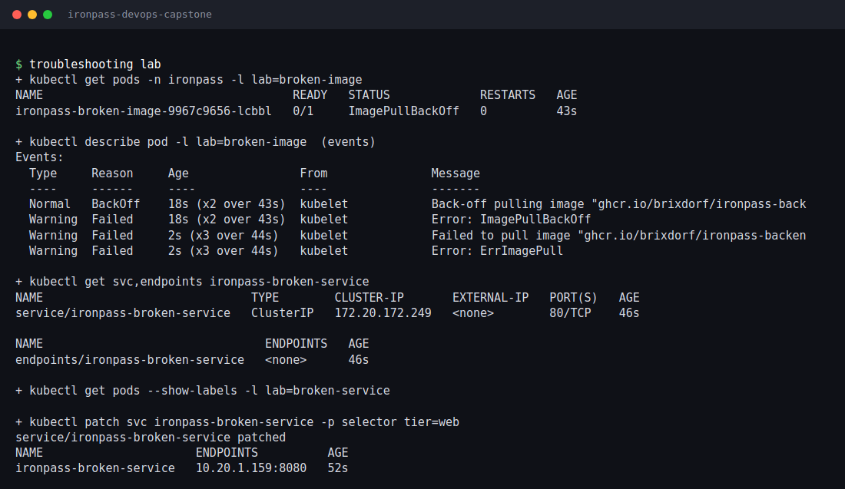
Troubleshooting lab
■ Broken image: ImagePullBackOff
■ Broken service: no endpoints
■ Tools: describe, events, endpoints
■ Fix notes in troubleshooting/
IronPass | DevOps capstone
13
Notes:
I made two broken manifests on purpose. The first has an image tag that does not exist, so the pod goes to ImagePullBackOff. The second has a typo in the service selector, so the service has no endpoints. Describe and get endpoints show the cause, and the fix is one command each.

Slide 14
What I learned
■ Every tool has one job, the pipeline joins them
■ A failing scan is useful, it made me fix real issues
■ Infrastructure as code makes the cluster repeatable
■ Probes, requests and metrics make an app operable
■ Cost matters: tag everything and tear down in order
IronPass | DevOps capstone
14
Notes:
The biggest lesson is that each tool has one job and the pipeline joins them. A scanner that fails the build is useful, because it made me fix real findings. Small commits made problems easy to find. And cost matters, so I wrote a teardown script that removes the load balancer before the network.

