Slide 1

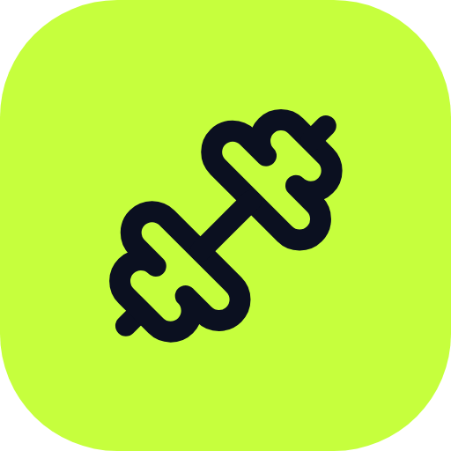

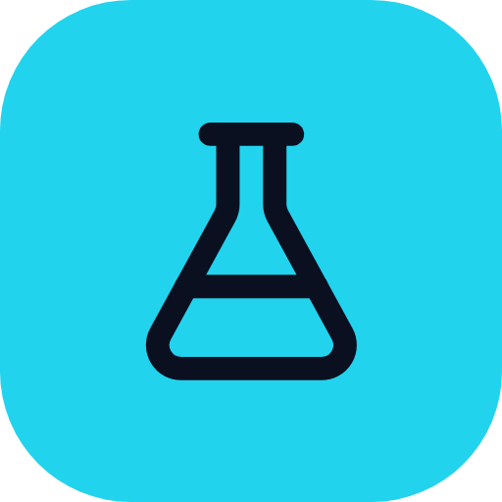
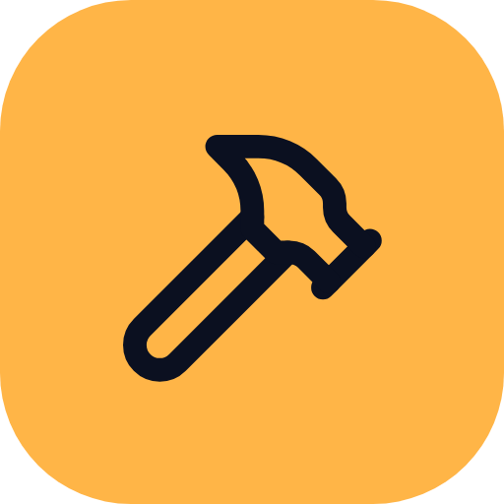

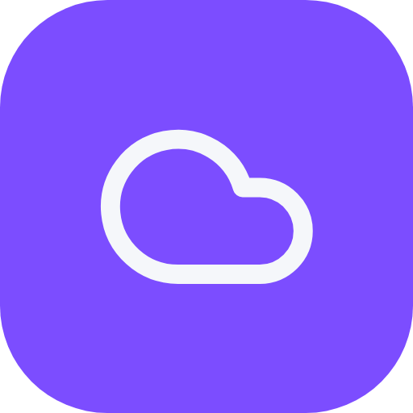

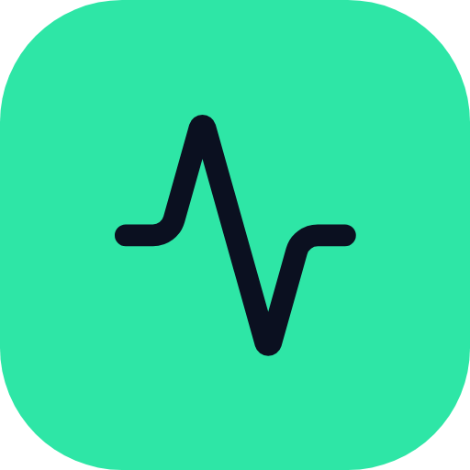
DEVOPS FINAL CAPSTONE
IronPass
From code to a monitored Kubernetes cluster
A gym membership app by Romit
Code
Test
Build
Scan
Provision
Deploy
Monitor
Notes:
Hi, I am Romit and this is IronPass, a gym membership app. I used it to learn how one app travels from my laptop to a monitored Kubernetes cluster on AWS. The seven colours at the bottom are the stages you will see on every slide.

Slide 2

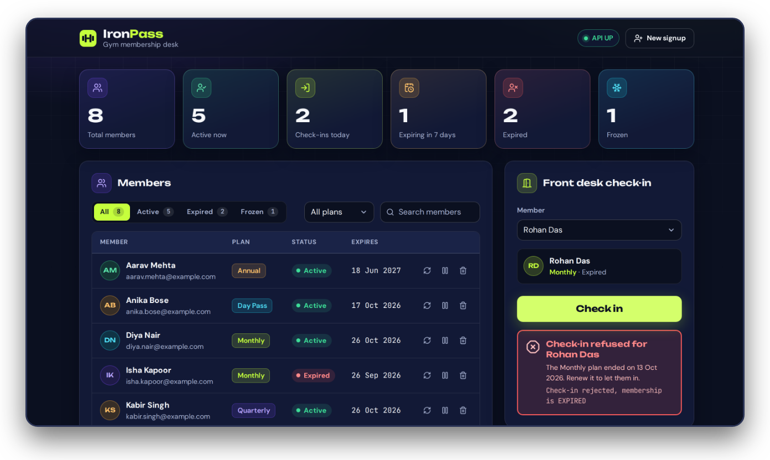
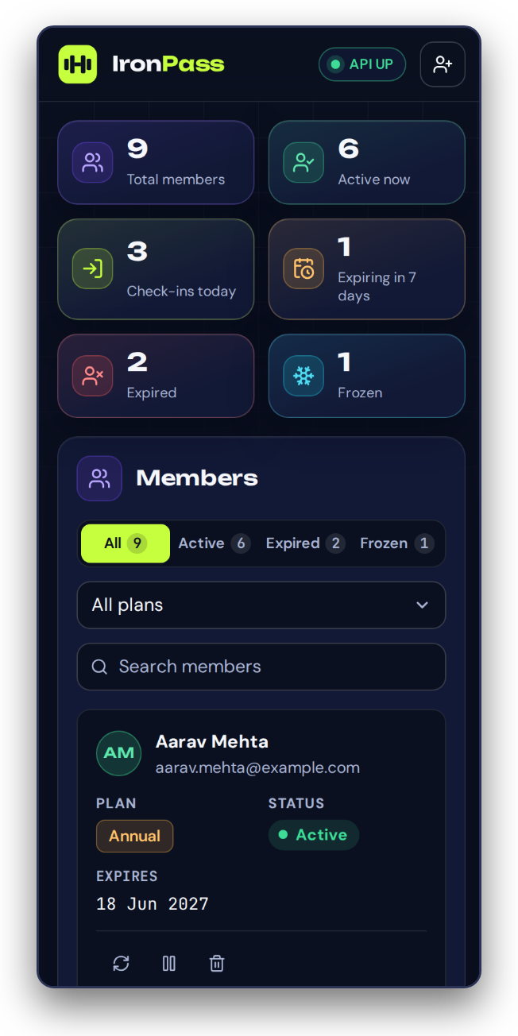
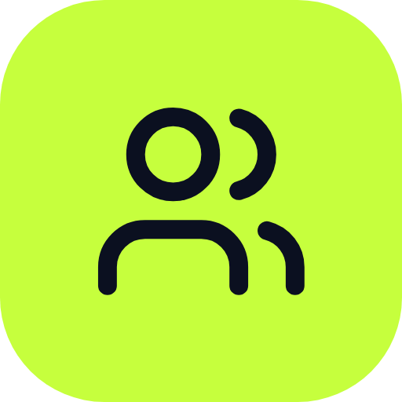
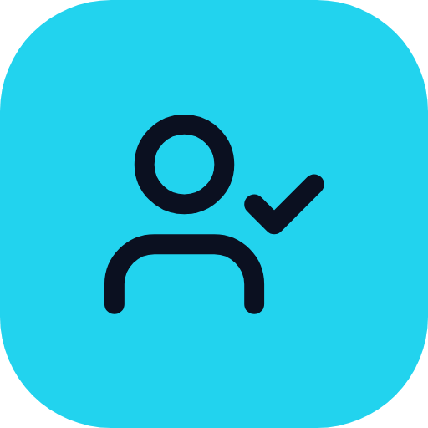
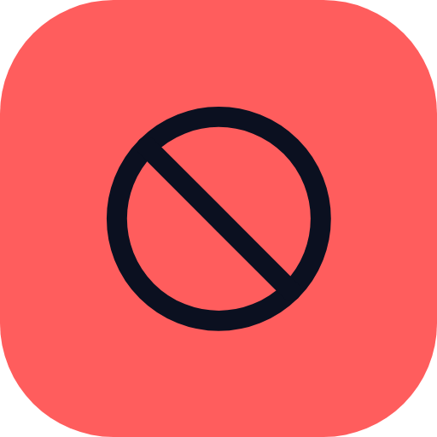
01 THE PRODUCT
The problem
Paper lists let expired members in.
Sign members up
Check them in
Expired plan, check-in refused
Refuse expired plans
Notes:
A gym front desk needs to know quickly who may come in. IronPass lets staff sign members up and check them in. If a member's plan has expired, the API refuses the check-in, and you can see that message on the screen. The page also works on a phone.

Slide 3

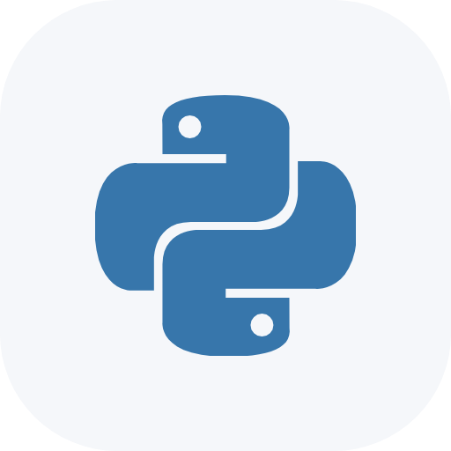

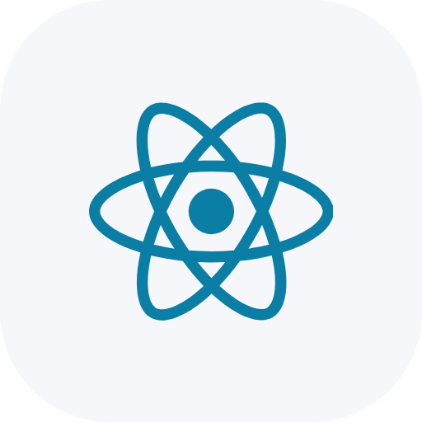
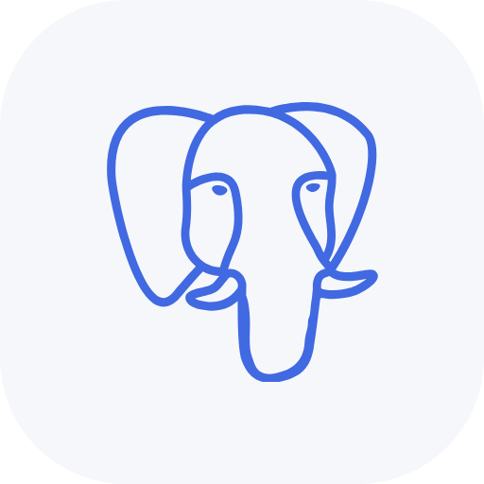
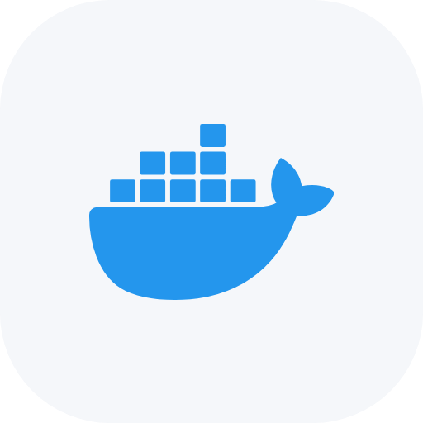
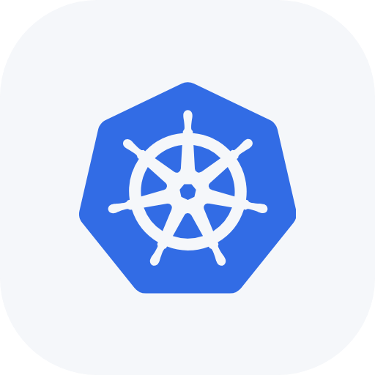
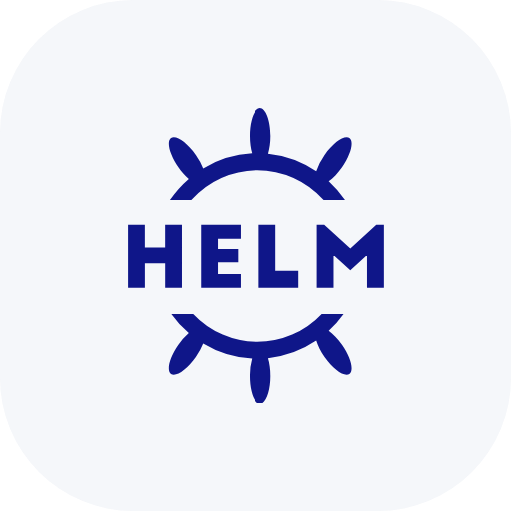
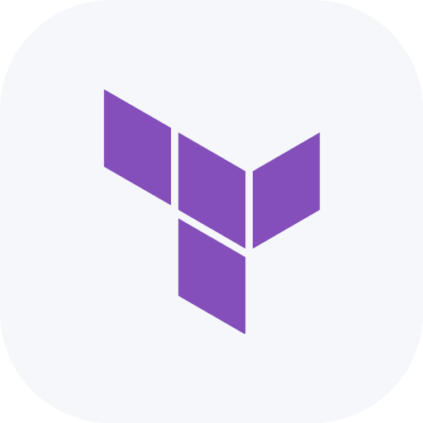
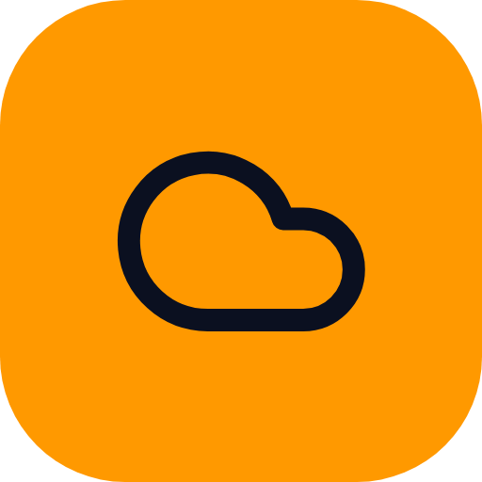
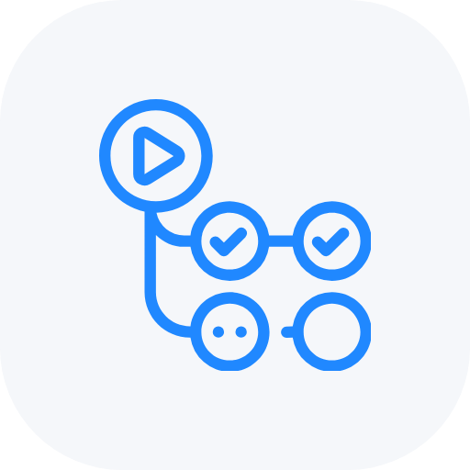


02 TECH STACK
Tech stack
Python backend, React frontend, PostgreSQL database, all in containers.
Python
FastAPI
React
PostgreSQL
Docker
Kubernetes
Helm
Terraform
AWS
GitHub Actions
Prometheus
Grafana
Notes:
The backend is Python with FastAPI, the frontend is React, and the data lives in PostgreSQL. Docker packs them into containers. Terraform builds the cloud, GitHub Actions is the pipeline, and Prometheus with Grafana watch the result.

Slide 4

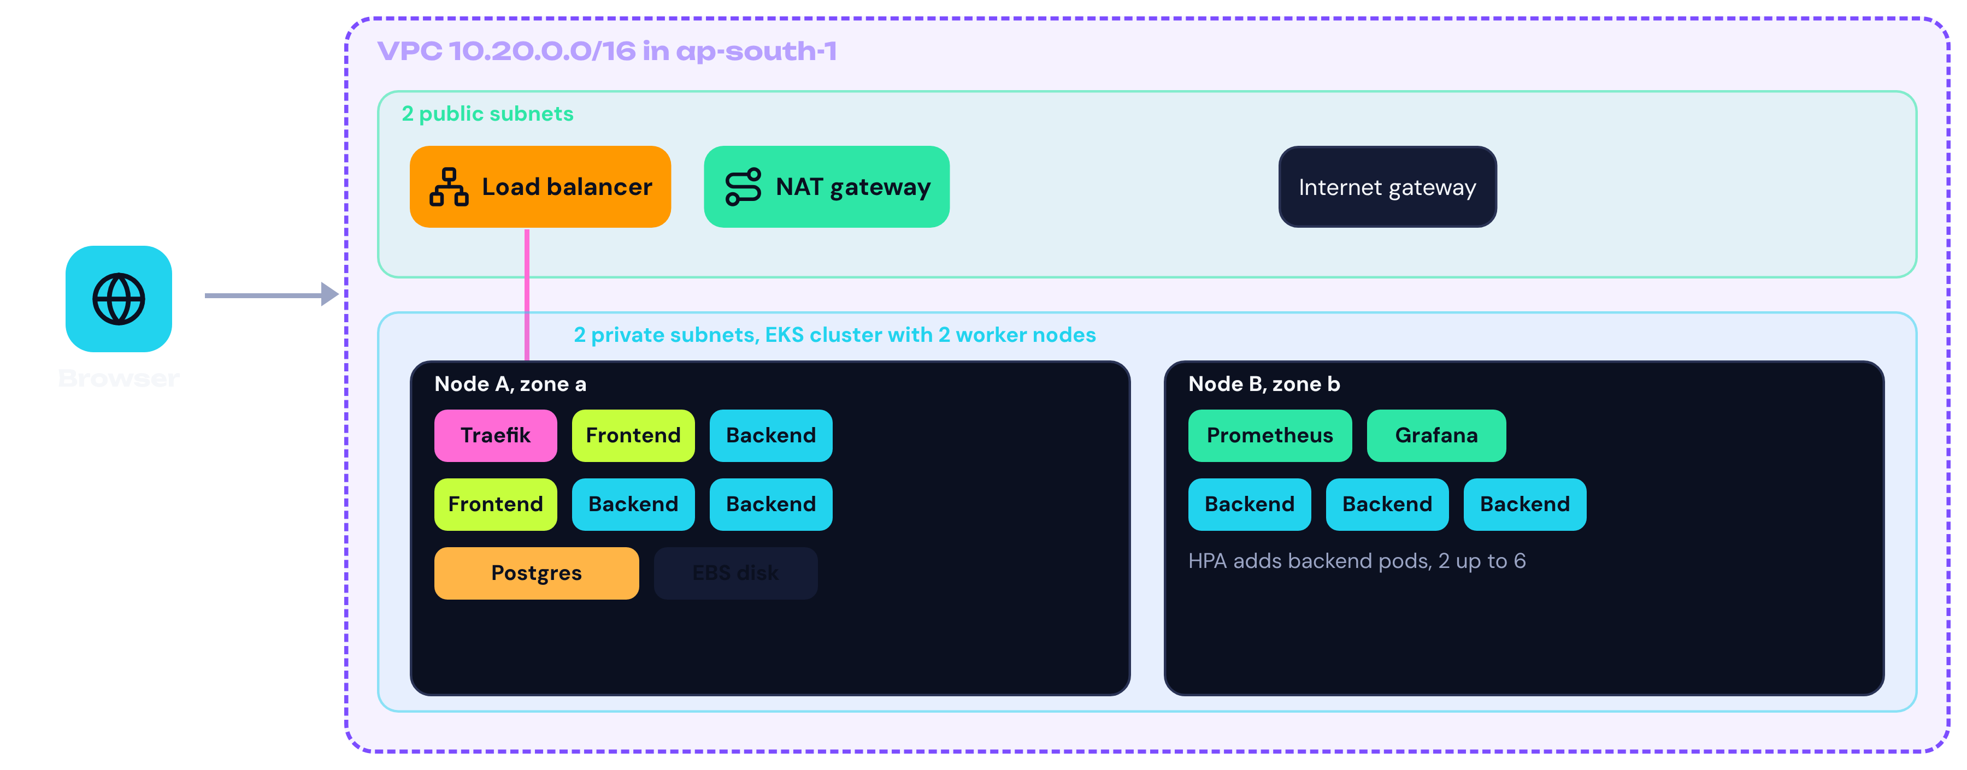
03 ARCHITECTURE
Architecture
Traefik routes web and API traffic into the cluster.
Notes:
This is the AWS picture. One network with two public and two private subnets, and an EKS cluster with two worker nodes in the private ones. Traffic comes in through a load balancer to Traefik, which sends it to the frontend and backend pods.

Slide 5
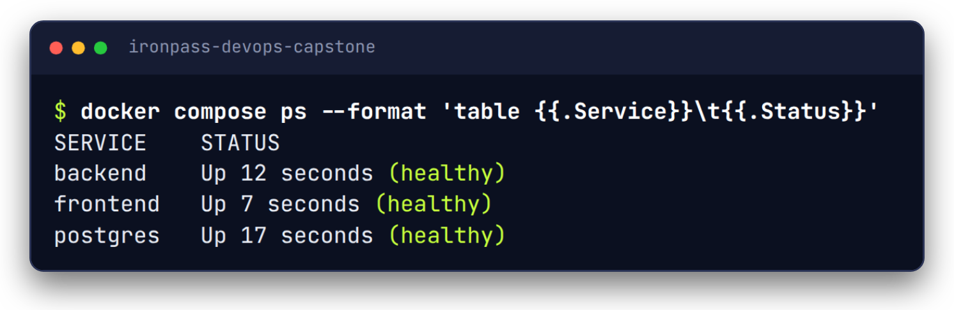
04 RUN LOCALLY
Run it with Docker
One command starts the database, the API and the website.
3
services, in order
3 of 3
clean starts healthy
0
records lost on restart
Notes:
docker compose up starts three containers. The database has a health check, and the backend and frontend wait until the one before them is healthy. I started it three times from clean and each time everything came up healthy, and a record I created was still there after a restart.

Slide 6
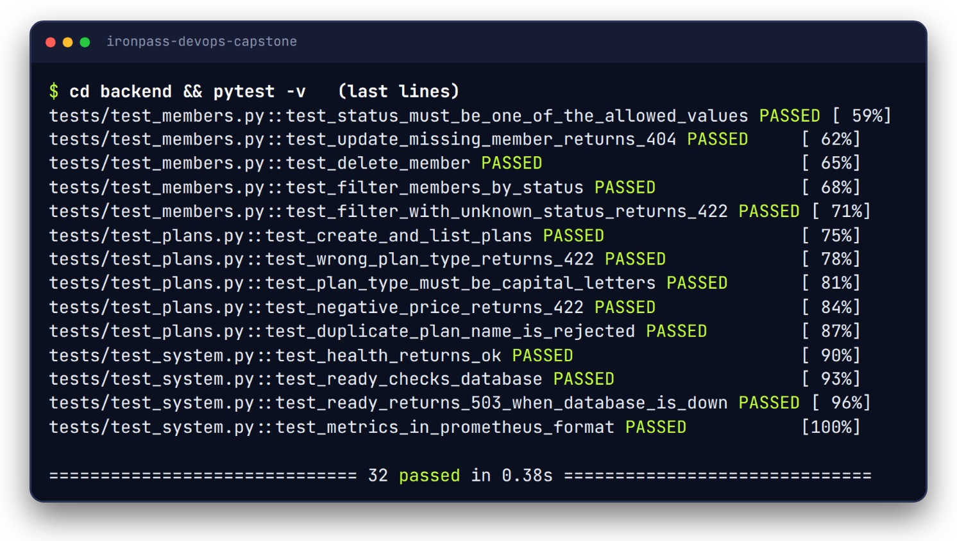
05 TEST
Tests
32
tests pass
Checks wrong input, missing members and the expired plan rule.
Notes:
There are thirty two tests and they all pass. They check real things like a wrong plan type returning an error, a missing member returning not found, and the rule that an expired plan cannot check in. The tests use a throwaway SQLite database, so real data is never touched.

Slide 7
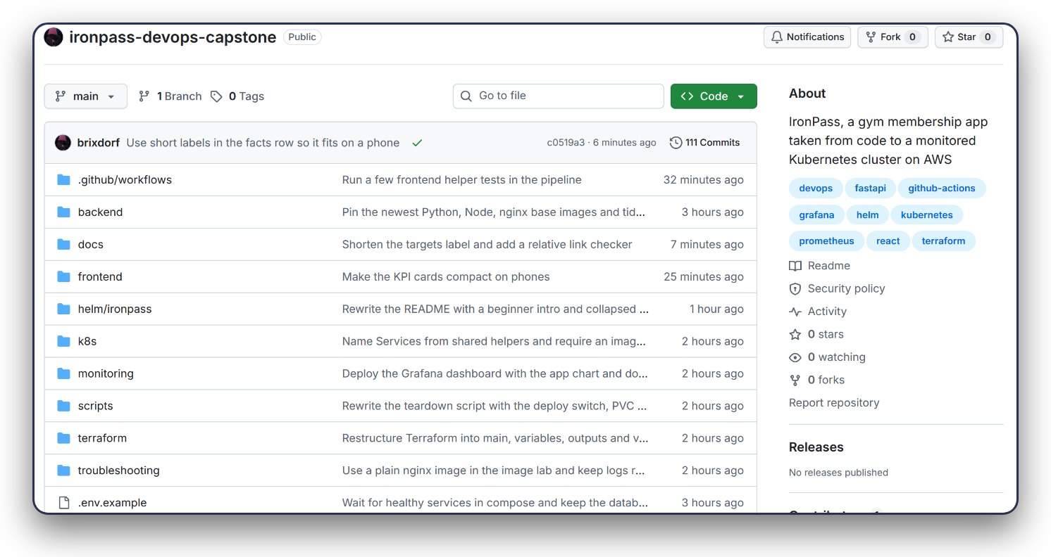
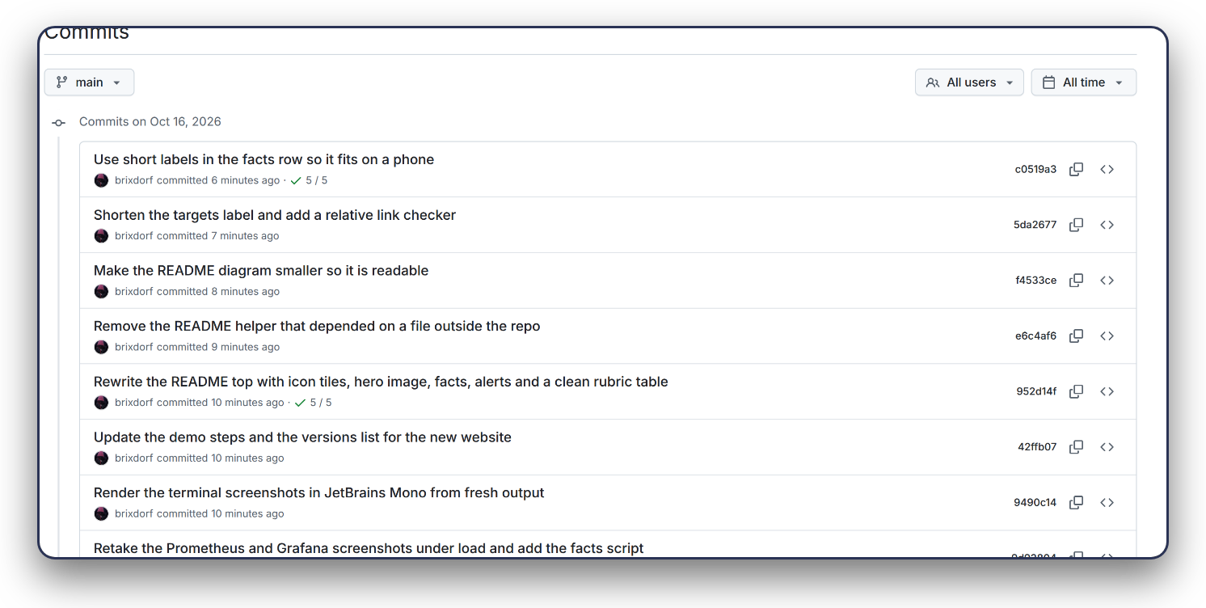
06 CODE
Git and GitHub
100+ commits
Small commits, clear messages, no secrets in git.
Notes:
The code lives in a public GitHub repository. I made many small commits, each with a plain message, so every change is easy to find. Passwords and keys are never stored in git.

Slide 8

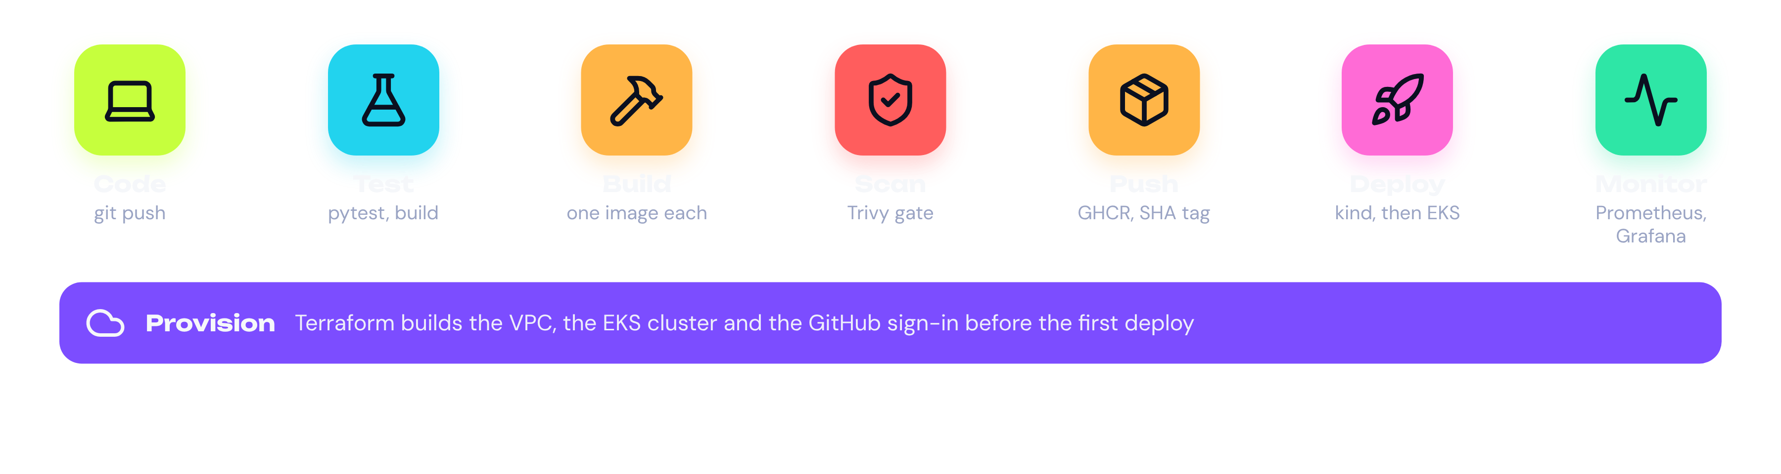
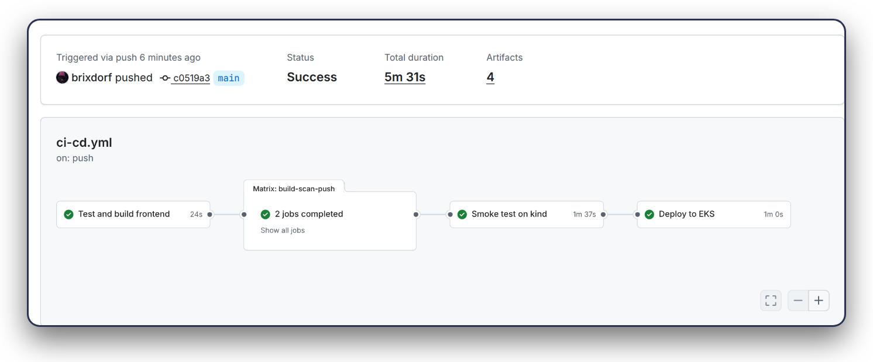


07 CI/CD
The pipeline
Tests gate everything
Scanned image is pushed
Smoke test, then EKS
Notes:
Every push to main starts this pipeline. It runs the tests, builds each image once, scans that same image with Trivy, pushes it and tries it on a temporary cluster before deploying to EKS. Terraform, the purple bar, builds the cloud before the first deploy.

Slide 9

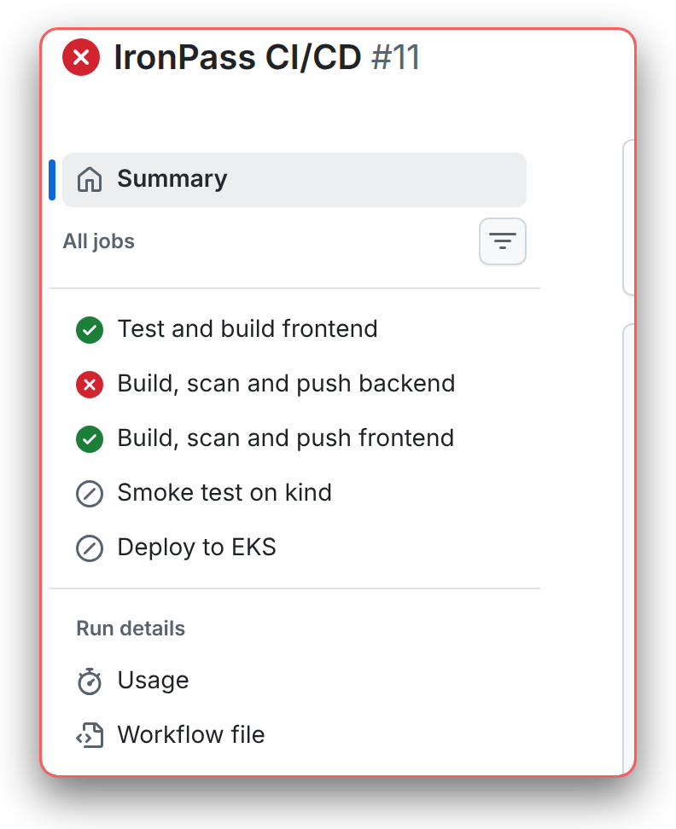
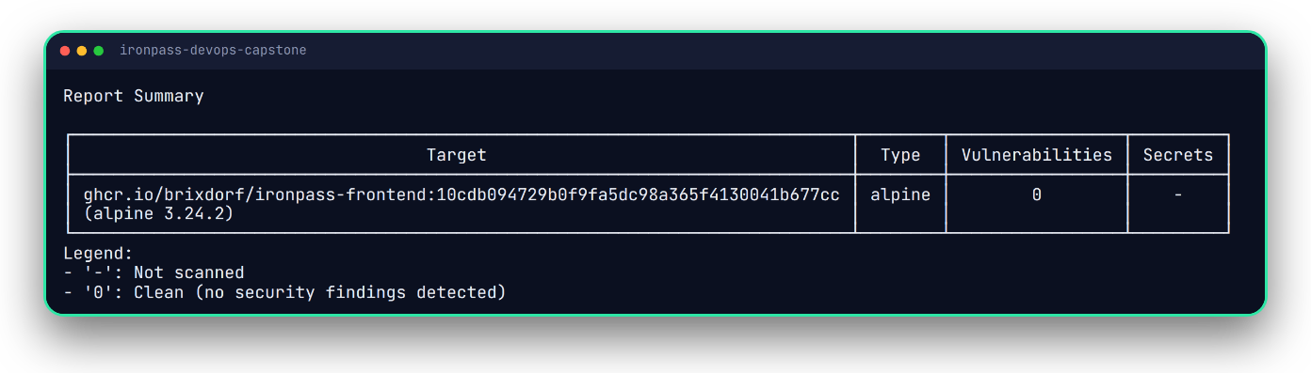
08 SCAN
Security scan
Trivy fails the build on fixable HIGH or CRITICAL issues.
A bad image stops the pipeline
My real images: 0 findings
Notes:
Trivy scans both images for known security problems. On the left I added an old library on purpose in a throwaway branch, and the pipeline stopped. On the right is the real result, where both images are clean.

Slide 10
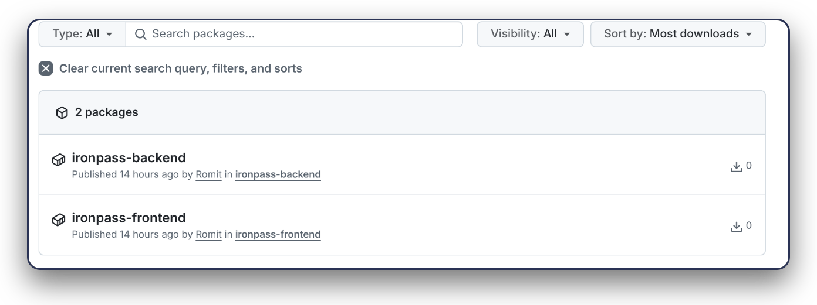
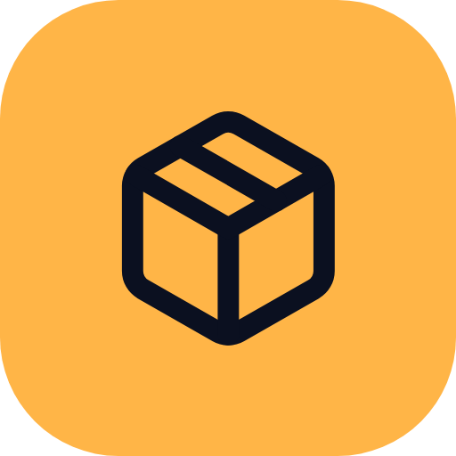

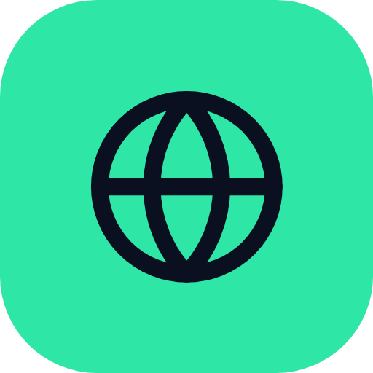
09 REGISTRY
Container registry
Tagged by commit
Built-in GITHUB_TOKEN
Public packages
Notes:
The images go to the GitHub Container Registry. Each one is tagged with the commit hash, so I can trace any running pod back to the exact code. The pipeline uses the built in token, so there are no stored passwords.

Slide 11
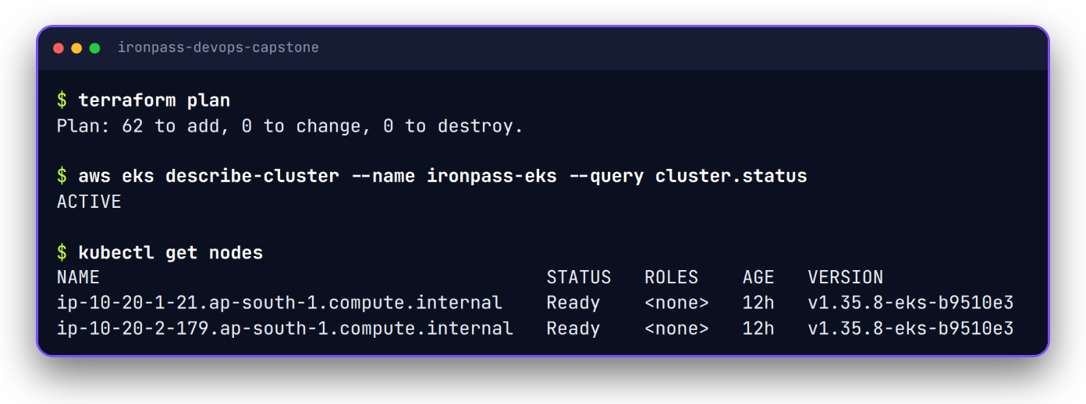
10 PROVISION
Terraform on AWS
62
resources from one plan
Code builds the network, the cluster and the GitHub sign-in.
Notes:
Terraform builds everything on AWS from code, so nobody clicks in the console. The plan shows sixty two resources, including the network, the EKS cluster and the sign in for GitHub. The nodes are c7i flex large because this free plan account refuses t3 medium.

Slide 12
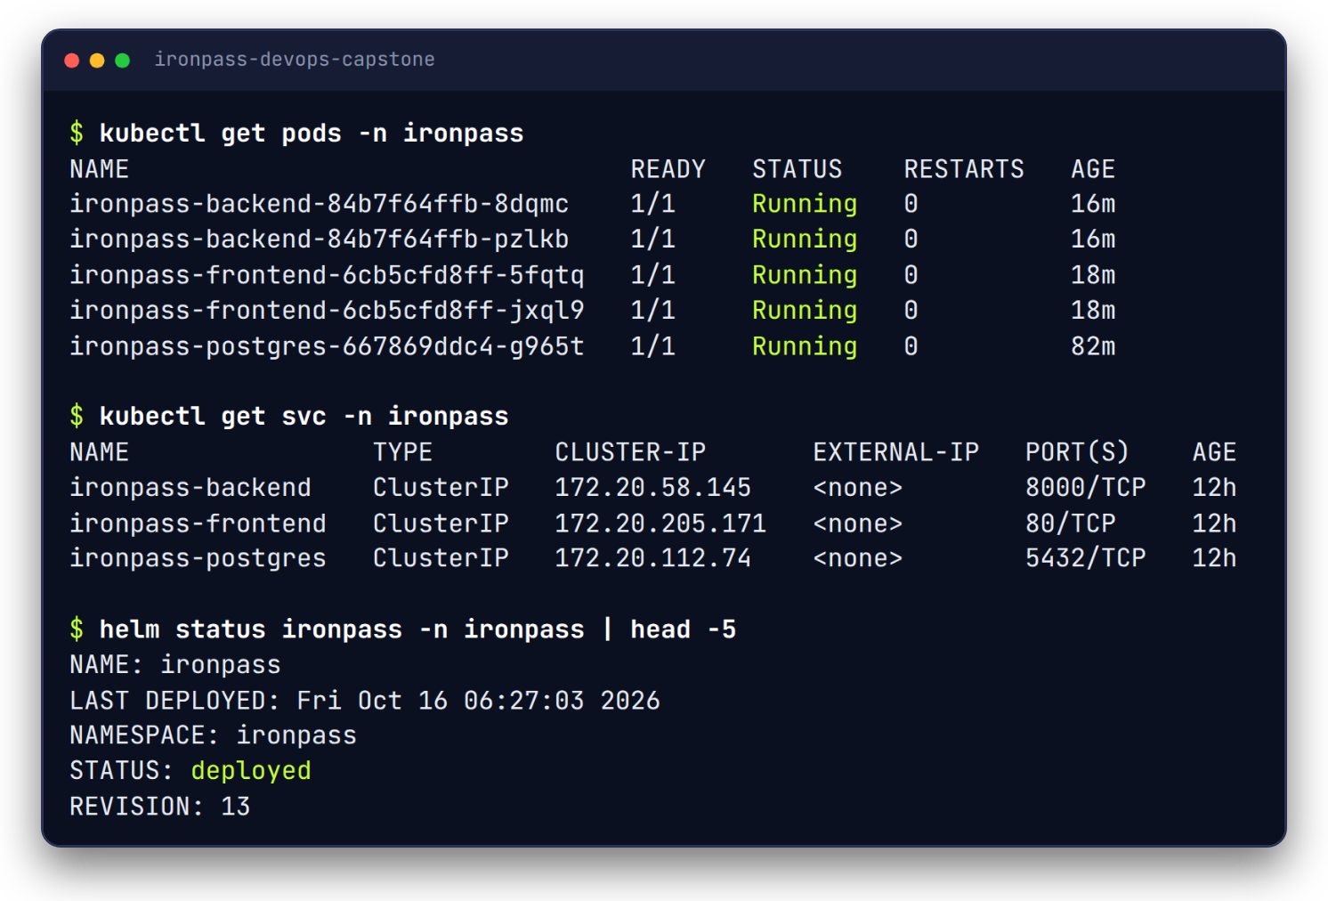
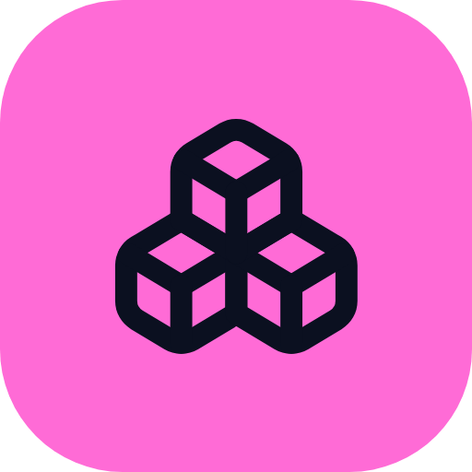
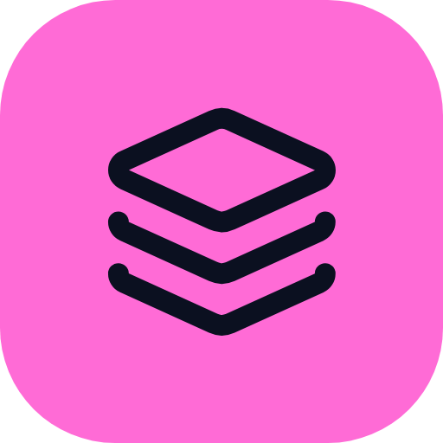

11 DEPLOY
Kubernetes and Helm
5 pods, 3 services
One Helm chart
Rollback in one command
Notes:
Helm installs the app on Kubernetes. There are two copies of the backend, two of the frontend and one database pod, each behind its own service. If a release goes wrong, helm rollback puts the old version back.

Slide 13
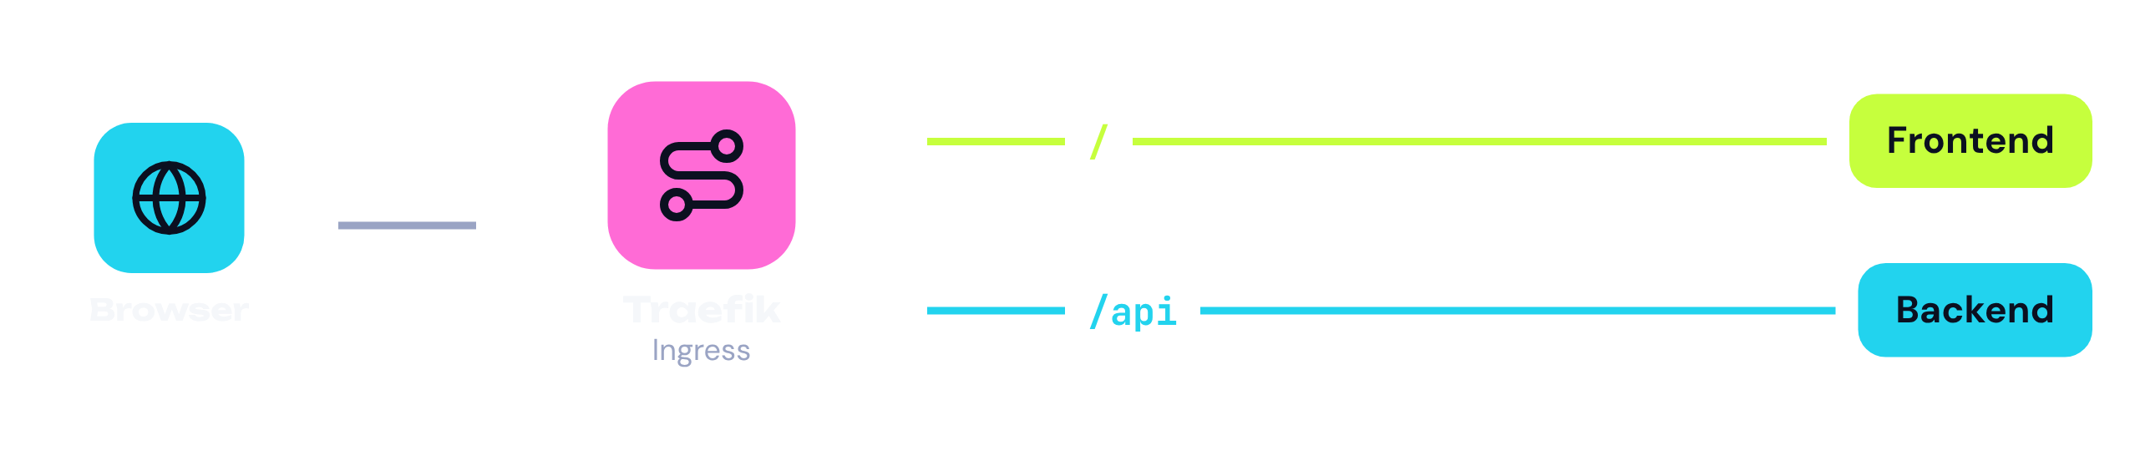
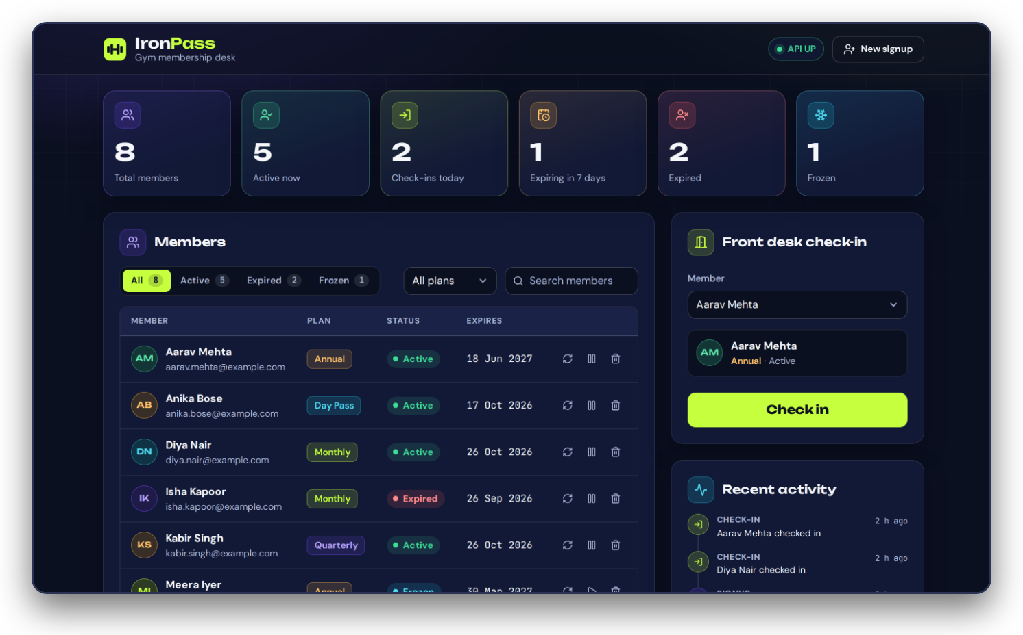
12 DEPLOY
Ingress
One address for the whole app.
Traefik replaced ingress-nginx, which is retired.
Notes:
The Ingress is the front door. Slash goes to the frontend and slash api goes to the backend, all on one load balancer address. I use Traefik because the Kubernetes project retired ingress-nginx, and I moved the live cluster over without a break.

Slide 14
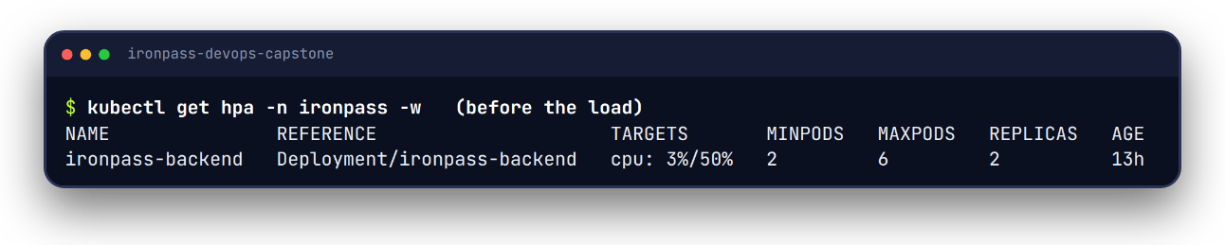
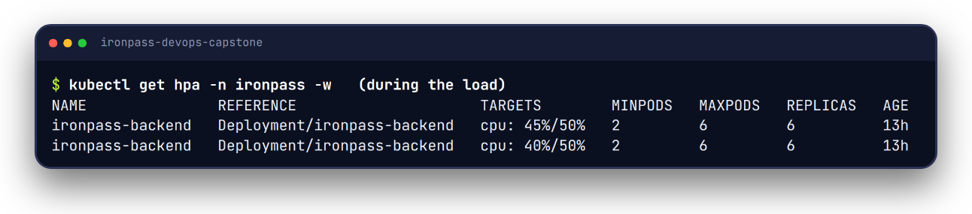
13 DEPLOY
Autoscaling
Before the load
2 to 6
backend pods under load
During the load
The load script raises CPU. The autoscaler adds pods.
Notes:
The backend has a horizontal pod autoscaler. When my load script pushed the CPU over fifty percent, it grew the backend from two pods to six, and it shrinks again when the load stops. It needs resource requests and metrics server to do this.

Slide 15

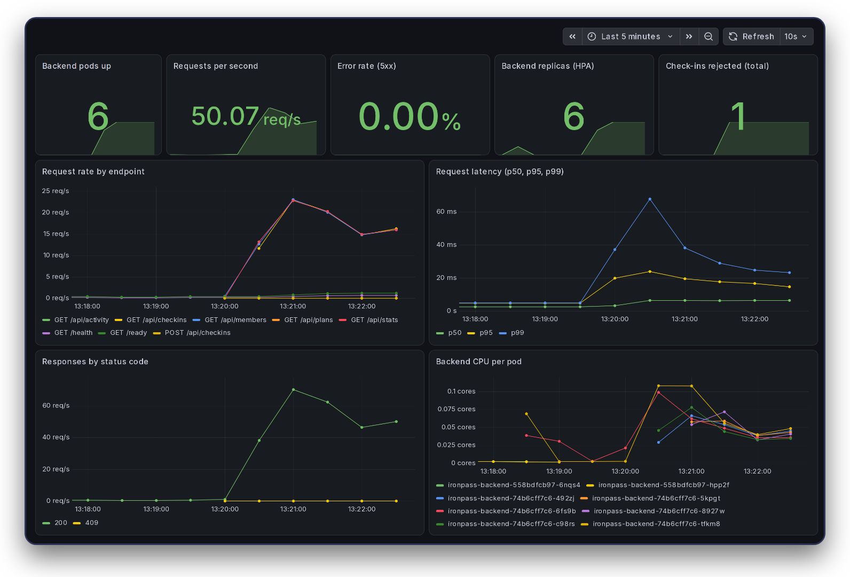
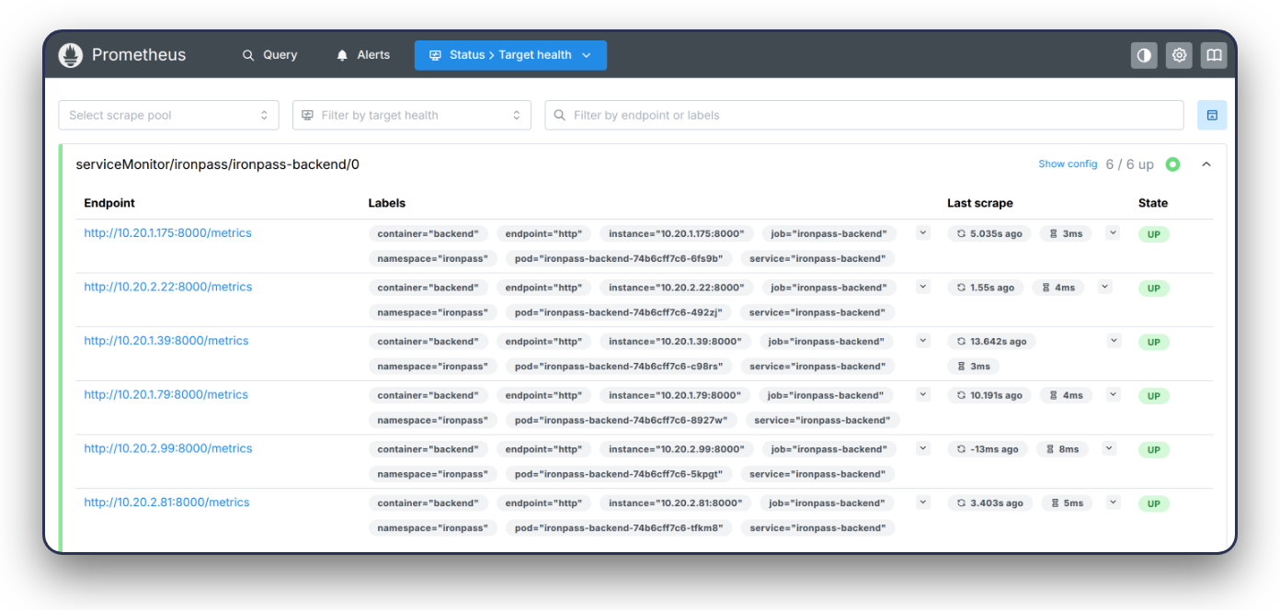
14 MONITOR
Monitoring
Prometheus scrapes the backend. Grafana shows rate, latency and errors.
Notes:
The backend exposes a metrics page. Prometheus collects it, and Grafana draws the request rate, the latency, the errors and the number of pods. The dashboard is stored as code in the Helm chart, so it appears by itself when the app is deployed.

Slide 16
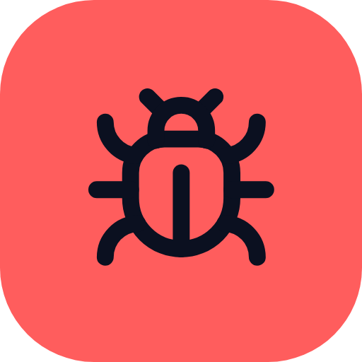

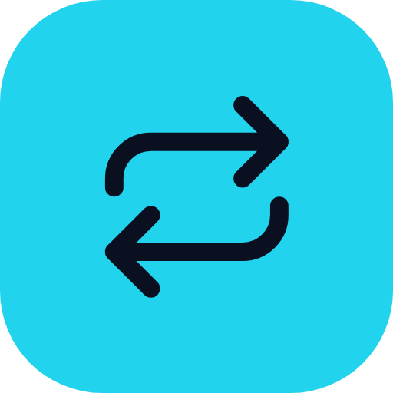
15 PRACTICE
Troubleshooting
ImagePullBackOff
No endpoints
CrashLoopBackOff
Wrong image tag.
Label typo.
Missing setting.
Found with kubectl, fixed with apply -f.
Notes:
I broke three deployments on purpose and fixed them. One had an image tag that does not exist, one had a label typo so the service found no pods, and one crashed because a setting was missing. For each I used kubectl get, describe, events and logs, then fixed the file and applied it again.

Slide 17
16 WHY KUBERNETES
Why Kubernetes?
 | Self-heals | Auto scales | Rolling updates | Any cloud
Docker Compose only | Partly | No | No | Yes
A single VM | No | No | No | Yes
Managed container service | Yes | Yes | Yes | No
Kubernetes | Yes | Yes | Yes | Yes
Kubernetes does it all, on any cloud. The price is more to learn.
Notes:
I looked at four ways to run the app. Compose alone and a single server are simple but cannot scale or heal themselves. A managed container service does, but only on one cloud. Kubernetes does all of it on any cloud, and the price is that it is harder to learn.

Slide 18

17 RESULTS
Results in numbers
32
15
5m 31s
0
tests pass
API endpoints
full pipeline
HIGH or CRITICAL
5
2 to 6
309 MB
90.5 MB
pods running
backend pods (HPA)
backend image
frontend image
Notes:
These are the real numbers from the project. Thirty two tests pass, the API has fifteen endpoints, and the whole pipeline takes about four minutes. Both images are clean in Trivy, the backend scales from two to six pods, and the images are small.

Slide 19

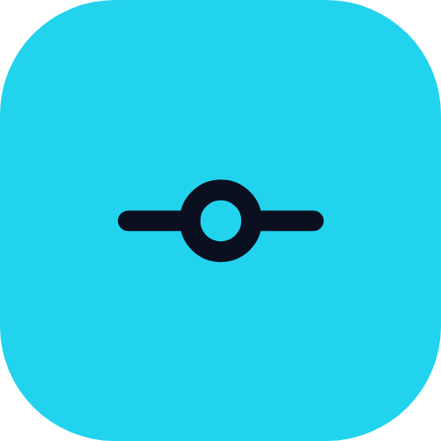
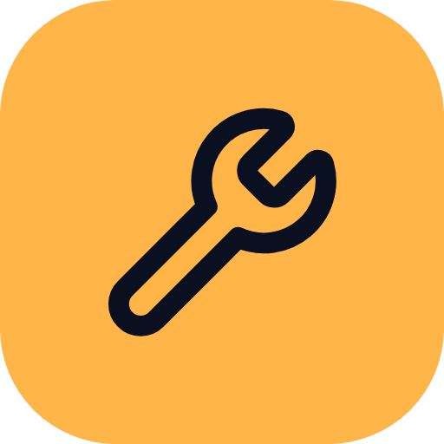
18 LEARNED
What I learned
One job per tool
Pin versions, scan images
Small commits, easy fixes
Seven stages, one pipeline.
Break it, then fix it
Notes:
My biggest lesson is that every tool has one job, and the pipeline joins them together. Pinning versions and scanning images catches problems early. Small commits make problems easy to find, and breaking things on purpose is the fastest way to learn how to fix them.

Slide 20


Thank you
From code to a monitored cluster.
github.com/brixdorf/ironpass-devops-capstone
Scan to open the repo
Notes:
Thank you for watching. The code, the screenshots and the documentation are all in the GitHub repository, and you can reach it with the QR code.

