Slide 1
Causal Discovery for Trustworthy AI
Fabrizio Russo
LUISS - 14/03/2025

Slide 2
Overview
My Journey
Causal Models
Causal Discovery
Methods
Conclusion
Questions

Slide 3

My Journey
From Finance to Artificial Intelligence
2009-2012 Roma – Tor Vergata: BSc Economics & Finance
Madrid – Autónoma: Erasmus
2013-2014 London: Sales Assistant
2014-2020 London: General Electric Capital & 4most
- Credit Risk Analyst
- Credit Risk Consultant
- Managing Consultant
- Head of Data Science
2016-2018 London – Birkbeck College: MSc Applied Statistics
2020-2024 London – Imperial College: PhD Safe and Trusted AI
2025-Present London – Imperial College: Research Associate

Slide 4
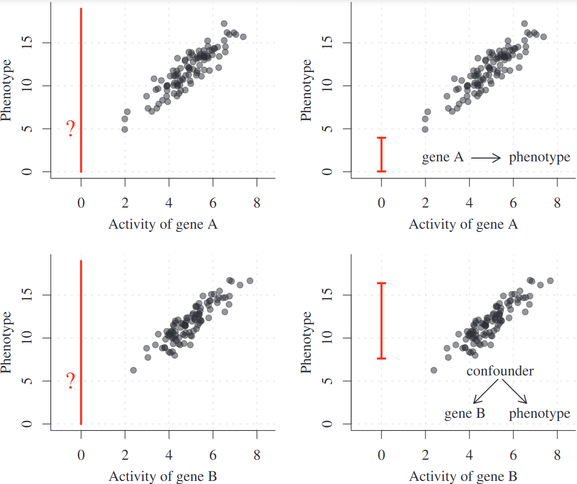
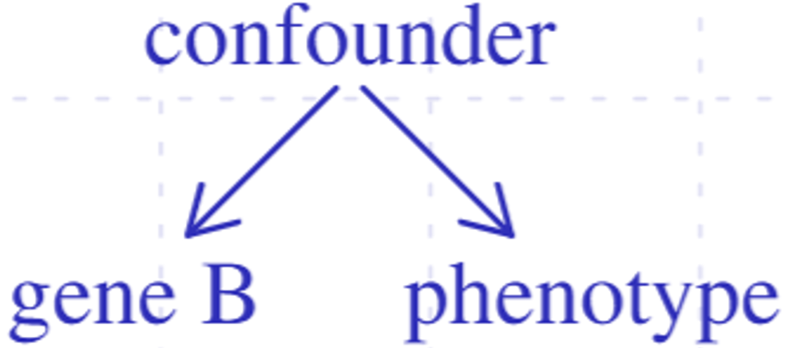
Causal Models
Example and images from Peters J, Janzing D and Scholkopf B. “Elements of Causal Inference”, 2017
Why Bother?
Predictive Models
Causal Models
What if we observe Phenotype = 10?
What if we observe gene A = 4?
What if we inhibit gene A?
What if patient X did not have gene B?

Slide 5
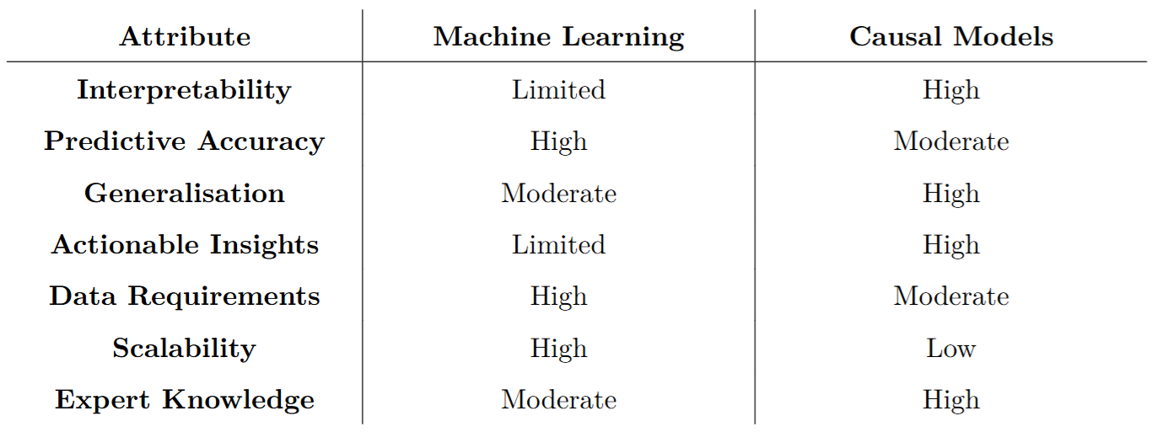
Machine Learning vs Causal Models
High-Level Comparison

Slide 6
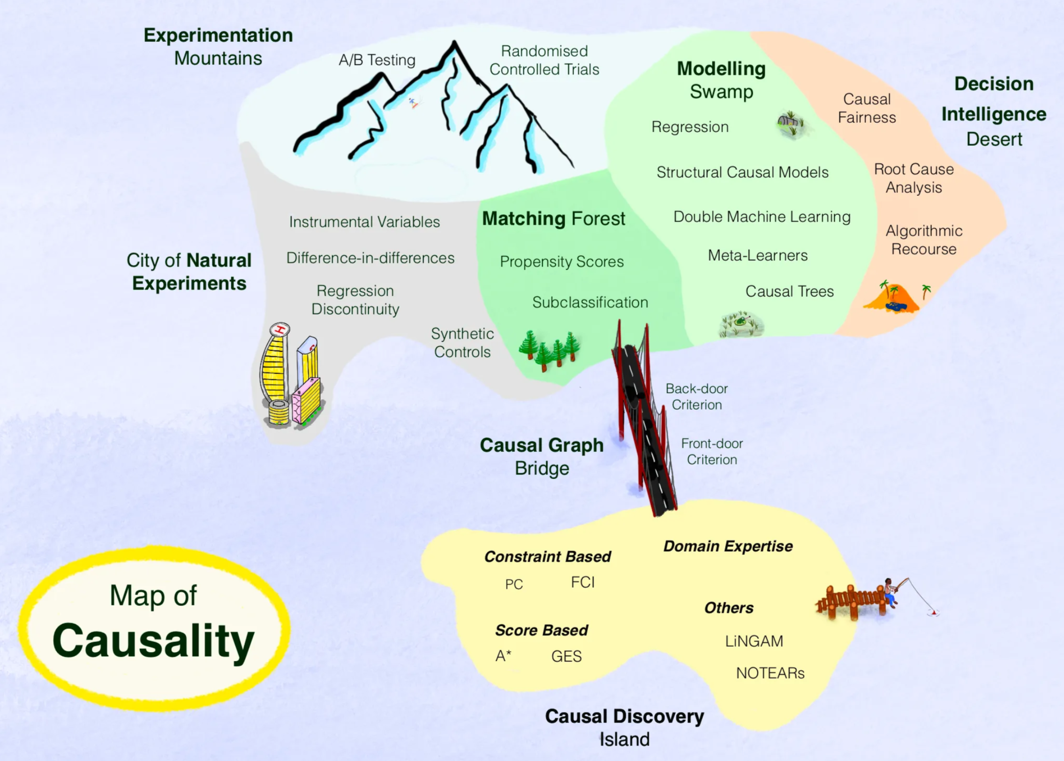
Image from https://towardsdatascience.com/how-to-understand-the-world-of-causality-c698cdc9f27c

Slide 7
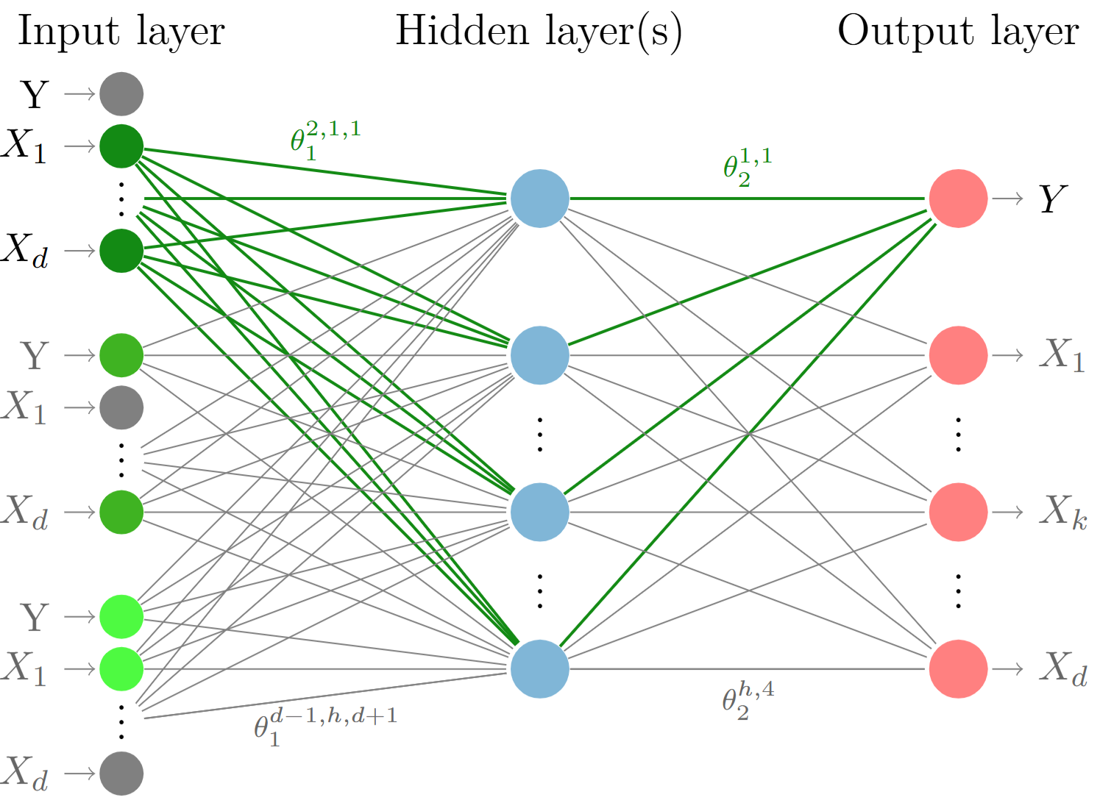
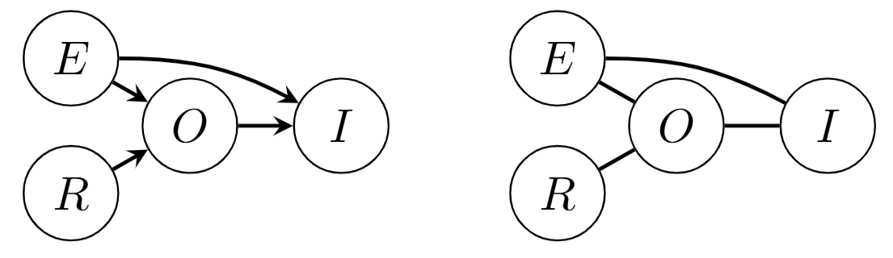
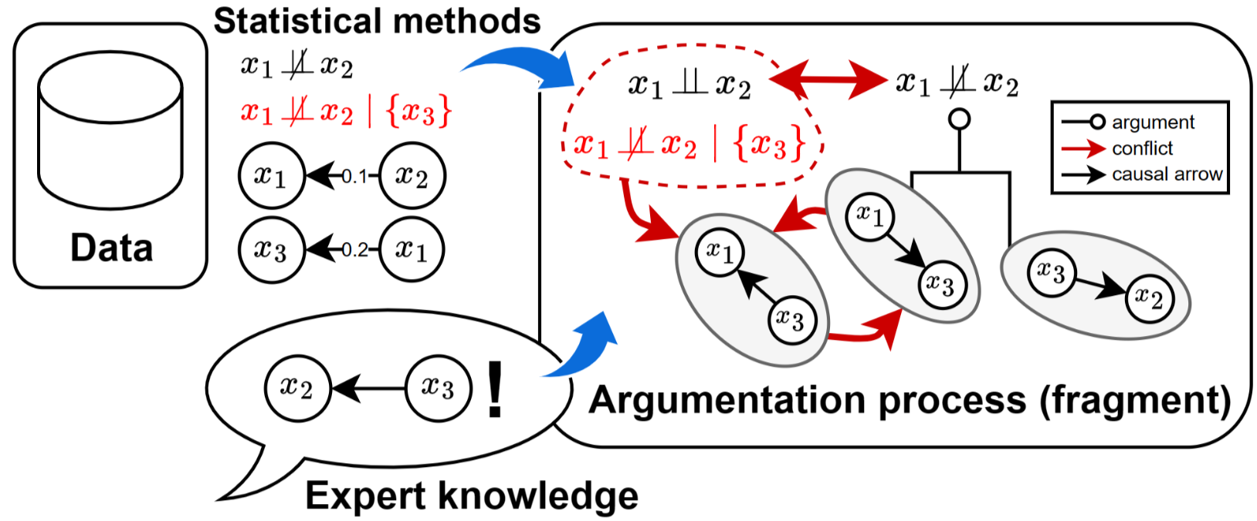



Causal Discovery for Trustworthy AI
Methods
Contestable Neural Networks
Causal Discovery with Shapley Values
Argumentative Causal Discovery
Published at ECAI 2023
Expose the learned graph to SMEs and allow them to modify it
Learn a causal Graph while fitting a neural network
Inject the graph back into the NN
Published at CLeaR 2025
Embed the decision rule into the PC algorithm
Learn a causal graph with asymptotic guarantees
Identify colliders given a skeleton using Shapley Values
Published at KR 2024
Represent DAGs and d-Separation in ABA
Allow external knowledge to be input into the framework
Guarantee consistency of output DAG with a subset of the input

Slide 8
Conclusions
& Future Work
Contestable NN
Method & Process to align NNs to SMEs’ causal view
Future: human studies, indirect effects, counterfactual reasoning
Shapley-PC
Method to improve robustness of causal discovery
Future: extend to other phases of PC, handle latent confounders, and score methods
Causal ABA
Method to increase consistency guarantees and allow contestability
Future: scalability, latent confounders, human studies

Slide 9
Questions?
Get in touch
fabrizio@imperial.ac.uk

