Slide 1
CausAlly
Collaborative Causal Discovery for AI-Aided Decision-Making
Fabrizio Russo – Minds and Machines Workshop – University of Queensland, 21.11.2025
Notes:
Good Morning, I appreciate the opportunity to present my research proposal today. The title of my proposal is CausAlly, which aims at delivering collaborative causal discovery for AI-aided decision making.
Every day, decision‑makers—from clinicians to policymakers—face questions like: Which intervention will actually reduce health inequalities?
Running randomized trials isn’t always feasible.
Instead, we turn to causal discovery algorithms that infer cause–effect from observational data.
But today’s methods are opaque: experts see a final graph, but can’t probe its assumptions, challenge its links, or guide the process. This black‑box nature undermines trust and limits adoption in high‑stakes settings.

Slide 2
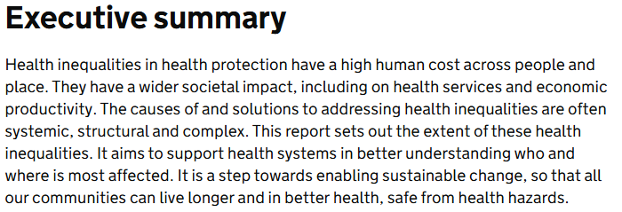
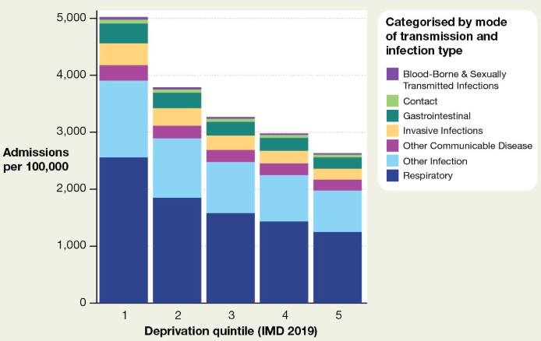
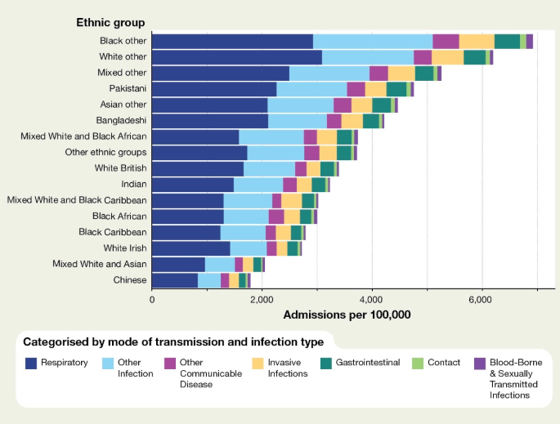
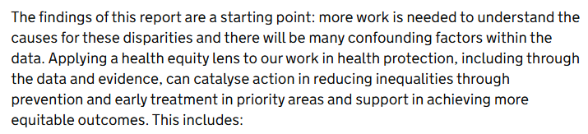
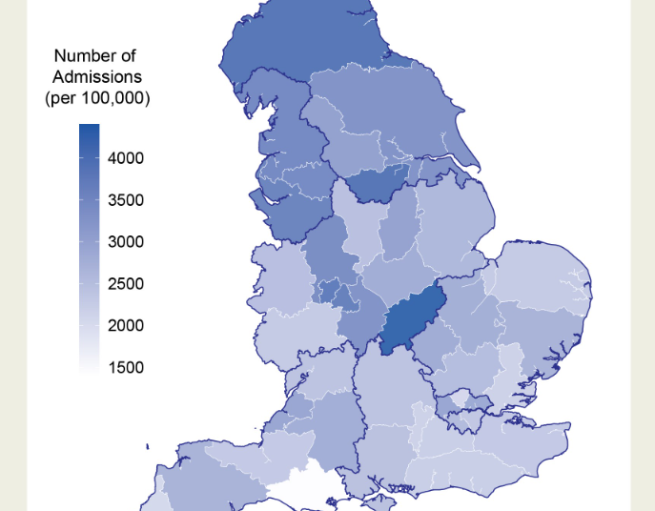
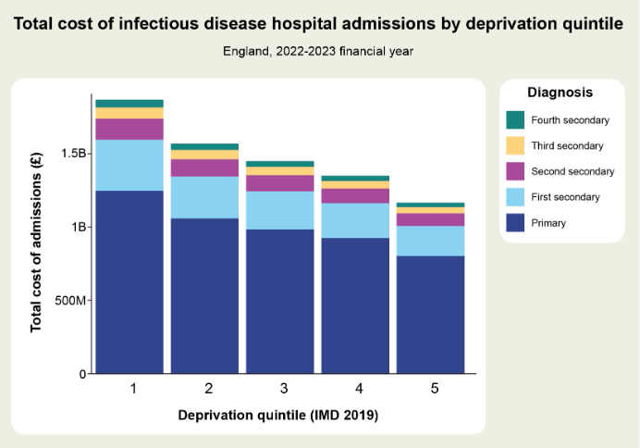
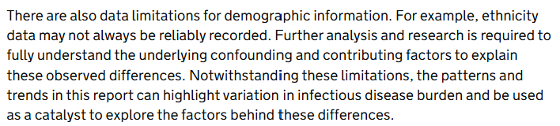




Health Inequalities in Health Protection
Notes:
Let’s have a look at a motivating example from a recent policy report:
The 2025 health inequalities in health protection report came out in May 2025. It highlighted
those living in the 20% most deprived areas have emergency hospital admission rates due to infectious disease almost twice as high as compared to the least deprived
Emergency hospital admission rates for tuberculosis (TB) were 29 times higher for the ‘Asian other’ group, 27 times higher for the Indian group and 15 times higher for the ‘Black African’ group, compared to the ‘White British’ group
those living in the North West have overall emergency hospital admission rates 1.3 times higher than the England average and over 1.5 higher than the South East
these inequalities are costly to the health system; inequalities in infectious disease emergency hospital admissions are estimated to amount to between £970 million and £1.5 billion per year in avoidable costs to the NHS
Understanding differences will support targeted and evidence-based strategies and interventions to be developed at local, regional and national levels to reduce inequalities and improve health security across England.

Slide 3
Causal Discovery and Causal Graphs
To the rescue…
“This analysis only considers admissions to hospital. There are some infections that rarely cause hospital admission but may also have marked inequalities, for example some sexually transmitted infections and bloodborne viruses.”
Transmission Type
Severity of Infection
Hospital Admissions
Risk of Infection
Socio-economic
Ethnicity
Overcrowded Housing
Notes:
In the report, when analysing the inequalities between different levels of deprivation, this is mentioned.
Some infections rarely cause admission
This is called selection bias – your data is biased because you are conditioning on a variable (hospital admission). Sometimes it is unavoidable, but with causal tools you can account for it in your analysis and avoid wrong conclusions.
For example, the causal graph for this phenomenon could look like this: where we would observe a correlation between transmission type and severity, within the hospitalised population, even if the two variables are not causally linked.
Then an immunologist suggests that there should be another path between type and admission, passing by the risk of infection.
Studies show also that socio-economic status will impact the risk of infection but there’s no studied link yet between this and overcrowding, or with Ethnicity acting as confounder of the two.
This could be augmented and validated by data, which is where CausAlly comes in.

Slide 4
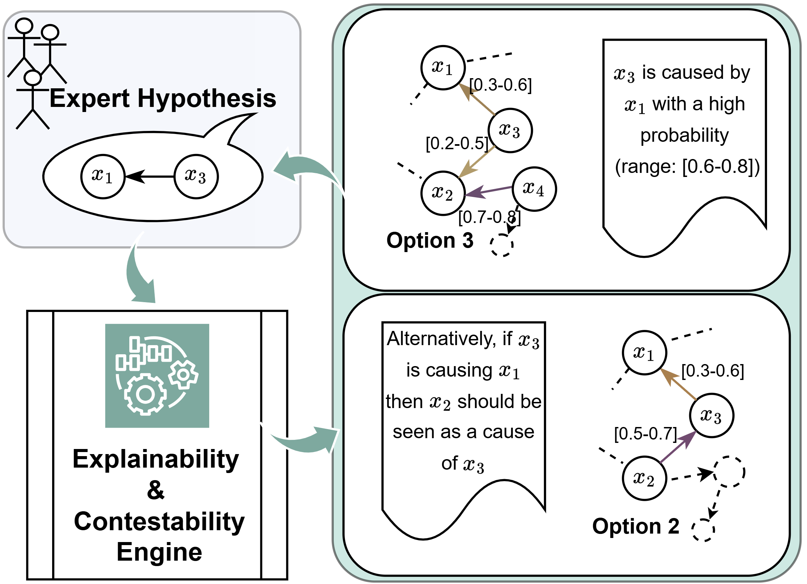
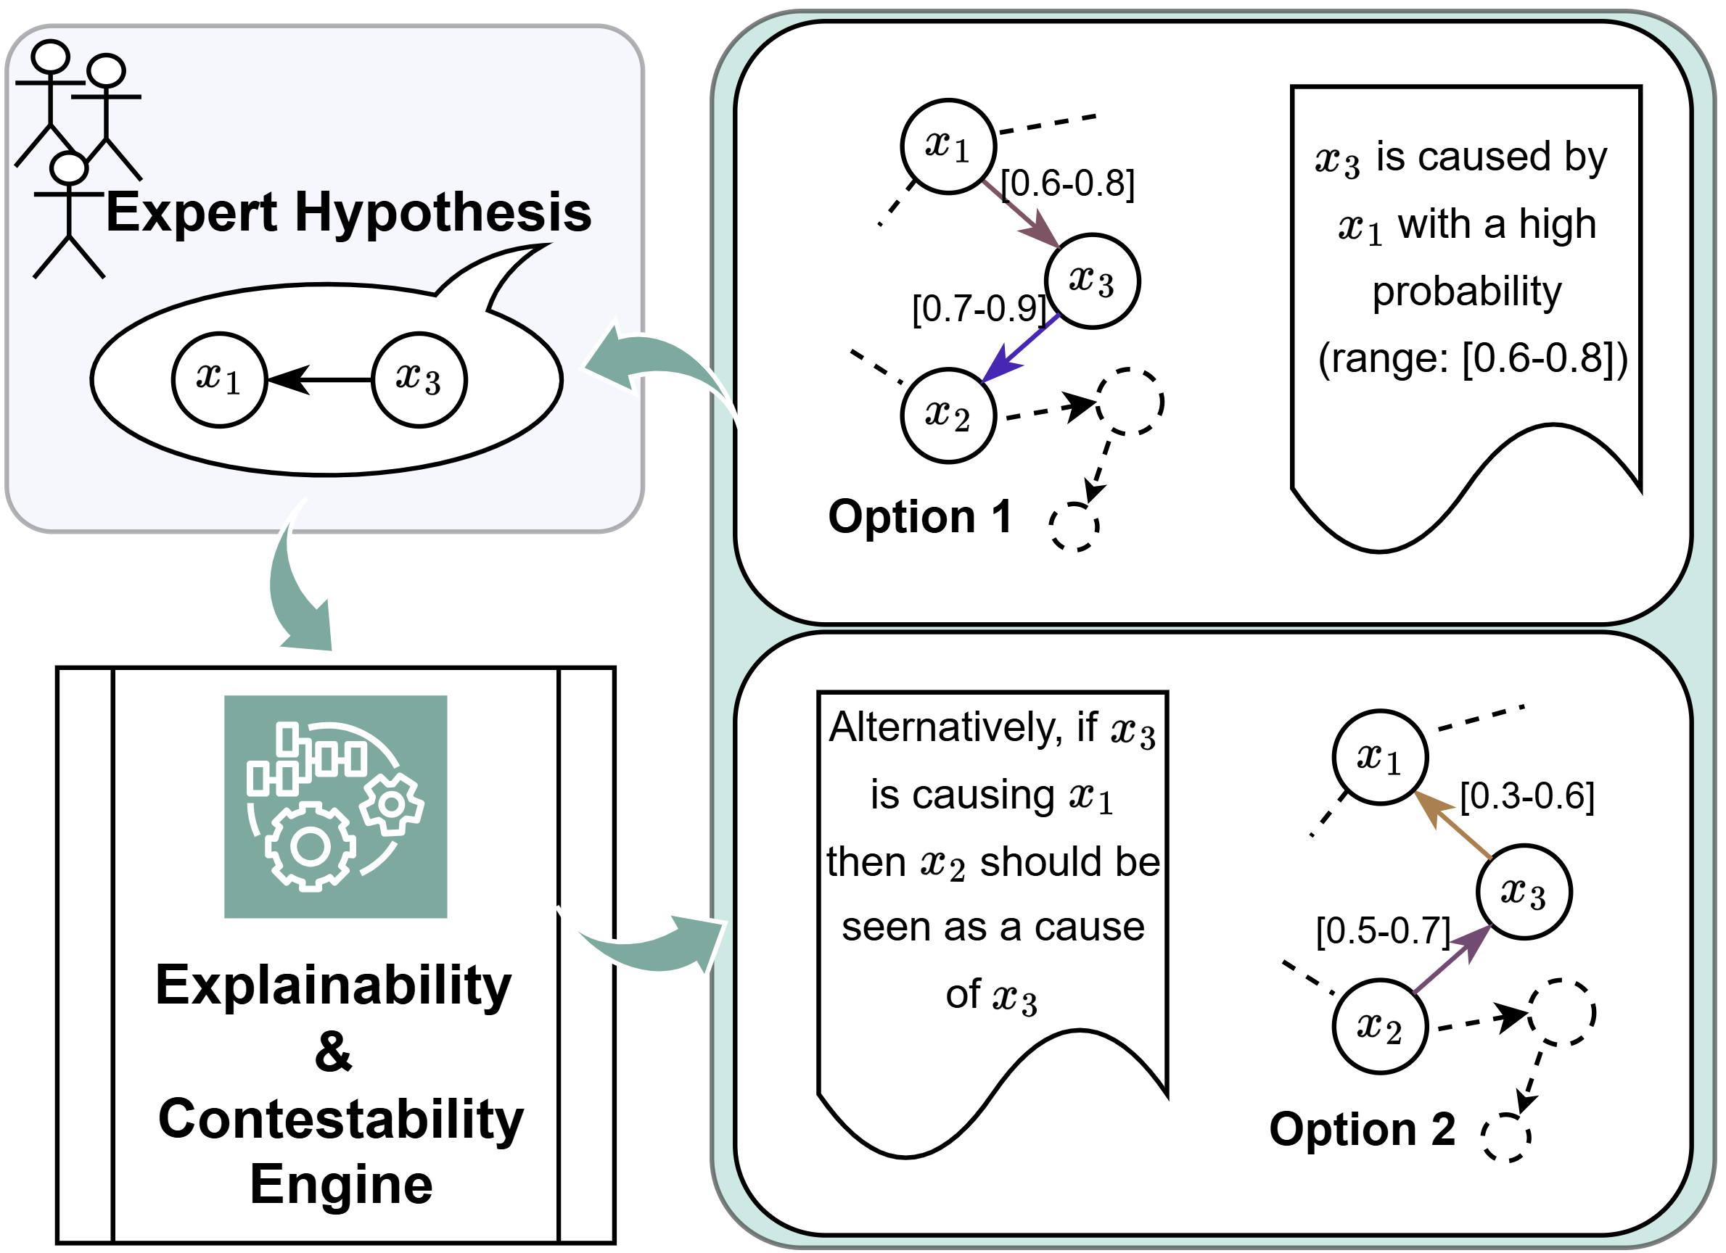
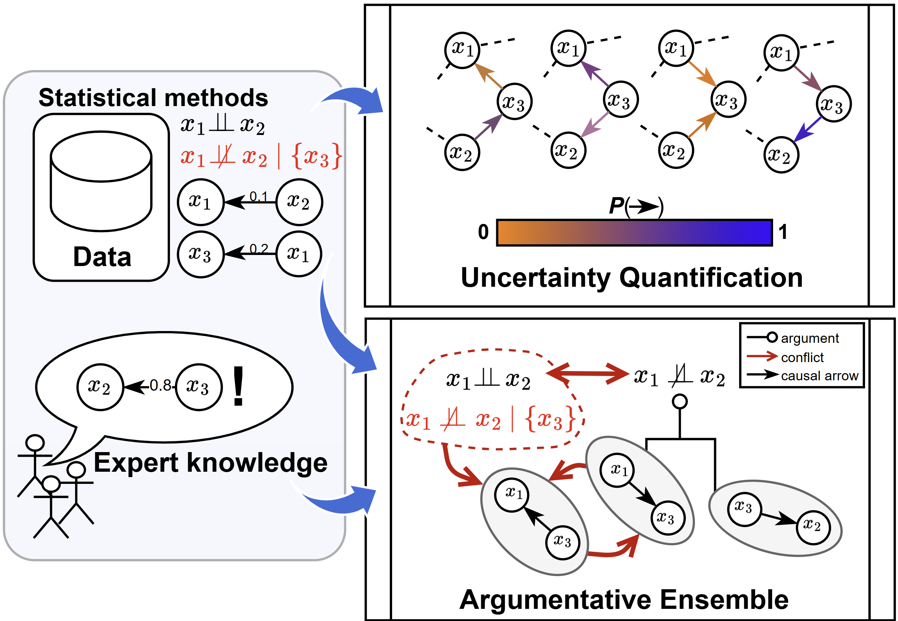


CausAlly – Collaborative Causal Discovery
A dialogue between experts and data
Notes:
CausAlly reframes causal discovery as an interactive conversation. Rather than passively observing a final model, experts propose alternatives, inspect evidence, and challenge assumptions.
It is based on a new paradigm called Evaluative AI, proposed by Tim Miller, which provably reduce cognitive biases in decision-making by supporting the expert rather than trying to convince them.
Under the hood, an ensemble of causal discovery methods runs in parallel. The interface surfaces where methods agree, where they conflict, and how confident each link is. This empowers experts to co‑create causal models they trust.
You can then challenge any arrow—say, ‘Why is overcrowiding not in this path?’—and the engine re‑evaluates with that constraint.
Key aspects of the proposal are:
the Evaluative AI nature of the proposed methodology, to decrease biases and put experts in the driver’s seat
The argumentative framework that will guide the integration of different views both from data and experts
The uncertainty-driven use of data, to guide informed and principled decision-making.

Slide 5
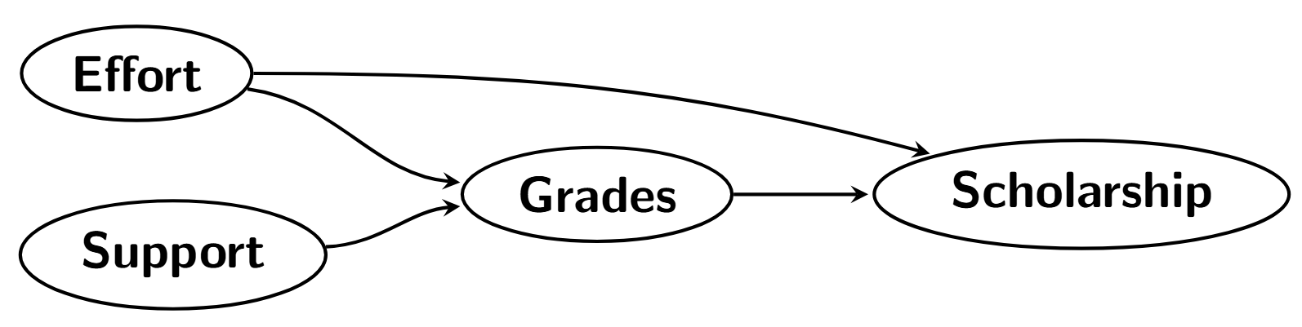
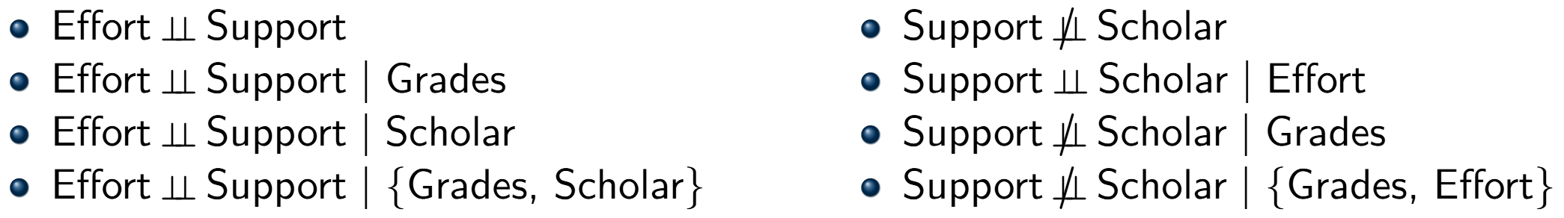
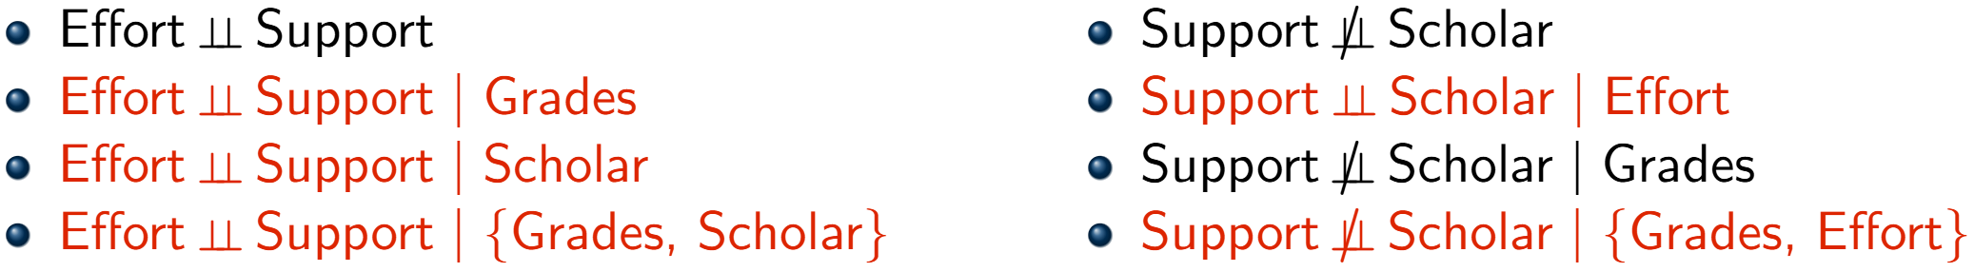
Causal Discovery
A simple example

Slide 6

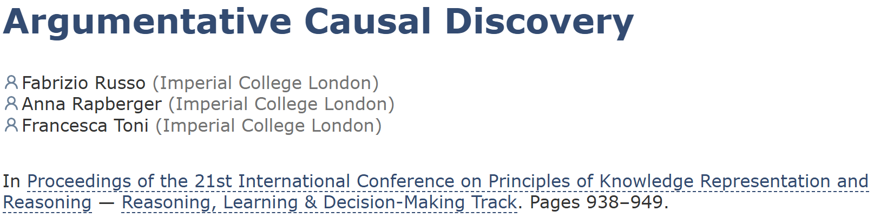
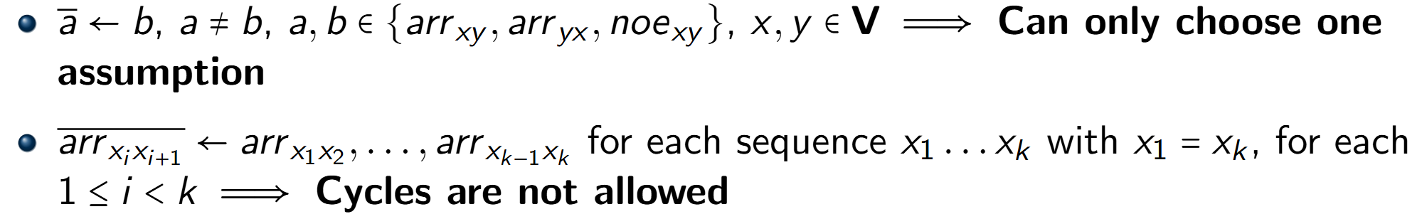
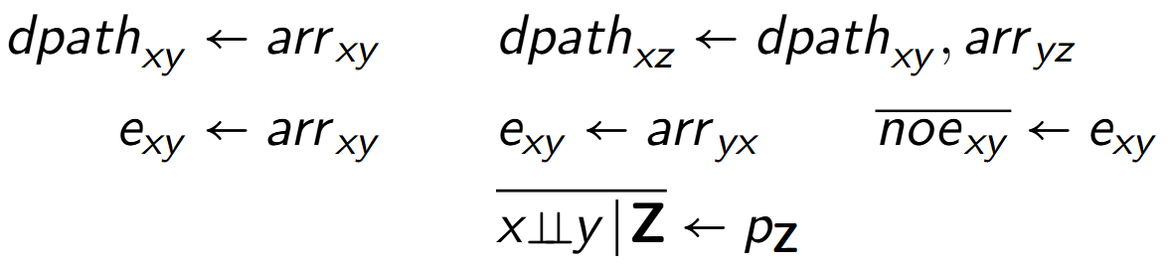
Causal ABA
Assumptions
Rules

Slide 7
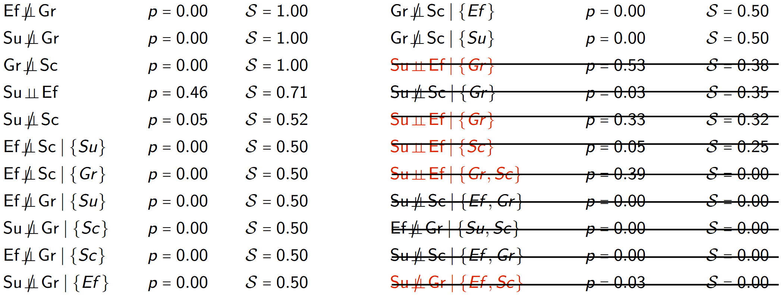
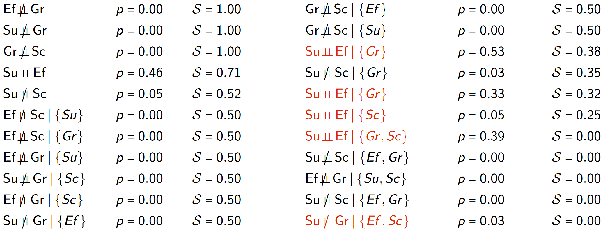
Causal ABA
Example continued

Slide 8
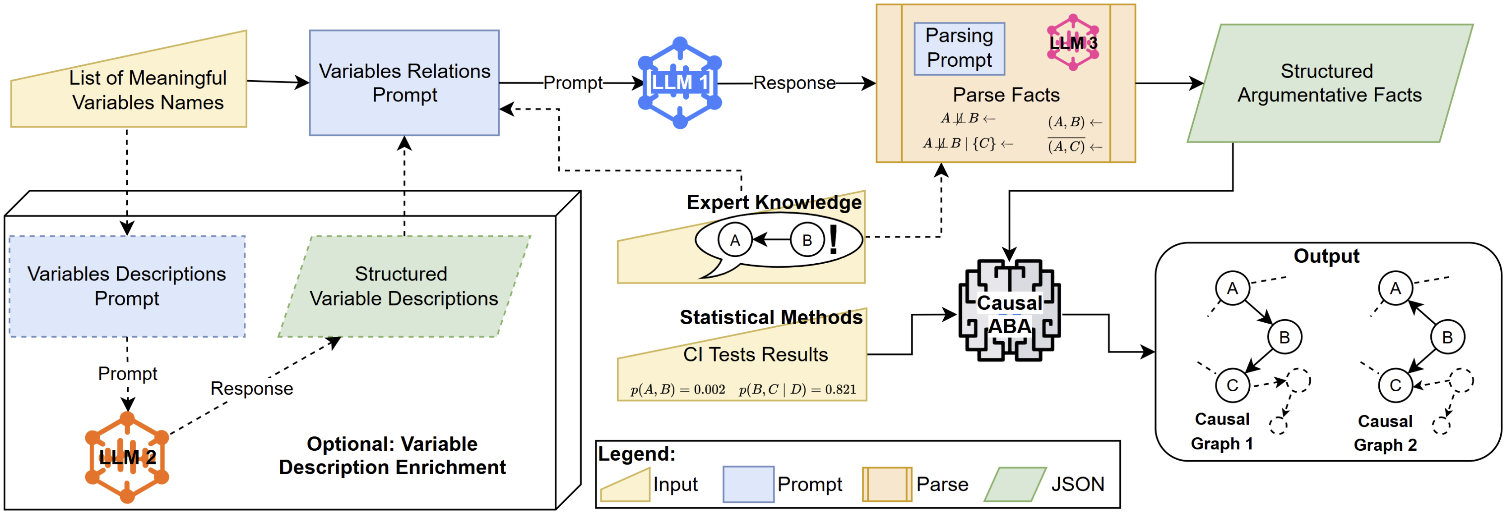
Causal ABA Ensemble

Slide 9
CausAlly – Collaborative Causal Discovery
A dialogue between experts and data
Notes:
CausAlly reframes causal discovery as an interactive conversation. Rather than passively observing a final model, experts propose alternatives, inspect evidence, and challenge assumptions.
It is based on a new paradigm called Evaluative AI, proposed by Tim Miller, which provably reduce cognitive biases in decision-making by supporting the expert rather than trying to convince them.
Under the hood, an ensemble of causal discovery methods runs in parallel. The interface surfaces where methods agree, where they conflict, and how confident each link is. This empowers experts to co‑create causal models they trust.
You can then challenge any arrow—say, ‘Why is overcrowiding not in this path?’—and the engine re‑evaluates with that constraint.
Key aspects of the proposal are:
the Evaluative AI nature of the proposed methodology, to decrease biases and put experts in the driver’s seat
The argumentative framework that will guide the integration of different views both from data and experts
The uncertainty-driven use of data, to guide informed and principled decision-making.

Slide 10
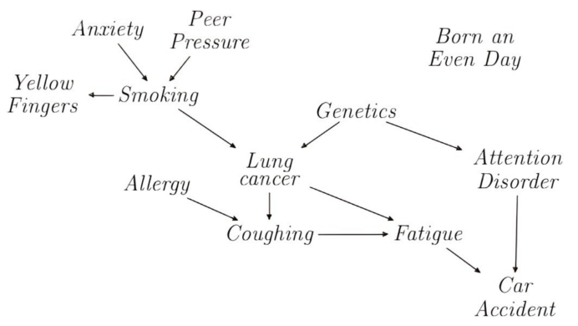
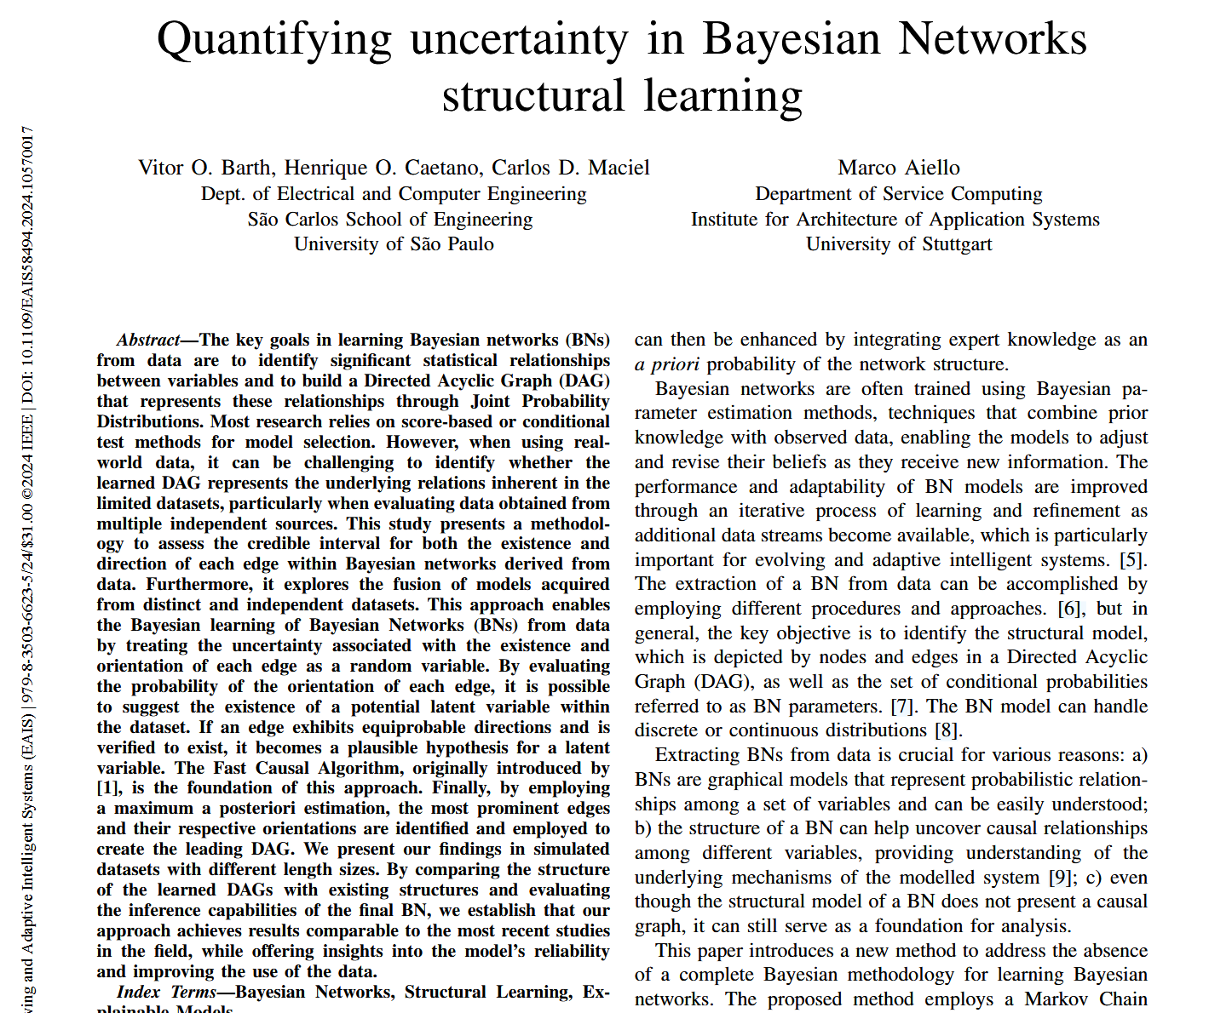
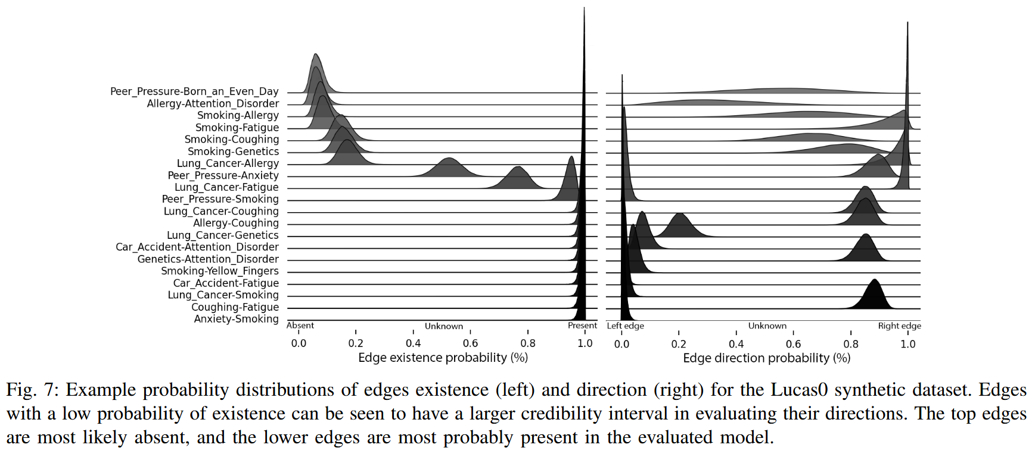
Uncertainty
In causal graphs

Slide 11
CausAlly – Collaborative Causal Discovery
A dialogue between experts and data
Notes:
CausAlly reframes causal discovery as an interactive conversation. Rather than passively observing a final model, experts propose alternatives, inspect evidence, and challenge assumptions.
It is based on a new paradigm called Evaluative AI, proposed by Tim Miller, which provably reduce cognitive biases in decision-making by supporting the expert rather than trying to convince them.
Under the hood, an ensemble of causal discovery methods runs in parallel. The interface surfaces where methods agree, where they conflict, and how confident each link is. This empowers experts to co‑create causal models they trust.
You can then challenge any arrow—say, ‘Why is overcrowiding not in this path?’—and the engine re‑evaluates with that constraint.
Key aspects of the proposal are:
the Evaluative AI nature of the proposed methodology, to decrease biases and put experts in the driver’s seat
The argumentative framework that will guide the integration of different views both from data and experts
The uncertainty-driven use of data, to guide informed and principled decision-making.

Slide 12
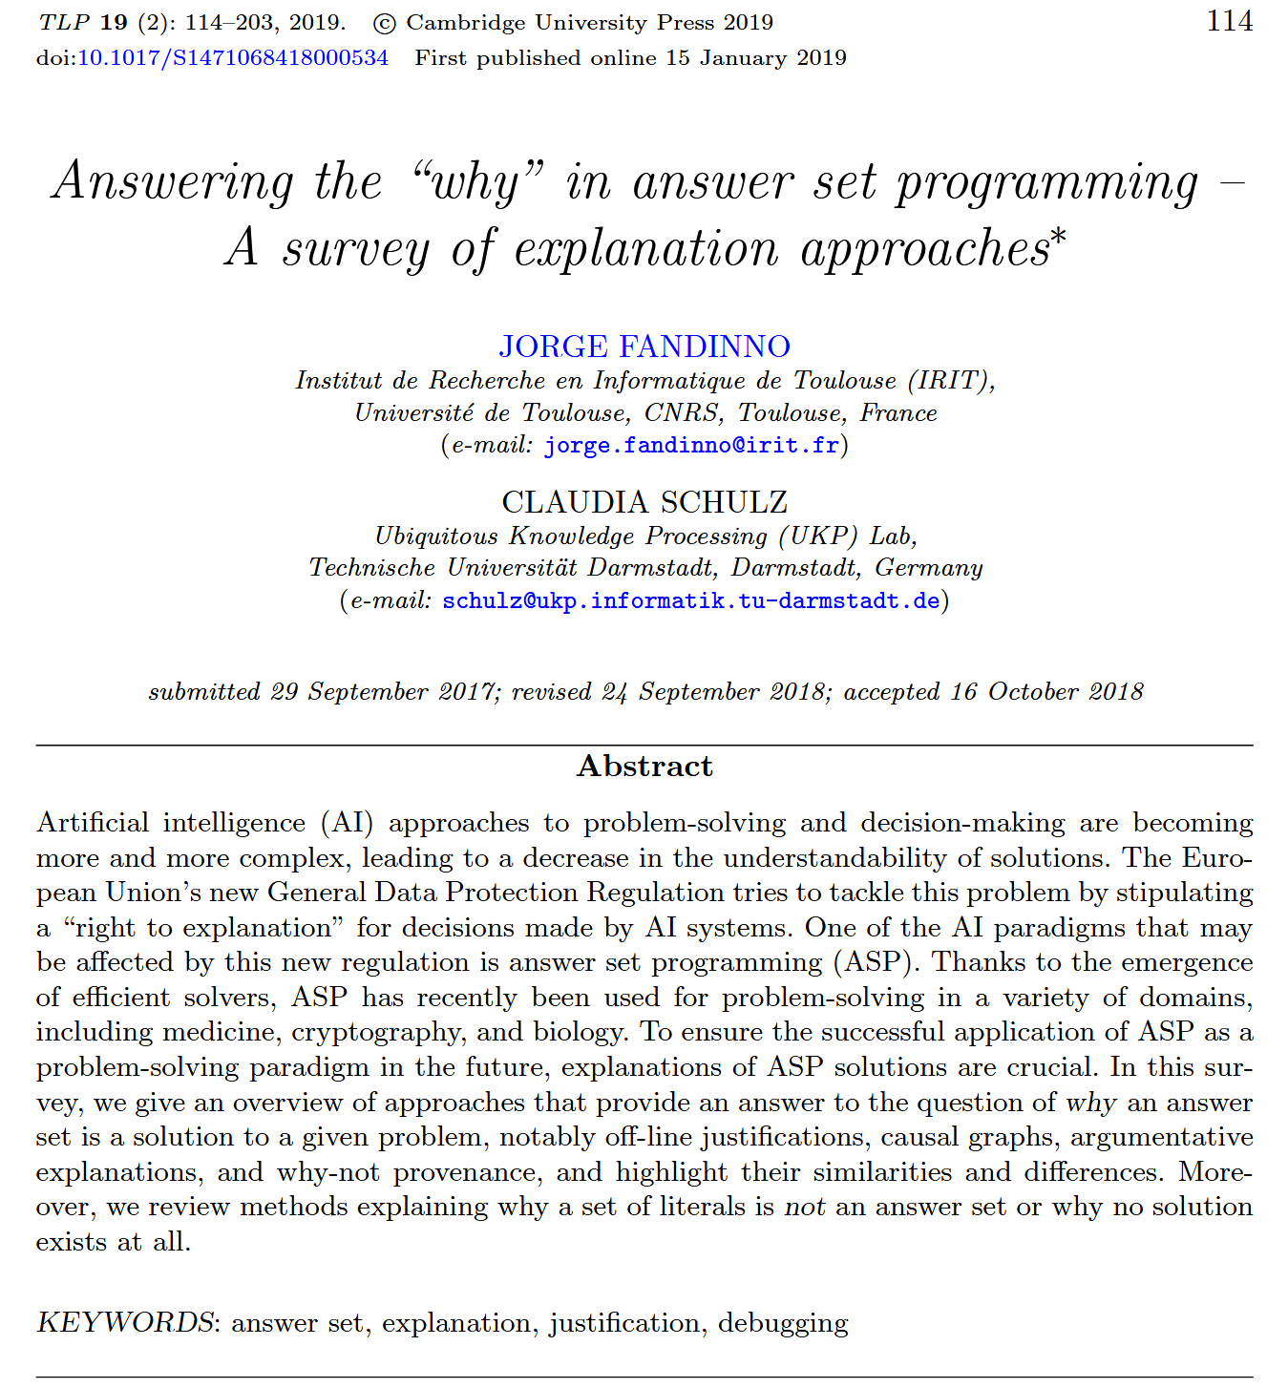
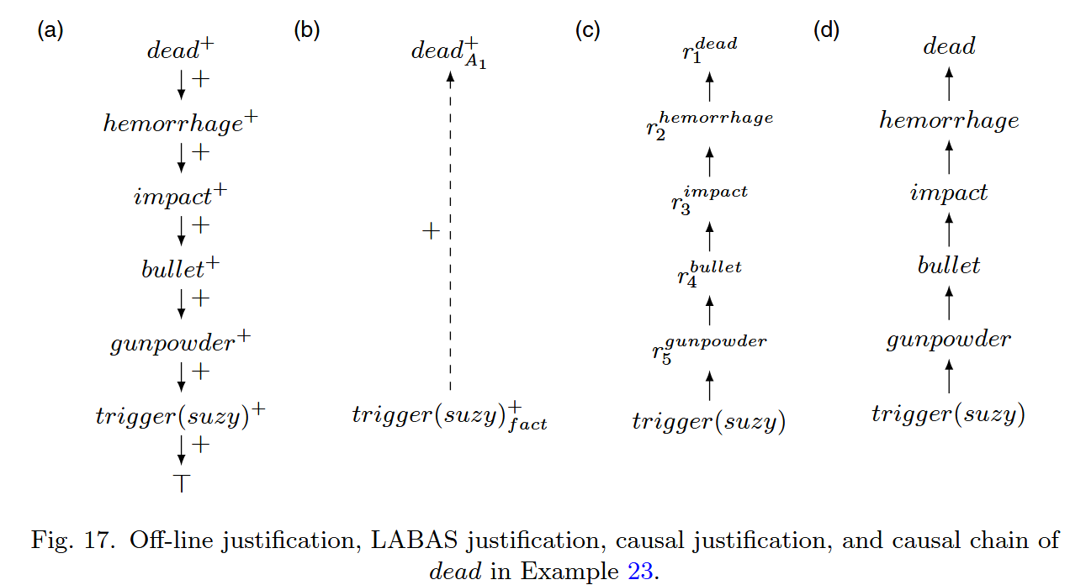
Explanations
In Answer Set Programming
Consider a scenario in which Suzy pulls the trigger of her gun, causing the gunpowder to explode. This causes the bullet to leave the gun at a high speed, impacting on Billy’s chest, provoking a massive hemorrhage, and, consequently, Billy’s death.

Slide 13
CausAlly – Collaborative Causal Discovery
A dialogue between experts and data
Notes:
CausAlly reframes causal discovery as an interactive conversation. Rather than passively observing a final model, experts propose alternatives, inspect evidence, and challenge assumptions.
It is based on a new paradigm called Evaluative AI, proposed by Tim Miller, which provably reduce cognitive biases in decision-making by supporting the expert rather than trying to convince them.
Under the hood, an ensemble of causal discovery methods runs in parallel. The interface surfaces where methods agree, where they conflict, and how confident each link is. This empowers experts to co‑create causal models they trust.
You can then challenge any arrow—say, ‘Why is overcrowiding not in this path?’—and the engine re‑evaluates with that constraint.
Key aspects of the proposal are:
the Evaluative AI nature of the proposed methodology, to decrease biases and put experts in the driver’s seat
The argumentative framework that will guide the integration of different views both from data and experts
The uncertainty-driven use of data, to guide informed and principled decision-making.

Slide 14
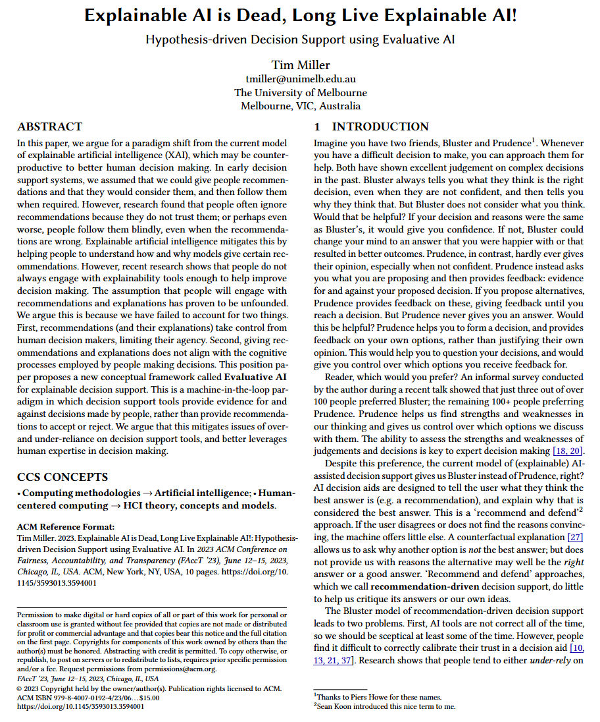
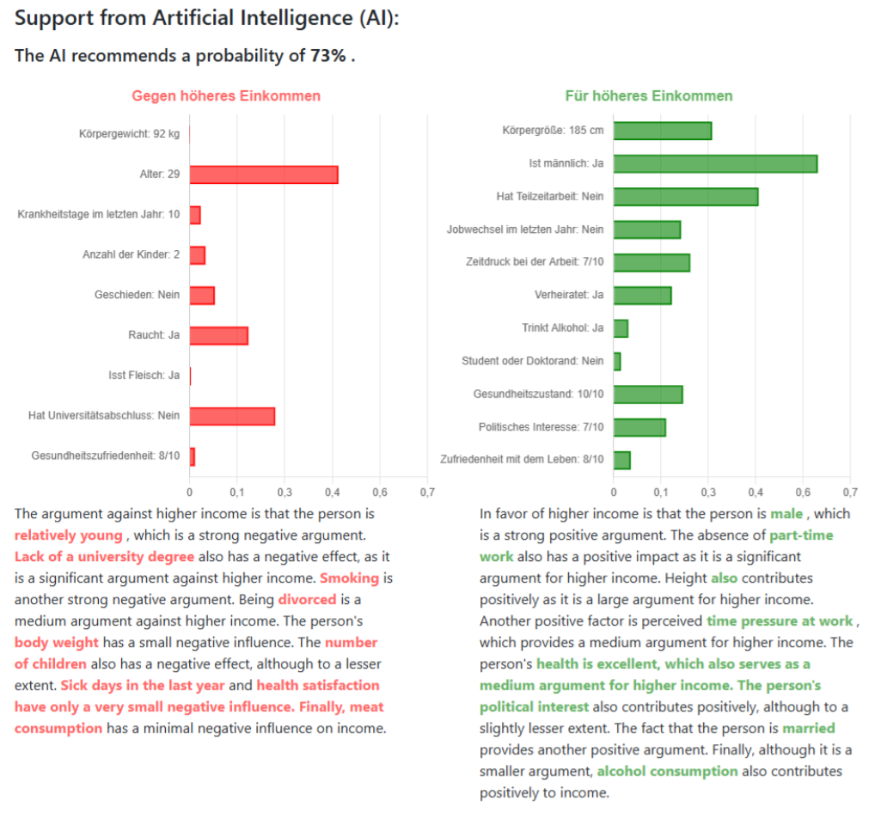
Evaluative AI

Slide 15
Causal Explanations or Explanations of Causality?
fabrizio@imperial.ac.uk
Notes:
Thank you—I look forward to your questions and discussion

Slide 16
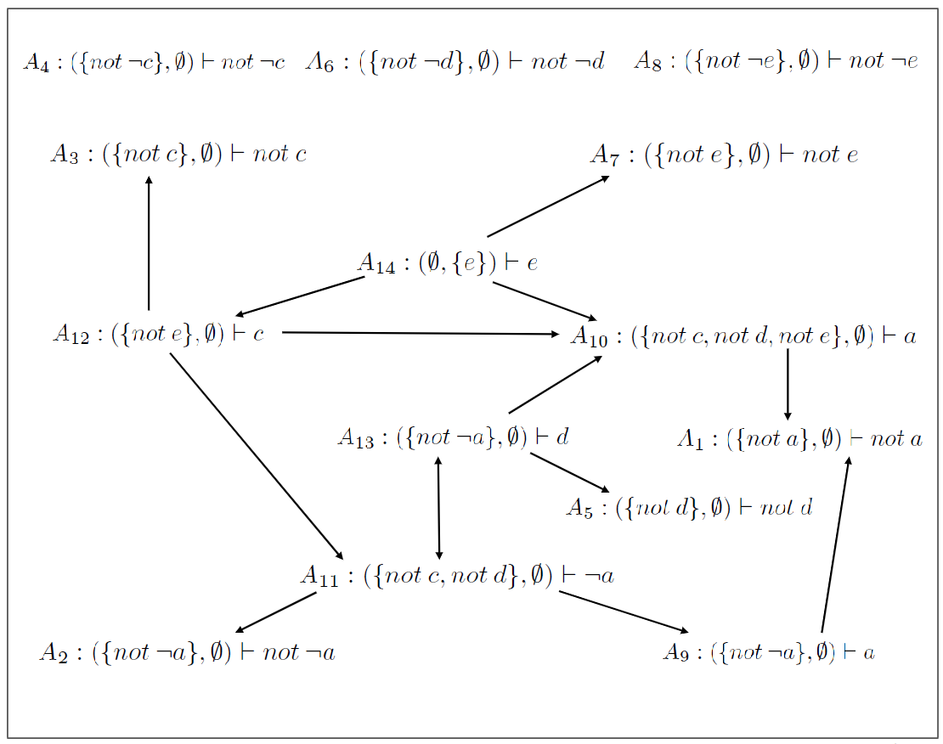
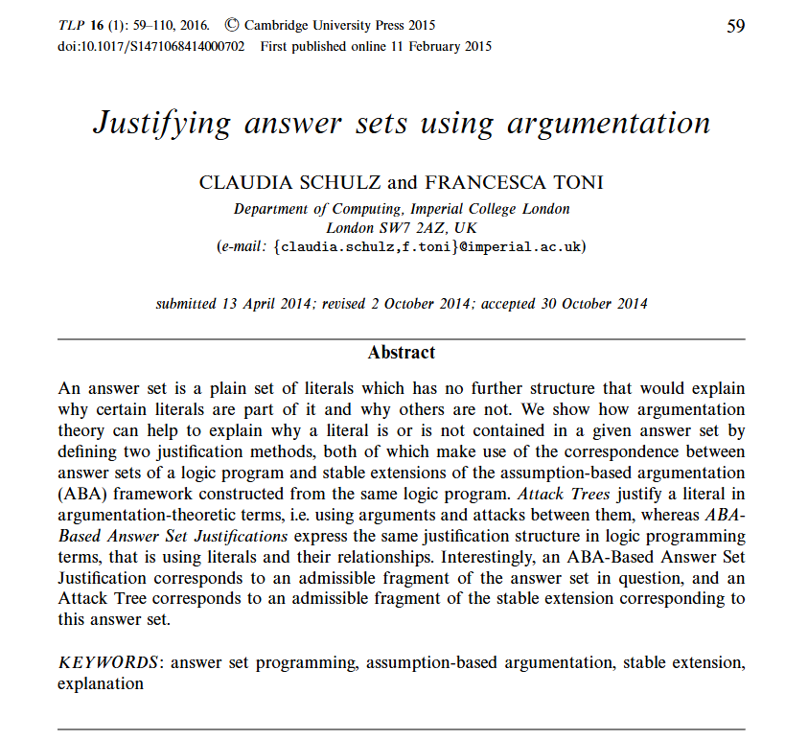
Explanations
Derivation Trees

Slide 17
Roadmap
and potential impact
Uncertainty
Ensembles
Bounds
Explainability
Visual
Dialogue
Contestability
Redress
Policy Case Study
Notes:
CausAlly delivers co‑created causal insights that policymakers can trust and act upon.
We’ll complete our ensemble and uncertainty modules,
Get on with explainability
And then contestability
With the aim to run a pilot with health‑policy partners on a real life policy question.
These features constitute novel elements of the causal discovery literature, with a very practical aim:
enable decision-makers might they be civil servants or health practitioners, to interrogate, refine, and trust the causal logic behind decisions.
Ultimately, this work introduces a new paradigm for AI-supported decision-making—one in which causal inference is not delivered to experts, but developed with them. It will help establish best practices for integrating causal reasoning into policy workflows, strengthen public trust in AI systems, and contribute to the UK’s broader ambition to lead in safe, transparent, and socially grounded AI adoption.

