Slide 1
Data Structures
Assoc. Prof. Dr. Meryem ŞERİFİ

Slide 2
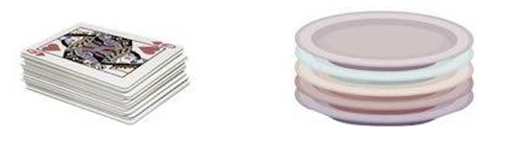
Stack
A stack is an Abstract Data Type (ADT), commonly used in most programming languages.
It is named stack as it behaves like a real-world stack, for example – a deck of cards or a pile of plates, etc.
A real-world stack allows operations at one end only. For example, we can place or remove a card or plate from the top of the stack only.

Slide 3
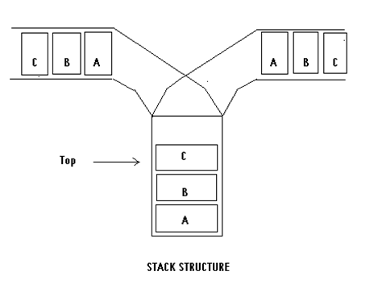
stack
A stack is a linear data structure that follows the Last In, First Out (LIFO) principle. This means the last element added to the stack will be the first one to be removed.

Slide 4
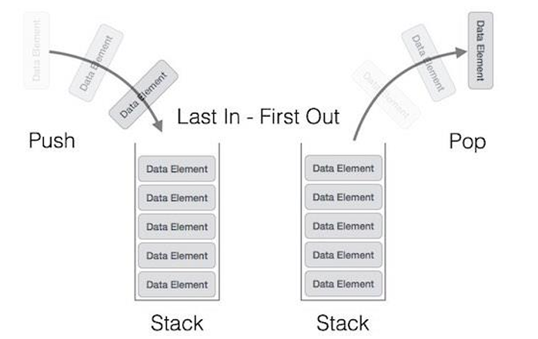
Stack
A stack can be implemented by means of Array, Structure, Pointer, and Linked List.

Slide 5
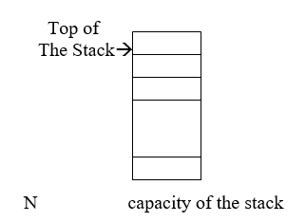
Stack
Stack is a region of memory in a computer system used for managing function calls, local variables, and control flow in programs.
If we represent a stack using vector elements
Stack can either be a fixed size one or it may have a sense of dynamic resizing.

Slide 6
Operations on Stacks
1. Push
Adds an element to the top of the stack.
2. Pop
Removes and returns the top element from the stack.
3. Peek/Top
Returns the top element of the stack without removing it.
4. IsEmpty
Checks if the stack is empty.
5. IsFull (for fixed-size stacks)
Checks if the stack has reached its maximum capacity (used in implementations with a predefined limit).
6. Size
Returns the number of elements currently in the stack.
7. Clear
Removes all elements from the stack, essentially resetting it to an empty state.

Slide 7
int peek() {
return stack[top];
}
bool isfull() {
if(top == MAXSIZE)
return true;
else
return false;
}

Slide 8
bool isempty() {
if(top == -1)
return true;
else
return false;
}

Slide 9
Operations on stack
Operations can be done only on the Top element.
A pointer Top keeps track of the top element in the stack.
Initially when the stack is empty Top has the zero value.
Each time a new element is inserted in the stack, pointer is incremented by one. This operation is called as Push operation.
And also the pointer is decremented by one each time a deletion is made from the stack. And this operation is called as Pop operation.

Slide 10
PUSH :
If Top >= n Then Print`Overflow message ` and exit
Top ← Top + 1
S(Top) ← X
Return
POP :
If Top <= 0 then print ` underflow message ` and exit
POP ← S(Top)
Top ← Top – 1
Return

Slide 11
Given a stack s, and an item i , performing the operation
push(s,i)
Adds the item i to the top of stack s. Similarly, the operation pop(s) removes the top element and returns it as a function value. Thus the assignment operation
i=pop(s);
removes the element at the top of s and assigns its value to i.
Let us assume that we have the following values in the stack( (a) and (b) only).

Slide 12
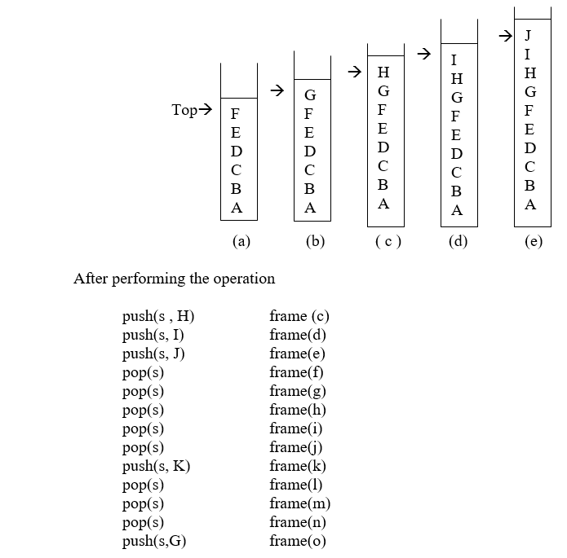

Slide 13
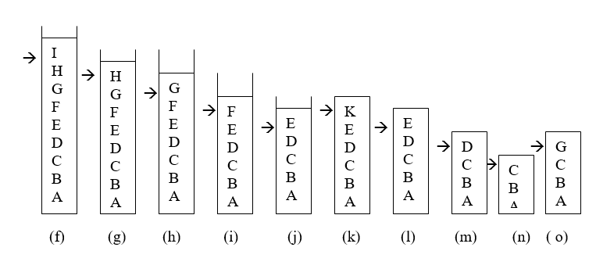

Slide 14
If a stack contains a single item and the stack is popped, the resulting stack contains no items and called the empty stack.
Although the push operation is applicable to any stack, the pop operation can not be applied to the empty stack because such a stack has no elements to pop.
Therefore, before applying pop operation to a stack, we must ensure that stack is not empty.
The operation empty(s) determines whether or not a stack s is empty. If the stack is empty, empty(s) returns the value TRUE; otherwise it returns the value FALSE.

Slide 15
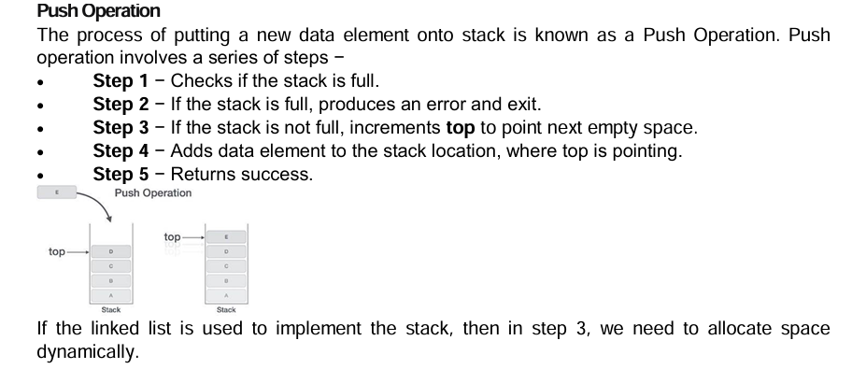

Slide 16
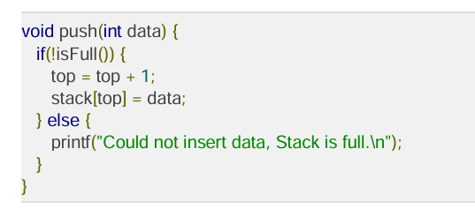

Slide 17
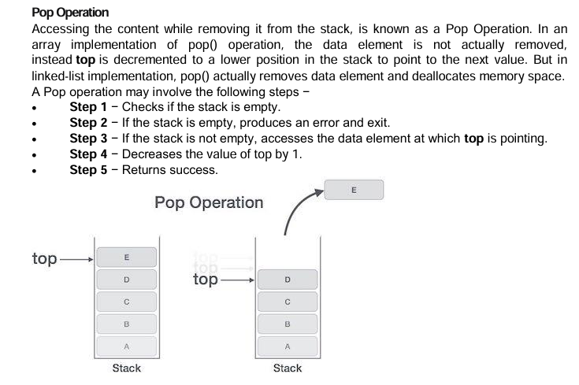

Slide 18
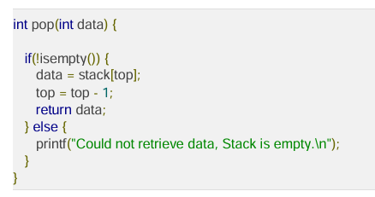

Slide 19
Another operation that can be performed on a stack to determine what the top item on a stack is without removing it.
This operation is written stacktop(s) and returns the top element of stack s.
The operation staktop(s) is not really a new operation, since it can be decomposed into a pop and a push.
i = stacktop(s);
is equivalent
i=pop(s);
push(s,i);

Slide 20
Example :
Consider a mathematical expression that includes several sets of nested parentheses; for example
7 – ( ( X * ( ( X + Y ) / ( J – 3 ) ) + Y ) / ( 4 – 2.5 ) )
We want to ensure that parentheses are nested correctly; that is, we want to check that
1. There are equal number of right and left parentheses.
2. Every right parenthesis is preceded by a matching left parenthesis.

Slide 21
Expressions such as
( ( A + B ) or A + B(
violate condition 1, and expression such as
) A + B ( - C or ( A + B ) ) – ( C + D
violate condition 2.

Slide 22
Let us define the parenthesis count at a particular point in an expression as the number of left parentheses minus the number of right parentheses that have been encountered in scanning the expression from its left end up to that particular point. If the parenthesis count is nonnegative, Then the two conditions that must hold .
1. The parenthesis count at the expression is 0. This implies that exactly as many right parentheses as left parentheses have been found.
2. The parenthesis count at each point in the expression is nonnegative. This implies that no right parenthesis is encountered for which a matching left parenthesis had not previously been encountered.

Slide 23
7 – ( ( X * ( ( X + Y ) / ( J – 3 ) ) + Y ) / ( 4 – 2.5 ) )
00 1 22 2 34 4 4 4 334 4 4 3 2 2 21 12 2 2 2 210

Slide 24
( ( A + B )
1 2 2 2 2 1
A + B (
0 0 0 1
) A + B ( - C
-1 -1 –1 –1 0 0 0
( A + B ) ) - ( C + D
1 1 1 1 0 –1 –10 0 0 0

Slide 25
Let us now change the problem and assume that three different types of delimiters exist which are parentheses((and)), brackets([and]), and braces ({and}).
Thus, strings such as
( A + B ]
[ ( A + B ] )
{ A – ( B ] }
are illegal
It is necessary to keep track of not only how many scopes have been opened but also of their types.

Slide 26
A stack may be used to keep track of the type of scopes encountered.
Whenever a scope opener is encountered, it is pushed onto the stack.
Whenever a scope ender is encountered, the stack is examined.
If the stack is empty, the scope ender does not have a matching opener and the string is therefore invalid.
If, however the stack is nonempty, we pop the stack and check whether the popped item corresponds to the scope ender.
If match occurs, we continue. If it does not, the string is invalid.
When the end of the string is reached, the stack must be empty; otherwise one or more scopes have been opened which have not been closed, and the string is invalid.

Slide 27
The algorithm for this procedure follows.
valid=true;
s=the empty stack;
while(we have not read the entire string)
{
read the next symbol(symb) of the string
if (symb==’(‘ | | symb ==’[‘ | | symb == ‘{‘ )
push(s, symb)
if (symb==’)‘ | | symb ==’]‘ | | symb == ‘}‘ )
if (emty(s))
valid = false;
else{
i = pop(s)
If ( i is not the matching opener of symb)
valid = false;
}
} /* end while */
if (!emty(s))
valid = false;
if (valid)
printf(“%s”, “the string is valid”);
else printf(“%s”,”the string is invalid “);

Slide 28
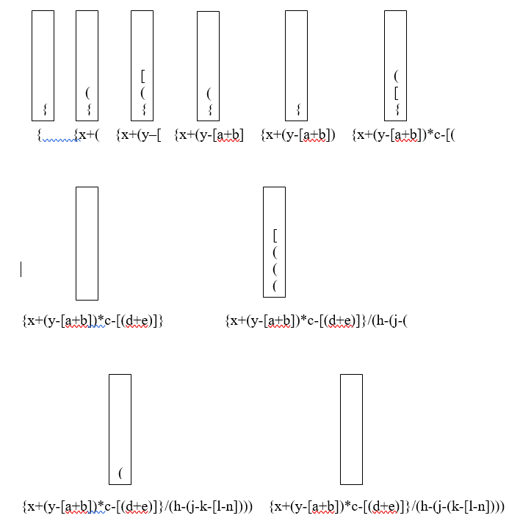
Assume that following string is given . Applying the given algorithm.
{ x + ( y – [ a + b ] ) * c – [ ( d + e ) ] } / ( h – ( j – ( k – [ l – n ] ) ) )

Slide 29
Representing Stacks in C
A Stack may be declared as a structure containing two objects :
An array to hold the elements of the stack,
and an integer to indicate the position of the current stack top within the array.
This can be done for a stack of integers by the declaration.
#define STACKSIZE 100
struct stack {
int top ;
int items[STACKSIZE];
};
Once this has been done, an actual stack s may be declared by
struct stack s;

Slide 30
The value of s.top is 4, there are five elements on the stack: s.items[0], s.items[1],..s.items[4].
When the stack is popped, the value of s.top is changed to 3 to indicate that there are now only four elements on the stack and the top element is s.items[3].
To initialize a stack s to the empty state, we may initially execute s.top=-1;
if (s.top == -1)
/* stack is emty */
else
/* stack is not empty */

Slide 31
int empty(struct stack *ps)
{
if (ps->top == -1)
return (TRUE);
else
return (FALSE);
}

Slide 32
Example: Push and POP algorithms can be written as functions in C as follows
#include<stdio.h>
#include<string.h>
#include<stdlib.h> //Dynamic Memory and exit() function
#include<conio.h> //Console-Input-Output
#define STACKSIZE 5
struct stack
{
int items[STACKSIZE];
int top;
} ;
void push(struct stack * ,int);
int pop(struct stack *);

Slide 33
int main(void)
{
struct stack s;
int xx;
char optype;
s.top=-1;
do
{
printf("ENter Operation type \n");
scanf("\n%c",&optype);
switch (optype)
{
case 'I':{
printf("ENter input Number \n");
scanf("%d",&xx);
push(&s,xx);
break;
}
case 'D':{
printf("%d %s",pop(&s)," is deleted \n");
break;
}
default :printf("%s","Illegal Oparation code \n");
}
}while (optype!='S');
return 0;
}

Slide 34
int pop(struct stack *ps)
{
int x;
if (ps->top==-1)
{
printf("%s","stack underflow");
exit(1);
}
else{
x=ps->items[ps->top];
ps->top=ps->top - 1;
}
return x;
}

Slide 35
void push(struct stack *ps, int x)
{
if (ps->top == STACKSIZE-1) {
printf("%s","stack overflow ");
exit(1);
}
else{
ps->top=ps->top + 1;// ++(ps->top)
ps->items[ps->top]=x;
}
}

Slide 36
Evaluation of Infix expression using stack structures
One of the most important step during the compilation of a higher level programming languages (C/C++, Java, Python, C#, JavaScript, Visual Basic, ….) is to evaluate an expression. How does compiler evaluates a given arithmetic or logical expression.
An expression is made up of
Operands
Operators and delimiters
For example : Arithmetic expression is given as
X ← A / (B^C + D) * E – 5 * C

Slide 37
6 operands are A , B, C, D, E, 5. One character letter or more, depends on programming languages. They can be legal variable names
Arithmetic operators : + , - , * , / , ^
Relational operators : < , <= , > , >= , <> , =
The first problem is to understand the meaning of an expression is to decide in what order the operation are carried out.
Now let us see how can a compiler accept such an expression and produce correct code which is postfix form.

Slide 38
Infix Postfix
A * B / C A B * C /
Consider the sum of A and B. We think of applying the operator “+” to the operands A and B and write the sum as A + B. This particular representation is called infix. There are two alternative notations for expressing the sum of A and B using symbols A, B , and +. These are
+ A B prefix
A B + postfix
The evaluation of the expression A + B * C , as written in standard infix notation, requires knowledge of which of the two operations, + or *, is to be performed first.

Slide 39
In the case of + and * we know that multiplication is to be done before addition(in the absence of parentheses to the contrary).
Thus A+B*C is interpreted as A + (B*C). We say that multiplication takes precedence over addition.
Applying the rules of precedence, we first convert the portion of the expression that is evaluated first, namely the multiplication. By doing this conversion in stages we obtain
A + (B * C) parentheses for emphasis
A + (B C *) convert the multiplication
A ( B C *) + convert the addition
A B C * + postfix form

Slide 40
When unparenthesized operators of the same precedence are scanned, the order is assumed to be left to right except in the case of exponentiation , where the order is assumed to be from right to left.
Thus A + B + C means (A + B )+C, whereas A ^ B ^ C means A ^ (B ^ C).
We give the following additional examples of converting from infix to postfix.
Infix Postfix
A + B A B +
A + B – C A B + C –
(A + B) * (C – D) A B + C D - *
A ^ B * C – D + E/F/(G + H) A B ^ C * D – E F/G H + / +
((A + B) * C – (D – E)) ^ (F + G) A B + C * D E - - F G + ^
A- B /(C * D ^ E) A B C D E ^ * / -

Slide 41
The precedence rules for converting an expression from infix to prefix are identical.
The only changes from prefix conversion is that the operator is placed before the operands rather than after them.
Infix Prefix
A + B + A B
A + B – C - + A B C
(A + B) * (C – D) * + A B - C D
A ^ B * C – D + E/F/(G + H) + - * ^ A B C D / / E F+G H
((A + B) * C – (D – E)) ^ (F + G) ^ - * +A B C - D E + F G
A - B /(C * D ^ E) - A / B * C ^ D E

Slide 42
Evaluation of postfix expression
Rule : From left to right find the first left most operator and apply the operation on two operand on the left of the operator.
Expression is : A B C ^ / D E * + A C * -
If we apply the rule for the following arithmetic expression
A B C ^ / D E * + A C * -
Operation Postfix
T₁ ← B ^ C A T₁ / D E * + A C * -
T₂ ← A / T₁ T₂ D E * + A C * -
T₃ ← D * E T₂ T₃ + A C * -
T₄ ← T₂ + T₃ T₄ A C * -
T₅ ← A * C T₄ T₅ –
T₆ ← T₄ – T₅ T₆

Slide 43
Evaluation algorithm
stack=the empty stack
While (not end of input){
Symb = next input character
If (symb is an operand) then
Push(stack , symb)
Else { / * symb is an operator */
Opnd2 = pop(stack)
Opnd1 = pop(stack)
Value = result of appliying symb to opnd1 and opnd2
Push(stack , value)
}
} /* end while */
return (pop(stack)
Suppose that we are asked to evaluate the following postfix expression
2 3 + - 3 8 2 / + * 2 ^ 3 +
resulted value will be 52

