Slide 1
Data Structures
Assoc. Prof. Dr. Meryem ŞERİFİ

Slide 2
Memory Allocation
In C, C++, and Java, memory can be allocated on either a stack or a heap.
Stack allocation happens in the function call stack, where each function gets its own memory for variables.
Heap memory is allocated dynamically during program execution.

Slide 3
Memory Allocation
Key Features of Stack Allocation
Memory is available only while the function is running.
Automatic deallocation occurs when the function ends.
If the stack memory is full, an error (StackOverflowError) occurs.
Safer than heap memory, as data can only be accessed by the owner thread.
Faster than heap allocation due to automatic memory management.

Slide 4
Memory Allocation
Unlike stack memory, heap memory is not freed automatically when a function ends.
Instead, it requires manual deallocation to reclaim unused memory.

Slide 5
Key Features of Heap Allocation
If heap memory is full, an error (OutOfMemory) occur.
Unlike stack memory, automatic deallocation does not happen; a garbage collector is needed to free unused memory.
Slower than stack memory due to manual allocation and garbage collection.
Less thread-safe, as heap memory is shared among all threads.
Typically larger in size compared to stack memory.
Heap memory persists as long as the entire application is running.

Slide 6
Memory Allocation
In C, memory allocation refers to how and where your program reserves space in RAM to store variables, arrays, structures, and dynamically created data.
It can happen in two main ways:
1. Static (Compile-Time) Memory Allocation
2. Dynamic (Run-Time) Memory Allocation

Slide 7
Memory Allocation
1. Static (Compile-Time) Memory Allocation
Memory is allocated before the program runs, during compilation.
Examples:
Global variables
Static variables
Local variables (inside functions → stack)
Fixed-size arrays

Slide 8
Memory Allocation
int x; // stack
int arr[100]; // stack (fixed size)
static int count; // static memory
Characteristics:
Size must be known at compile time
Fast
Automatically freed when the function ends (for stack variables)
Less flexible

Slide 9
Memory Allocation
2-Dynamic (Run-Time) Memory Allocation
Memory is allocated while the program is running, using the heap.
You use the following library functions from <stdlib.h>:
Function | Purpose
malloc(size) | Allocate memory
calloc(n, size) | Allocate and zero-initialize memory
realloc(ptr, new_size) | Resize previously allocated memory
free(ptr) | Release memory

Slide 10
Memory Allocation
#include <stdio.h>
#include <stdlib.h>
int main() {
int *ptr;
ptr = (int*) malloc(5 * sizeof(int)); // allocate space for 5 integers
if (ptr == NULL) {
printf("Memory not allocated!\n");
return 1;
}

Slide 11
Memory Allocation
// use the memory
for (int i = 0; i < 5; i++)
ptr[i] = i + 1;
// print
for (int i = 0; i < 5; i++)
printf("%d ", ptr[i]);
free(ptr); // the memory must be manually freed
return 0;
}

Slide 12
Memory Allocation
Characteristics:
Size can be decided at runtime
More flexible
Slower than static allocation
Programmer must free memory manually

Slide 13
Memory Allocation
Dynamic memory allocation allows a program to ask the OS for memory at runtime.
Size is not known before the program runs
Example: asking the user for the number of students:
int n;
scanf("%d", &n);
int *grades = malloc(n * sizeof(int));

Slide 14
Memory Allocation
We need large memory
Stack is small (typically a few MB).
int big[10000000]; // stack overflow
Heap can be hundreds of megabytes or even gigabytes.
int *big = malloc(10000000 * sizeof(int)); // OK

Slide 15
Memory Allocation
The data must live after the function ends
Local variables disappear when the function finishes.
int* getArray() {
int *a = malloc(10 * sizeof(int)); // lives until free()
return a;
}

Slide 16
Memory Allocation
General Memory Layout
Each running program has its own memory layout, separated from other programs. The layout consists of a lot of segments, including:
stack: stores local variables
heap: dynamic memory for programmer to allocate
data: stores global variables, separated into initialized and uninitialized
text: stores the code being executed

Slide 17
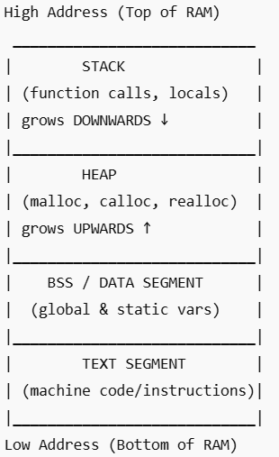
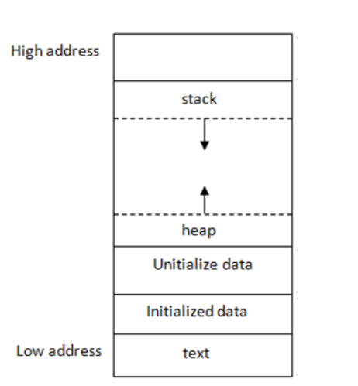
Memory Allocation

Slide 18
Allocating a Block of Memory
A block of memory can be allocated using the function malloc
  Reserves a block of memory of specified size and returns a pointer of type void
  The return pointer can be type-casted to any pointer type
General format:
type *p;
  p = (type *) malloc (byte_size);

Slide 19
Example
p = (int *) malloc(100 * sizeof(int));
  A memory space equivalent to 100 times the size of an int bytes is reserved
  The address of the first byte of the allocated memory is assigned to the pointer p of type int
p
400 bytes of space

Slide 20
Contd.
cptr = (char *) malloc (20);
  Allocates 20 bytes of space for the pointer cptr of type char
sptr = (struct stud *) malloc(10*sizeof(struct stud));
  Allocates space for a structure array of 10 elements. sptr points to a structure element of type struct stud
Always use sizeof operator to find number of bytes for a data type, as it can vary from machine to machine

Slide 21
Points to Note
malloc always allocates a block of contiguous bytes
  The allocation can fail if sufficient contiguous memory space is not available
  If it fails, malloc returns NULL
  if ((p = (int *) malloc(100 * sizeof(int))) == NULL)
  {
  printf (“\n Memory cannot be allocated”);
  exit();
  }

Slide 22
Using the malloc’d Array
Once the memory is allocated, it can be used with pointers, or with array notation
Example:
    int *p, n, i;
    scanf(“%d”, &n);
    p = (int *) malloc (n * sizeof(int));
    for (i=0; i<n; ++i)
    scanf(“%d”, &p[i]);
The n integers allocated can be accessed as *p, *(p+1), *(p+2),…, *(p+n-1) or just as p[0], p[1], p[2], …,p[n-1]

Slide 23
Example
int main()
{
int i,N;
float *height;
float sum=0,avg;
printf("Input no. of students\n");
scanf("%d", &N);
height = (float *)
malloc(N * sizeof(float));
printf("Input heights for %d
students \n",N);
for (i=0; i<N; i++)
scanf ("%f", &height[i]);
for(i=0;i<N;i++)
sum += height[i];
avg = sum / (float) N;
printf("Average height = %f \n",
avg);
free (height);
return 0;
}

Slide 24
Releasing the Allocated Space: free
An allocated block can be returned to the system for future use by using the free function
General syntax:
  free (ptr);
where ptr is a pointer to a memory block which has been previously created using malloc
Note that no size needs to be mentioned for the allocated block, the system remembers it for each pointer returned

