Slide 1

Bonytail (GIEL) Demographic Modeling
in Off-Channel Habitat (OCH)
What the data support, what the models can do, and how this compares to the proposed IPM
Brian Kesner · Marsh & Associates · 2026

Slide 2
Why We Model Bonytail
• Stocked adults are the backbone of the Lower Colorado River Bonytail program
• Off-channel ponds (IP2, IP5, IP6) are the only places where Bonytail persist
• We need to understand:
– Annual survival
– Die-offs
– Recruitment
– Differences among ponds
– Whether environmental or origin effects matter
Bonytail (GIEL) Off-Channel Modeling

Slide 3
What Data We Actually Have
• PIT-tag detections (continuous scanning)
• Netting captures (episodic)
• Stocking records
• Known die-off windows
• Sparse juvenile recruitment
• No environmental covariates currently collected
• No parentage data integrated for GIEL
• Key point: the data are real, but thin and uneven
Bonytail (GIEL) Off-Channel Modeling

Slide 4
What a Bayesian Model Does (Plain Language)
• Think of it as a smart averaging machine
• It tries millions of possible “worlds”
• Keeps the ones that match the data
• Produces ranges of plausible survival values, not single numbers
• Handles uncertainty gracefully
• Perfect for noisy ecological data
Bonytail (GIEL) Off-Channel Modeling

Slide 5
Why NIMBLE / Robust Design Works Well Here
• Tracks every fish across months and years
• Uses both PIT scanning and netting
• Enforces biological rules (fish can’t reappear after dying)
• Handles missing detections
• Allows explicit die-off windows
• Simple enough to match the data; flexible enough to capture real events
Bonytail (GIEL) Off-Channel Modeling

Slide 6
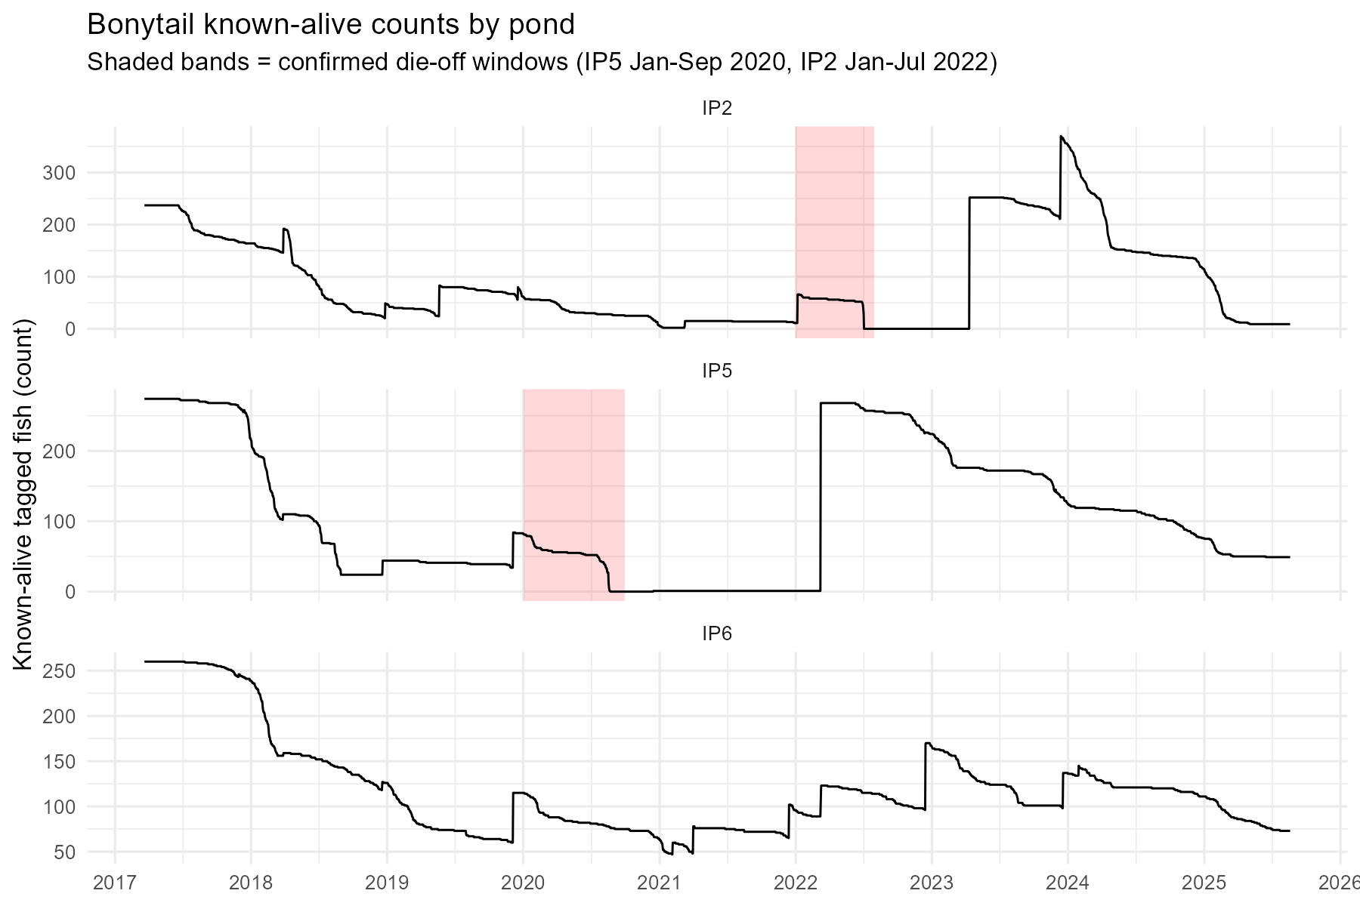
What the Data Show About Bonytail Survival
• Three ponds, three stories:
– IP6: stable survival, no die-offs
– IP5: catastrophic die-off in 2020
– IP2: catastrophic die-off in 2022, plus chronically low survival in other years
• Takeaway: survival is dominated by discrete events, not smooth trends
Bonytail (GIEL) Off-Channel Modeling

Slide 7
Die-Offs Are Real and Well-Defined
• IP5: January–September 2020
• IP2: January–July 2022
• Both documented as pump failures (operational, not environmental)
• PIT scanning confirms these are true mortality events, not detection gaps
Bonytail (GIEL) Off-Channel Modeling

Slide 8
Why We Use Explicit Event Terms (dE)
• They directly represent known die-off windows
• They allow survival to drop sharply only during the event
• They match the biology and the monitoring record
• They outperform diffuse “year random effects” when events span most of a season
Bonytail (GIEL) Off-Channel Modeling

Slide 9
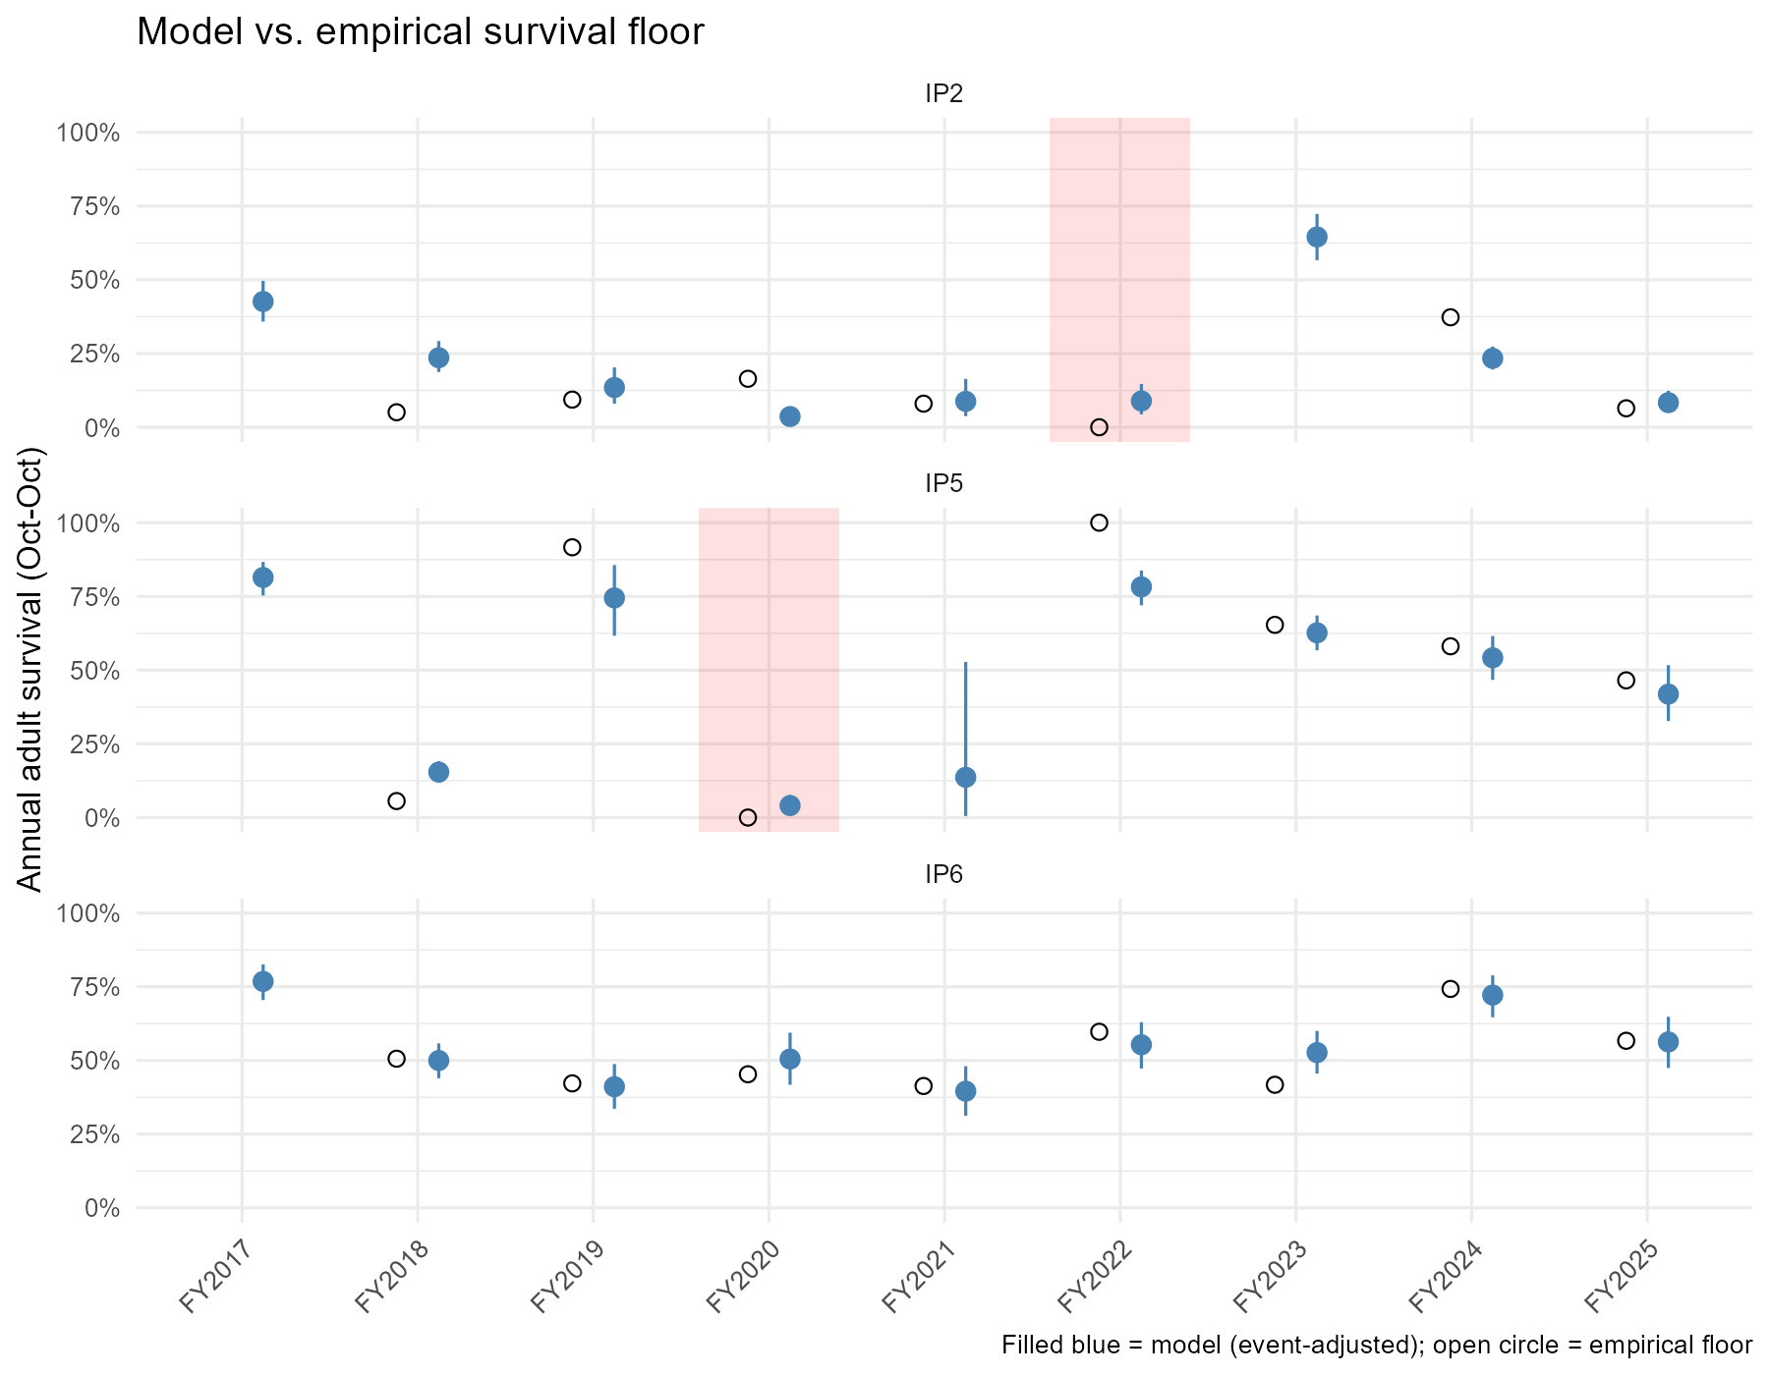
Partial-Season Events Are Harder to Capture
• IP5 FY2020: 9 months → model matches floor almost perfectly
• IP2 FY2022: 7 months → model under-corrects (survival too high)
• Same pattern seen in Razorback Sucker (IP1 FY2022)
• Takeaway: partial-season crashes are structurally hard for any model
Bonytail (GIEL) Off-Channel Modeling

Slide 10
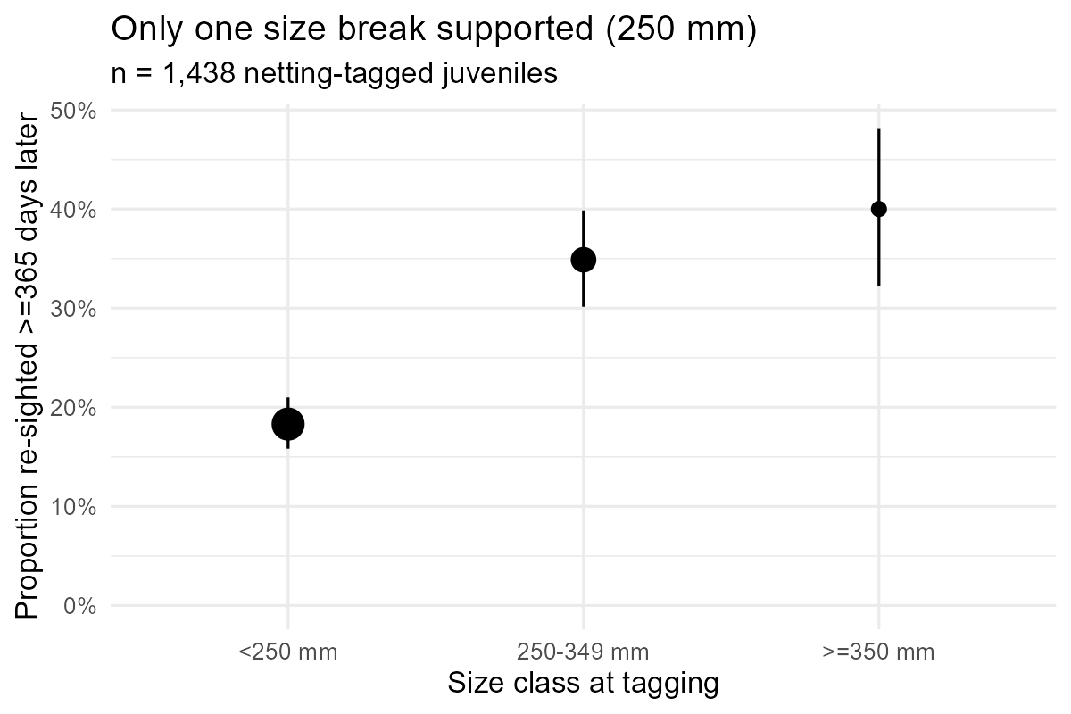
Size Structure: Only One Break Supported
• Juveniles <250 mm survive poorly
• Juveniles ≥250 mm survive much better
• No difference between 250–349 mm and ≥350 mm
• Data support 2 stages, not 3–4
• Takeaway: the proposed IPM’s multi-stage structure is not identifiable
Bonytail (GIEL) Off-Channel Modeling

Slide 11
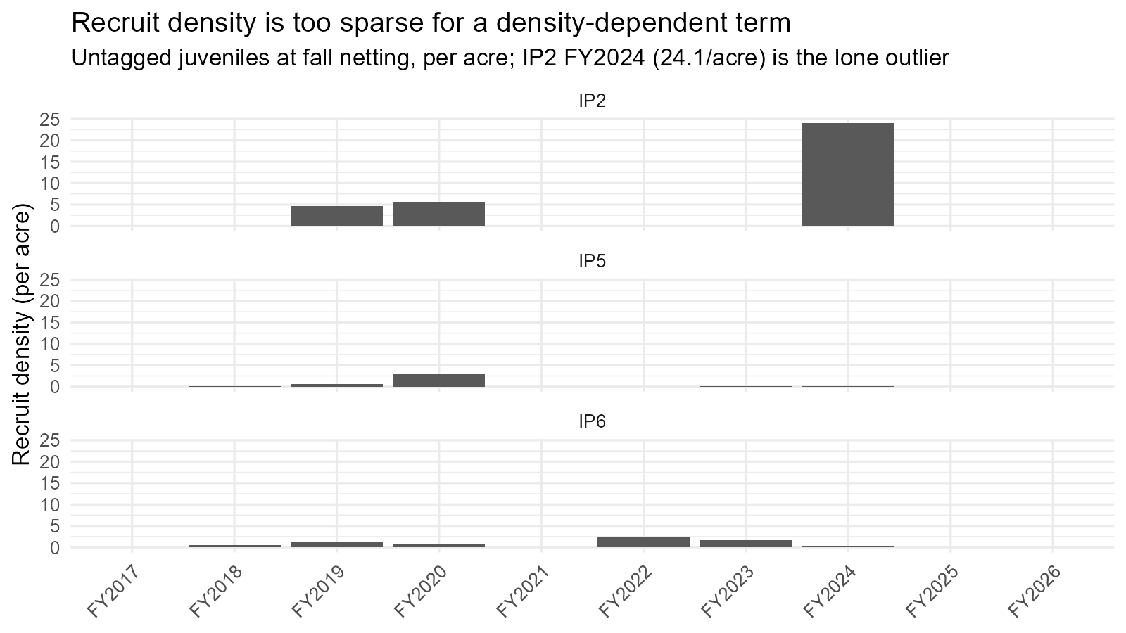
Recruit Density: Too Sparse for Density-Dependent Modeling
• Most pond-seasons: zero recruits
• One outlier: 24 per acre
• No continuous gradient
• No slope to estimate
• Takeaway: density-dependent survival/growth is not supported
Bonytail (GIEL) Off-Channel Modeling

Slide 12
Empirical Survival Swings Widely
• Non-event seasons range from 5% to 92% survival
• No smooth pattern
• No environmental gradient visible
• A single covariate slope cannot explain this variation
Bonytail (GIEL) Off-Channel Modeling

Slide 13
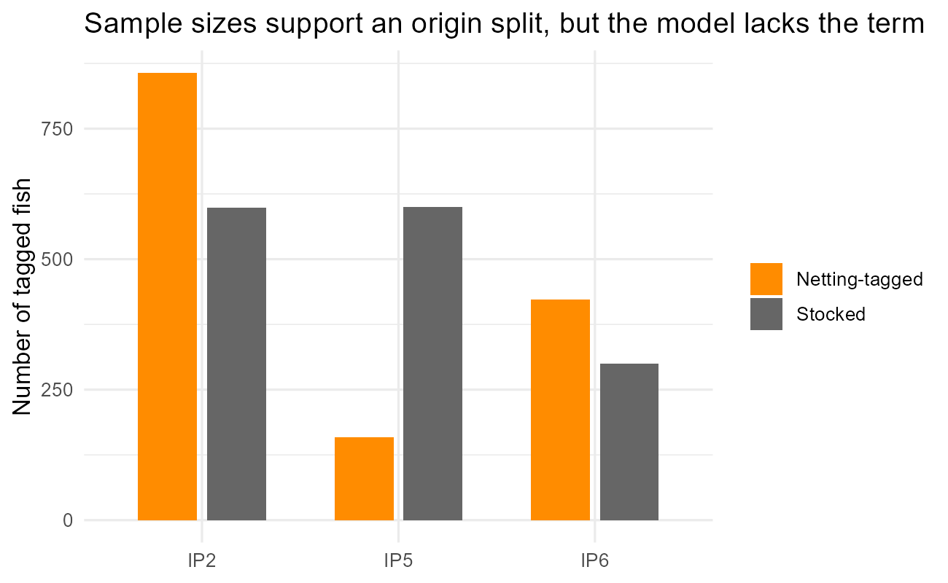
Origin-Based Survival: Possible, But Not Yet Modeled
• Plenty of wild-tagged fish to test stocked vs. wild
• But current model architecture does not include origin effects on adult survival
• Would require a model extension
• Should be tested cautiously given sparse non-event data
Bonytail (GIEL) Off-Channel Modeling

Slide 14
What the Proposed IPM Assumes
• The proposed IPM includes:
– 4 life stages
– Environmental covariates on adult survival and reproduction
– Release/habitat covariates on post-stocking survival
– Origin-based survival splits
– Parentage-based reproduction
– Year random effects absorbing die-offs
– Shared covariate slopes across ponds
• Takeaway: it assumes rich, continuous data
Bonytail (GIEL) Off-Channel Modeling

Slide 15
Why the Proposed IPM Doesn’t Fit the Data
• Data support 2 stages, not 4
• Survival is driven by discrete die-offs, not environmental gradients
• Recruit density is too sparse for density-dependent terms
• Non-event survival swings wildly with no pattern
• Partial-season die-offs are under-corrected by year random effects
• Parentage data not integrated for GIEL
• Environmental covariates not collected
• Open-water survival cannot be modeled reliably (Havasu precedent)
Bonytail (GIEL) Off-Channel Modeling

Slide 16
Havasu Study: A Reality Check
• Telemetry + PIT scanning attempted to model open-water survival
• Result: survival and detection estimates “nearly 0 to 1”
• Even time-varying CJS/Barker models failed
• Shows that even rich data struggle to identify survival curves
• Takeaway: routine OCH data cannot support the proposed IPM’s complexity
Bonytail (GIEL) Off-Channel Modeling

Slide 17
What the Current Model Gets Right
• Correct stage structure
• Correct die-off representation
• Correct handling of sparse recruitment
• Correct separation of ponds
• Correct identification of catastrophic events
• Correct survival estimates for stable ponds (IP6)
• Correct survival estimates for full-season crashes (IP5 FY2020)
Bonytail (GIEL) Off-Channel Modeling

Slide 18
What Needs Further Investigation
• IP2’s chronically low survival outside the 2022 crash
• Whether IP2 has additional unflagged mortality episodes
• Whether origin-based survival splits are identifiable
• Whether partial-season die-offs need pond-season-specific dE terms
Bonytail (GIEL) Off-Channel Modeling

Slide 19
Bottom Line
• The proposed IPM is biologically rich but structurally ahead of the data
• The current 2-stage robust-design model is better matched to what the data can support
• The highest-value next steps are pond-specific investigations, not adding covariate layers
• A future IPM could be possible only if new data streams are added (environmental, parentage)
Bonytail (GIEL) Off-Channel Modeling

Slide 20
Next Steps
• Investigate IP2 for additional mortality episodes
• Consider pond-season-specific event terms for partial-season crashes
• Explore adding origin effects to adult survival
• Evaluate feasibility of collecting environmental covariates
• Assess availability of GIEL parentage data from UNM
• Maintain the robust-design model as the operational tool
Bonytail (GIEL) Off-Channel Modeling

Slide 21
Questions & Discussion
Marsh & Associates

